Slide 1
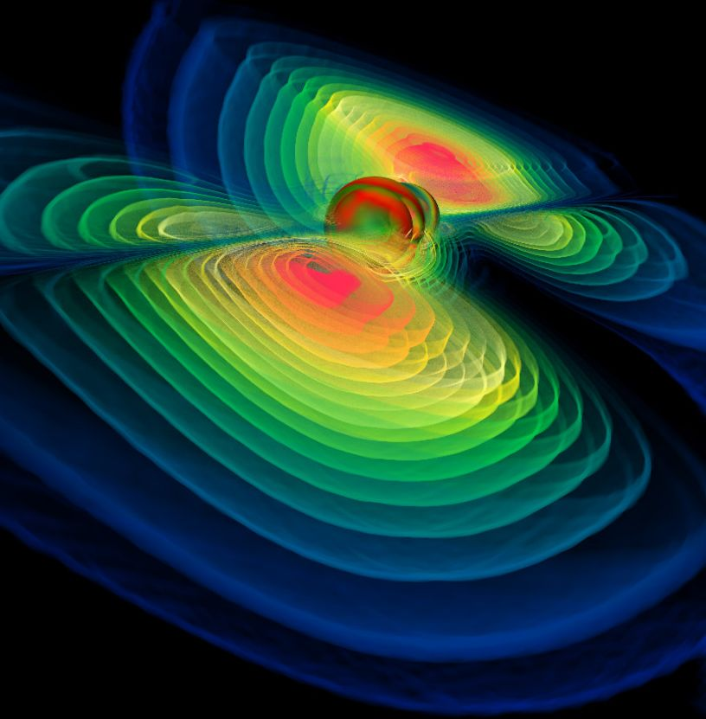




O4 LIGO-Virgo-KAGRA
Network Status & Plans
Iberian GW Meeting – 23 June 2025
T. Dent, for the LVK Collaborations
Image Credit: NASA/GSFC

Slide 2
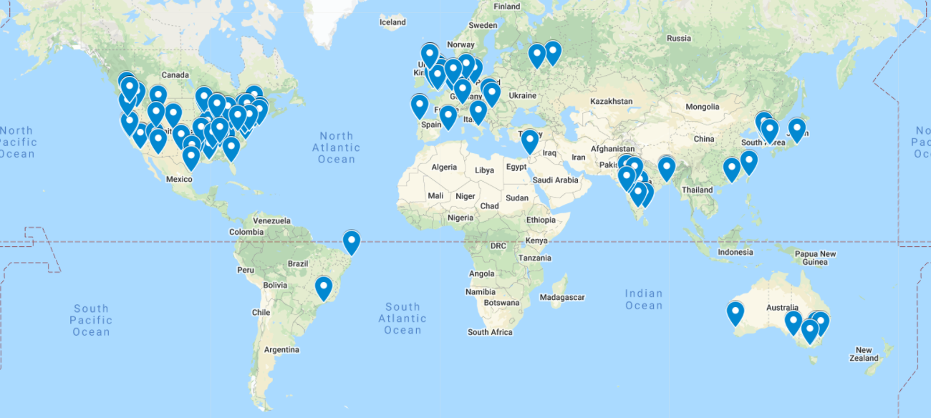

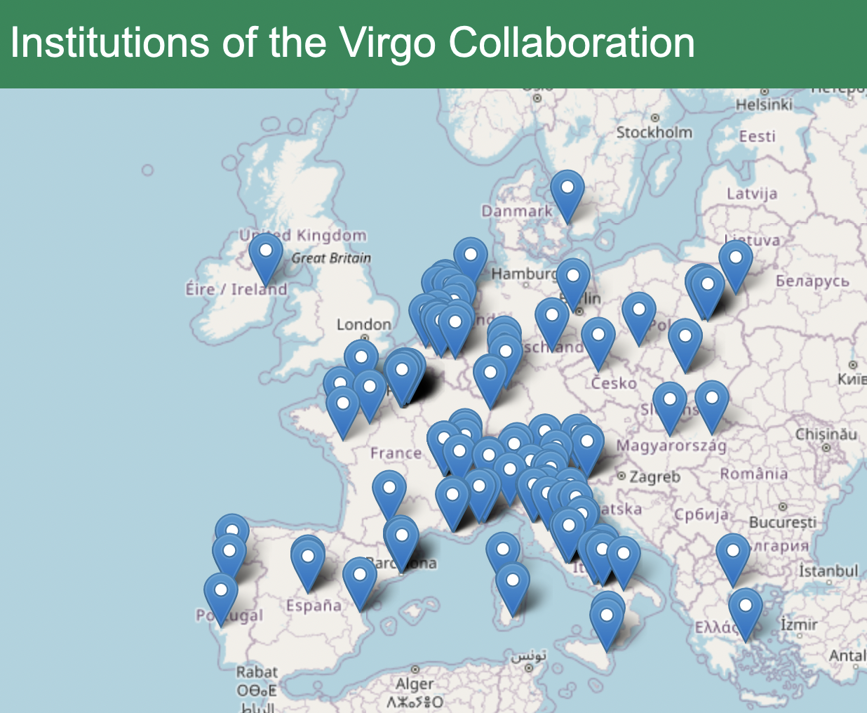
LIGO-Virgo-KAGRA collaborations
& others
outside
Europe !
2

Slide 3
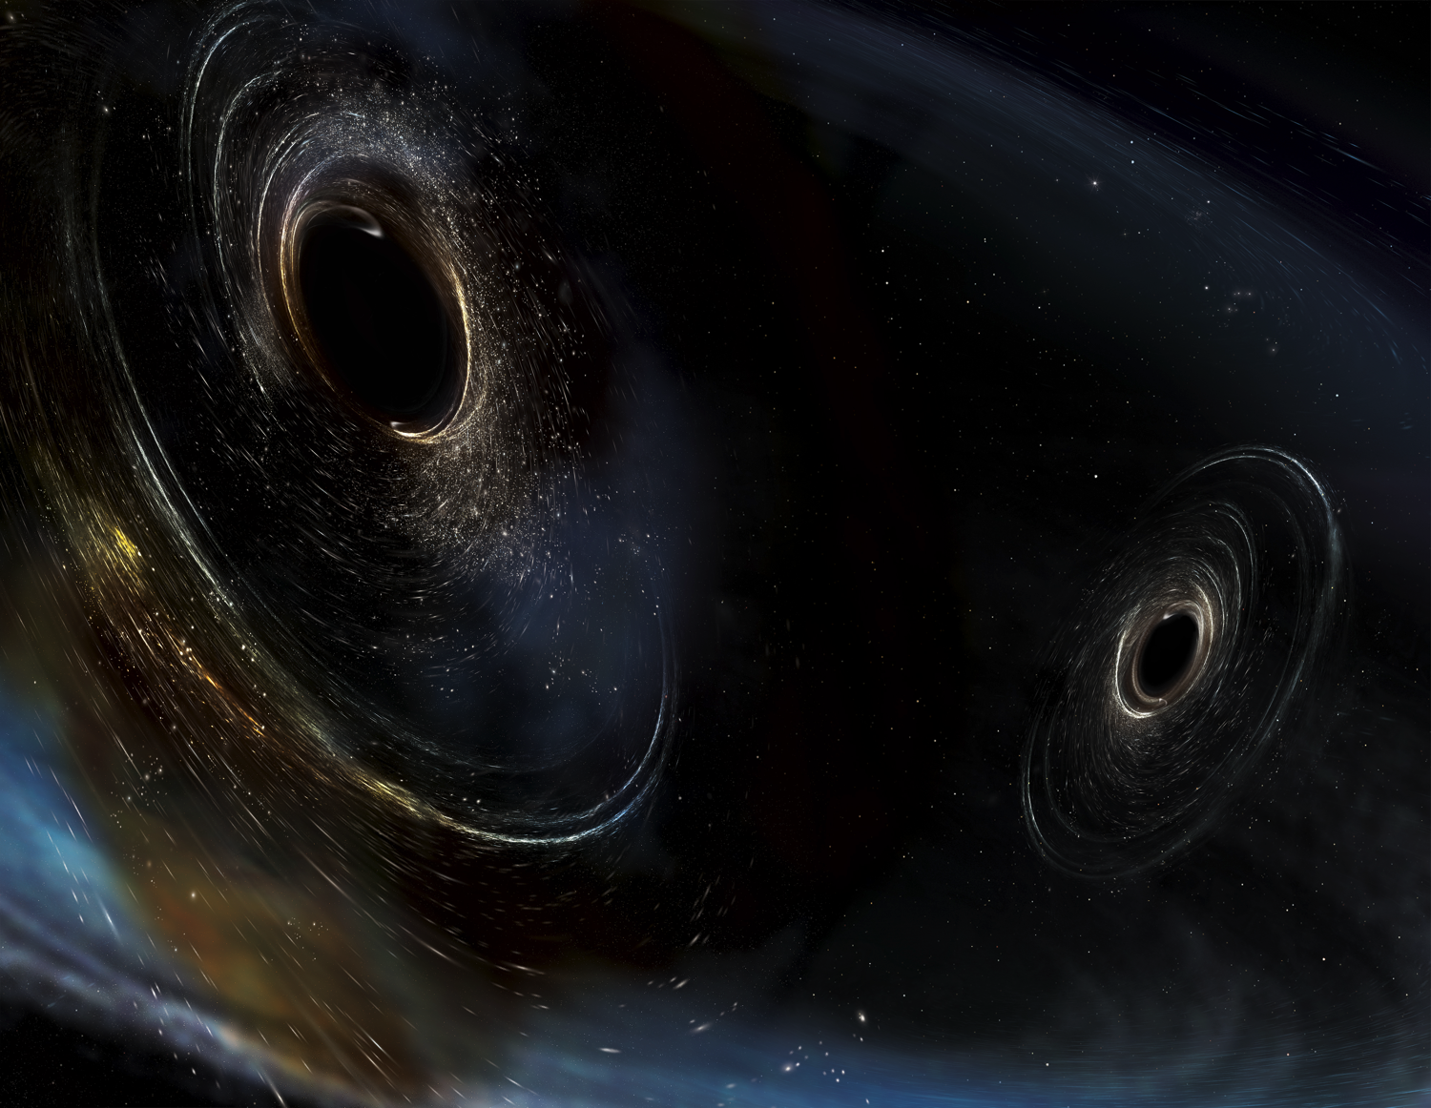
Plan of the talk
The weakest force : gravity
Ground-based GW detectors & sources
CBC GW science : astrophysics, relativity, …
LVK observations up to O3 (2015-2020)
The O4 run (2023-2025)
O5 and looking forward (A# et al.)
Image Credit: Aurore Simonnet/SSU

Slide 4
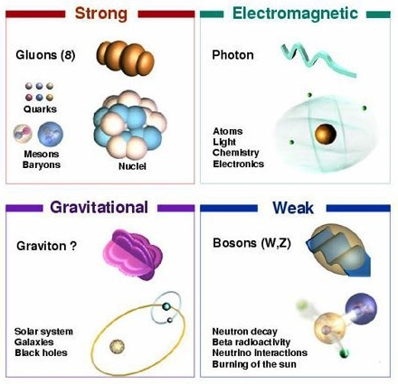
4 (known) fundamental forces

Slide 5


How to ‘see’ GW
Tidal effect on spatially
separated test particles
Can extract energy
– imagine a spring
connecting particles
Measure variations in
distance or travel time
Strain

Slide 6
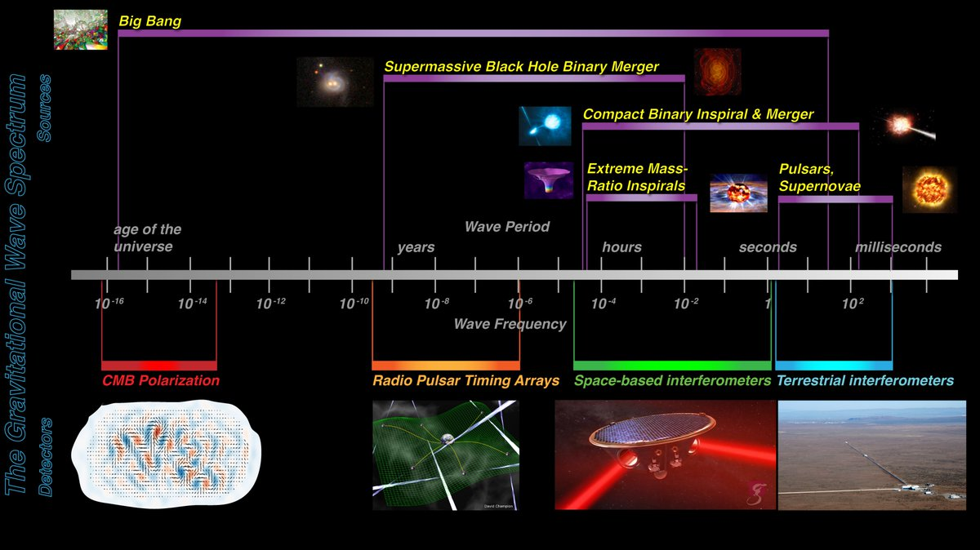
The broad spectrum of GW
NASA / Ira Thorpe
Hz

Slide 7
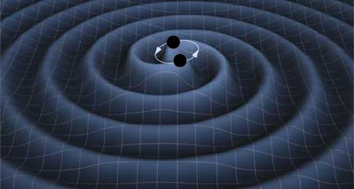
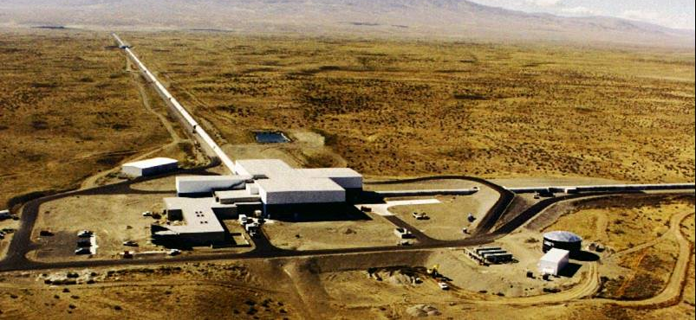
GROUND-BASED GW DETECTORS

Slide 8
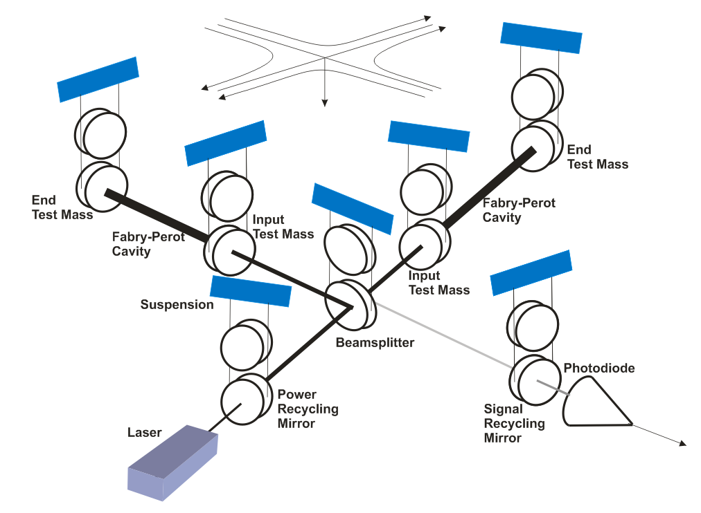
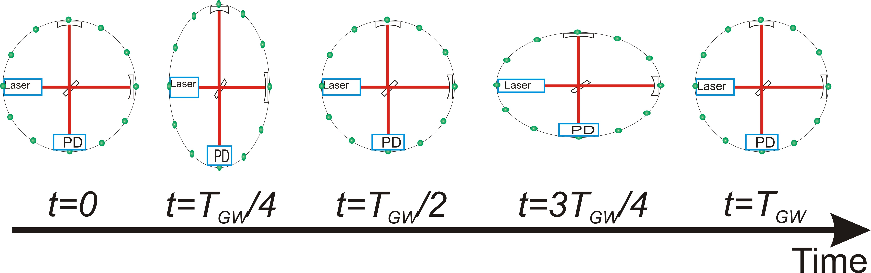
Laser interferometric detection
‘Michelson interferometer’
end mirrors free to move
along arms
Differential length change
δ(L_{x} − L_{y}) = h(t) · L
⇒ time of flight difference
⇒ relative phase difference
@ beam-splitter
⇒ transmitted intensity
variation @ PD

Slide 9
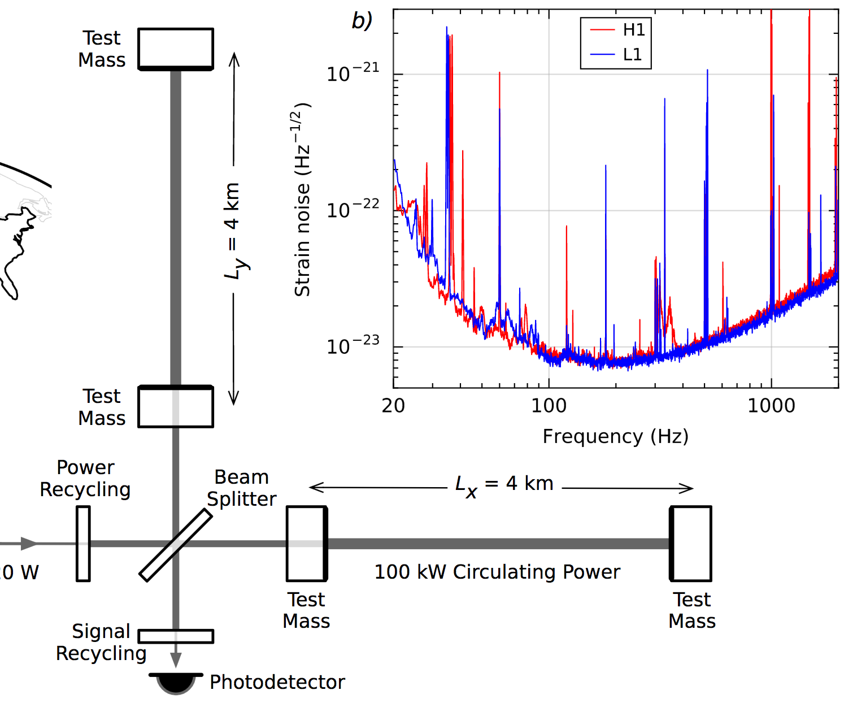
Down to <𝟣e–𝟤𝟥: Enhance the signal
  Long arms
  High power ultra-stable laser
  Power recycling (factor ~𝟥𝟧)
  Resonant arm cavities
  (factor ~𝟥𝟢𝟢)
  Signal recycling
LVC, PRL 116 061102 (2016)

Slide 10
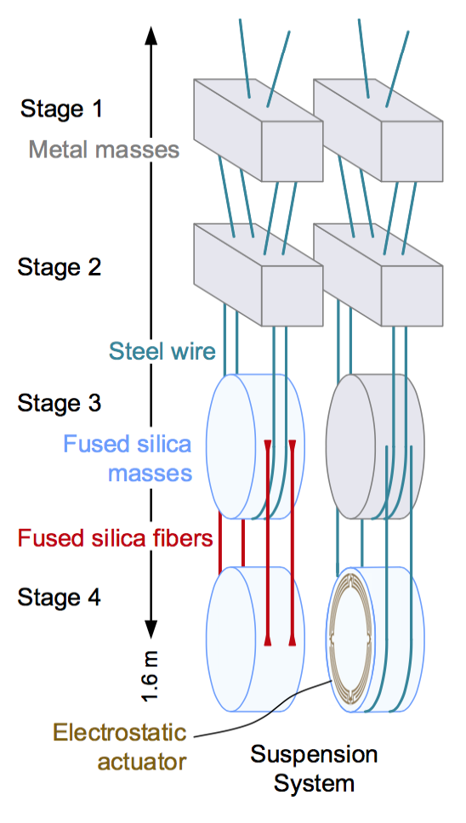
Down to <𝟣e–𝟤𝟥: Suppress noise
Seismic noise reduction
  Active seismic isolation
  Quadruple pendulum
  suspension
  ~𝟣𝟢 orders of magnitude displacement noise suppression above 𝟣𝟢Hz

Slide 11
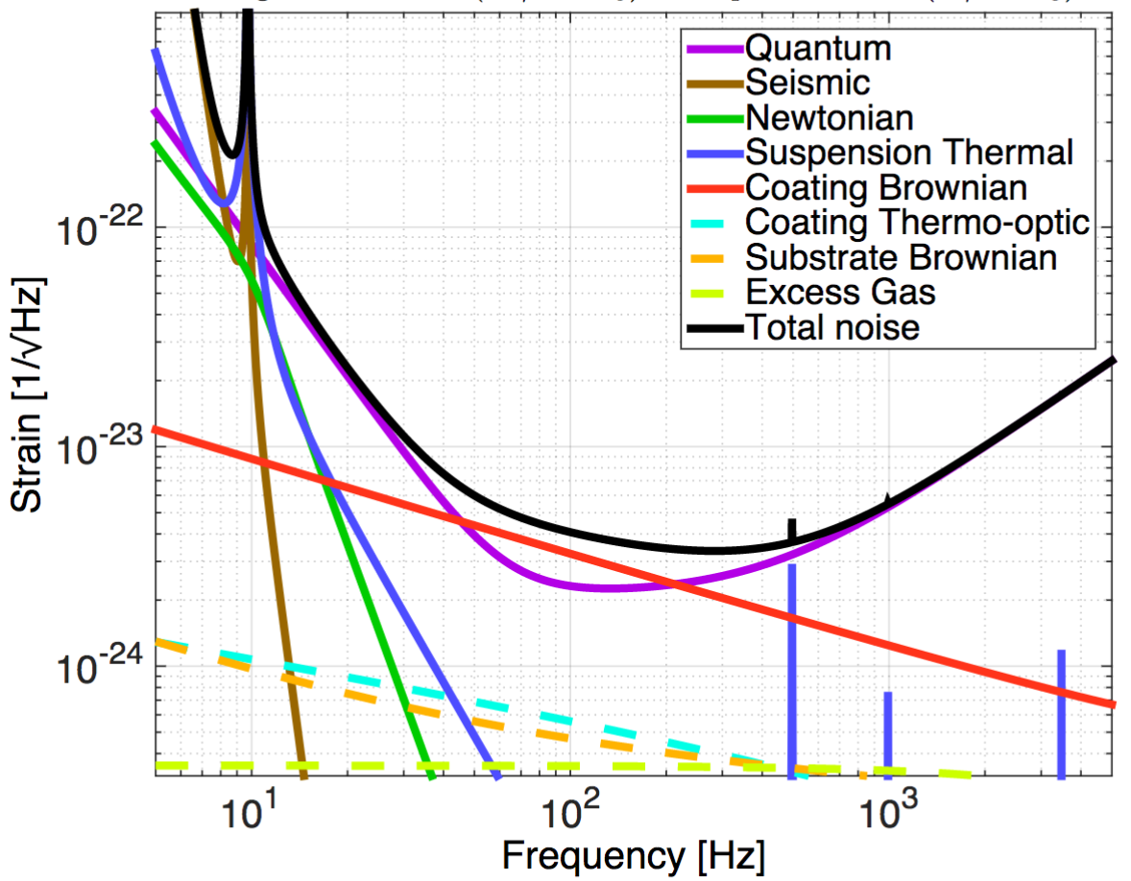
Precision Interferometry :
Understanding Measurement Noises
Fundamental Noises
Displacement Noises
→ 𝚫L(f)
  Seismic noise
  Radiation Pressure
  Thermal noise
    Suspensions
    Optics
Sensing Noises
→ 𝚫t_{photon}(f)
    Shot Noise
    Residual Gas
Technical Noises
Hundreds of them …
Advanced LIGO Design Noise Budget
https://dcc.ligo.org/LIGO-T1800044/public

Slide 12
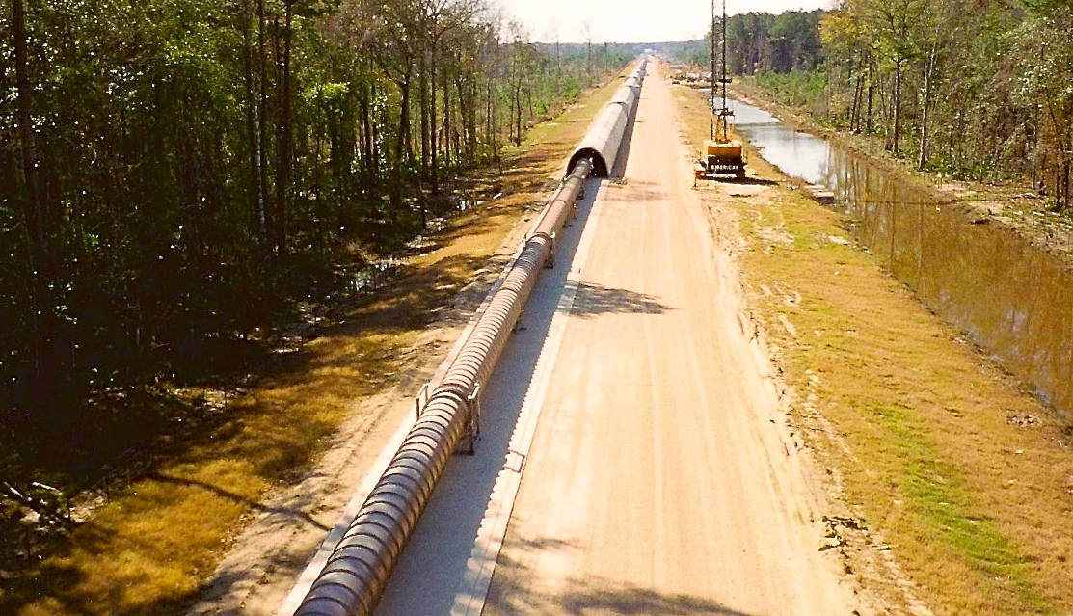
The LIGO Vacuum System
Consists of
  9000 m³ volume
  30000 m² surface area
  50000 m of spiral welds
  10⁻⁸ - 10⁻⁹ torr
At each observatory

Slide 13
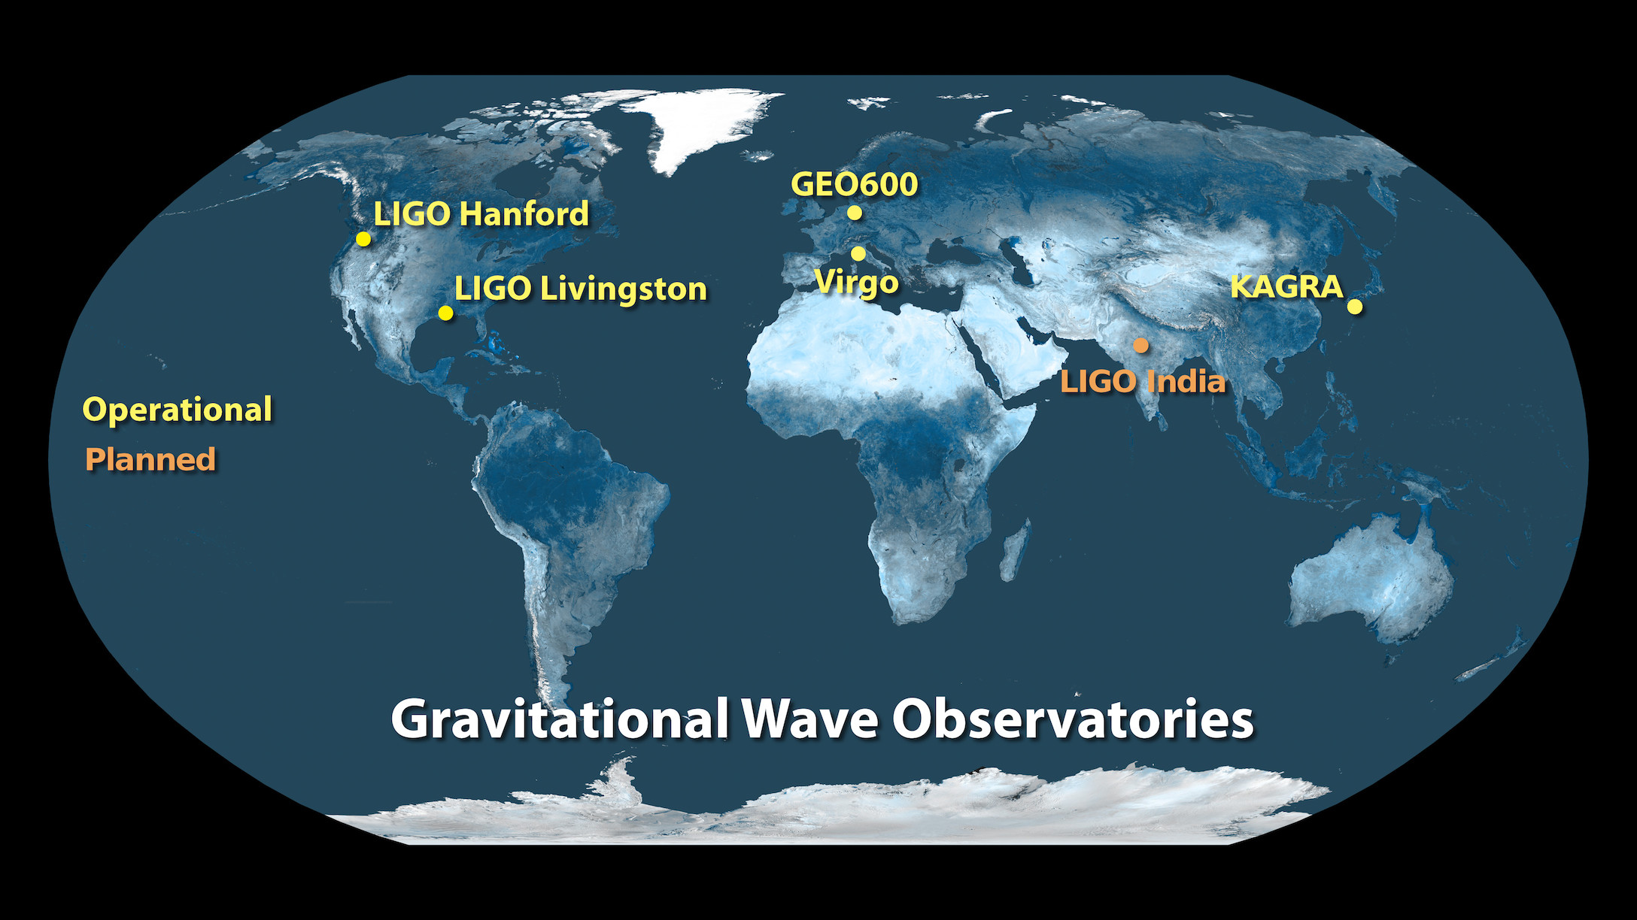
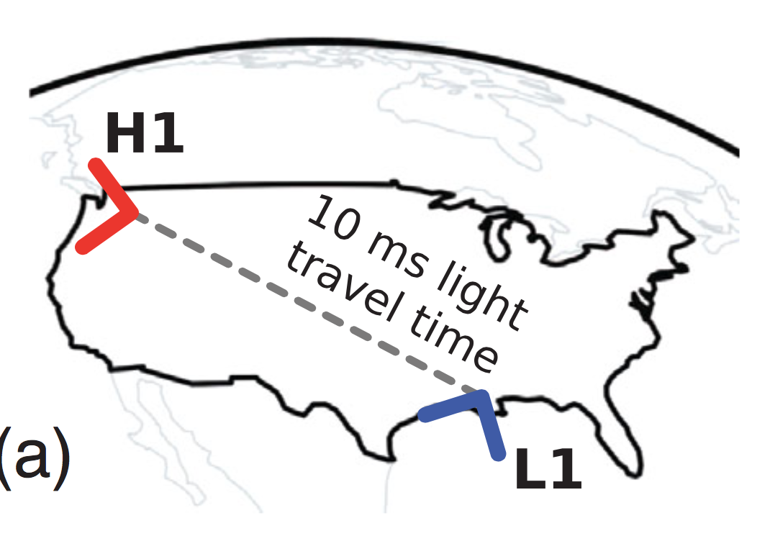
A global network
Image credit: LIGO Lab
Detection rate, sky coverage, network duty cycle
Greater accuracy on source parameters
- Distance, sky location, orientation of source ...

Slide 14
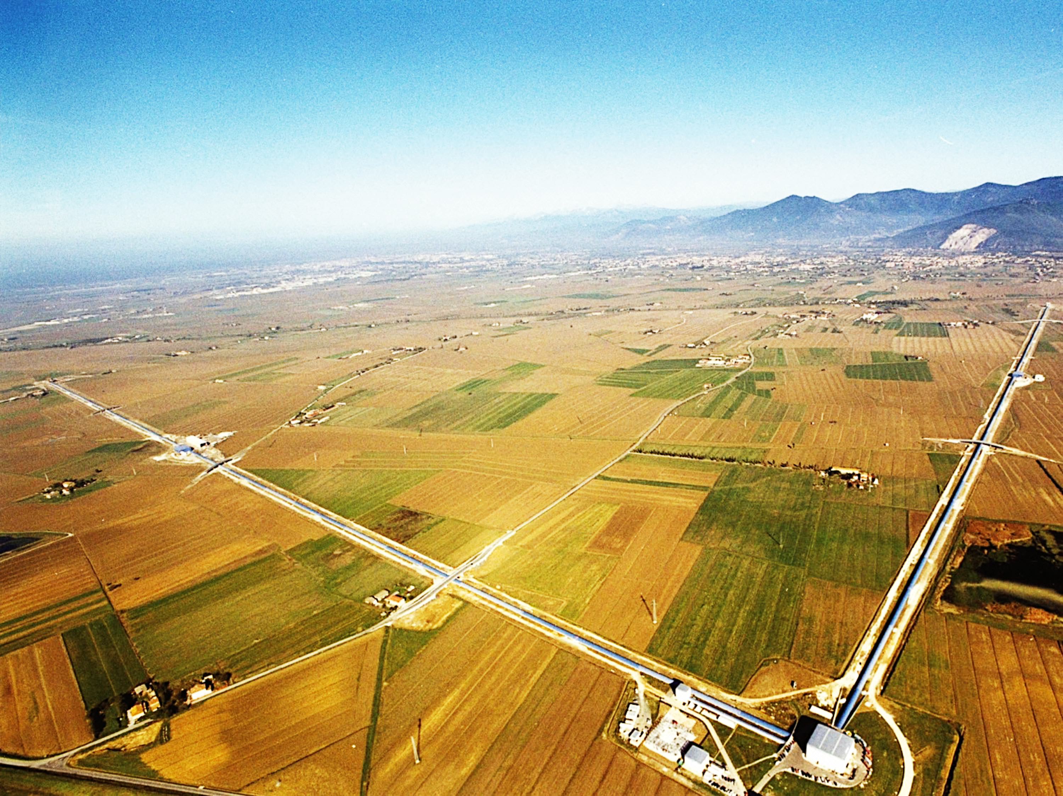

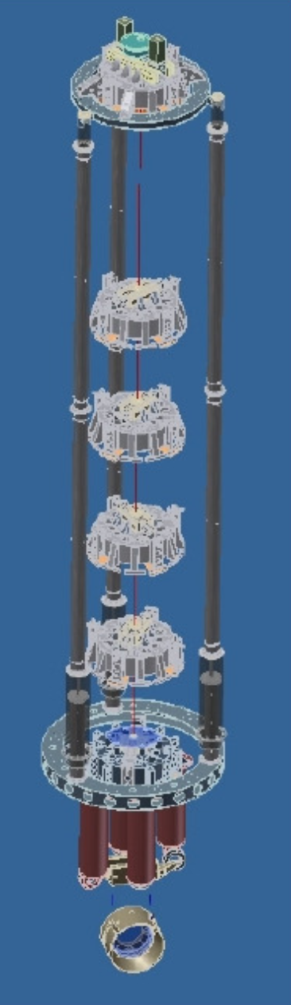
ADVANCED VIRGO
163 Institutions in 20 different countries
~915 collaboration members
Date

Slide 15
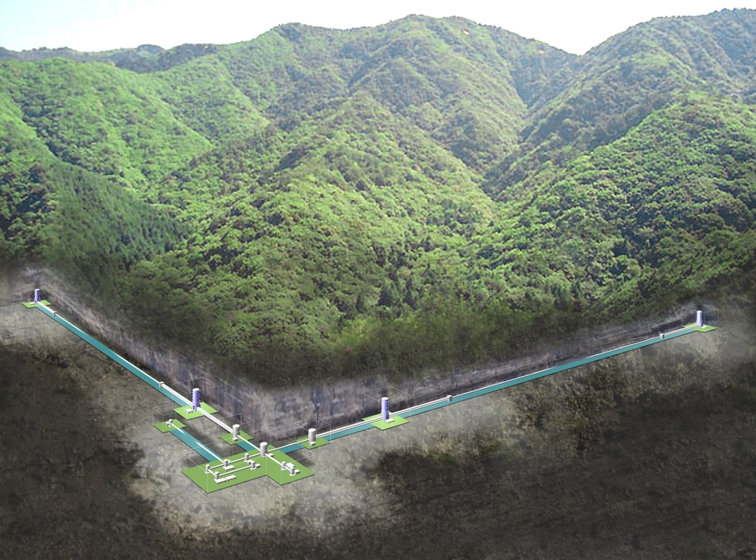
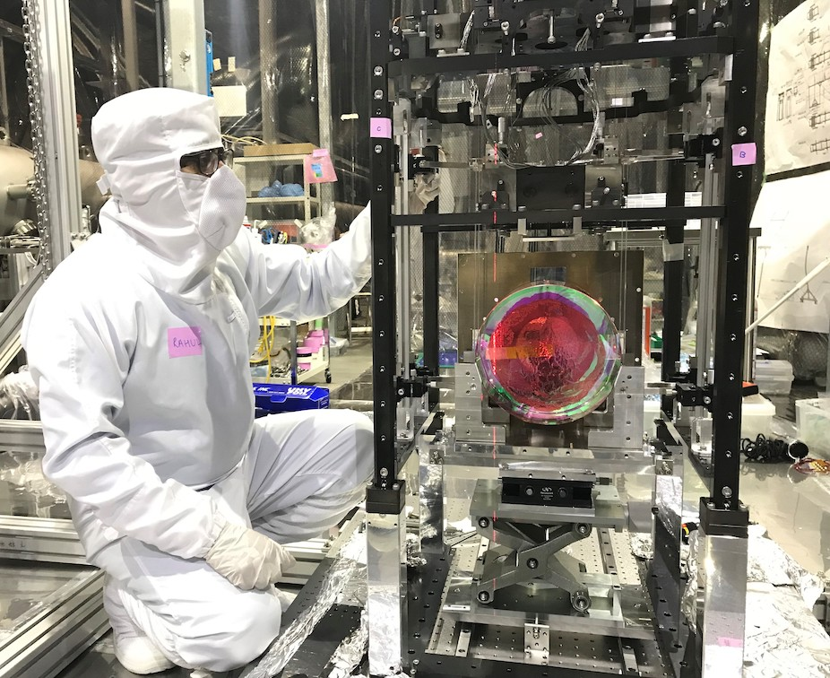

Cryogenic sapphire mirror payload
Image Credit: Rahul Kumar/LIGO Lab

Slide 16
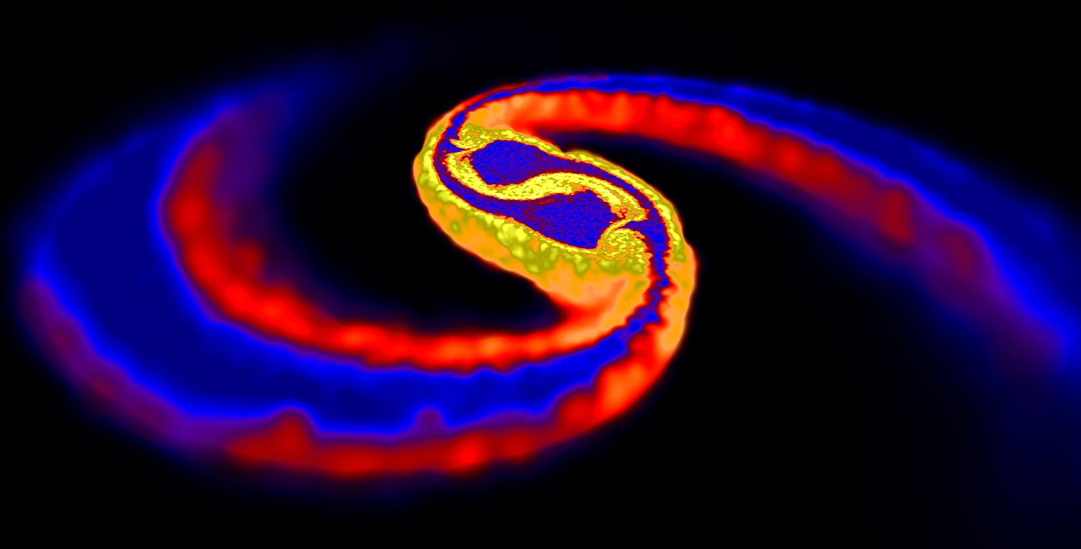
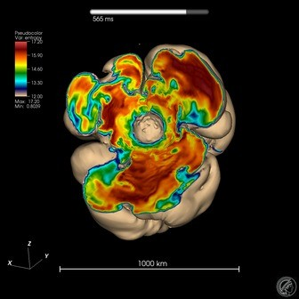
Transient GW sources
Highly relativistic systems
CBC
Burst
Image : D. Price (Exeter) & S. Rosswog (Bremen)
Cataclysmic events of compact
astrophysical objects
  NeutronStar / BlackHole binary
  mergers
  CoreCollapseSuperNovae
  Pulsar glitches / oscillation modes ?
  Exotics : cosmic string kinks ? ...
Simulation: F. Hanke et al. (MPIA Garching)

Slide 17
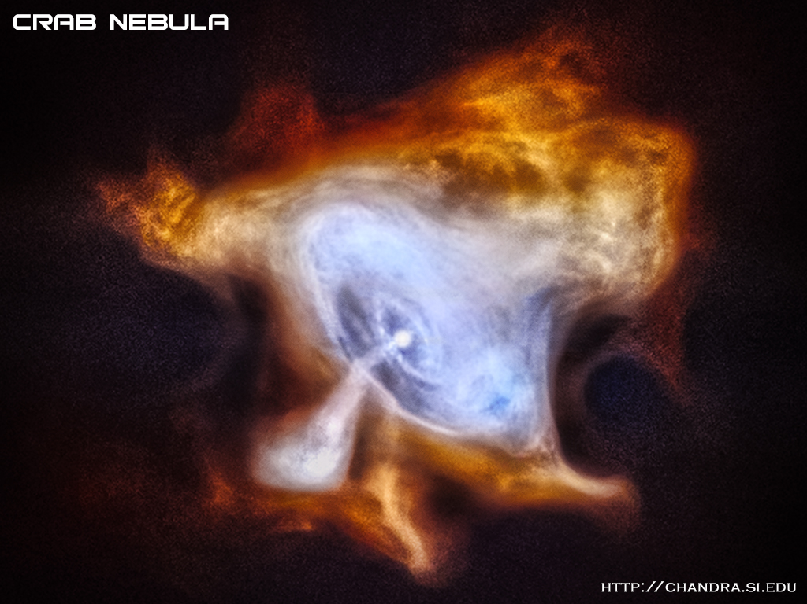
Persistent GW sources
Continuous Wave : sinusoids from rotating NS
  many potential sources in Galaxy
Stochastic : random ‘background’
from superposition of unresolved
sources
  astrophysical
  transients at high redshift
  primordial
  quantum fluctuations / critical
  phenomena in very early Universe
Chandra X-ray images of Crab pulsar

Slide 18
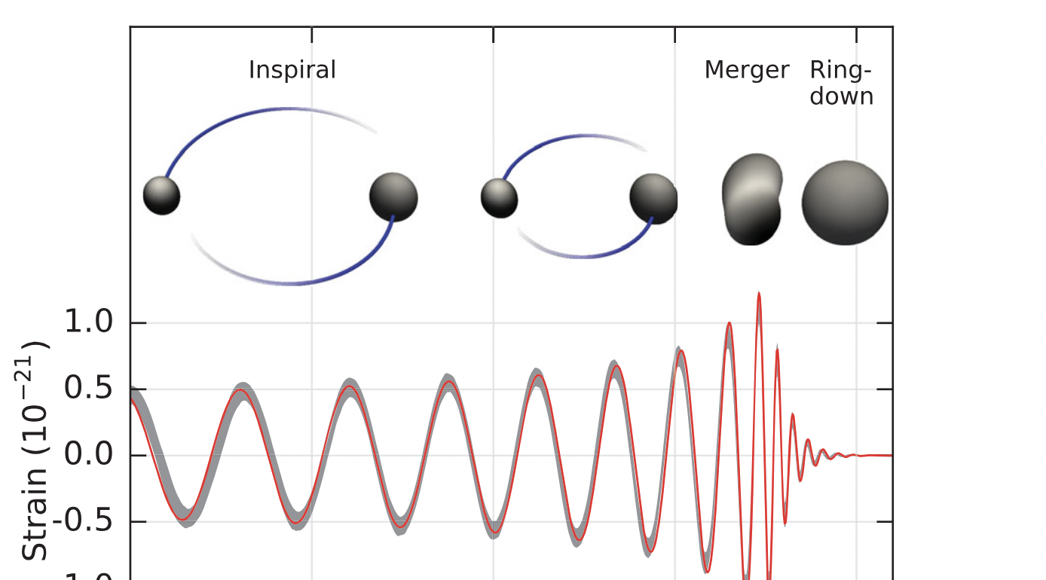
Anatomy of a binary merger
Numerical Relativity
Post-Newtonian
Black Hole
Perturbation
Theory
LVC PRL 116, 061102 (2016)

Slide 19
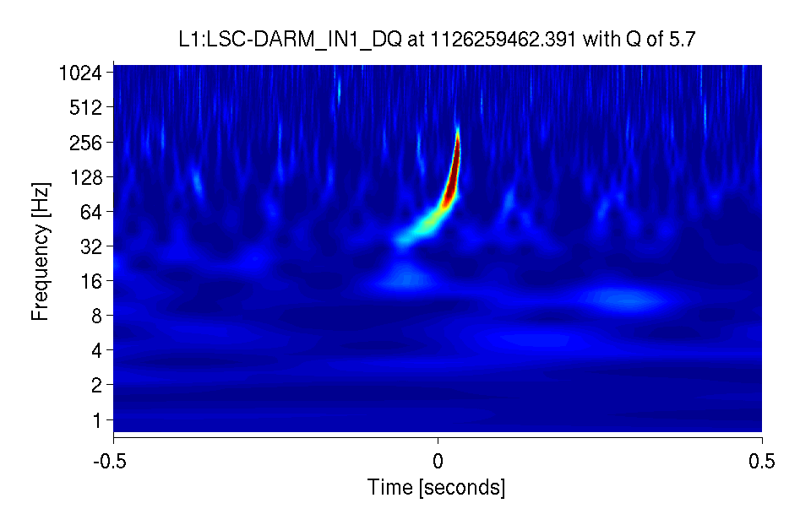
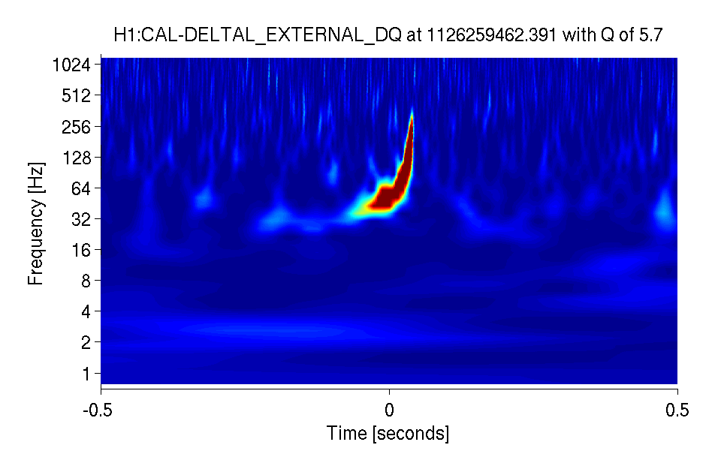
Anatomy of a binary merger
Numerical Relativity
Post-Newtonian
Black Hole
Perturbation
Theory
LVC PRL 116, 061102 (2016)
14 September 2015, 09:50:45 UTC

Slide 20
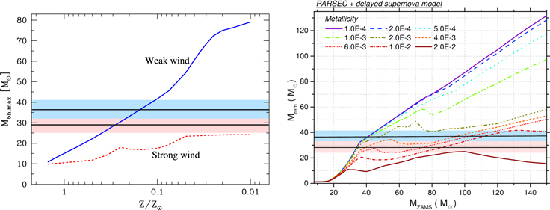
Astrophysics from BBH mergers
Stellar winds ‘weak’
allowing ~30 M☉ BH to form
GW150914

Slide 21
Astrophysics from BBH mergers
Stellar winds ‘weak’
allowing ~30 M☉ BH to form
Likely forming at
low metallicity
GW150914

Slide 22
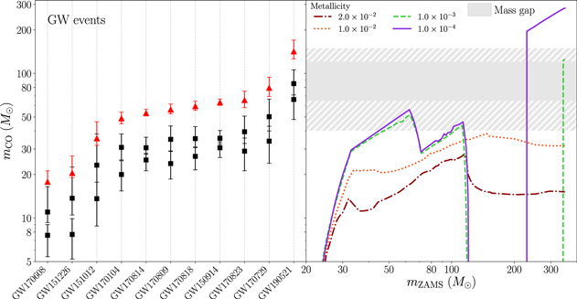
Astrophysics from BBH mergers
Stellar winds ‘weak’
allowing ~30 M☉ BH to form
Likely forming at
low metallicity
~85 M☉ BH above
‘mass gap’ from
SN pair instability
⇒ hierarchical formation?
GW190521

Slide 23
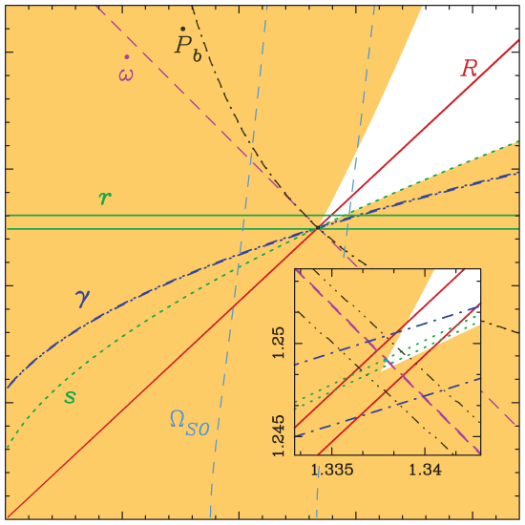
Exploring GR with GW sources
Strong field : compact objects (NS, BH)
and behaviour ‘close to’ singularities via NR
Precise constraints on low velocity PN expansion
  v/c up to ~0.4
  ‘Higher modes’ (beyond quadrupole)
Black hole perturbation theory - ‘ringdown’
Small mass ratio expansion – ‘self-force’
  Probe of Schwarzschild / Kerr geometry
Exotics : black hole mimickers, boson stars …
Early Universe : quantum fluctuations … ??
Consistency of relativistic effects in double pulsar J0737–3039A, B (Image M. Kramer)

Slide 24
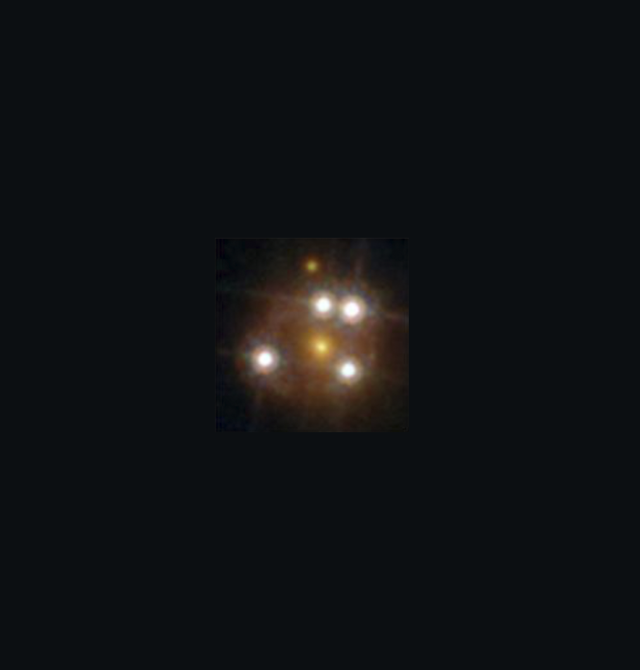
Exploring GR with GW propagation
Verify 2 transverse tensor polarizations
Constrain non-GR dispersion (eg graviton mass)
Constrain Lorentz symmetry violation …
(‘Strong’ or ‘Weak’) Gravitational Lensing of GW
  Amplification of signal
  Multiple transient “images”, other possible effects
Verify speed of GW propagation
  Multi-messenger events with prompt emission

Slide 25

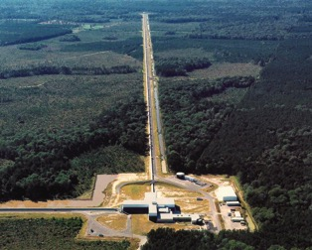
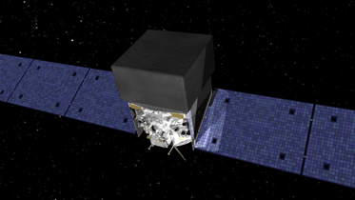
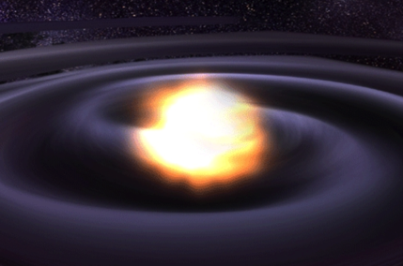
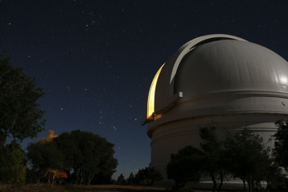
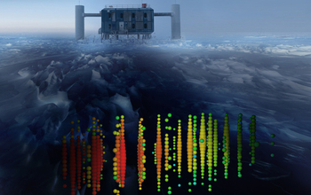
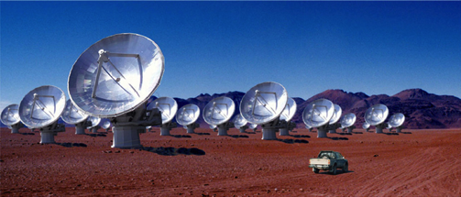
Multi-messenger Astronomy with GW
Binary Neutron Star /
Neutron Star – Black Hole
Merger
X-rays / Gamma-rays
Gravitational Waves
UV / Visible / Infrared Light
HE Neutrinos
Radio

Slide 26
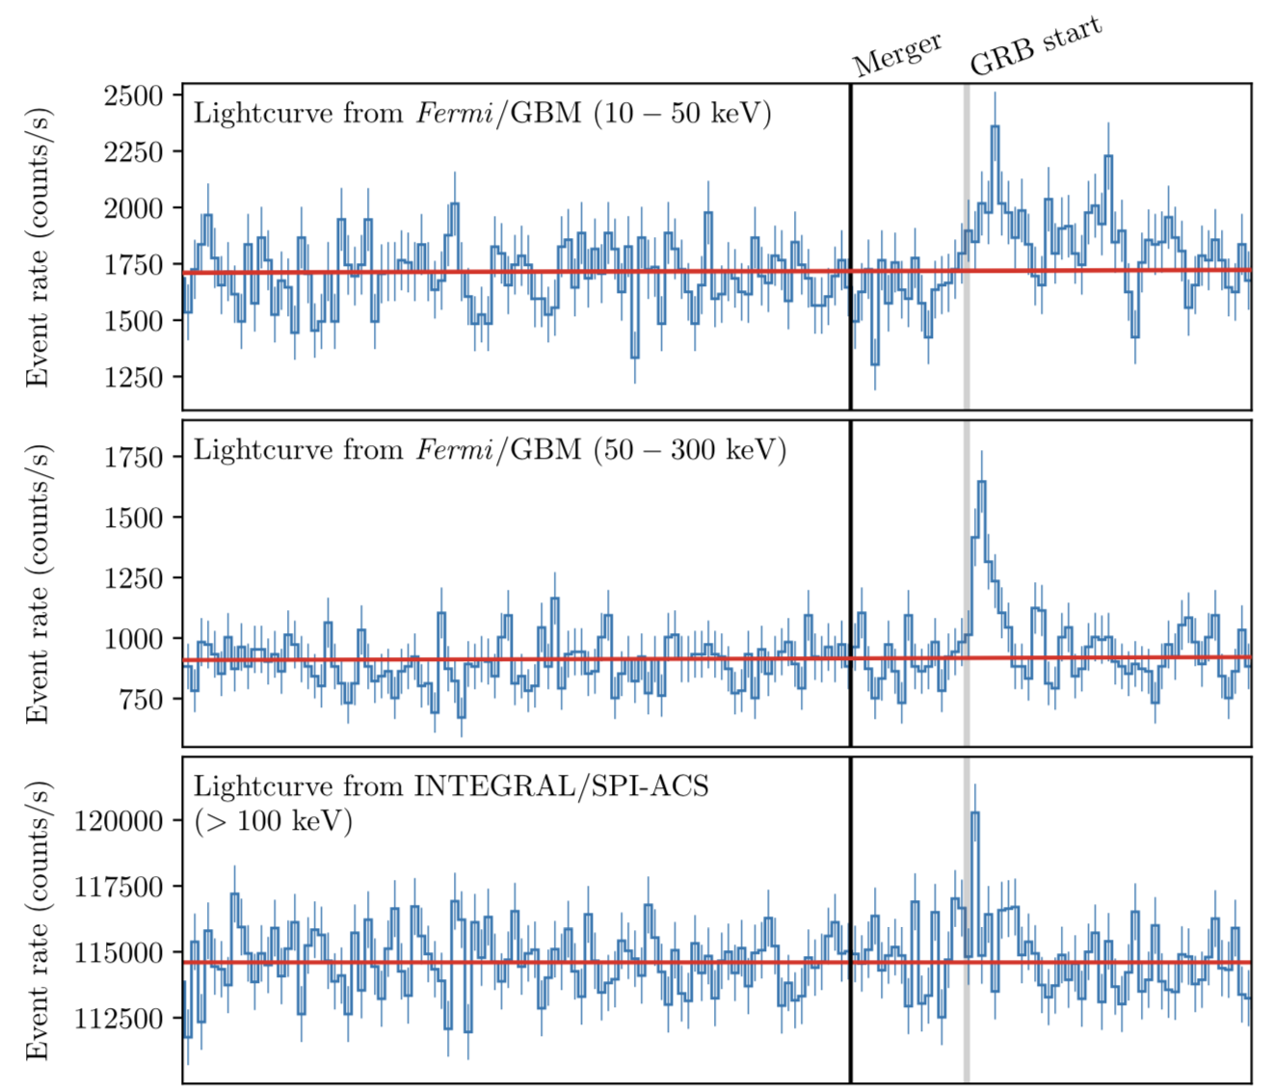
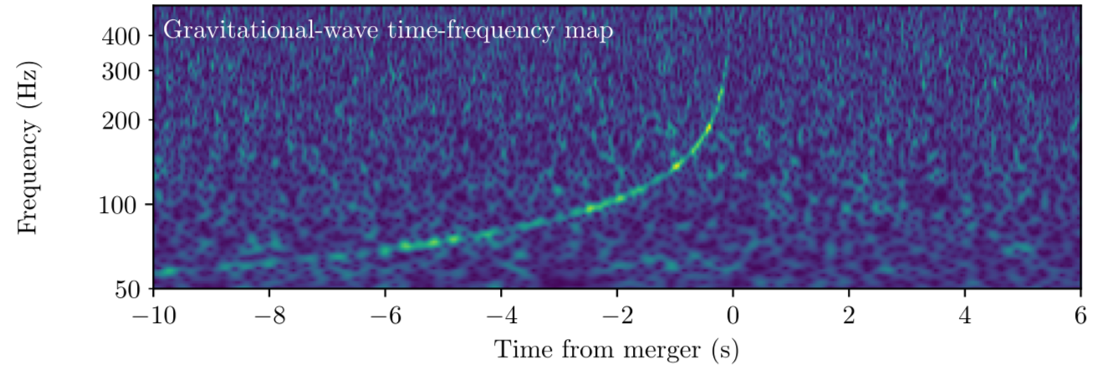
GW170817 / GRB 170817A
First GW multi-
messenger observation
Time and sky position
coincident between
GW and gamma-ray
observatories

Slide 27
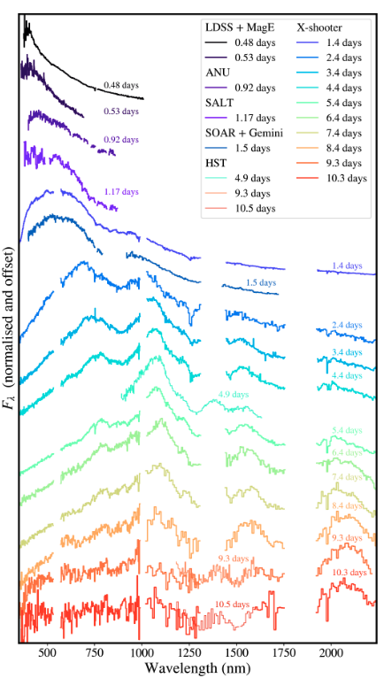
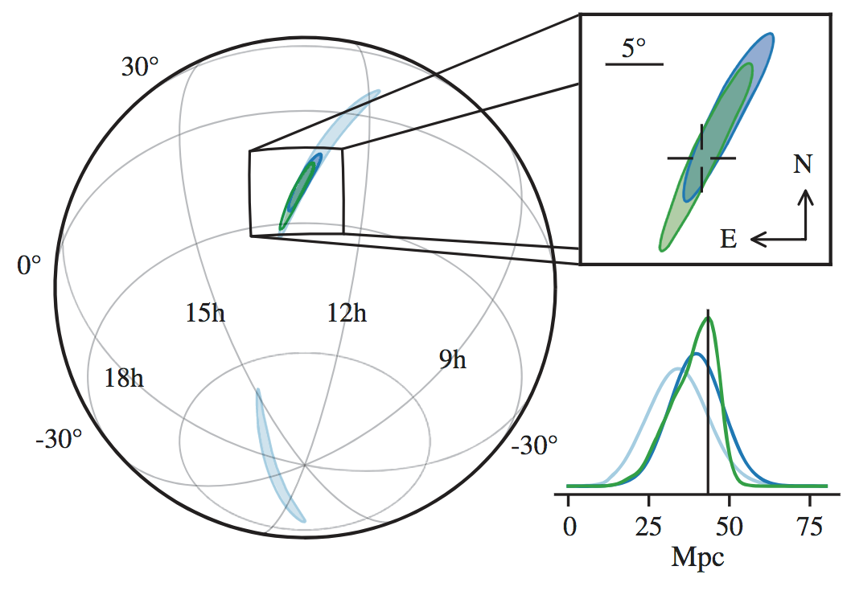
GW170817 / GRB 170817A
First GW multi-
messenger observation
Time and sky position
coincident between
GW and gamma-ray
observatories
Optical, UV & IR
counterpart (‘kilonova’)
Sneppen et al. arXiv:2404.08730

Slide 28
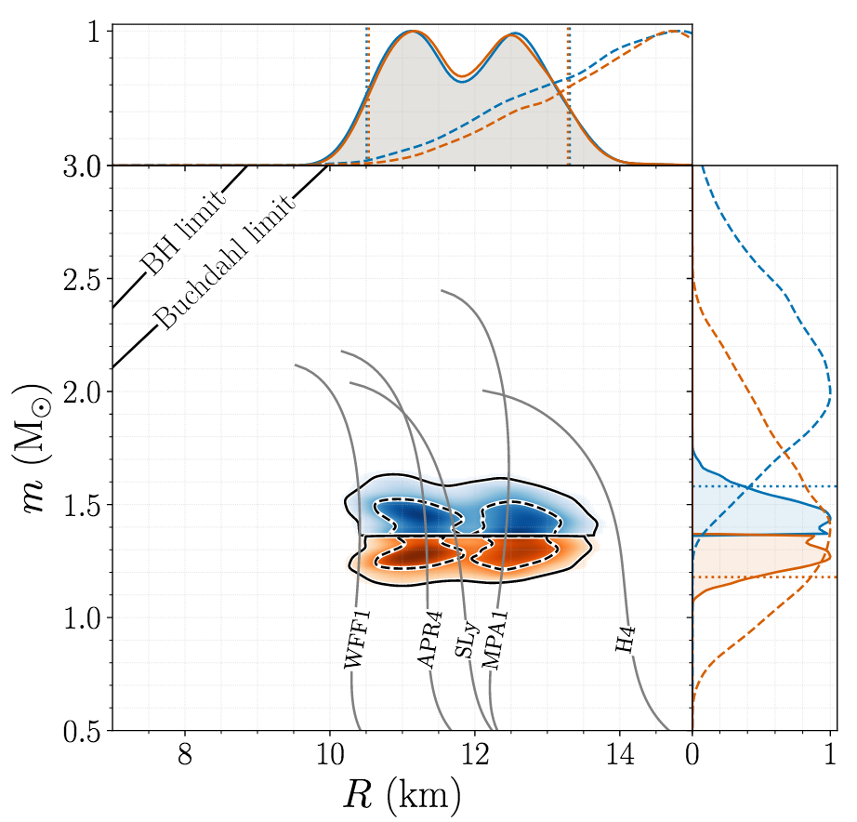
Science from multi-messenger
BNS detection
Speed of GW = speed of light
Rules out many non-GR ‘dark energy’ theories
Heavy element nucleosynthesis in NS collisions
Independent estimate of Hubble constant
Bounds on NS tidal deformability & equation of state
Bounds on high energy neutrino emission (IceCube, Pierre Auger)
28

Slide 29
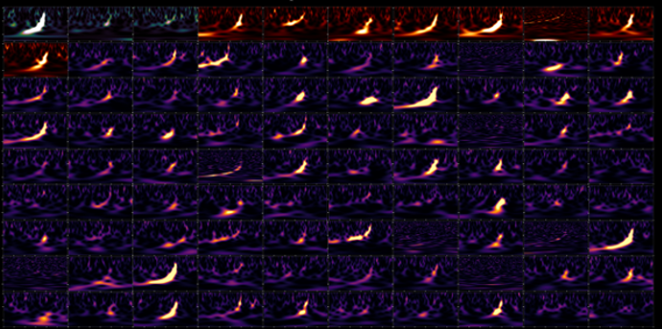
LVK Highlights : O3 AND onward
Detections of compact binary mergers from 2015-2020
Image credit: LVK / S. Ghonge & K. Jani

Slide 30
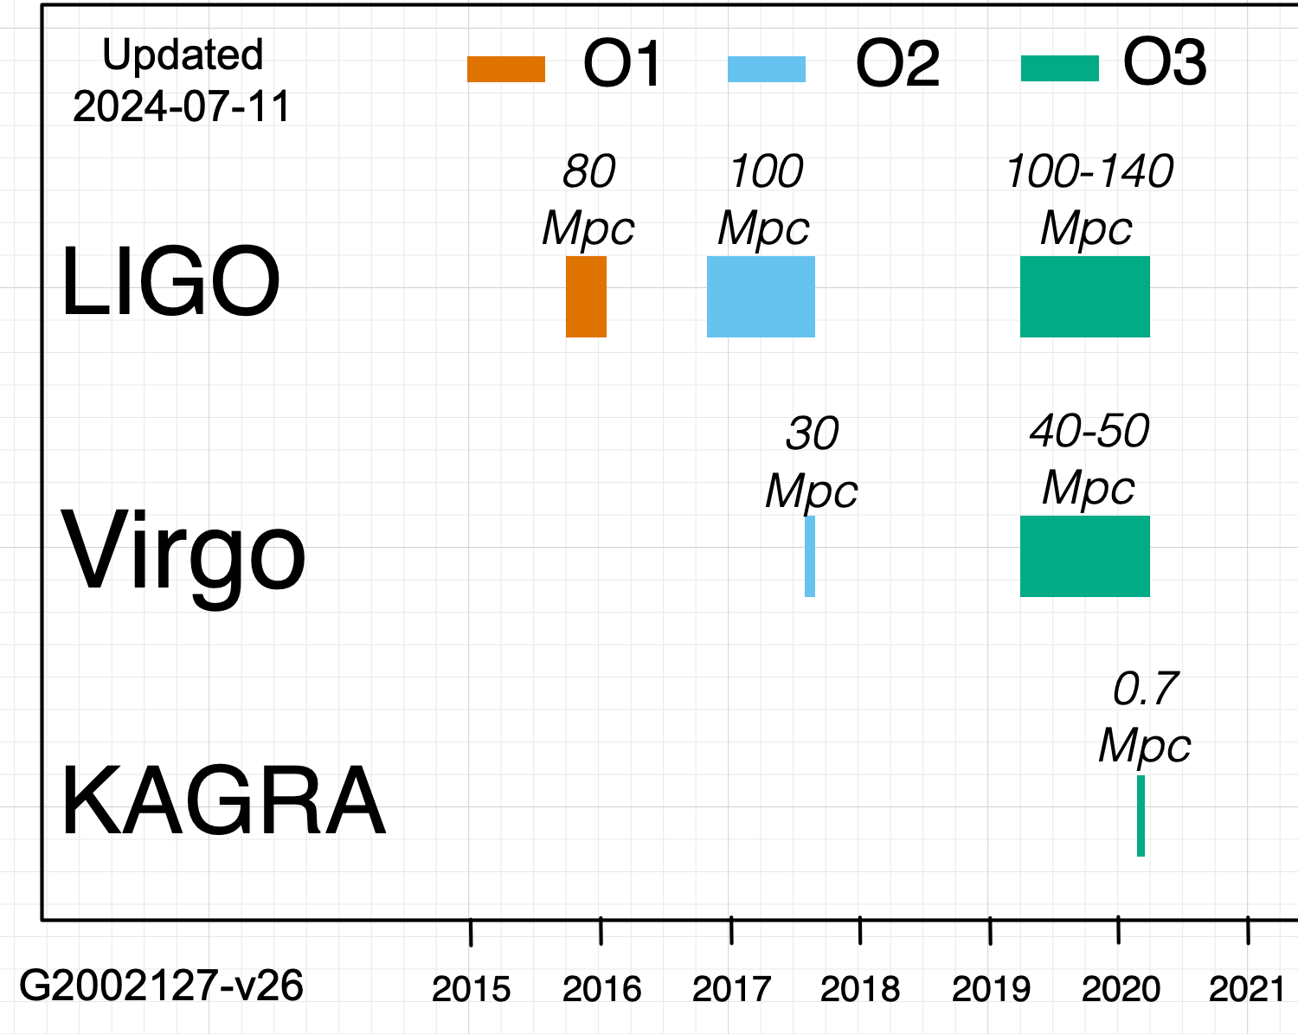
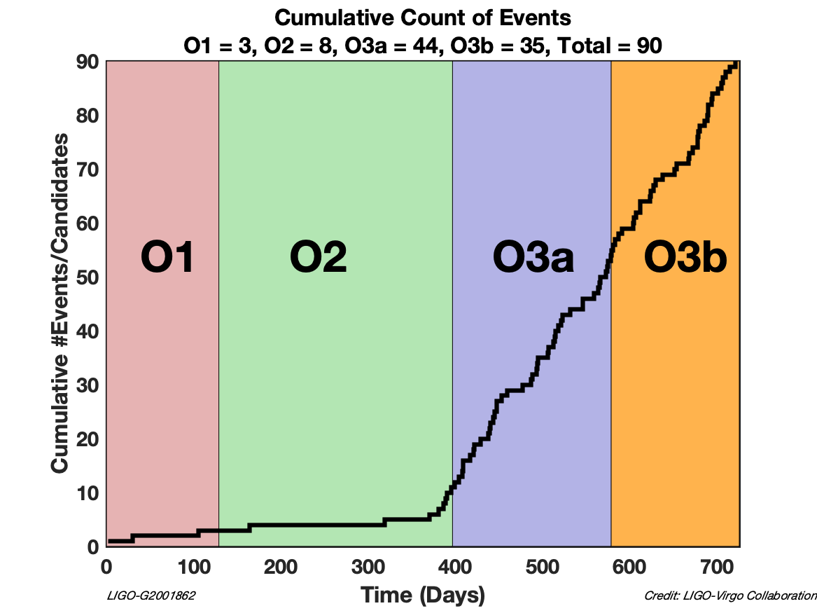
LIGO-Virgo observations up to 2020
O3 run : April 2019 through March 2020
90 ‘significant’ binary merger candidates (cumulative O1-O3)

Slide 31
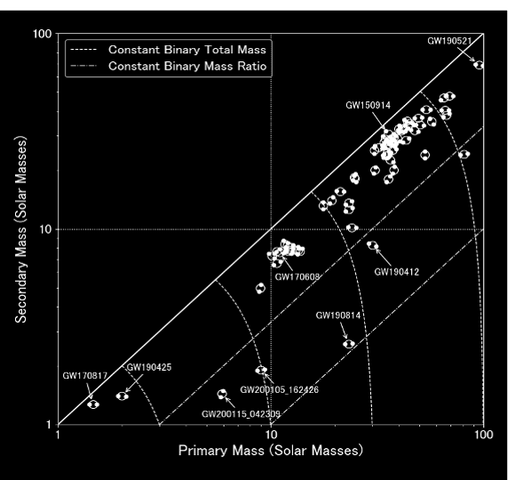
IMBH …
https://www.ligo.org/science/
Publication-O3bAstroDist/
Broad BBH population
Outliers .. ?
BNS detections
NS-BH detections
31

Slide 32
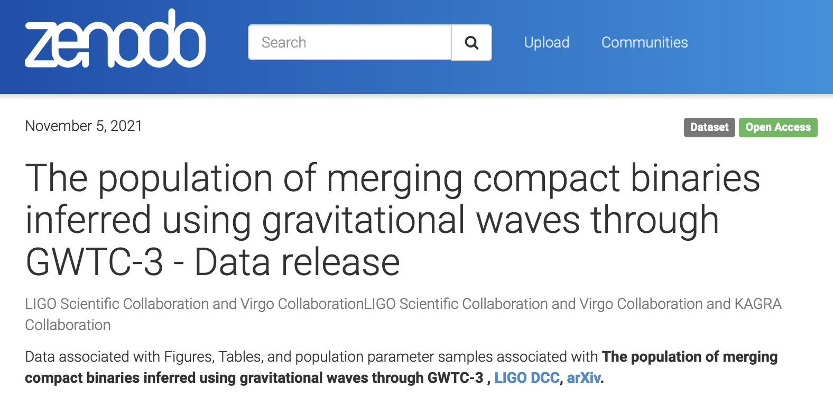
LVK public data products
GW Open Science Center data on GWTC-3
Data release for
papers : inference
samples, table data,
tutorial notebook …
https://www.gw-openscience.org/eventapi/html/GWTC-3/
https://dcc.ligo.org/LIGO-P2100239/public
https://zenodo.org/record/5655785

Slide 33
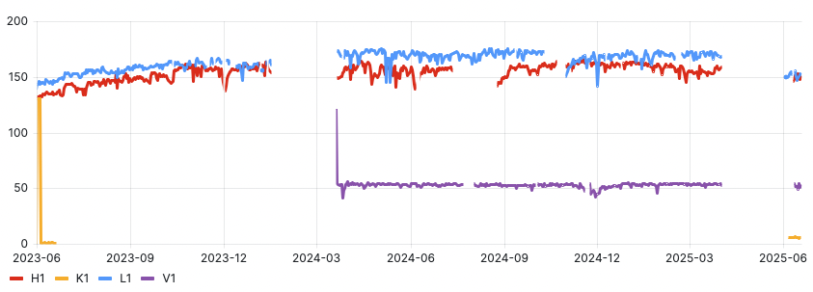
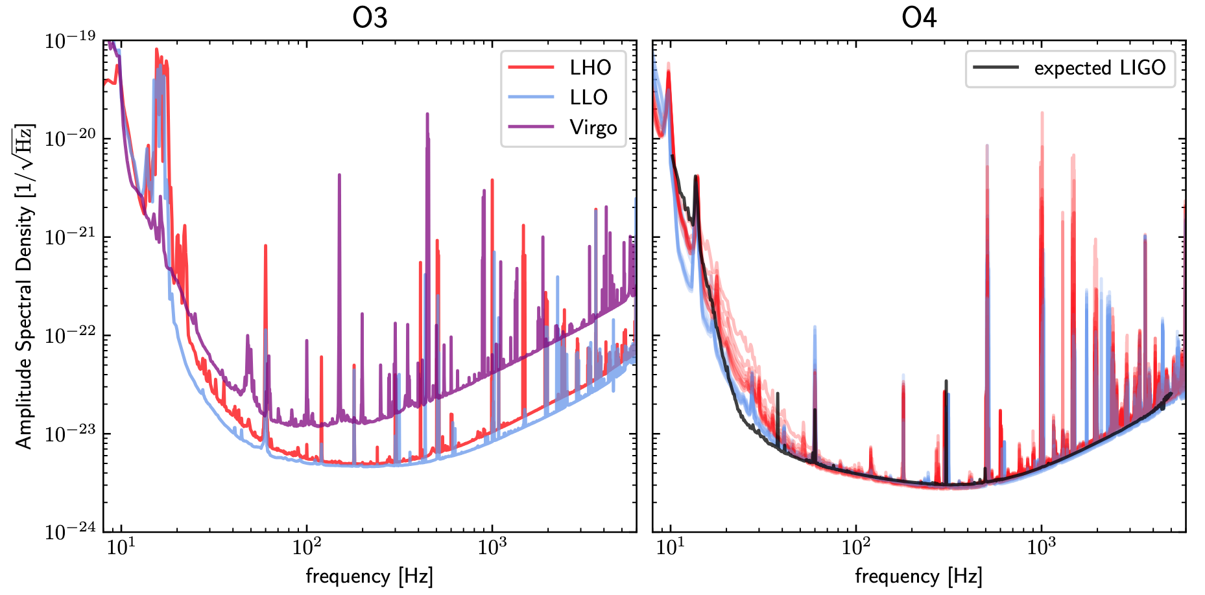
O4 run : observing since May 2023
Average BNS inspiral range (Mpc)
O4a
O4b
O4c (ongoing)
LIGO using frequency-dependent squeezing of photon state
April 2024 : Virgo joined
Essick+ (in prep.)

Slide 34
O4 run : observing since May 2023
Average BNS inspiral range (Mpc)
O4a
O4b
O4c (ongoing)
LIGO using frequency-dependent squeezing of photon state
April 2024 : Virgo joined

Slide 35
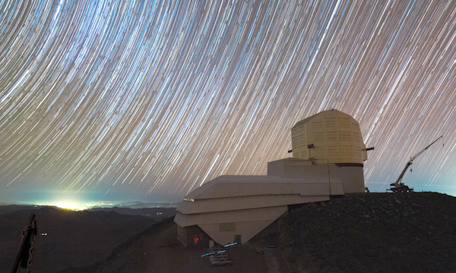
O4 run : observing since May 2023
Average BNS inspiral range (Mpc)
O4a
O4b
O4c (ongoing)
LIGO using frequency-dependent squeezing of photon state
April 2024 : Virgo joined
O4c extended through November 2025
  allow for preparation of O5 upgrade hardware
  & joint followups with Rubin Observatory
KAGRA had significant setbacks from Noto Peninsula Earthquake (Jan 2024)
  Rejoined O4 with sensitivity ~10 Mpc

Slide 36
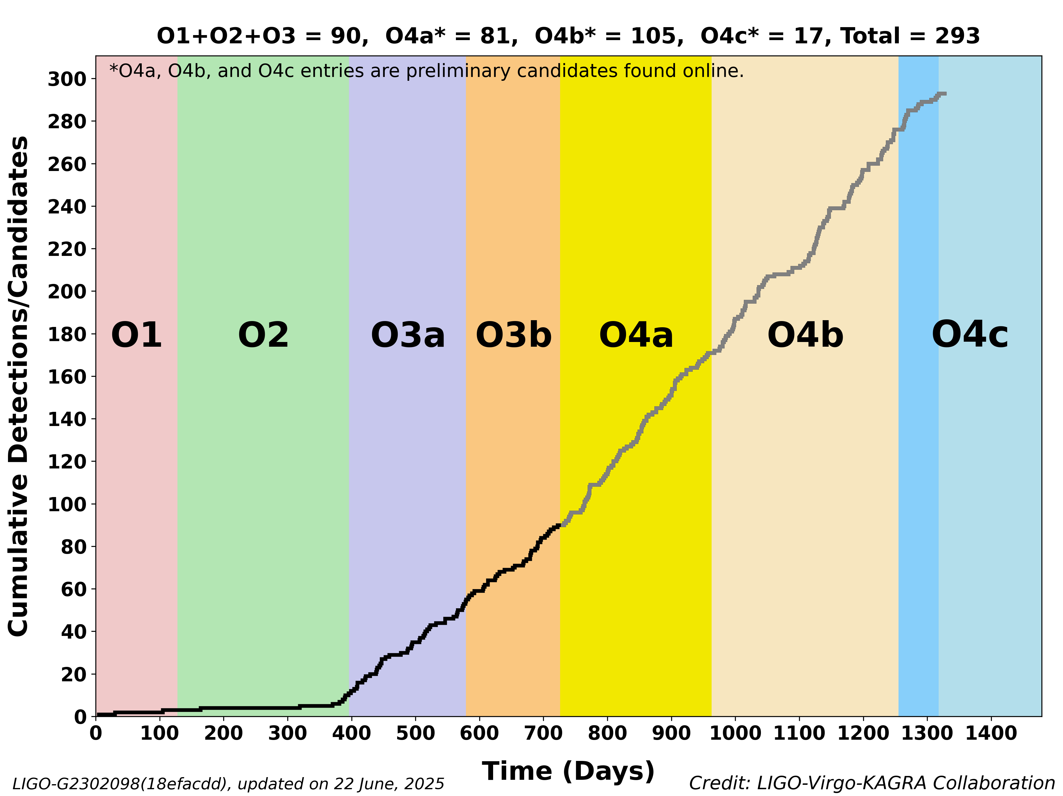
O4 run : observing since May 2023

Slide 37

O4 run : observing since May 2023

Slide 38



O4 public event highlights
230518 : pre-run engineering data
Probable NS-BH merger
230529 : single-detector event
Another possible NS-BH merger
(see next slide …)
240615 : smallest localization area
5 deg² due to 3 detectors
(first of 2 alerts on same day!)
https://gracedb.ligo.org/superevents/public/

Slide 39


GW230529 : the lightest NS-BH ?
First publication of O4 run
Strengthens evidence
against supposed
‘mass gap’ 3-5 M☉
No direct measurement
of tidal (NS matter) effects
Increases estimated rate
of future NS-BH mergers
with EM emission

Slide 40




New for O4c : Public ℳ estimates
Precisely measured from inspiral signal in the low mass regime
Accurately estimated by search pipelines in the low mass regime
GW170817
ℳ (Reconstructed)
ℳ (Injected)

Slide 41
Binned chirp mass information
New data product providing source chirp mass in the form of binned probabilities.
The predetermined bins are the following (in units of solar masses):
[0.1, 0.87, 1.0, 1.1, 1.2, 1.3, 1.4, 1.5, 1.7, 1.9, 2.1, 2.3, 3, 5.5, 11, 22, 44, 88, 1000]
Example: A chirp mass of 0.87 M☉ may correspond to a 1 M☉, 1 M☉ merger.
Bins are ‘fine’ in the HasSSM and HasNS regime where chirp mass is recovered more accurately,
Become coarse for higher masses in the BBH regime.

Slide 42
Binned chirp mass information
New data product providing source chirp mass in the form of binned probabilities.
The predetermined bins are the following (in units of solar masses):
[0.1, 0.87, 1.0, 1.1, 1.2, 1.3, 1.4, 1.5, 1.7, 1.9, 2.1, 2.3, 3, 5.5, 11, 22, 44, 88, 1000]
Example: A chirp mass of 1.2 M☉ may correspond to a 1.4 M☉, 1.4 M☉ merger.
Example: A chirp mass of 3 M☉ may correspond to a 10 M☉, 1.4 M☉ merger.
Bins are ‘fine’ in the HasSSM and HasNS regime where chirp mass is recovered more accurately
Become coarse for higher masses in the BBH regime.

Slide 43
Binned chirp mass information
New data product providing source chirp mass in the form of binned probabilities.
The predetermined bins are the following (in units of solar masses):
[0.1, 0.87, 1.0, 1.1, 1.2, 1.3, 1.4, 1.5, 1.7, 1.9, 2.1, 2.3, 3, 5.5, 11, 22, 44, 88, 1000]
Example: A chirp mass of 8.7 M☉ may correspond to a 10 M☉, 10 M☉ merger.
Example: A chirp mass of 44 M☉ may correspond to a 50 M☉, 50 M☉ merger.
Bins are ‘fine’ in the HasSSM and HasNS regime where chirp mass is recovered more accurately
Become coarse for higher masses in the BBH regime.

Slide 44
Integration into public alerts
The most probable bin is reported in the GCN circular
.json of all bin probabilities and .png histogram on GraceDB (public)
  Low-latency estimate available in ~seconds along with
  em-bright+p(astro) : mchirp_source.json
  PE estimate available alongside update alert within ~hour(s) : mchirp_source_PE.json

Slide 45

Integration into public alerts
The most probable bin is reported in the GCN circular
.json of all bin probabilities and .png histogram on GraceDB (public)
  Low-latency estimate available in ~seconds along with
  em-bright+p(astro) : mchirp_source.json
  PE estimate available alongside update alert ~hour(s) : mchirp_source_PE.json

Slide 46

CBC detection capabilities in O4a
Extensive injection (simulated signal) campaign for CBC searches
Essick et al. in prep

Slide 47

CBC detection capabilities in O4a
Extensive injection (simulated signal) campaign for CBC searches
Essick et al. in prep

Slide 48



CBC detection capabilities in O4a
Extensive injection (simulated signal) campaign for CBC searches
Essick et al. in prep

Slide 49
“What We Did Over The Summer Holidays”
Many upcoming O4a LVK papers (O4a data release late Aug.)
… watch this space !
Transient detection catalog : introduction, methods, results
Burst, stochastic, continuous wave, sub-solar-mass CBC searches
Population properties of CBC sources
H0 measurement using CBC sources
Tests of GR and search for GW lensing with CBC sources
Exceptional event paper(s)

Slide 50

LVK Observational WP 2024-5 https://dcc.ligo.org/LIGO-T2400403/public

Slide 51

INTO The future . . .

Slide 52


O5 : the ‘A+’ design
Mid-scale upgrade of
original ‘Advanced LIGO’
Most critical technology :
improved mirror coatings
to deal with higher arm power
Virgo O5 plans currently under reassessment
https://observing.docs.ligo.org/plan/
LIGO-T1800042

Slide 53


Post-O5 : A# / Virgo_nEXT /...
Upgrades exploiting existing facilities to the limit
Targets factor ~2 increase in range over O5
Stepping stone to future detector technologies
Fill gap in observational capability to ‘next generation’ of observatories
LIGO-India : LIO, Aundha planned to operate early 2030s
D. Reitze, https://www.nsf.gov/mps/phy/nggw/present_ligo.pdf

Slide 54
Conclusions
O4 run underway with Virgo & KAGRA ⇒ Nov 2025
Lots of O4a results planned for release …
O4b catalogue and results in the pipeline
Many discoveries remain to be made !
This material is based upon work supported by NSF’s LIGO Laboratory which is a major facility fully funded by the National Science Foundation.

