Slide 1


Beyond Standard Diffusion: The Impact of Inhomogeneous CR Propagation and Anisotropies
Pedro de la Torre Luque --- pedro.delatorre@uam.es
Ramón y Cajal fellowship (UAM/IFT - Madrid)
CIEMAT, Madrid - 29/01/2026

Slide 2
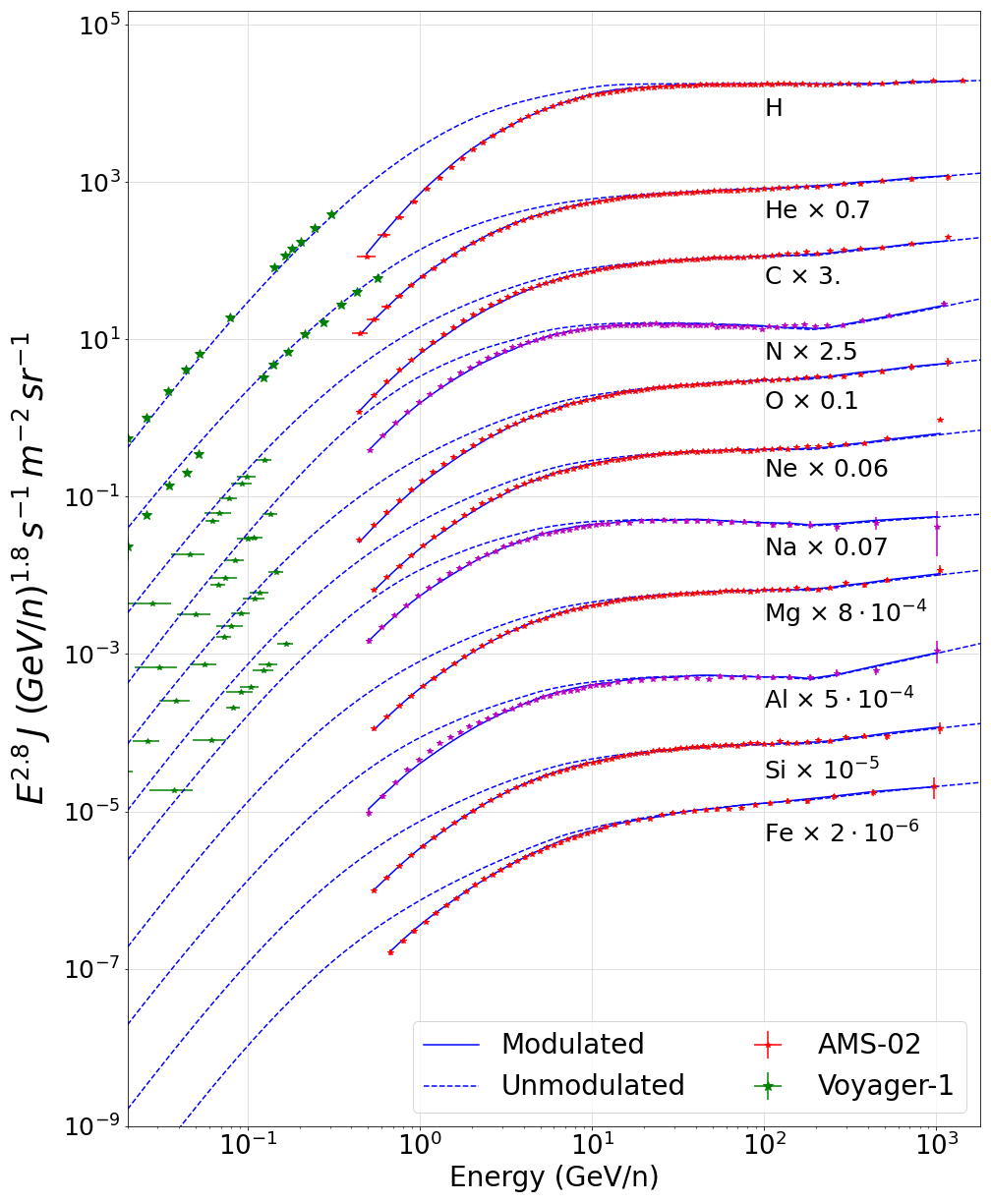
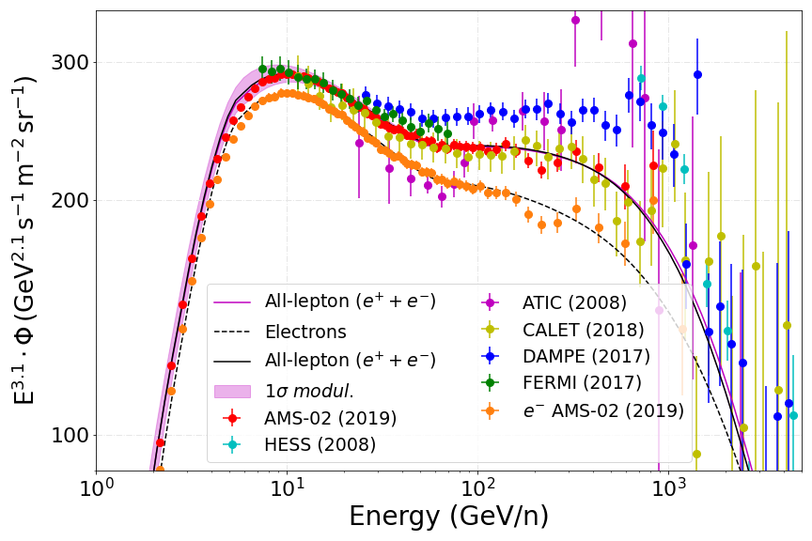
Standard picture of Gal. CRs
PDL et al JCAP 07 (2022) 07
In the standard paradigm, Galactic CR sources are SNRs, which inject them following (broken) power-laws and which diffuse homogenously
PDL et al JCAP 07 (2022) 07
Notes:
Gas usually is taken from radially symmetric models and spallation interactions with head-on approx.
However, new data identify: Several breaks in spectra of local CRs, problems to explain acceleration of HE CRs (calling for other sources), possible anomalies in antiparticles. Theory also tells us that we might have other accelerators and that diffusion cannot be uniform and isotropic.

Slide 3
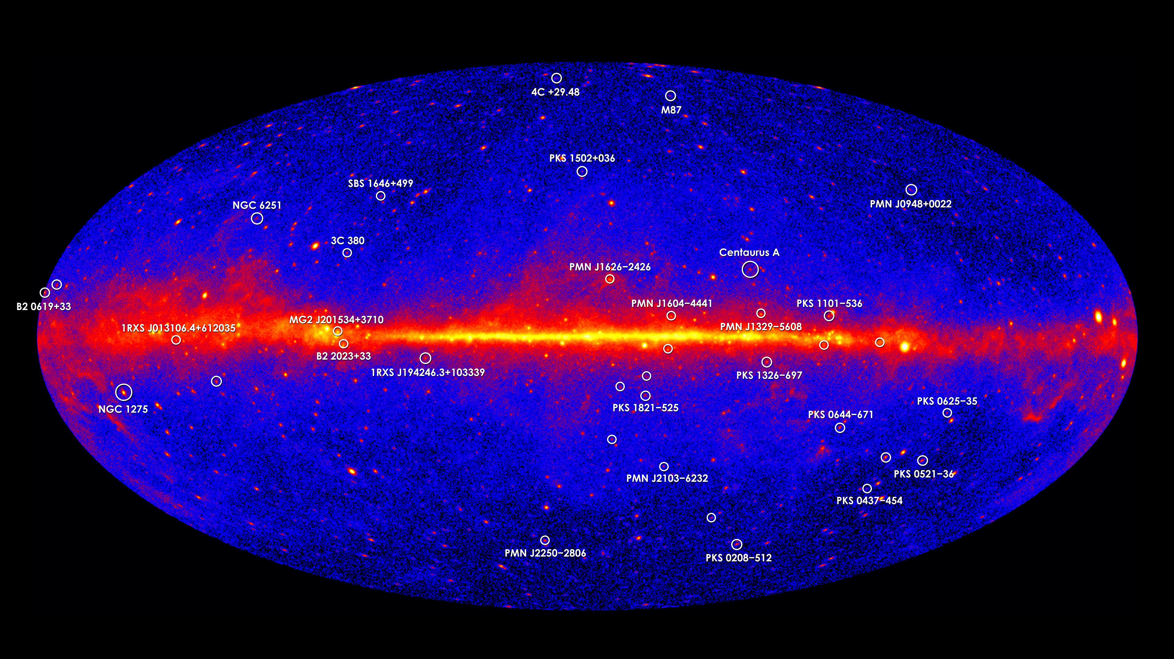
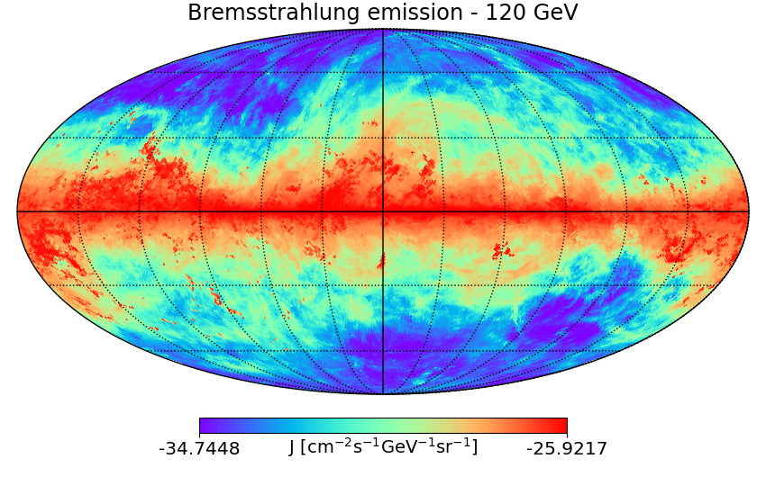
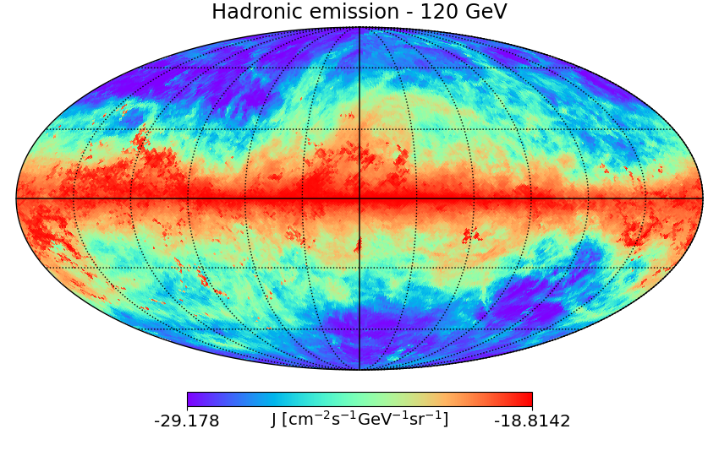
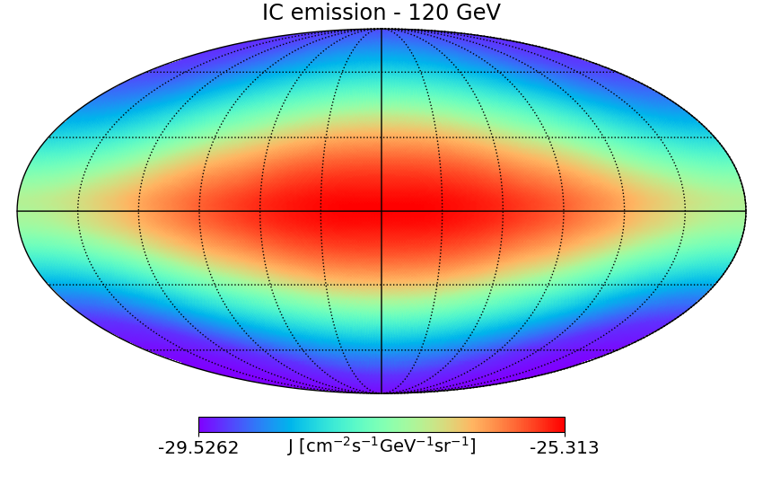
The gamma-ray diffuse sky
Diffuse emission totally correlated with the propagation of cosmic rays
Dominated by protons, He (and e⁻)
$e +N →e^{′}+γ$’ + N
$$p+p → π0$$
$$π0→2 γ$$
$e +γ →e^{′}+γ$’
Hadronic (and Bremss.) emission follows the ISM gas distribution
IC emission depends on the energy density of the ISRFs
Notes:
Neutrino diffuse emission is actually sources + real diffuse

Slide 4
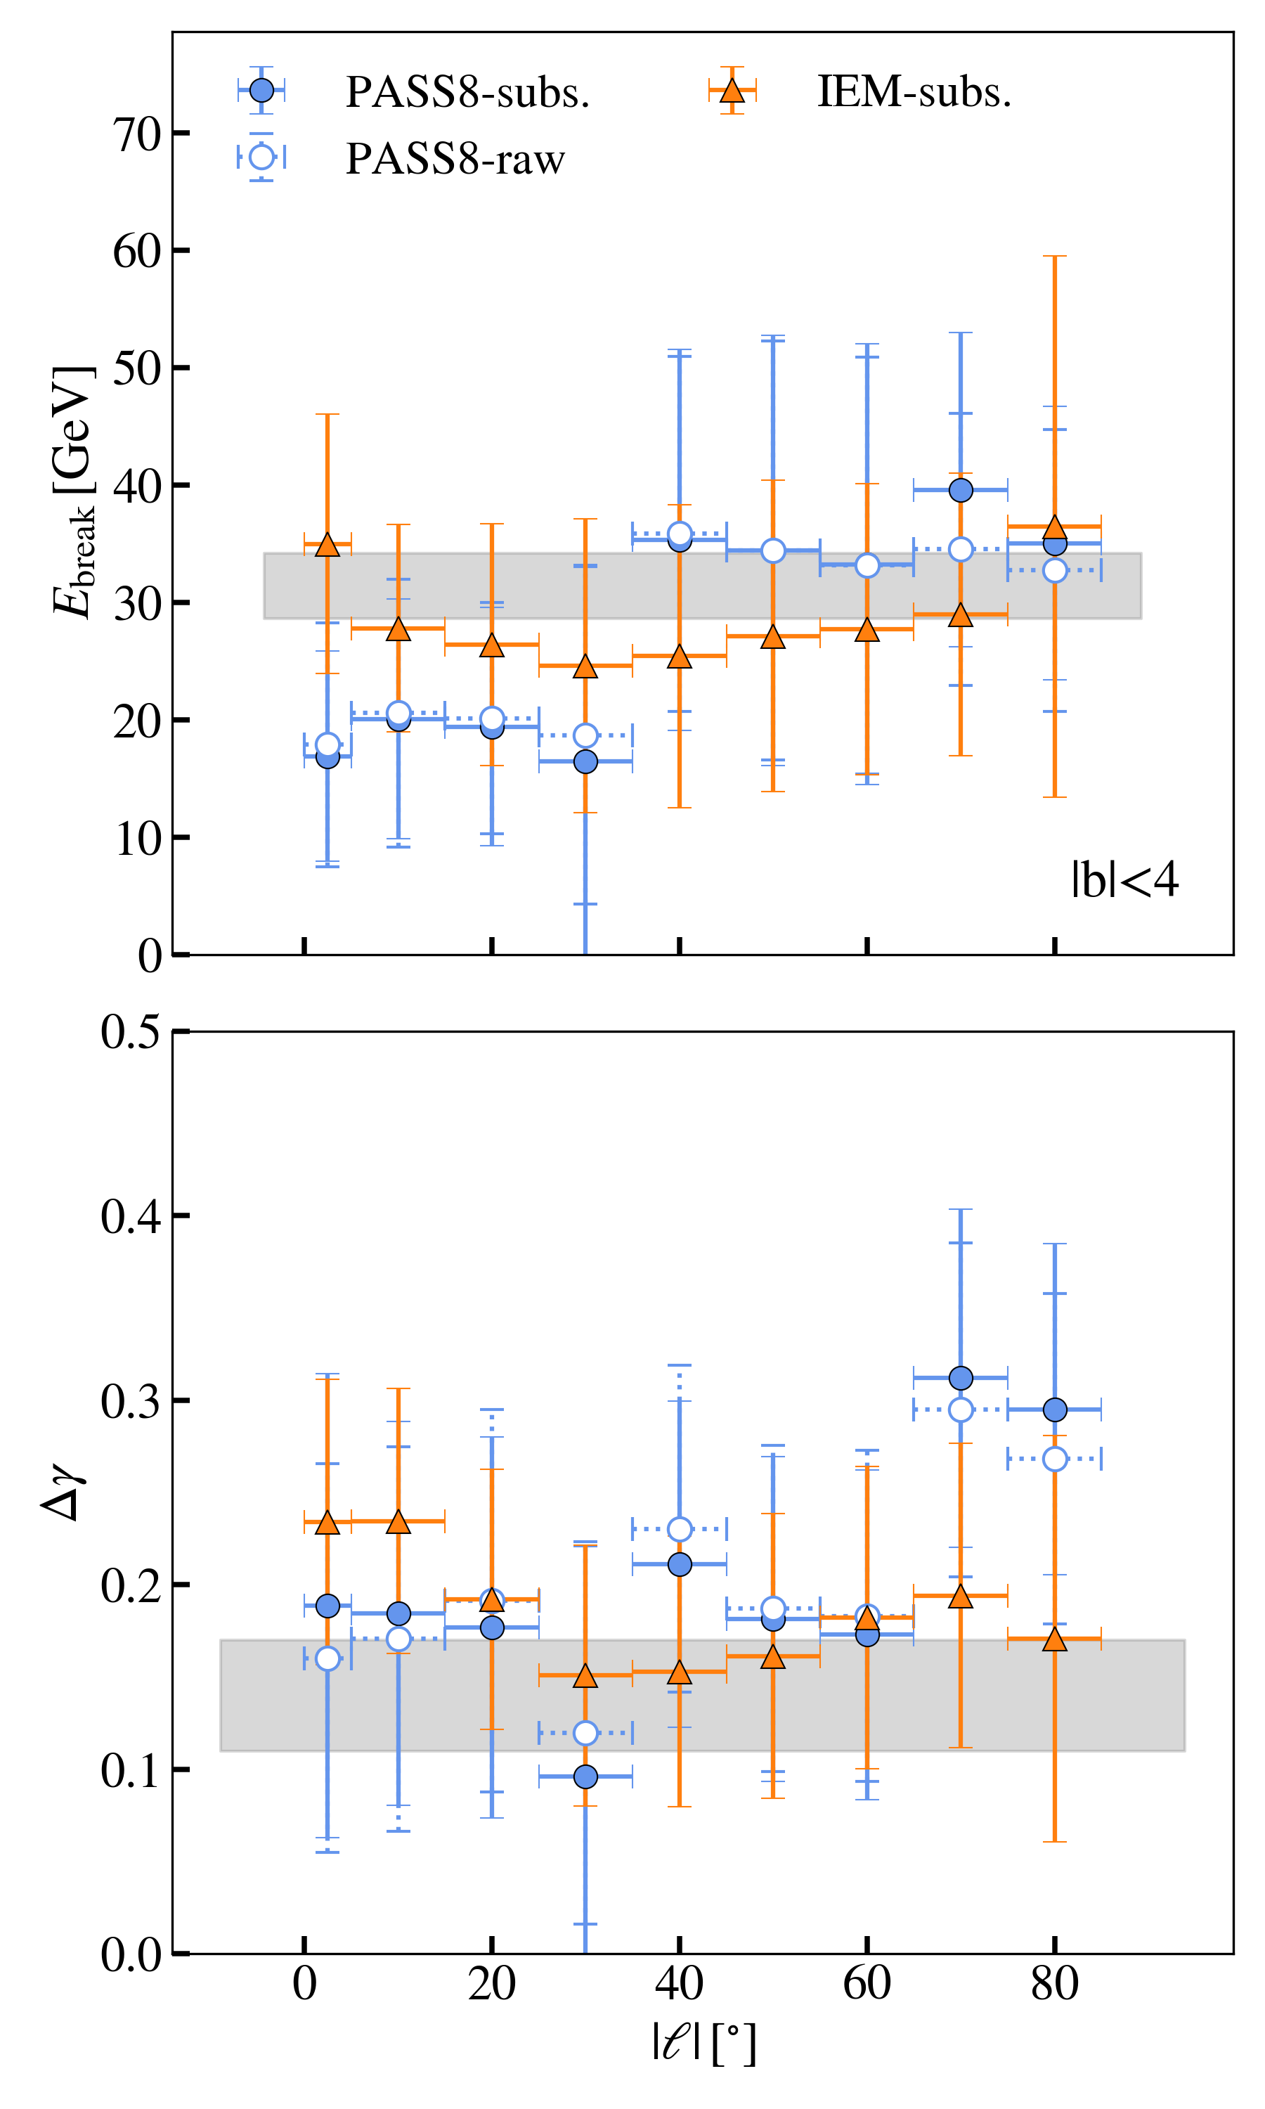
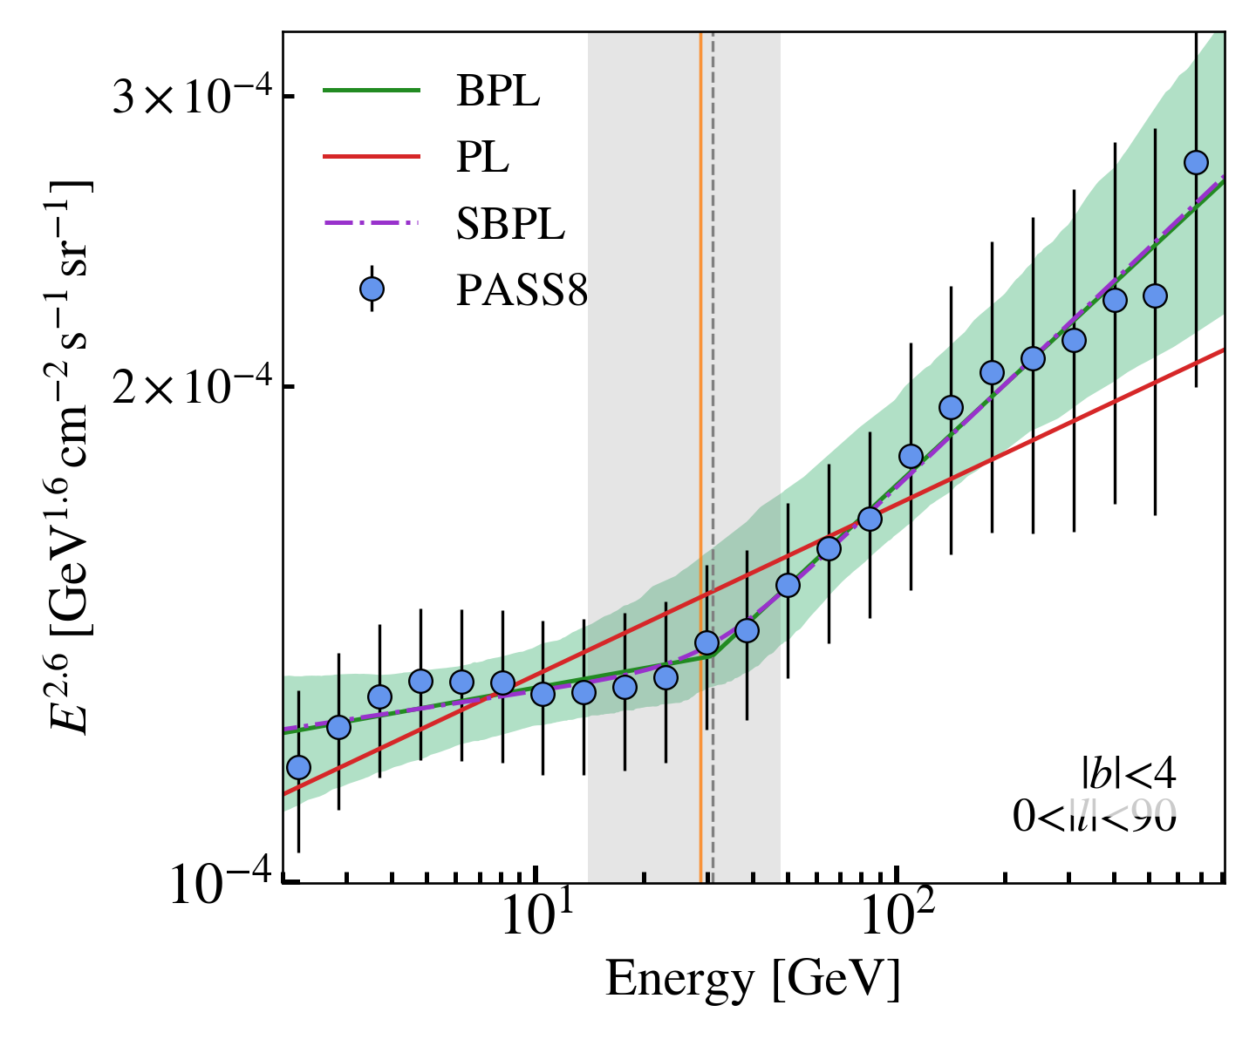
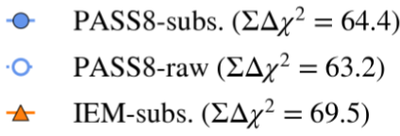
The CR “Hardening” at 300 GV
Valenciano, PDL+ To appear
Clear evidence of the local CR break in Fermi-LAT data
  It provides evidence that the break at ~300 GV is a global feature (i.e. appears consistently in all windows)
  The change in spectral slope roughly follows that from a transition from Kolmogorov to Kraichnan turbulence
Searches with CTA will help unveil the origin of the ‘’DAMPE bump’’
PRELIMINARY
PRELIMINARY

Slide 5
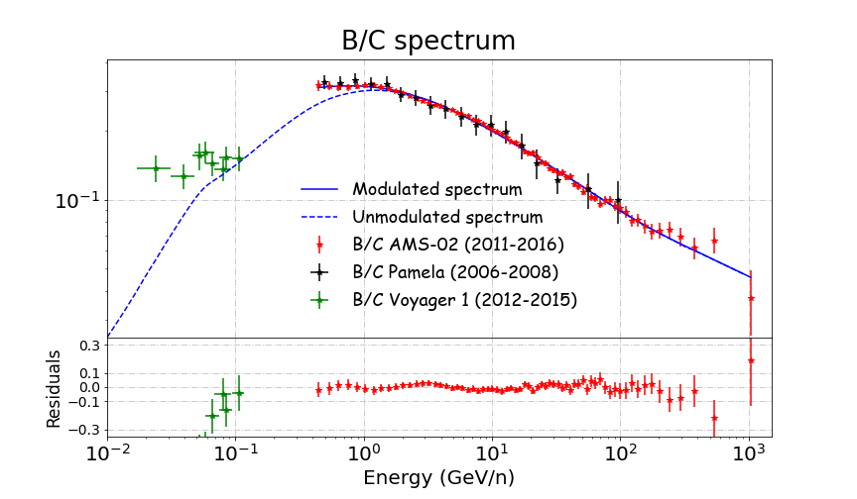
The Galactic gamma-ray diffuse sky – Local cosmic rays
$\frac{\text{J}\text{sec}}{\text{J}\text{pr}} \sim$σ(E)/ $D\left(E\right)$
$D\left(E, x\right)$ ~ D₀${\left(\frac{E}{E0}\right)}^{δ(x)}F(x)$
PDL et al JCAP 07 (2022) 07, 008
PDL et al JCAP03 (2021) 099
$$δ\left(x=REarth\right) \sim 0.5$$
$$J∝E^{ (α+δ)}$$

Slide 6
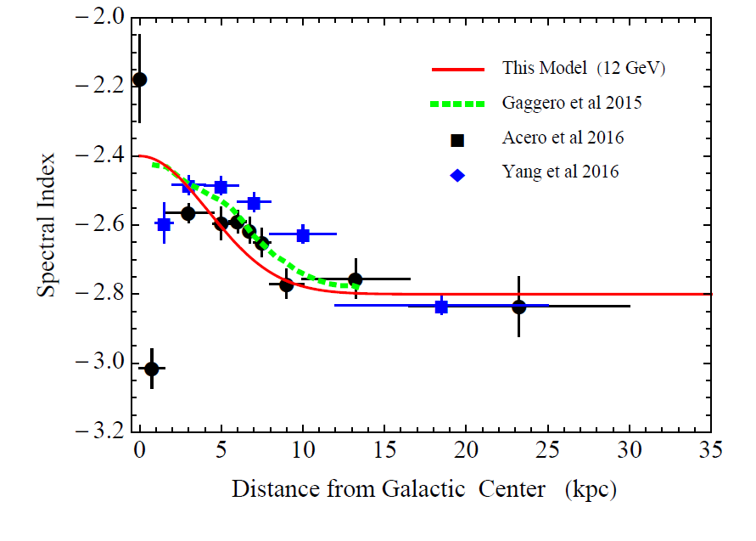
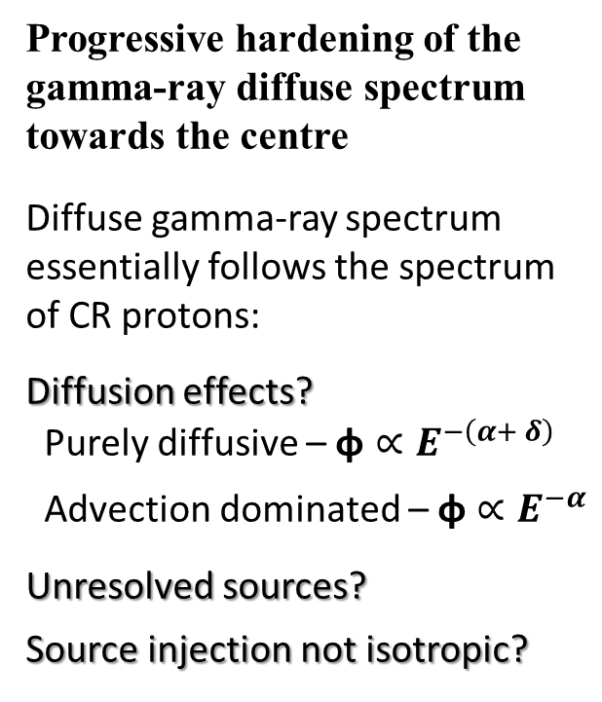
The Galactic gamma-ray diffuse sky – Non-uniform transport?
The conventional picture of spatially-constant diffusion is not able to explain this consistently
Progressive hardening of the gamma-ray diffuse spectrum towards the centre
Diffuse gamma-ray spectrum essentially follows the spectrum of CR protons:
Diffusion effects?
Purely diffusive – $\text{φ}∝E^{−\left(α+ δ\right)}$
Advection dominated – $\text{φ}∝E^{−α}$
Unresolved sources?
Source injection not isotropic?
Lipari et al 2020 (12 GeV)
P. Lipari, S.Vernetto 2020

Slide 7
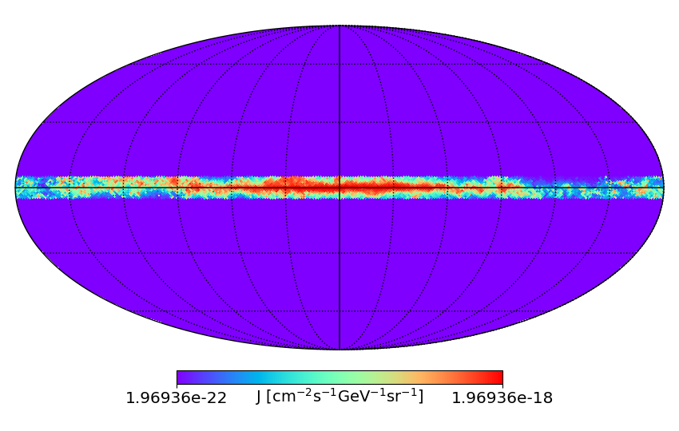
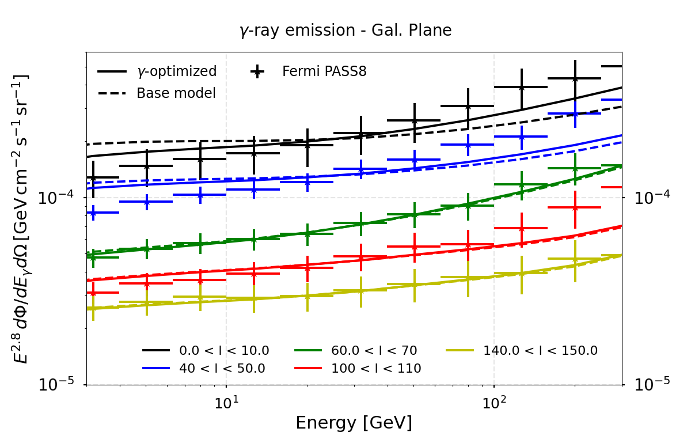
Inhomogeneous diffusion model
Diffusion coefficient changes towards the Galaxy centre $D∝E^{ δ(R)}$
$$δ\left(R\right)=δ0+δAR$$
PDL et al ArXiv:2502.18268
ArXiV:2203.15759
|b| < 5
DRAGON2
$$D= {D_{0}β\left(\frac{E}{E_{0}}\right)}^{δ(R)}$$
  Base model: Constant ($δ_{A}$ = 0)
  γ-optimized model: $δ_{A}$ = 0.04
  $δ_{0}$ = 0.17
Notes:
The normalization of the spectra at different longitudes is tuned by changing the XCO value

Slide 8
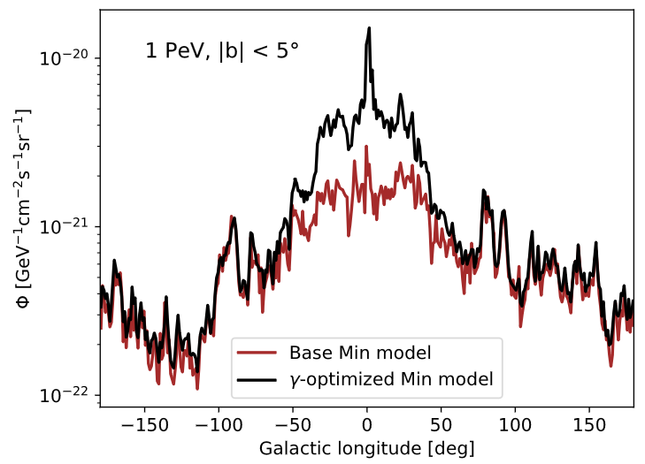
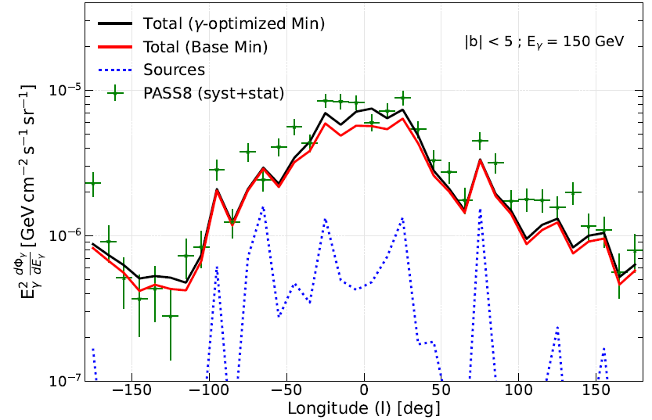
Comparing to Fermi-LAT
We expect a huge difference on the diffuse high-energy neutrino and gamma-ray flux around the Galactic Center!
PeV diffuse emission measurements could confirm such prediction.
Important implications for CTAO or SWGO, and for dedicated studies of the Galactic Centre
Source emission (4FGL-DR2 cat.), EGB and unresolved emissions added to compare with data
Only the XCO factor slightly tuned to improve normalization with respect to Fermi-LAT data
Good spectral and morphological agreement even though we do not carry out a dedicated fit

Slide 9
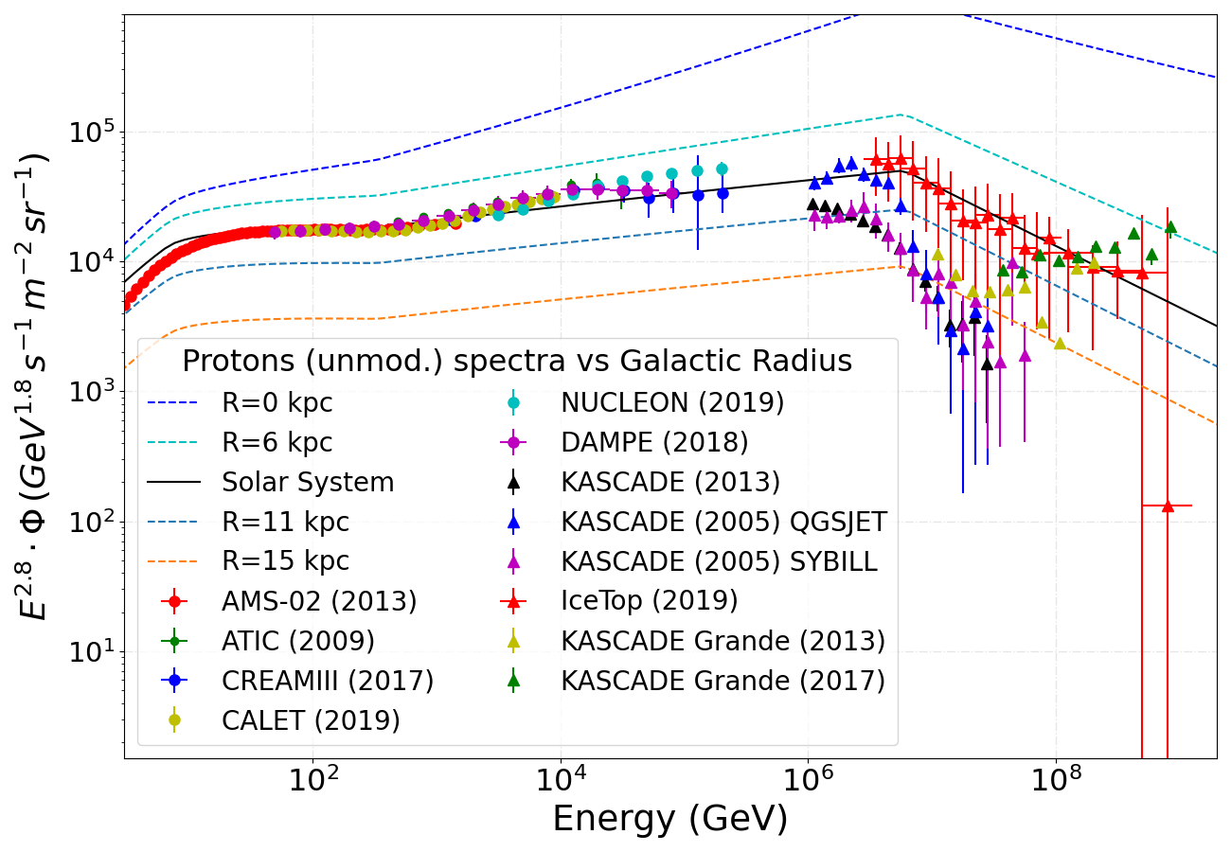
Inhomogeneous diffusion model (δ → δ(R))
Different interpretations of local data
Local sources vs global features
Two different interpretations (models) of the local proton and He data based on the “bump” at ~10 TeV found by DAMPE and the discrepancy from particle shower experiments.
MAX model adopted connects AMS-02 data with IceTop
MIN model adopted connects the DAMPE “bump” with KASCADE
Both models incorporate a break at ~ 300 GeV and a strong softening at a few PeV
PDL. et al arXiv: 2203.15759
MAX model

Slide 10
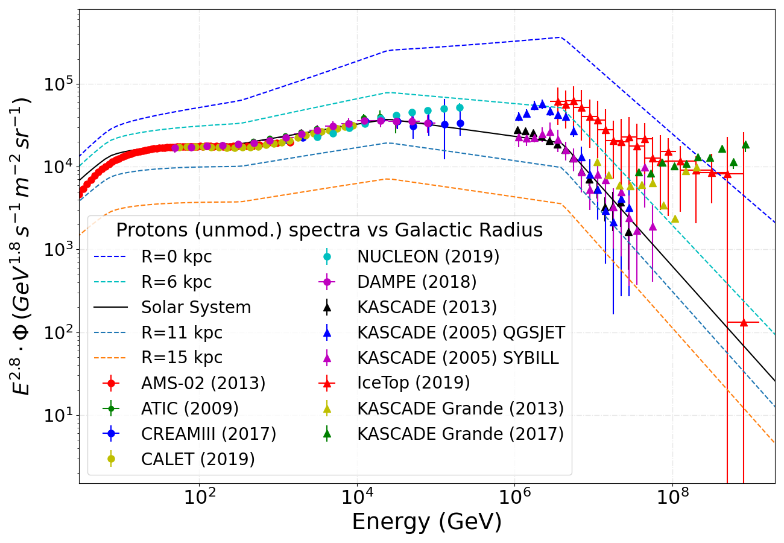
Inhomogeneous diffusion model (δ → δ(R))
Different interpretations of local data
Local sources vs global features
Two different interpretations (models) of the local proton and He data based on the “bump” at ~10 TeV found by DAMPE and the discrepancy from particle shower experiments.
MAX model adopted connects AMS-02 data with IceTop
MIN model adopted connects the DAMPE “bump” with KASCADE
Both models incorporate a break at ~ 300 GeV and a strong softening at a few PeV
PDL. et al arXiv: 2203.15759
MIN model

Slide 11
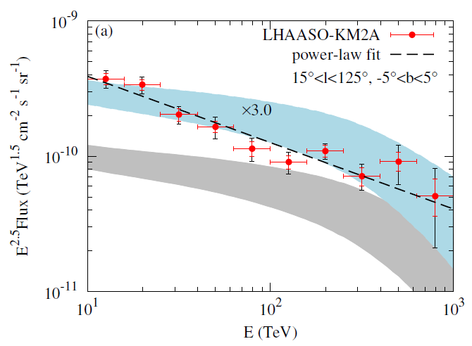
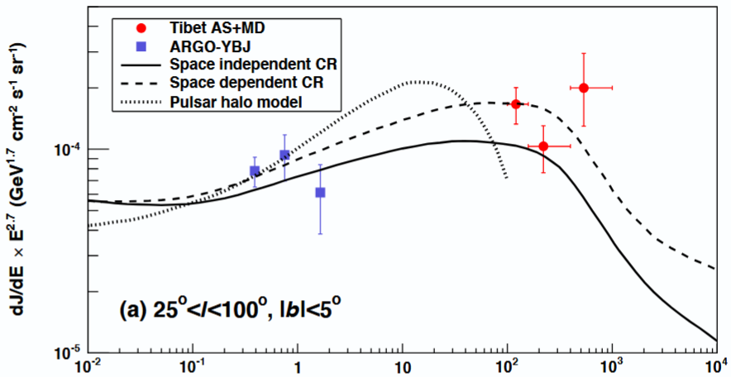
LHAASO and TIBET measurements: A larger γ-ray diffuse flux than expected?
Does this hint for inhomogeneous diffusion? Unresolved sources?
Anemori et al PRL 126, 141101 (2021)
TIBET-Asγ collaboration
Cao et al PRL 131, 151001 (2023)
LHAASO collaboration

Slide 12
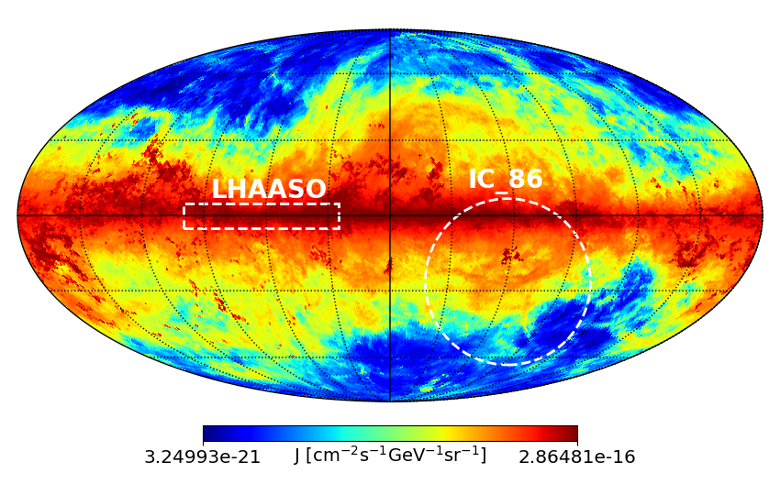
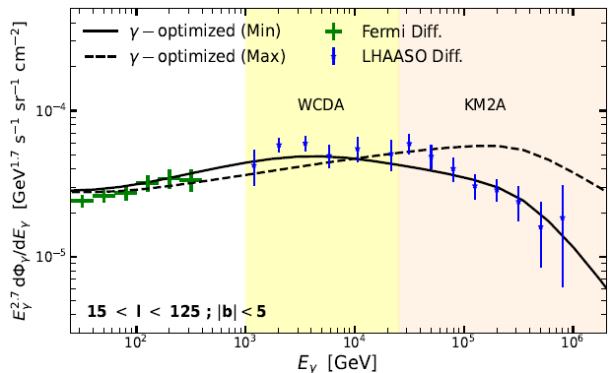
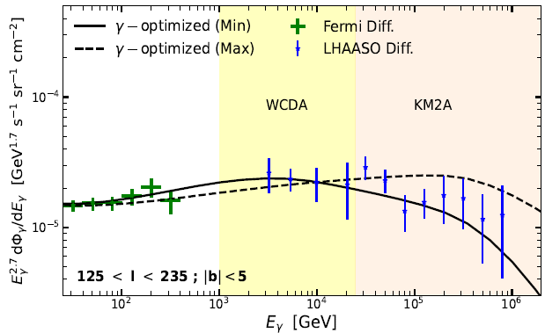
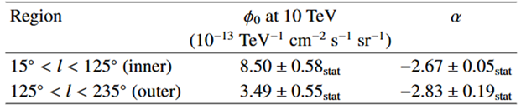
Inhomogeneous diffusion model
The diffuse emission meets PeV data
PDL+ ArXiv:2502.18268
(Table II of ArXiv:2411.16021)

Slide 13
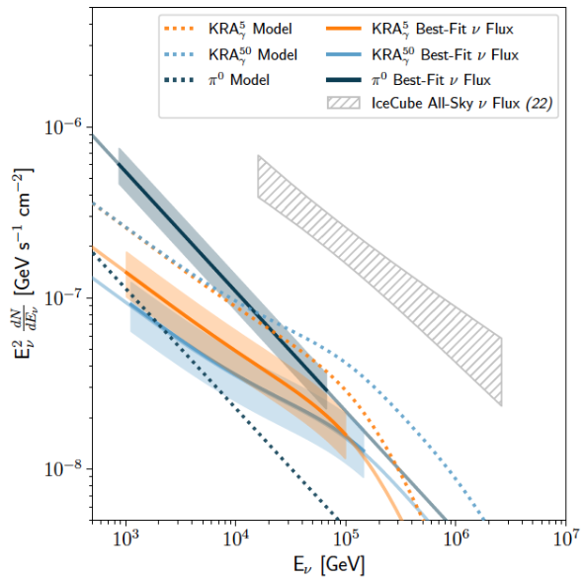
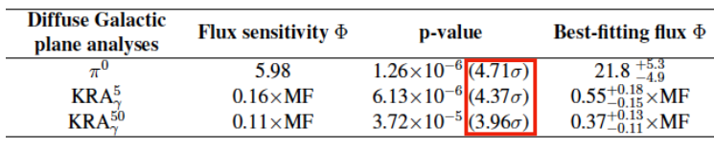
IceCube measured the diffuse neutrino emission!
Neutrinos are also generated by CR collisions with ISM. This emission is similar in intensity and spectral shape to the gamma-ray emission
Indication that a Galactic diffuse component (10-20% of the total flux above 200 TeV) was clearly already identified by IceCube. Confirmed by IceCube !!
IceCube Coll. Nature 2023

Slide 14
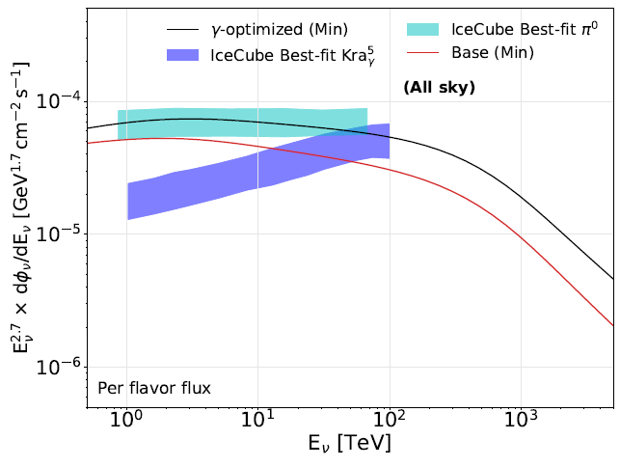
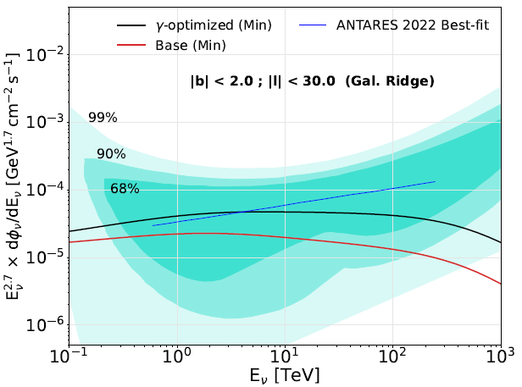
Diffuse gamma-ray production: detection of neutrinos as a smoking gun
This model predicts a neutrino flux in excellent agreement with the best-fit measurements of IceCube. Neutrino observations toward the GC are key to understand the different contributions involved and how diffusion operates in the Galaxy
PDL+ ArXiv:2502.18268
Notes:
Nested diffusion might lead to same behaviour – If sources are distributed more concentrated this can mimic inhomogeneous diffusion

Slide 15
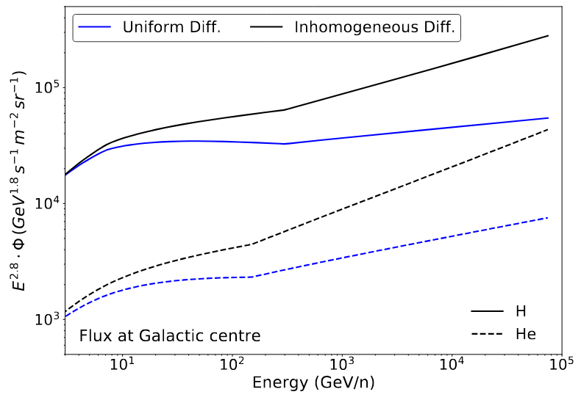
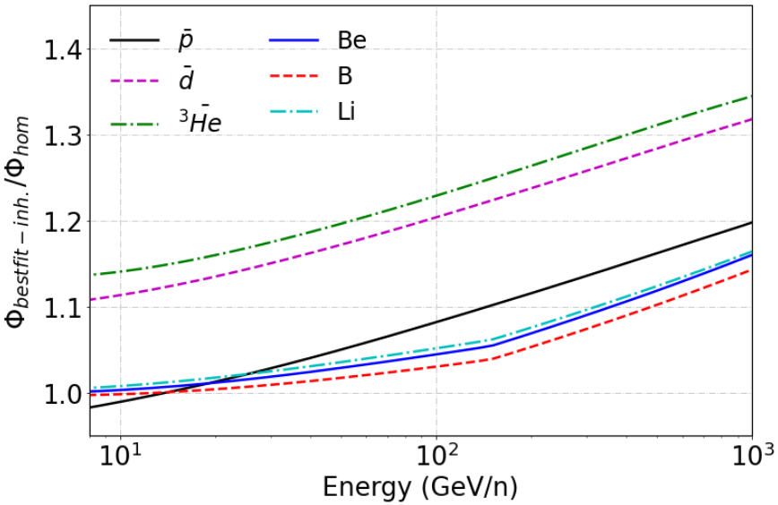
Consequences of such scenario?
Primary and Secondary CRs are expected to get a harder spectrum
Secondary-to-primary ratios won’t be very sensitive to it because of spallation interactions
But antiproton-to-proton ratio might be! Since antiprotons are produced with lower energy
Tovar-Pardo, PDL 2024 ArXiv:2405.12918

Slide 16
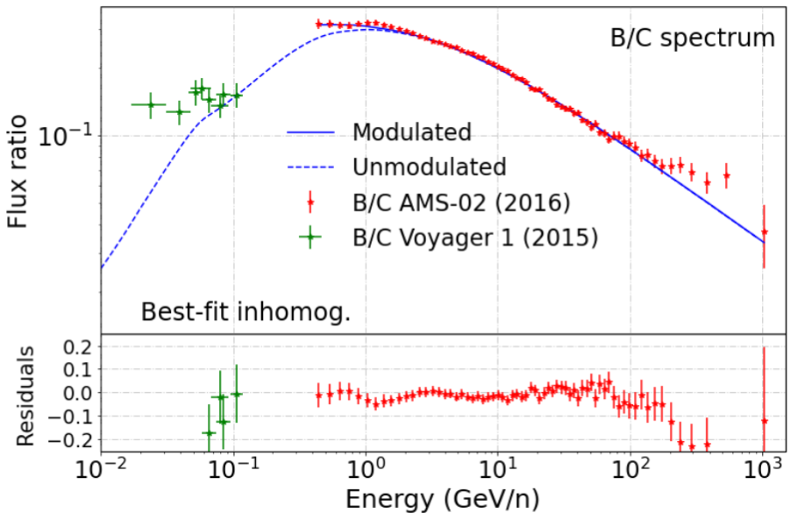
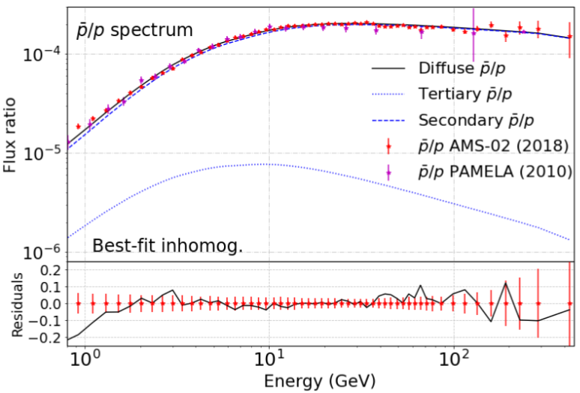
Consequences of such scenario?
Primary and Secondary CRs are expected to get a harder spectrum
Secondary-to-primary ratios won’t be very sensitive to it because of spallation interactions
But antiproton-to-proton ratio might be! Since antiprotons are produced with lower energy
Tovar-Pardo, PDL 2024 ArXiv:2405.12918

Slide 17
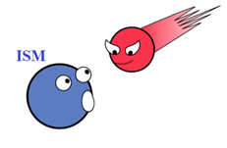
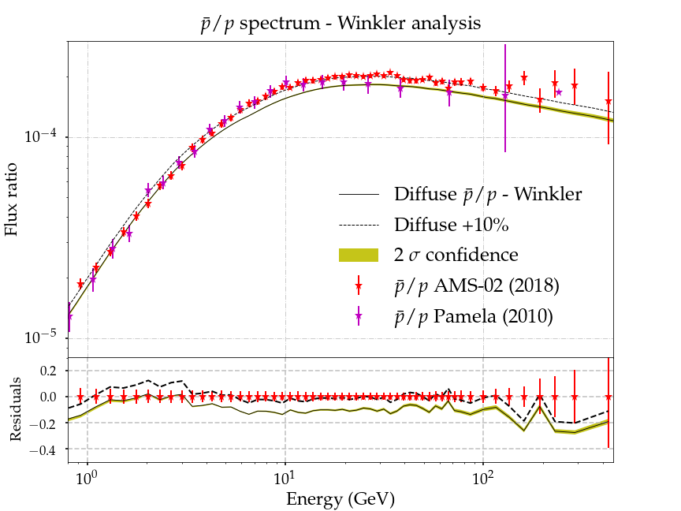
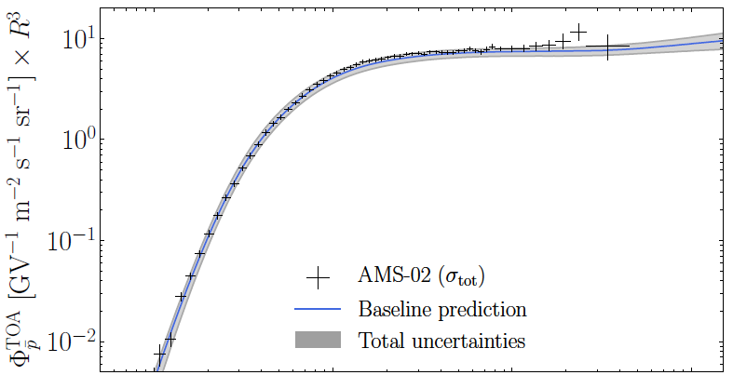
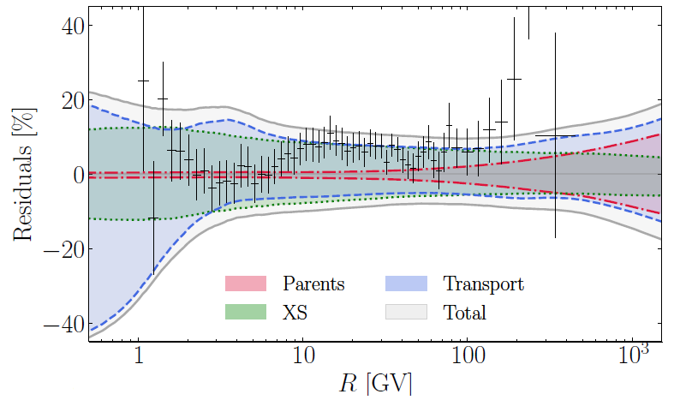
Hints for anomalies in antiproton data?
$$CR$$
While antiproton data seem compatible with the rest of CRs, a preference for a harder spectrum has been reported several times
p_{CR} + p_{ISM} → p
χ + χ → p
Acceleration of antiprotons and positrons around SNRs? P. Mertsch et al. 2020 PRD 104, 103029
PDL JCAP 11 (2021) 018
P.D.L. JCAP 11 (2021) 018
Boudaud+ PRR 2, 023022 (2020)

Slide 18
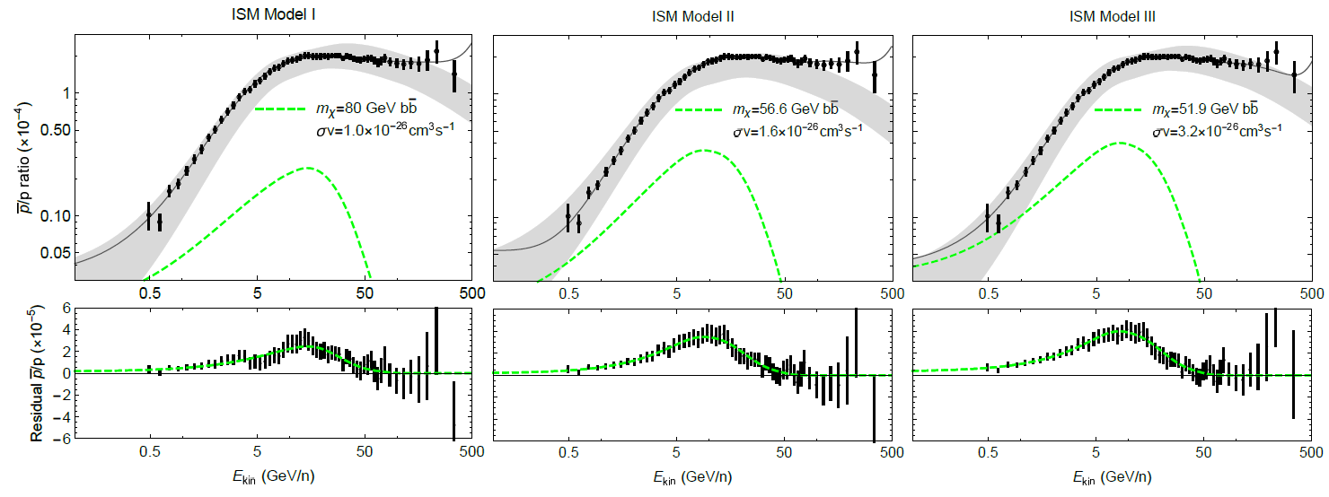
Antiproton excess – A DM signal?
$$CR$$
Several studies claimed the possibility of an excess of data over the predicted flux at around 10-20 GeV, which can be the signature of dark matter annihilating or decaying into antiprotons
p_{CR} + p_{ISM} → p
χ + χ → p
Cholis et al PRD 99, 103026

Slide 19
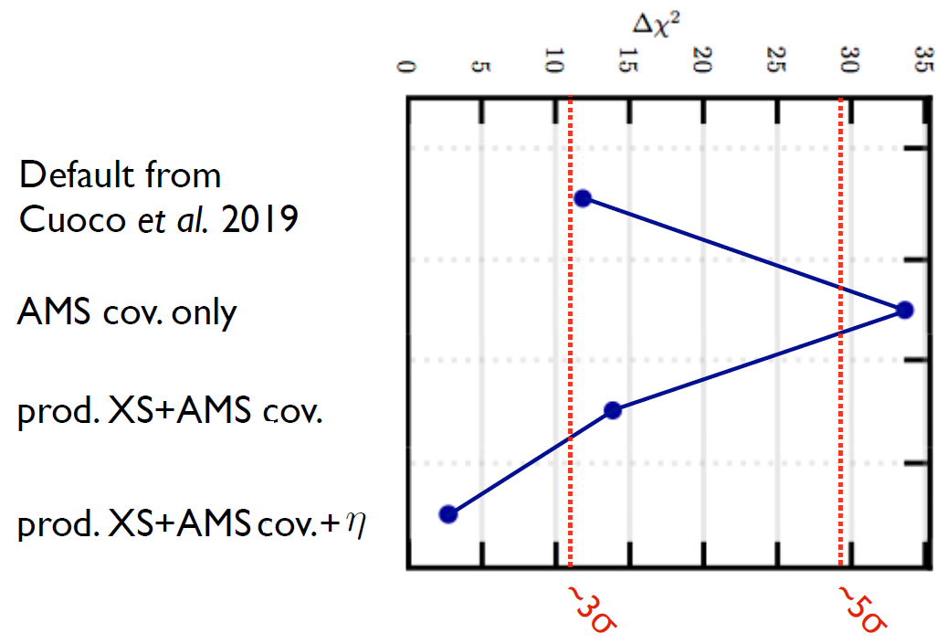
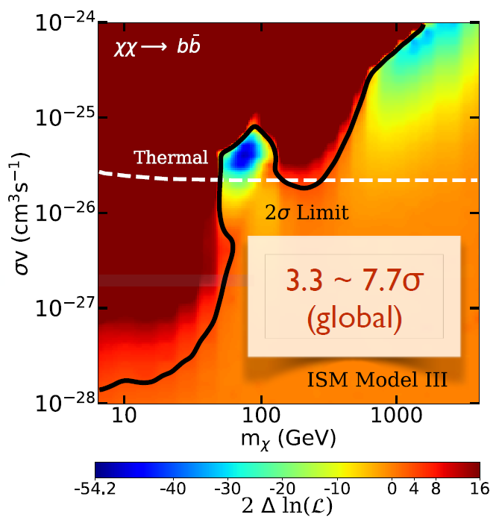
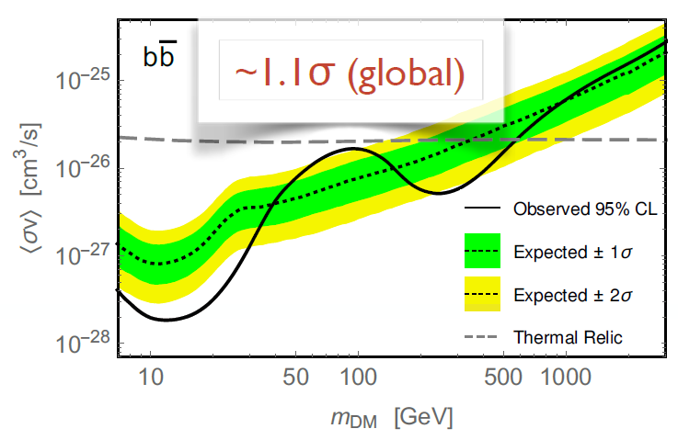
Antiproton excess – A DM signal?
$$CR$$
Many analyses coincided in the position of the excess, but not in its significance… Main ingredients affecting these analyses are: Correlations in AMS-02 errors, cross sections and propag. params
p_{CR} + p_{ISM} → p
χ + χ → p
Hooper, Cholis, Linden 2019
Jan Heisig MIAPP 2021
Reinert, Winkler 2018
$$D(E)\sim D0βηEδ$$
18

Slide 20
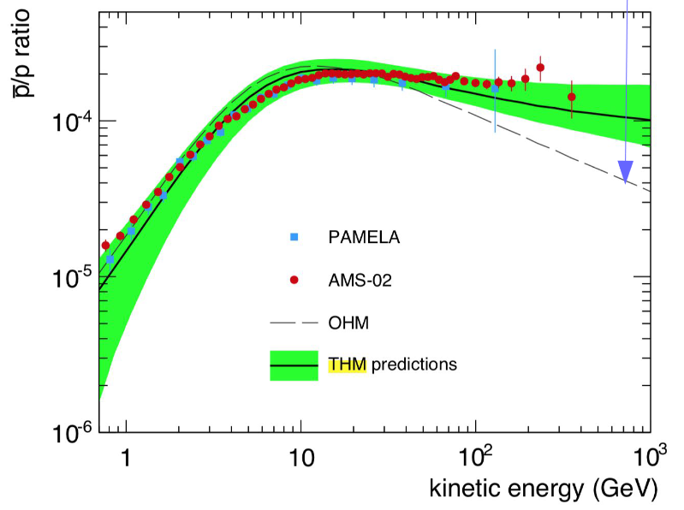
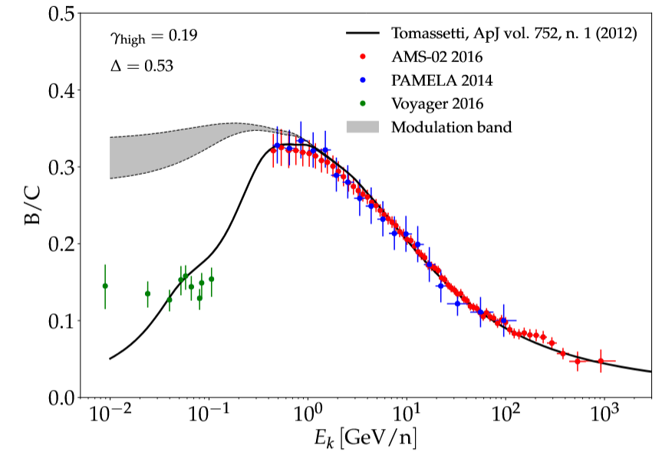
Tomassetti’s two-zone model (Tomassetti APJ 762 - 2012)
It proposes a different diffusion based on plasma properties: Diffusion in the halo (as a hot plasma) vs diffusion in the disk (warm plasma)
Explains 300 GV break and hardens the antiproton-over-proton ratio. It leads to a lower significance for the DM signal
(See also: Zhao et al 2021 arXiv:2109.04112)
Feng et al PRD 94, 123007 (2016)
It can offer an explanation for the dipole anisotropy
Gas Inhomogeneities and the non-uniformity of the CR transport are not explored in depth
Fornieri, …, PDL, PRD 104 (2021) 10, 103013

Slide 21
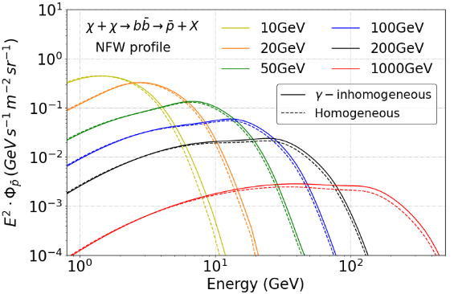
Consequences of inh. diffusion for DM signals?
While we see that the secondary to primary ratios harden slightly, we do not find any significant difference in DM signals for masses below the TeV
Tovar-Pardo, PDL 2024 ArXiv:2405.12918

Slide 22
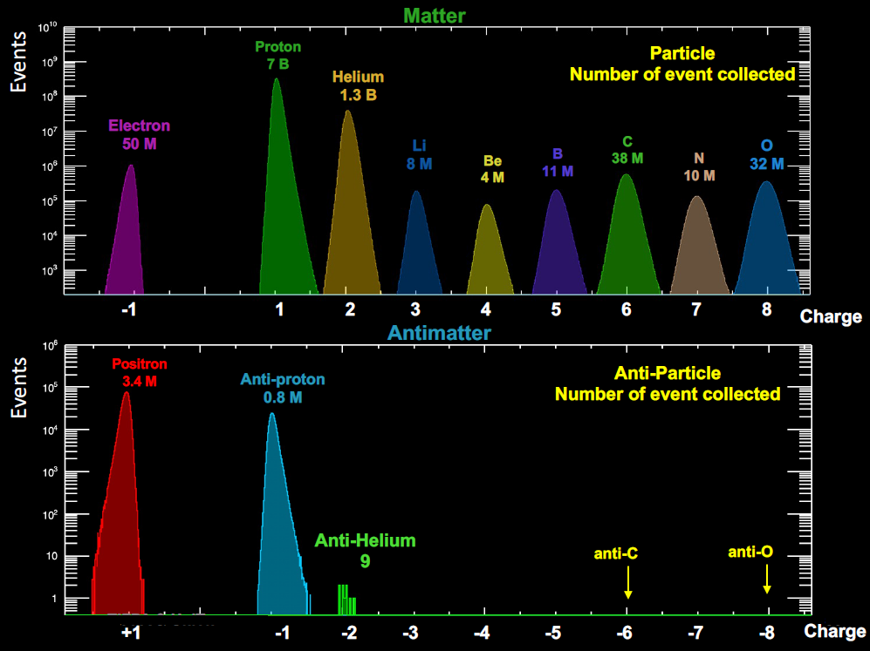
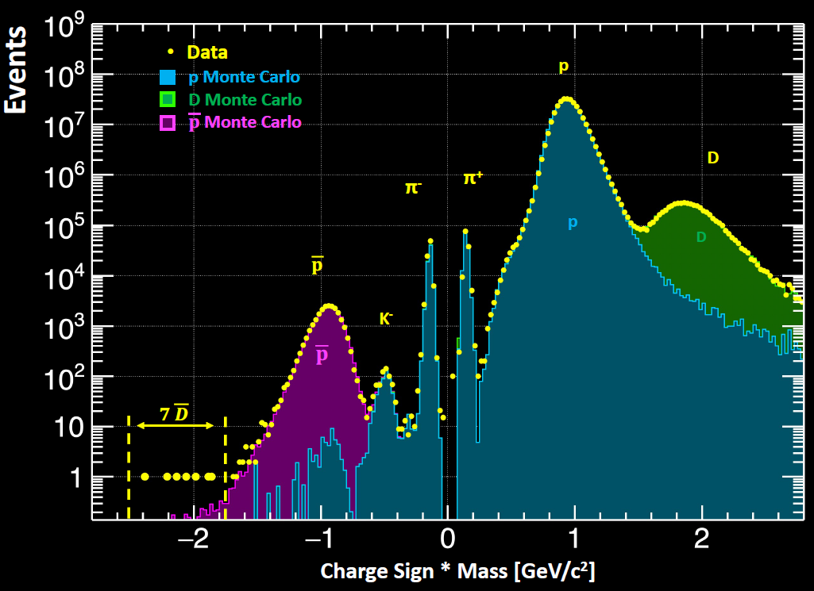
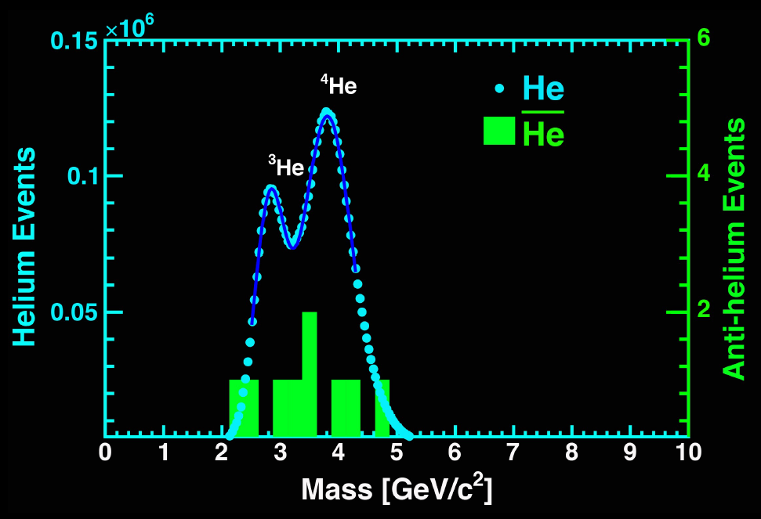
ANTI-NUCLEI: AMS-02 mass-charge spectra
Paolo Zuccon MIAPP 2021

Slide 23
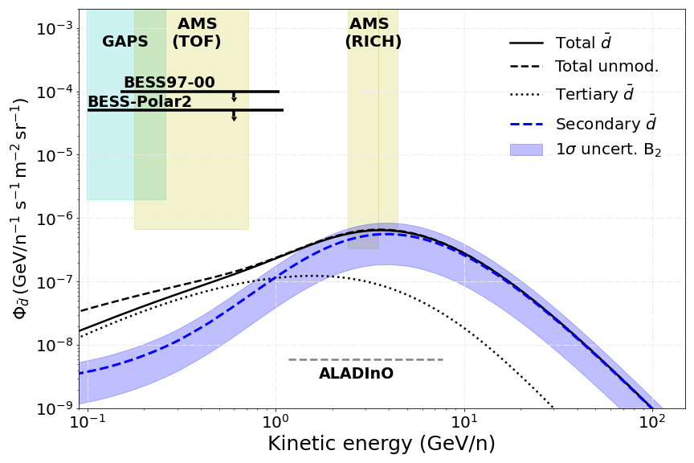
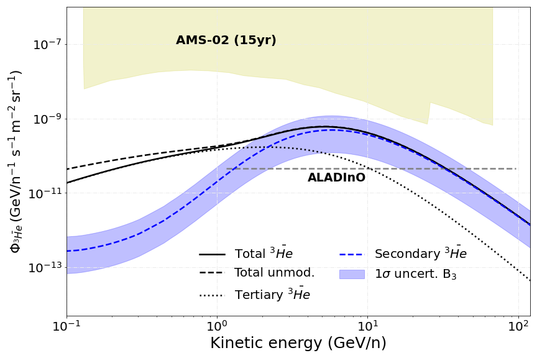

Astrophysical production
$$CR$$
CR + ISM → He, d
Can we explain the AMS-02 measurements without invoking any exotic source?
Main uncertainty is the coalescence parameter; the rest of uncertainties are under ~10%
We expect to have measurements of the d flux in the next years!! But nothing about He till ALADInO or AMS-100 (foreseen to 2039)
PDL et al, ArXiv: 2404.13114

Slide 24
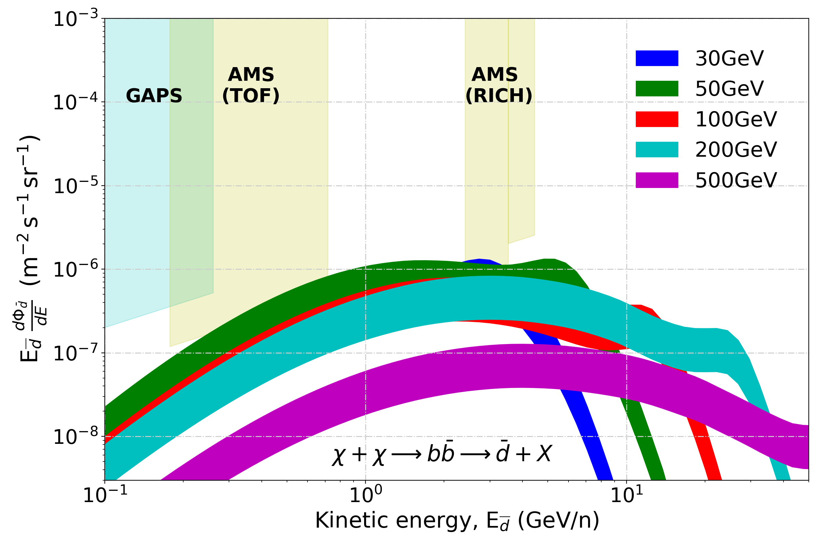
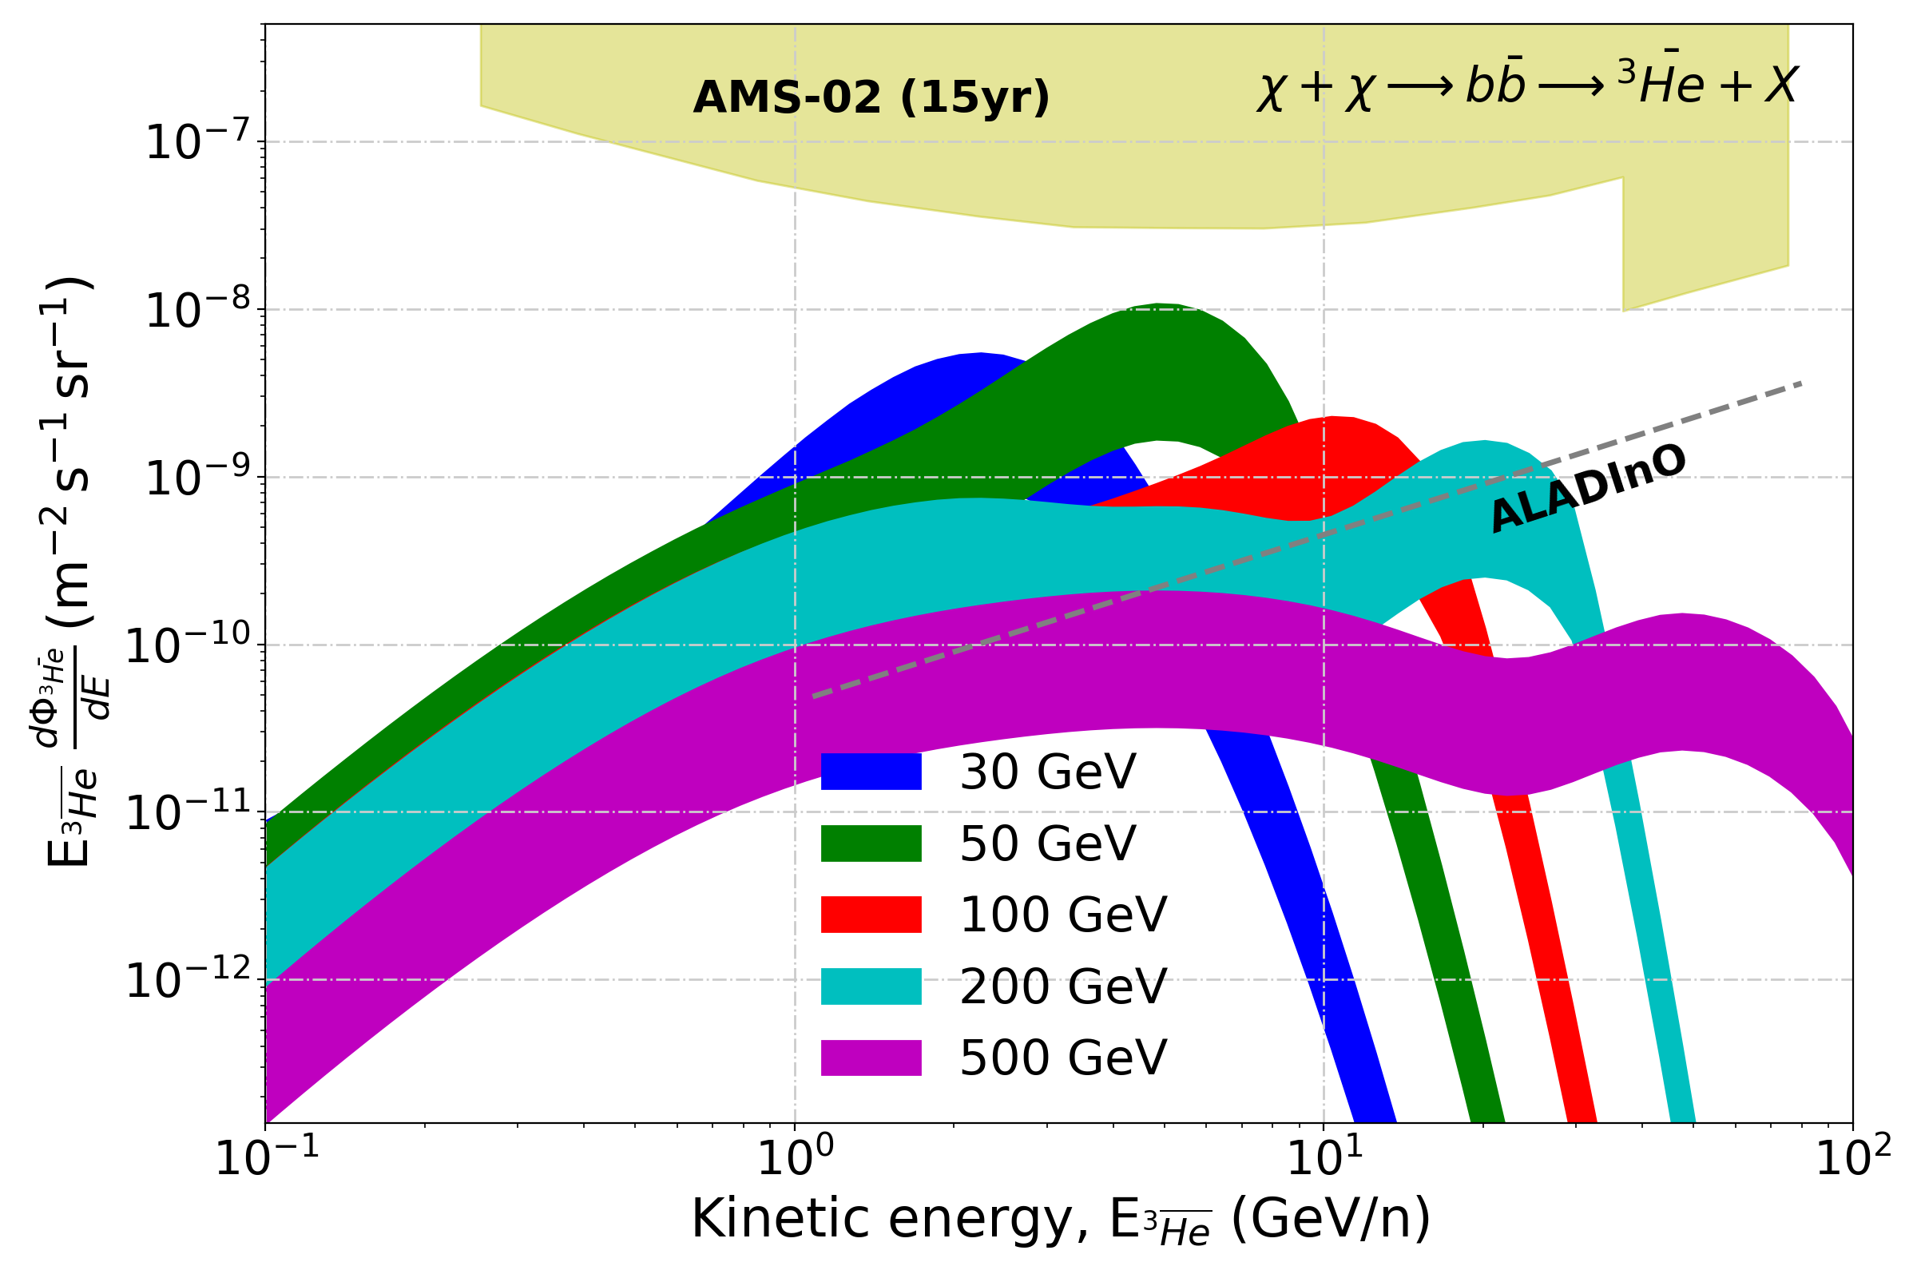

DM production: Upper Limits
q
χ
He, d
q
χ
Maximal antinuclei flux allowed from our antiproton bounds. Even in optimistic cases, it seems we cannot explain the detection of a single antihelium-3 event by AMS-02, And clearly, we are unable to explain any detection of antihelium-4 by AMS-02…
PDL et al, ArXiv: 2404.13114

Slide 25


Consequences of inh. diffusion?
Antinuclei fluxes slightly increases (around 10% at 1 GeV) → Too small to explain any detection. DM signals are not different either
Tovar-Pardo, PDL 2024 ArXiv:2405.12918

Slide 26
Other anisotropies that depart from the standard paradigm also impact these studies…

Slide 27


The halo height
The spatial distribution of the gas can have a large impact in the prediction of unstable isotopes
We may need a combination of different observables again
PDL, Linden JCAP 02 (2025) 062
Radio
Di Bernardo+ ArXiv:1210.4546
Orlando+ ArXiv:1309.2947
Gamma rays
Zaharias+ ArXiv:1212.6755

Slide 28


The halo height… and the local bubble
The spatial distribution of the gas can have a large impact in the prediction of unstable isotopes – Also electrons and heavy CRs
It is not clear whether diffusion must be different within this region either…
Donato et al A&A 381 (2002) 539
PDL, Linden JCAP 02 (2025) 062

Slide 29



Determination of the halo size
DRAGON2 cross sections
Notes:
ACE, IMP, ISEE, ISOMAX, Ulysses and Voyager-1

Slide 30


Determination of the halo size
Other cosmic-ray clocks can be used, but cross sections uncertainties can be even larger!
PDL, Linden JCAP 02 (2025) 062

Slide 31

FLUKA cross sections
http://www.fluka.org/fluka.php
FLUKA is a Monte Carlo event generator, dedicated to hadron and nuclei interactions and which is especially optimized for the study of cosmic rays. Computations with this code allows us to derive cross sections in a broad range of energies and species.
The result is a set a cross sections of secondary CRs that can be used in CR propagation codes. We have also computed cross sections for gamma-ray, secondary electrons and positrons, neutrinos and antiprotons.
A few Refs:
G. Battistoni et al, Annals of Nuclear Energy, Vol. 82 (2015)
T. Böhlen Nuclear data sheets, Vol. 120 (2014)
F. Cerutti, “FLUKA: theoretical grounds and wished new data”, Talk at XSCR (2017)

Slide 32


Combined fit of secondary CRs with FLUKA
MC Monte Carlo analysis: Combination of the ratios of secondary CRs (PDL. et al JCAP07, 2021, 010) including nuisance parameters (Scale factors) for renormalizing FLUKA cross sections.
We can simultaneously reproduce all light secondary CRs with small scaling factors (~10%) !!
PDL et al JCAP 07 (2022) 07, 008
NOT INCLUDED IN THE FIT !

Slide 33

How valid is the head-on approximation below Li?

Slide 34



Deuteron seems incompatible with our expectations
Fluka provides a similar prediction as when using other cross sections params., all being steep compared to the data above a few GeV/n. The head-on approximation does not seem to be the problem… Correlated errors? Other contributions?
VERY PRELIMINARY

Slide 35
To concludE
Beyond Standard Diffusion: The Impact of Inhomogeneous CR Propagation and Anisotropies
Gamma rays offer crucial information about the propagation of cosmic rays in different zones of the Galaxy, despite the remaining high uncertainties… No clear evidence in its favour is found, but several hints exist now
Heavy CRs could help find evidence for such inhomogeneities in diffusion. Potential impact on heavy CRs not tested yet
Adopting realistic gas density distributions might be necessary given the high accuracy of data
Fluka cross sections seem very promising and independent of the limited data although much work is needed to characterize them and improve them further
pedro.delatorre@uam.es CIEMAT, Madrid 29/01/2026

Slide 36



The gamma-ray sky seen by Fermi-LAT
> 7000 point-like sources have been observed by the Fermi satellite
~ 100 extended sources
Extragalactic and isotropic background (EBL)
Galactic diffuse gamma-ray background
Notes:
Blazars, star-forming galaxies and radio galaxies

Slide 37





A few key observations show evidence that CRs propagate in the Galaxy for millions of years
Transport of CRs is described as a diffusive process!
Charged particles are accelerated by astrophysical sources and propagate throughout the Galaxy during millions of years, due to scattering with plasma waves.
$$\text{τ}\text{esc}\left(E\right) ∝E^{−δ}$$
Gaisser & Stanev, 2005
Lukasiak, et al. (1994)
apj, 423, 426
CR + ISM → B, Be, Li, F, Sc, …
Turbulence confines CRs within the Galaxy for Myrs

Slide 38








Secondary-to-primary ratios – Diffusion coefficient
Simplest approximation to the diffusion equation:
$$\frac{∂Jpr}{∂t}=Q\left(E\right)−\frac{Jpr}{\text{τ}\text{esc} }$$
$$D(E, r)\sim D_{0}E^{δ}F(r)$$
$\frac{\text{J}\text{sec}}{\text{J}\text{pr}} \sim$σ(E)/ $D\left(E\right)$
$$Jpr\left(E\right) \sim \text{Q}\left(E\right)\text{τ}\text{esc}\left(E\right) \sim \frac{\text{Q}(E)}{\text{D}(E)}$$
The CR fluxes at E>tens of GeV/n are the convolution of diffusion and injection power-laws
PDLTL. et al JCAP03 (2021) 099
$$Jpr\left(E\right) \sim \frac{\text{Q}inj(E)}{\text{D}(E)}∝E−(αinj+δ)$$
$\frac{\text{J}\text{sec}}{\text{J}\text{pr}} \sim$σ(E)/ $D\left(E\right)$
$$Jsec\left(E\right)\sim \frac{\text{σ}\text{(}\text{E}\text{)}\text{J}pr(E)}{\text{D}(E)}∝E−(αinj+2δ)$$

Slide 39


e⁺e⁻ propagation horizon
GeV-TeV $e^{−}$ are dominated by the emission from local sources!
CALET Collab. IDM 2022
PDL et al ArXiv:2305.02958

Slide 40


The Galactic gamma-ray diffuse sky – electrons contribution
Electrons lose energy very quickly due to their interaction with the magnetic field (leading to synchrotron emission) and ISRFs (inverse Compton emission)
Therefore, the electron spectrum measured at Earth is very influenced by the presence of local sources → Difficult to estimate with precision the IC emission in different parts of the Galaxy
PDL. et al arXiv:2502.18268

Slide 41


Dark matter bounds from antiproton combined analyses
Maximum significance found to be below 2$σ$ (local)!
P.D.L. et al, in preparation
(DM masses in GeV)
The DM signal is constrained to be, at most, a 10% of the total p flux (for ~100 GeV DM)
Moreover, there is some tension with the GCE!!
However, we are constrained to the classical model of production of antiprotons

Slide 42

Dark matter bounds from antiproton combined analyses
Maximum significance found to be below 2$σ$ (local)!
P.D.L. et al, in preparation
(DM masses in GeV)
The DM signal is constrained to be, at most, a 10% of the total p flux (for ~100 GeV DM)
Moreover, there is some tension with the GCE!!
However, we are constrained to the classical model of production of antiprotons

Slide 43
The Galactic gamma-ray diffuse sky – Local cosmic rays
Too limited information on Galactic CR propagation to build theoretical models beyond the Solar System
PDL et al JCAP 07 (2022) 07, 008
PDL et al JCAP03 (2021) 099
$$δ\left(x=REarth\right) \sim 0.5$$
$$J∝E^{ (α+δ)}$$

Slide 44

Non-uniform transport:
An Inhomogeneous diffusion model
Many reasons to believe that the turbulence is progressively different towards the Galactic centre:
- Magnetic field intensity (and direction)
- Gas distribution (contributing to damping of MHD waves)
- Distribution of sources
- Anisotropy of turbulence cascade
- Non-steady particle distribution?
Cerri et al ArXiv:1707.07694

Slide 45

Impact of non-uniform transport
Semenov, Krtavsov, Caprioli 2021
Injection mechanism and acceleration of CRs (PeVatrons?)
Environments of PWNe and SNRs as well as the mechanism of turbulence generation and propagation, …
Astrophysical plasmas, magnetic fields, ionization rates in MCs, …
Galaxy formation
GeV excess?

Slide 46


Comparing to Fermi-LAT
Source emission (4FGL-DR2 cat.), EGB and unresolved emissions added to compare with data
Only the XCO factor slightly tuned to improve normalization with respect to Fermi-LAT data
Good spectral and morphological agreement even though we do not carry out a dedicated fit

Slide 47




γ-optimized model vs Fermi
ISM gas distribution based on the ring gas model developed by Q. Remy
ISRF distribution (CMB + IR + Stellar) from Vernetto&Lipari Phys. Rev. D 94, 063009
XCO factor divided in rings to tune the normalization (main caveat!!)
P.D.L. et al arXiv: 2209.10011

Slide 48


Diffuse gamma-ray production: detection of neutrinos as a smoking gun
P.D.L et al, Front.Astr.Space Sci. 9 (2022) 1041838
Neutrinos are also generated by CR collisions with ISM. This emission is similar in intensity and spectral shape to the gamma-ray emission
2$σ$ hint observed by IceCube (Aartsen, et al. 2019, Astrop. J., 886, 12).
4.1$σ$ observed in track-like IceCube events (arXiv: 2208.080423).
Indication that a Galactic diffuse component (10-20% of the total flux above 200 TeV) was clearly already identified by IceCube.
Notes:
galactic flux less than 14% of the total flux. Galactic centre region

Slide 49

Diffuse gamma-ray production: detection of neutrinos as a smoking gun
This model predicts a neutrino flux in excellent agreement with the best-fit measurements of IceCube
However, no much room for high-energy neutrino sources → Is that most of the γ-ray PeVatrons have a leptonic origin?
IceCube observation slightly favour the scenario of a Galactic flux correlated with the CR distribution, although uncertainties are enormous
γ-optimized model predicts both the observed high-energy neutrino and high-energy γ-ray emissions perfectly
Notes:
galactic flux less than 14% of the total flux. Galactic centre region

Slide 50

The window to prove (or disprove) many possible astrophysical excesses
Anti-nuclei as the dark matter smoking gun
For kinematical reasons, the production of anti-nuclei from CR interactions is not important at energies below the GeV, offering a clear way to spot the production of anti-nuclei from dark matter (at least for masses below ~hundreds of GeV)
Secondary anti-nuclei produced from homologous interactions as for p, but highly suppressed (due to coalescence)!
Korsmeier+ (2018) PRD97, 103011

Slide 51

Propagation setup
Propagation code: github.com/tospines/Customised-DRAGON-versions/Custom_DRAGON2_v2-Antinuclei/
Implementation of anti-nuclei dark matter and secondary production in DRAGON2
Cross sections derived from analytical coalescence model. Using fits of antiproton (antineutron) production from Winkler, JCAP 02, 048 (2017)
DM spectrum at production derived from Pythia 8.2 simulating a neutral colourless resonance. Space and momentum (p_{c}) conditions for coalescence. Also including production from anti-hyperons
Inelastic cross sections and tertiary production computed extrapolating antiproton parametrizations
PDL et al, ArXiv: 2404.13114

Slide 52


How to explain the AMS-02 He detection?
Winkler et al 2211.00025
Our standard predictions do not explain total He events and foreseen a ratio He-4/He-3 of ∼ 1/1000
Only a few ideas proposed so far:
Galactic anti-clouds (Poulin et al. 1808.08961) (see also 2304.04623)
Stability and cosmological implications must be revised
QCD-Like Dark sector (Winkler, PDL, Linden 2211.00025)
Can explain AMS-02 observations but need some tuning
Fireball anti-nucleosynthesis (Fedderke et al. 2402.15581)
Fireballs must be very stable for long times and carry negative . net antibaryon number

Slide 53


QCD-Like Dark sector
From factorized model: $N_{A}∝{\left(N_{p}\right)}^{A}$

Slide 54
Evaluation of cross sections for CR interactions with the FLUKA code
http://www.fluka.org/fluka.php
FLUKA has been used in other CR studies as in Mazziotta, P.D.L. et al PRD 101(8):083011 (2020), as well as for other astrophysical applications as atmospheric neutrino studies (Astropart. Phys., 23:526–534, 2005) or gamma-ray flares from the Sun (Solar Phys., 294(8):103, 2019).
We have computed inelastic and inclusive cross sections of interactions of all isotopes of the CR nuclei up to Z=26 (Iron) with protons and helium, including a careful analysis of those short-living particles produced (ghost nuclei) from 1 MeV/n to 35 TeV/n.
The result is a set a cross sections of secondary CRs that can be used in CR propagation codes. We have also computed cross sections for gamma-ray, secondary electrons and positrons, neutrinos and antiprotons.
Notes:
PEANUT: PreEquilibrium Approach to NUclear Thermalization)
GINC: Generalized Intranuclear cascade; Above threshold Gribov-Glauber mechanism; Preequilibrium; Coalescence
rQMD: relativistic Quantum Molecular Dynamics

Slide 55

The FLUKA toolkit and the evaluation of cross sections for CR interactions
http://www.fluka.org/fluka.php
  Resonances produced in hadron-nucleon inelastic collisions dominate from the MeV up to 3-5 GeV
  Above 3-5 GeV hadronizations through Dual Parton Model (DPMJET-3) takes over
  Extension to hadron-nucleus collisions is achieved through the PEANUT model (GINC) + relaxation
  Nucleus-Nucleus use Boltzmann thermal equation at E<0.1GeV/u, rQDM model up to 5 GeV/u and DPMJET above
Credit: Paola sala
Notes:
PEANUT: PreEquilibrium Approach to NUclear Thermalization)
GINC: Generalized Intranuclear cascade; Above threshold Gribov-Glauber mechanism; Preequilibrium; Coalescence

Slide 56




FLUKA (direct) inclusive cross sections
PDL et al JCAP 07 (2022) 07, 008

Slide 57






FLUKA inelastic cross sections
PDL et al JCAP 07 (2022) 07, 008

