Slide 1
Joint Research Centre
Energy, Mobility and Climate

Slide 2
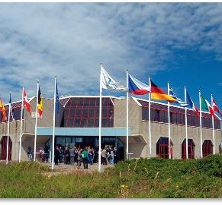
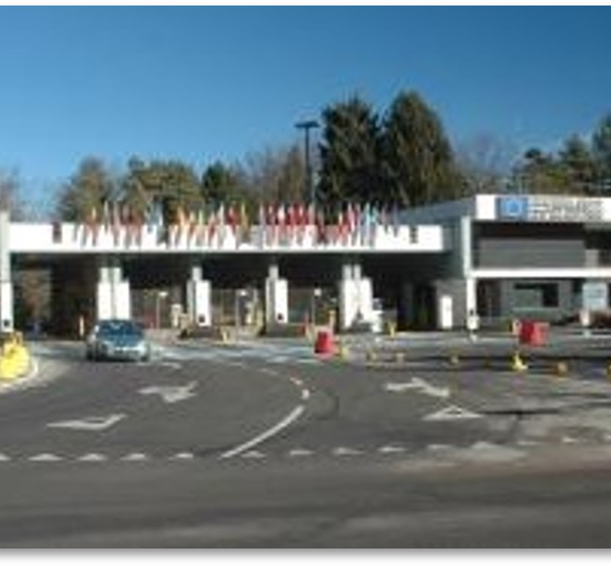
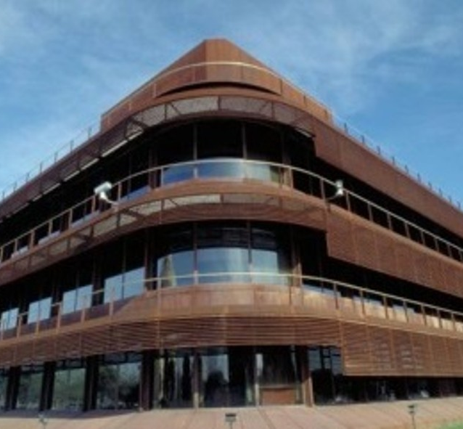
JRC Directorate for Energy, Mobility and Climate
The mission of the JRC's Directorate for Energy, Mobility and Climate is to provide support to EU policies and technology innovation related to:
Energy – to ensure sustainable, safe, fair, secure and efficient energy production, distribution and use
Mobility – to foster sustainable, smart, fair and efficient mobility in Europe
Climate – to support to integrated air quality, climate and related policies
Petten
Ispra
Seville
Notes:
I would like to present the JRC activities in non-nuclear energy, mobility and climate.
This will set the context for our joint work and illustrate how our partnership can deliver meaningful impact.
The mission of the JRC Directorate on Energy, Mobility and Climate is to provide scientific evidence to support EU policies and technology innovation in three closely linked areas:
Energy – ensuring sustainable, safe, fair, secure and efficient energy production, distribution and use;
Mobility – fostering sustainable, smart, fair and efficient mobility in Europe;
Climate – supporting integrated air quality, climate and related policies.
The Directorate is based in the Netherlands and theDirectorate staff is also present in Italy (Ispra) and, here in Spain, in Seville.
We are addressing the growing complexity of the energy and mobility transition by providing the European Commission, Member States, and industry with data and analysis to address decarbonisation while securing complementary objectives such as security of supply, affordability, and preservation of ecosystem health.
For this, we collect and analyse a large array of data, use models and laboratory experiments, to produce and share evidence addressing the underlying challenges of the energy and mobility transition in a coherent way.

Slide 3

25 research portfolios to support Commission priorities
A new plan for Europe’s sustainable prosperity and competitiveness
A new era for European Defence and Security
Supporting people, strengthening our societies and our social model
Sustaining our quality of life: food security, water and nature
Protecting our democracy, upholding our values
A global Europe: Leveraging our power and partnerships
Delivering together and preparing our Union for the future
1
Just, competitive and sustainable green transition
2
3
4
5
Small modular reactors and innovative reactor systems
Energy solutions
Pathways to climate neutrality
Nuclear safety – technology and skills
6
Future transport, mobility and related infrastructure
7
Sustainable materials
and products for a circular, resilient and competitive Europe
10
Financial and economic drivers of competitiveness
Future transport, mobility and related infrastructure
Strategic technologies for economic security and innovative industrial ecosystems
Societal resilience, systemic disruptive events and risks: enhancing anticipation, preparedness, and response
11
12
Blueprints for a strong European Health Union
14
Sustainable materials
and products for a circular, resilient and competitive Europe
15
Science for security and law enforcement
16
17
Demographic resilience and effective migration strategies
18
Economic, social and territorial intelligence and impact
19
Zero pollution, biodiversity restoration and natural capita accounting
20
Transition to more resilient and sustainable food systems in an EU and global context
Nuclear safeguards
21
Coherent policies through Earth observation intelligence
22
Climate adaptation and water resilience
23
Innovation for democracy and public governance
24
Science for Global Gateway and neighbourhood policy, including enlargement
25
Foresight, support to science and innovative policymaking
Notes:
As you have already heard, at the JRC we structure our work programme into 25 multidisciplinary research portfolios –which are the building blocks for our research. The Directorate contributes to more than half of these research portfolios.
It is through these portfolios-and in particular-our Portfolio 6 on Future mobility, transport and related infrastructure that we will contribute to the important areas for collaboration that we jointly identified in our agreement.

Slide 4
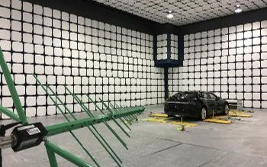
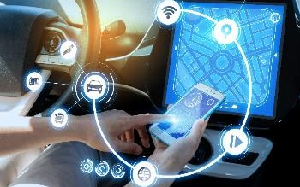
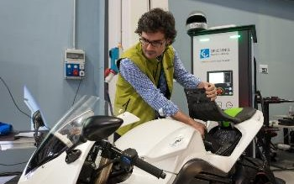
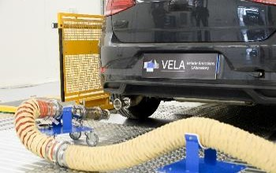
Future Transport, Mobility and related Infrastructure
Research, Innovation and Competitiveness in Transport
Vehicle Emissions Laboratories (VELA)
Decarbonisation of transport
Vehicle Standards and Market Surveillance
Notes:
Through our portfolio on Future, transport, mobility and related infrastructure we aim to provide comprehensive expertise in the transport sector, anticipating solutions for decarbonising transport and moving towards smarter, safer, cleaner, fairer and energy-efficient mobility systems.
We have supported the development of the international vehicle regulatory framework during the past 20 years in all UN and EU working parties.
Moreover, we contributed to the radical transformation of the automotive sector and to the harmonisation of Regulations across the globe.
We are also responsible for carrying out the market surveillance of vehicles in the European market, for their compliance with emission and safety standards.
We have been expanding the scope of our activities to new mobility systems (especially those empowered by AI such as autonomous vehicles and drones) and transport modes beyond road, focusing on maritime and aviation.
We are very pleased to join forces together with you on assessing the environmental impact of transport, and on transport research and innovation, based on our excellent cooperation since a few years now. My colleagues will provide a more detailed overview of our planned activities later.

Slide 5
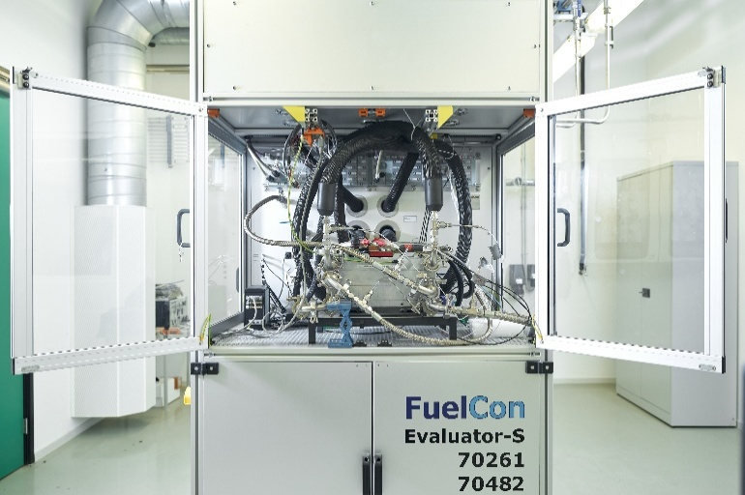
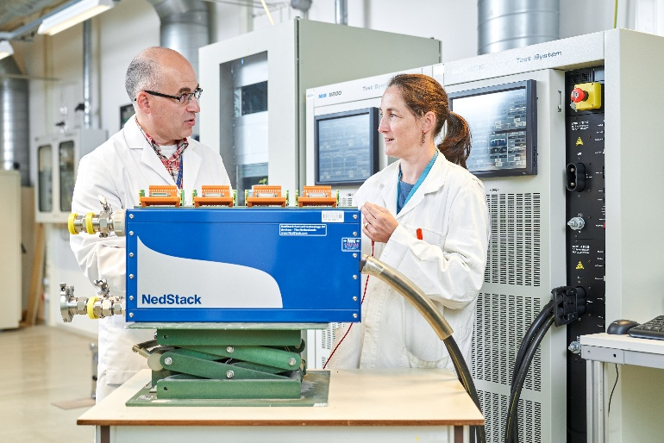
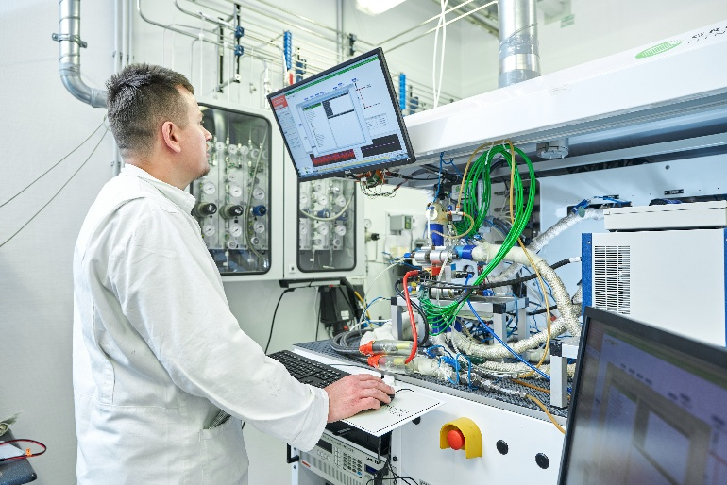
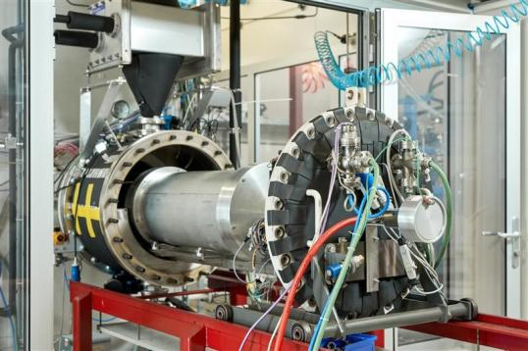
Battery and Hydrogen Technologies
What?
Batteries
Hydrogen and fuel cells
Why?
Can’t decarbonise without them
Users need to trust their performance and safety
How?
Experimental work
Standardisation
Science for policy (technology monitoring and sustainability assessment)
Notes:
I would like to highlight further activities contributing to both transport and energy decarbonisation – namely those on batteries and hydrogen. We focus on three main aspects:
First, experimental testing – We run dedicated laboratories in Petten where we assess performance, durability and safety of battery systems and hydrogen technologies, including those used in electric vehicles and heavy-duty transport. This covers, for example, behaviour under extreme conditions, fastcharging, and ageing.
Second, standardisation – Based on our experimental activities, we contribute to developing and validating testing methods and standards. This is crucial for EU vehicle and component regulations, type-approval and for building user trust in new technologies.
Third, technology monitoring and sustainability assessment – We monitor emerging technologies, assess their environmental and social footprint over the full life cycle, and support EU policy initiatives on sustainable batteries, hydrogen strategies and infrastructure deployment.

Slide 6
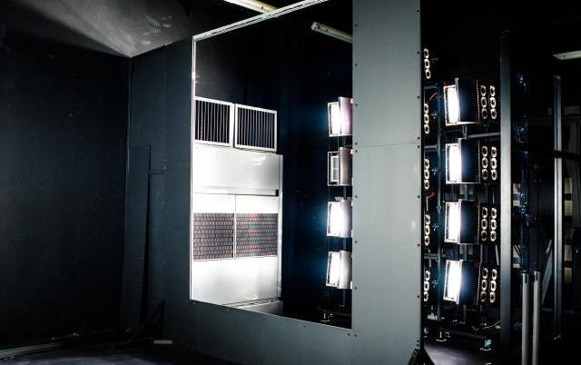
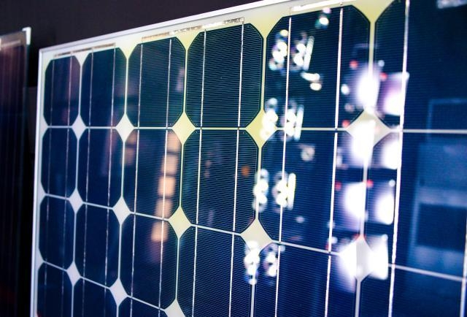
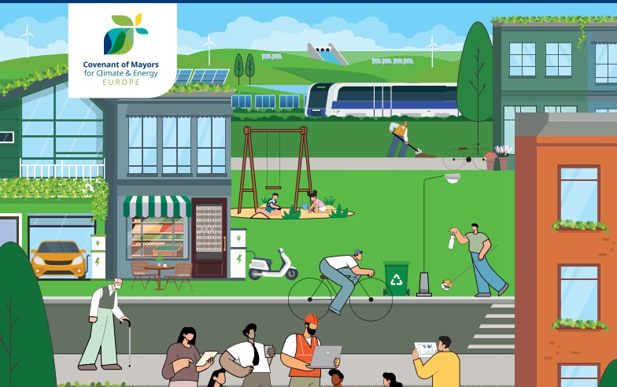
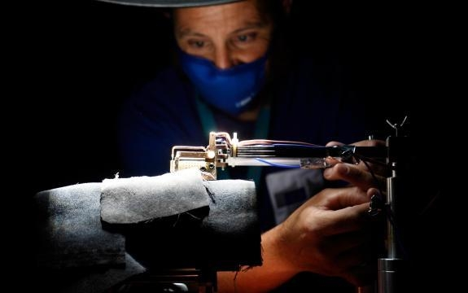
Energy Efficiency and Renewables
Energy efficiency, building renovation
Renewables (e.g. PV: European Solar Test Installation; bioenergy)
City decarbonisation – Covenant of Mayors, Climate neutral smart cities
Notes:
Another key area of our activities that I would like to highlight is renewables and energy efficiency.
We operate the European Solar Test Installation dedicated to the performance and reliability testing of different PV cell and module technologies.
We look at:
Efficiency and degradation under realistic operating conditions;
Performance of novel materials and architectures;
Implications for standards and certification in the EU context. We actively participate in the development of EU and international PV standards.
We are very pleased to count on the active participation of CIEMAT experts to the annual international intercomparison of Spectra Radiometers organised by the European Solar Test Installation. This is a week-long measurement campaign that allows participants to check and compare the performance of their equipment against that of reference instruments.
We also work on sustainable bioenergy, and we provide scientific support to initiatives such as the Covenant of Mayors and climate neutral and smart cities, where deployment of renewables, storage and efficient buildings is integrated at urban scale.

Slide 7
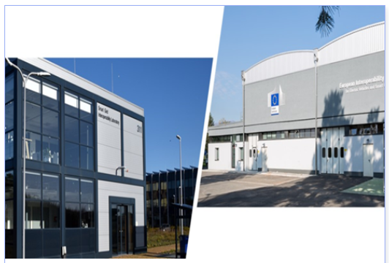

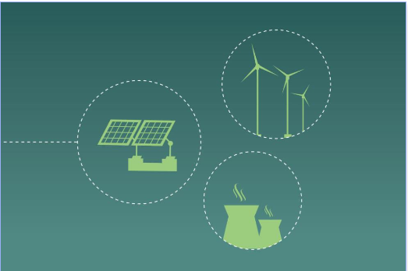
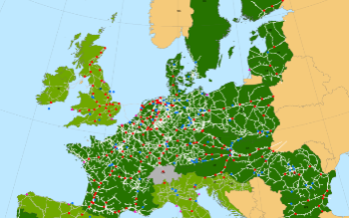
Energy Security, Digitalisation and Markets
Smart Grid Interoperability Laboratory ​
Artificial Intelligence and the Energy sector
Market design and sector integration
Security of electricity and gas supply and system resilience
Notes:
We also work at the intersection of energy systems, digitalisation and markets: testing how smart homes and electric vehicles interact with the grid at our facilities in Petten and Ispra, and analysing the role of artificial intelligence in power system operations.
We are informing EU legislation on retail and wholesale energy markets and strengthening the security and resilience of electricity and gas supply in Europe and neighbouring countries, including through regular resilience exercises with NATO.

Slide 8
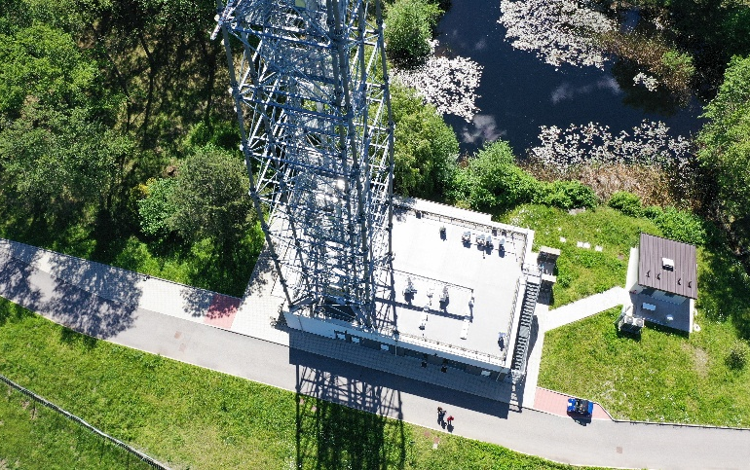
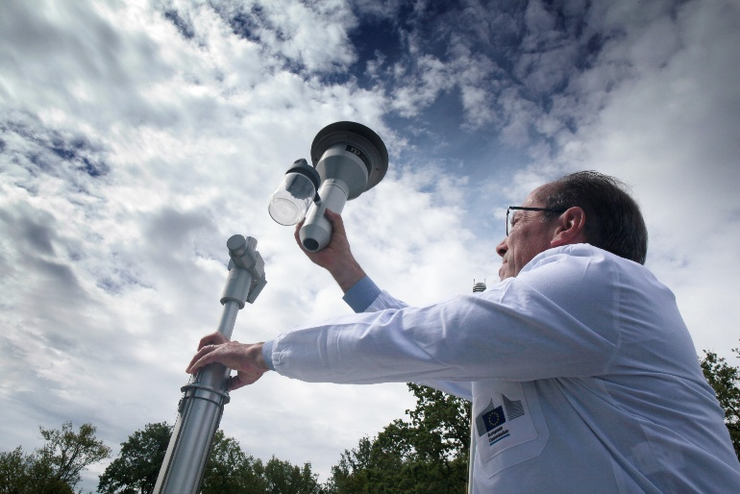
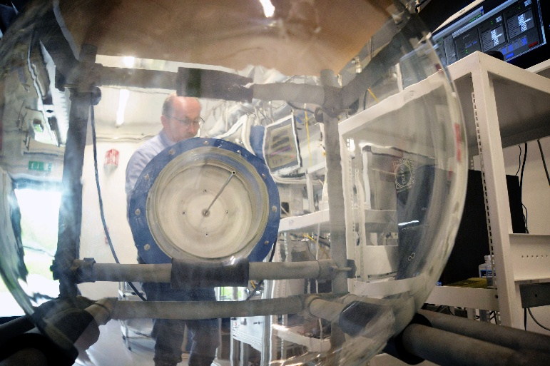
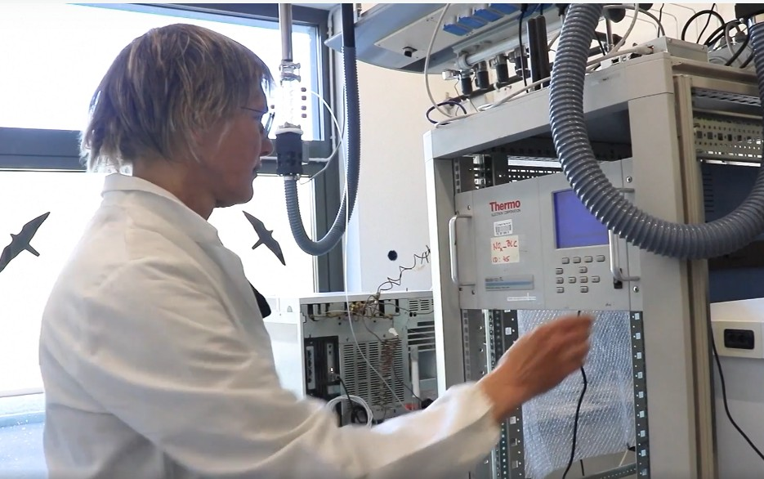
Clean Air and Climate
Climate targets coherence with zero-pollution ambition
Verifying climate objectives
Participation in ACTRIS
Global action: Arctic, Western Balkans, Ukraine
Notes:
We also contribute to clean air and climate policy. We examine for example:
How climate targets align with the zero pollution ambition for air quality;
Whether climate objectives are met, by monitoring greenhouse gas emissions.
We combine advanced monitoring, modelling and ecosystem observations to understand the wider impacts of emissions from energy and transport technologies.
Here I’d like to highlight that we collaborate with the CIEMAT Atmospheric modelling group in the frame of the United Nations Economic Commission for Europe (UNECE) Task Force on Hemispheric Transport of Air Pollution and in the Task Force on Integrated Assessment modelling.
Moreover, our research facilities –just like the ones of CIEMAT- are also signatories of the Aerosol, Clouds and Trace Gases Research Infrastructure (ACTRIS).

Slide 9
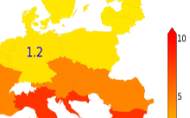
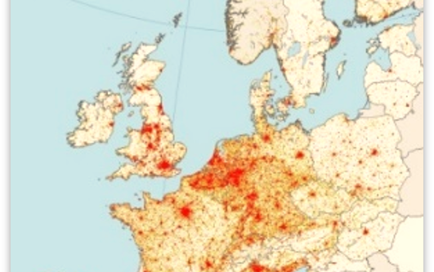
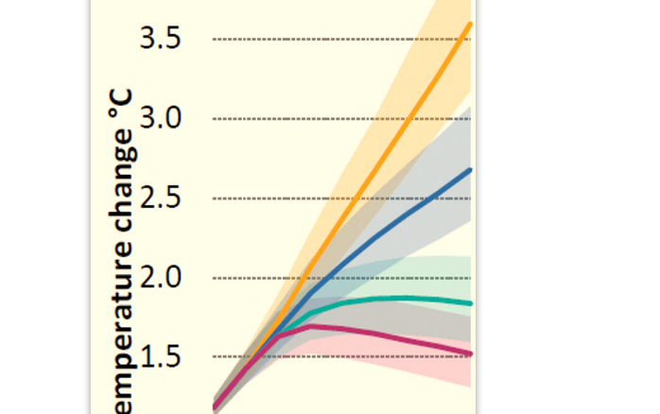
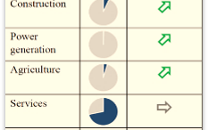
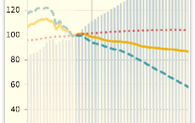
Economics of Climate Change, Energy and Transport
Northern Europe relative welfare loss = 1
Other Externalities: Road Congestion Indicators
JRC Global Energy and Climate Outlook
Support to Energy & Climate IAs: Macroeconomic analyses
The POTEnCIA EU Energy System model
Notes:
We also have developed a complex climate, energy and transport modelling suite that has helped define the current energy and climate objectives. This modelling suite helps the Commission, for example, to:
Analyse technology pathways and their macroeconomic impacts and
Perform multisectoral and welfare analyses to look at the distribution of costs and benefits of decarbonisation policies.

Slide 10








Energy Transition Insights for Policy
Social aspects
Research, Innovation & Competitiveness
ENERGY
TRANSITION
Multi-sectoral analysis
Decarbonisation of industry
Strategic Energy Technology-Plan
Energy and Industry Geography Lab (EIGL)
Supply chains
Heating & Cooling
Notes:
Last but not least, another part of our work looks at the energy transition across sectors, with a focus on industrial decarbonisation, as well as on how to ensure the competitiveness of EU clean tech.
We offer for example:
Insights into supply chains for critical technologies and materials, including batteries and PV;
Assessments of the social and regional impacts of the transition, which is important when deploying new infrastructures or industrial facilities.
We substantially contribute to the Annual Progress Report on Competitiveness of Clean Energy Technologies, which accompanies the State of the Energy Union report. This is done through the Clean Energy Technology Observatory, among others. In 2025 CETO published 18 technology reports - we already highlighted the report on nuclear power. CETO touches upon both mature technologies –ranging from PV, solar thermal and bioenergy to early-stage clean energy technologies.
To conclude, this is only a glimpse of our activities on non-nuclear energy, mobility and climate– it shows both the JRC and CIEMAT are very actively involved in research driving forward the EU climate neutrality objectives.
Let us use today’s meeting to set the stage for a fruitful partnership—one that anticipates future challenges, integrates diverse expertise, and delivers meaningful impact.

Slide 11
Thank you

