Slide 1
The Joint Research Centre - the science and knowledge service of the European Commission
Ulla Engelmann
Director of the Joint Research Centre for Nuclear Safety and Security
European Commission
Madrid, 4 March 2026

Slide 2
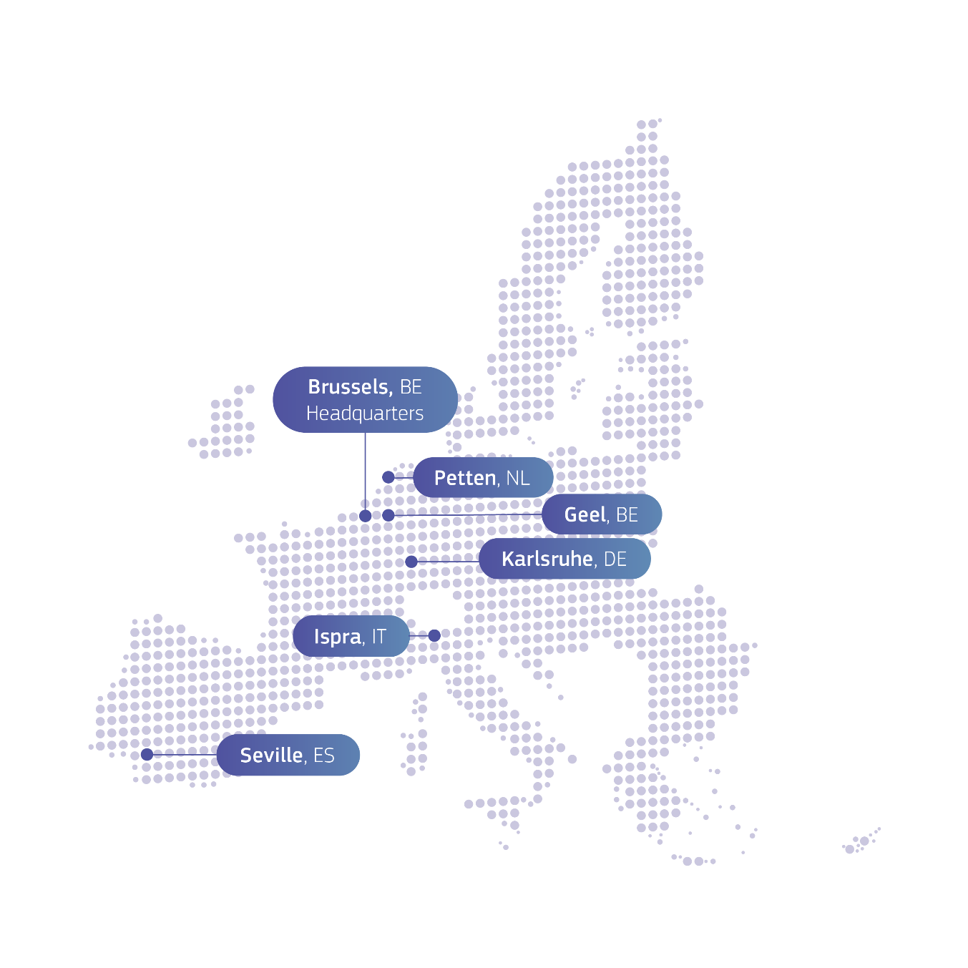
JRC sites map
The Joint Research Centre provides independent, evidence-based knowledge and science, supporting EU policies to positively impact society.
Headquarters in Brussels and research facilities
located in 5 Member States:
Belgium (Geel)
Germany (Karlsruhe)
Italy (Ispra)
The Netherlands (Petten)
Spain (Seville)

Slide 3

JRC’s role
Independent of private, commercial or national interests
Works for more than 40 European Commission’s policy departments
Fully policy-relevant and world class knowledge production
Priorities driven knowledge and competence management
One JRC – anticipating emerging issues,
understanding complexities and bridging silos
Addressing challenges of research
(information deluge, multidisciplinarity,
integrity, reproducibility)

Slide 4
25 research portfolios to support Commission priorities
A new plan for Europe’s sustainable prosperity and competitiveness
A new era for European Defence and Security
Supporting people, strengthening our societies and our social model
Sustaining our quality of life: food security, water and nature
Protecting our democracy, upholding our values
A global Europe: Leveraging our power and partnerships
Delivering together and preparing our Union for the future
1
Just, competitive and sustainable green transition
2
3
4
5
Small modular reactors and innovative reactor systems
Energy solutions
Pathways to climate neutrality
Nuclear safety – technology and skills
6
Future transport, mobility and related infrastructure
7
Sustainable materials
and products for a circular, resilient and competitive Europe
8
Digital transformation: technologies, cybersecurity, and socio-economic impact
9
10
Financial and economic drivers of competitiveness
Artificial intelligence and data
11
Strategic technologies for economic security and innovative industrial ecosystems
12
13
Synergies for a stronger EU in space, security and defence
14
Societal resilience, systemic disruptive events and risks: enhancing anticipation, preparedness, and response
15
Blueprints for a strong European Health Union
Science for security and law enforcement
16
17
Demographic resilience and effective migration strategies
18
Economic, social and territorial intelligence and impact
19
Zero pollution, biodiversity restoration and natural capita accounting
20
Transition to more resilient and sustainable food systems in an EU and global context
Nuclear safeguards
21
Coherent policies through Earth observation intelligence
22
Climate adaptation and water resilience
23
Innovation for democracy and public governance
24
Science for Global Gateway and neighborhood policy, including enlargement
25
Foresight, support to science and innovative policymaking

Slide 5
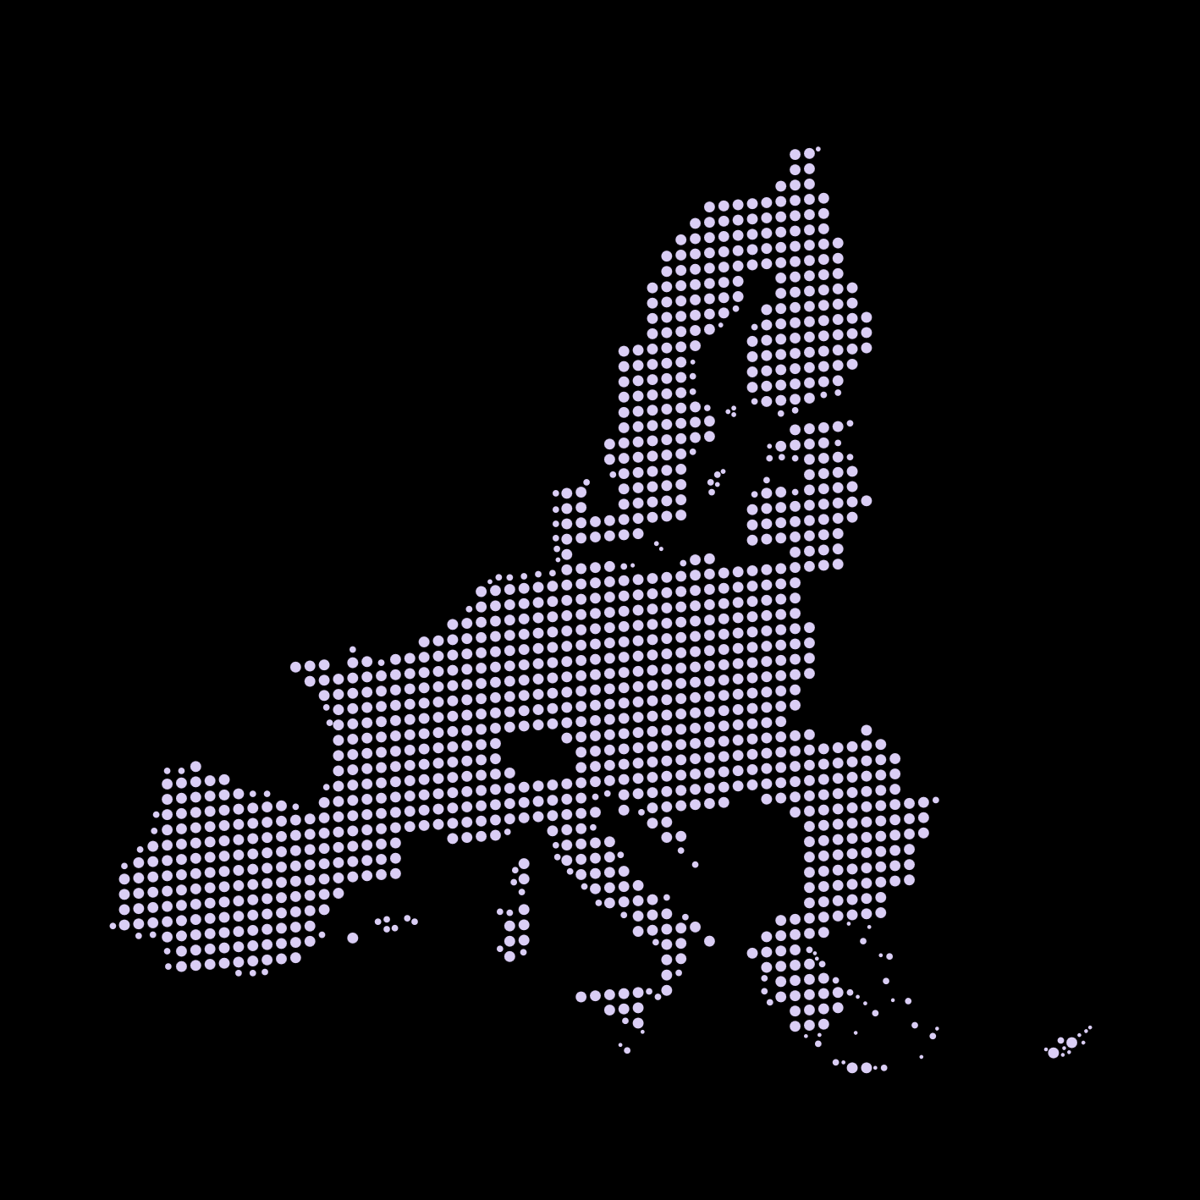





Directorate G: Nuclear Safety and Security
Nuclear Knowledge and Competence
Radioactive Waste Management
Non-power Applications and Radiation Protection
Nuclear Safeguards and Security
Nuclear Safety of Nuclear Power Plants
Nuclear Reactor Safety,
Emergency Preparedness
Petten
Nuclear Fuel Safety​
Advanced Nuclear Knowledge​
Safeguards & Forensics​
Waste Management
Geel
Standards for Nuclear Safety, Security & Safeguards
Karlsruhe
Ispra
Nuclear Security & Safeguards​
Decommissioning (Directorate J)

Slide 6
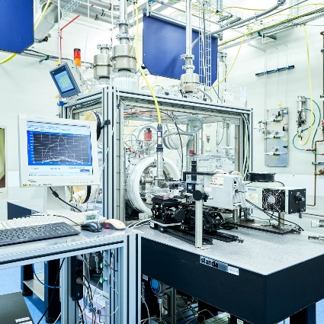
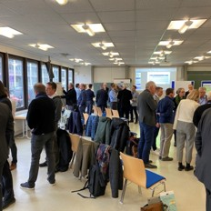
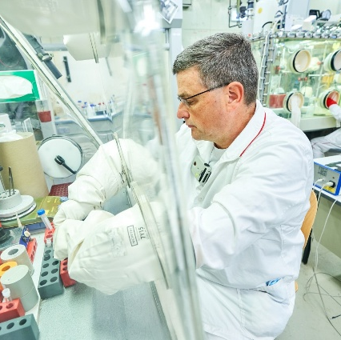
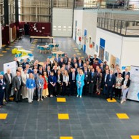
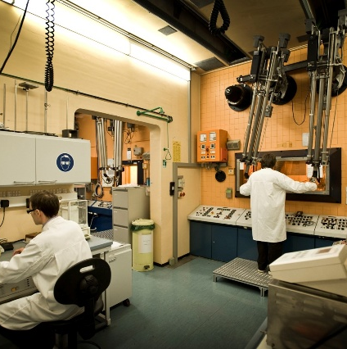
JRC's Nuclear Strategy – priority areas
Nuclear Modelling
Waste & Decom-missioning
SMRs
Nuclear Skills
Medical applications

Slide 7
Portfolio structure
& nuclear research priorities for 2025-2027
Nuclear Safeguards
Purely Nuclear activities | PF 4 | Nuclear safety – technology & skills
 | PF 5 | SMRs and other innovative reactor systems
 | PF 16 | Nuclear safeguards
Merging Nuclear & non-nuclear activities | PF 9 | AI and data
 | PF 12 | Health
 | PF 13 | Space, Security and Defense
 | PF 14 | Anticipation, risks, resilience
 | PF 15 | Security and law enforcement
 | PF 25 | Foresight and innovative policymaking
Nuclear Safety – Technology & Skills
  Core research activities and science for policy on 3S and non-power applications
  Emphasis on safety/safeguards assessment for innovative nuclear systems
  Nuclear competences and contribution to emerging areas (Security/Defence, AI…)
PF16: SMRs & other Innovative Reactor Systems
Nuclear
Medicine
Strategic Trade Control
Security
AI
Emergency Preparedness & Response
  Nuclear derived techniques are applicable to even more research fields !

Slide 8
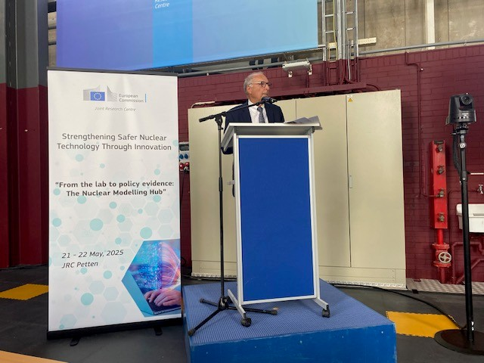

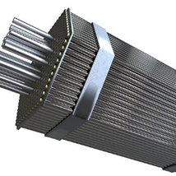
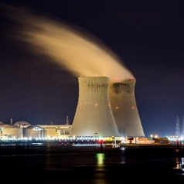

JRC Modelling Hub
In 2025, JRC launched the JRC Modelling Hub - combining our unique scientific infrastructure and decades of experimental data into an integrated approach to decision-making in the nuclear domain while promoting collaboration, knowledge sharing, skills, and competences.
Micro
Macro
Installation
System
JRC Modelling Hub launch event, JRC Petten, 21-22 May 2025

Slide 9
1st CETO Report on Nuclear Energy
Nuclear Power
Technology
Costs
Funding
Supply chain
Critical Raw Materials
CETO
Clean Energy Technology Observatory
Notes:
The Clean Energy Technology Observatory, or CETO, is a project by the European Commission that tracks and analyses the EU's activities in clean energy technologies. It looks into their market outlook and how they fit into the broader energy system. In 2025, CETO expanded its focus to include the manufacturing capacity for clean technologies in Europe, aligning with initiatives like the Net Zero Industry Act and the Clean Industrial Deal.
Also in the 2025 series, CETO issued its first report on nuclear energy. This report provided a snapshot of nuclear power's status in Europe, focusing on traditional nuclear plants, SMRs, and their supply chains, but excluding top a large extent Generation IV and the fuel cycle's back end. It examined electricity production costs, supply chain issues, industry aspects, and European competitiveness, especially in the trade of nuclear equipment and fuels. Looking ahead, while trade and patents will remain in focus, we will adjust the emphasis on technology in future reports to give a more rounded perspective across the series.

Slide 10
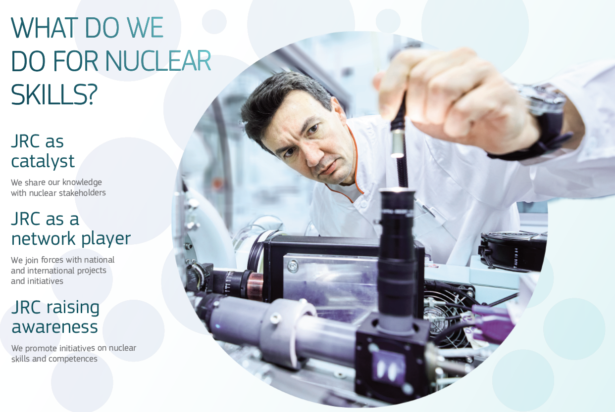
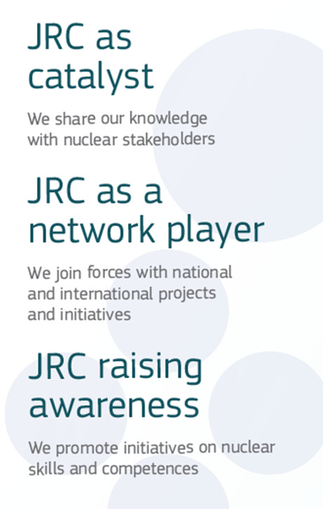
JRC’s vision for Nuclear Skills
The JRC has adopted a Portfolio structure for its Work Programme.
The NUSKILLS project is implemented in Portfolio 4 – “Nuclear safety: technology and skills”

Slide 11
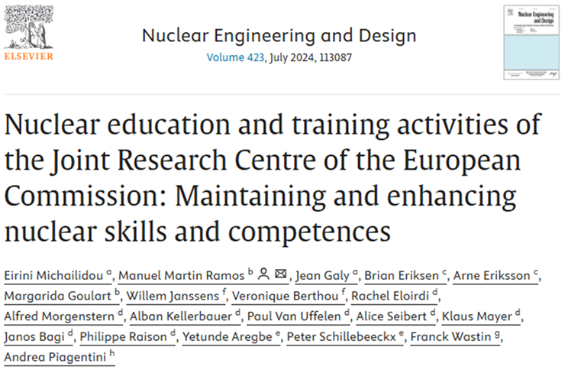
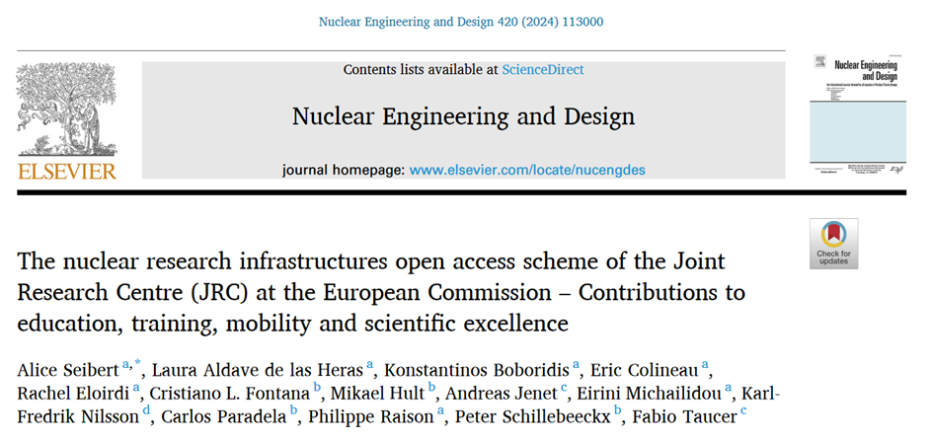
JRC’s offers and outreach
We want to involve the younger generation
We monitor HR needs
We offer Traineeships
We open our Labs
We train professionals
We collaborate with MS
We participate in Euratom projects and start own initiatives

Slide 12
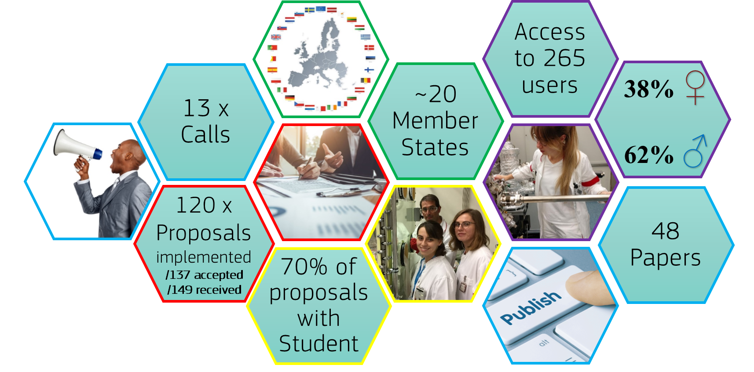
JRC Open Access – Nuclear Research Infrastructure
2020-2024
Access based on:
Scientific merit
Peer review of proposals
Fair and transparent selection procedure

Slide 13


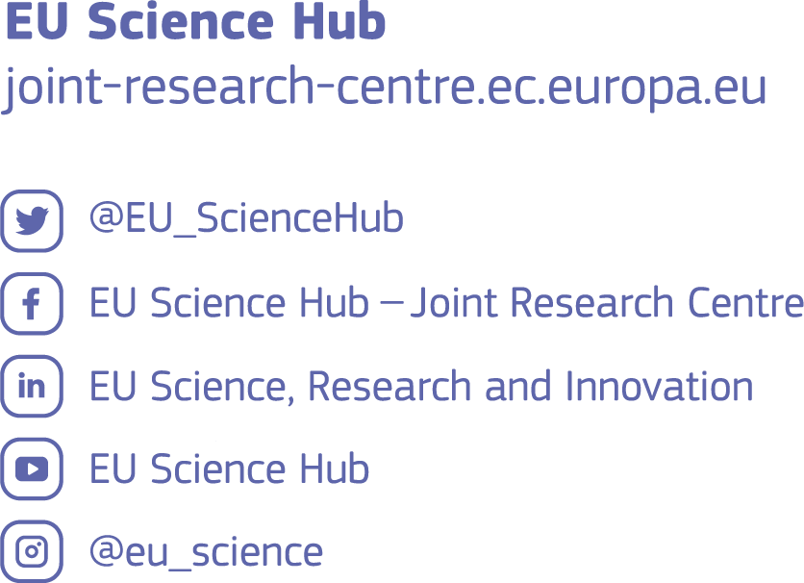

Thank you
and keep in touch
© European Atomic Energy Community 2024
Otherwise note the reuse of this presentation is authorised under the CC BY 4.0 license. For any use or reproduction of elements that are not owned by the EU, permission may need to be sought directly from
the relevant right holders.

