Slide 1


High Level Waste Unit
Nuclear Fission Unit
High Level Waste Unit activities and
collaborations with JRC
Hitos Galán, Head of High Level Waste Unit
Kick-off meeting JRC-CIEMAT Agreement, 4th March 2026, Madrid

Slide 2
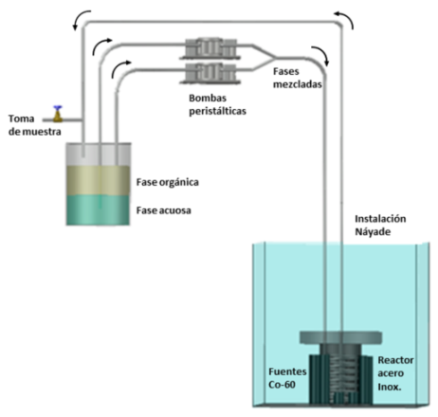
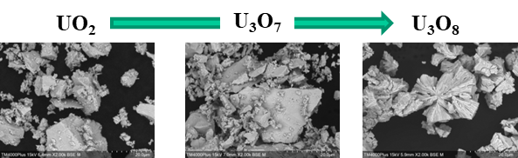
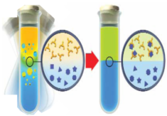
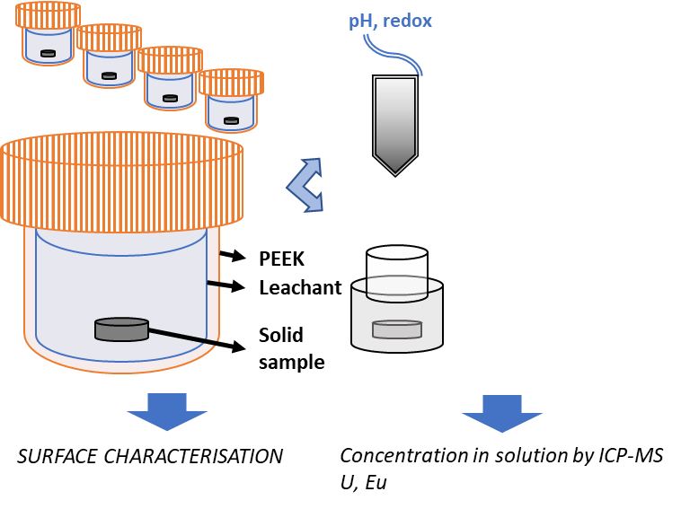
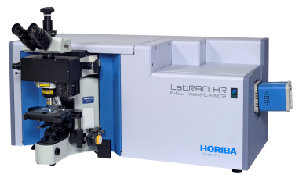
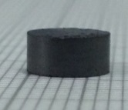
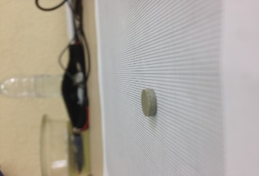
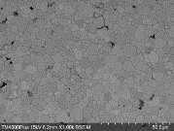
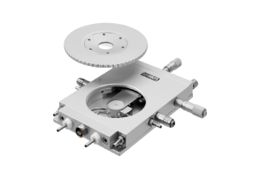
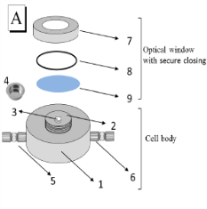
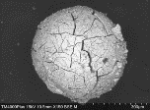
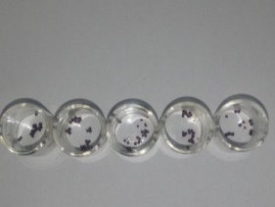
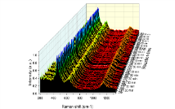
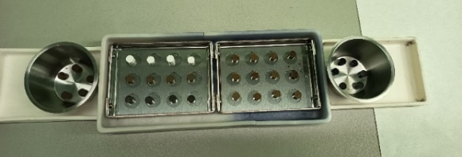
HLWU main objectives and research lines
Development of knowledge and technology for enhancing nuclear energy sustainability regarding high-level radioactive waste management
Characterization and study of the SNF behavior and evolution under different disposal conditions
Development of hydrometallurgical separation processes for advanced nuclear fuel cycles
Fabrication and conversion of nuclear fuels
Methodological developments for radiactive material characterization
Handling SNF is not permitted
CIEMAT radioactive facilities
Surrogate materials and spiked solutions
2
Kick-off meeting JRC-CIEMAT Agreement, 4th March 2026, Madrid

Slide 3
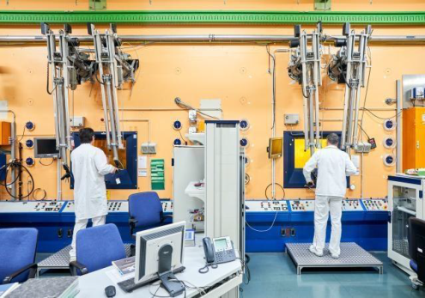
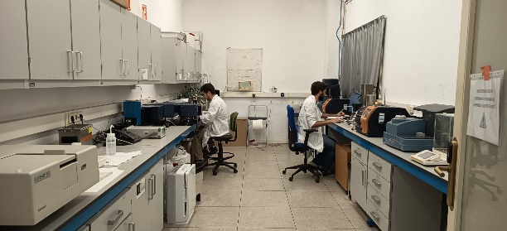
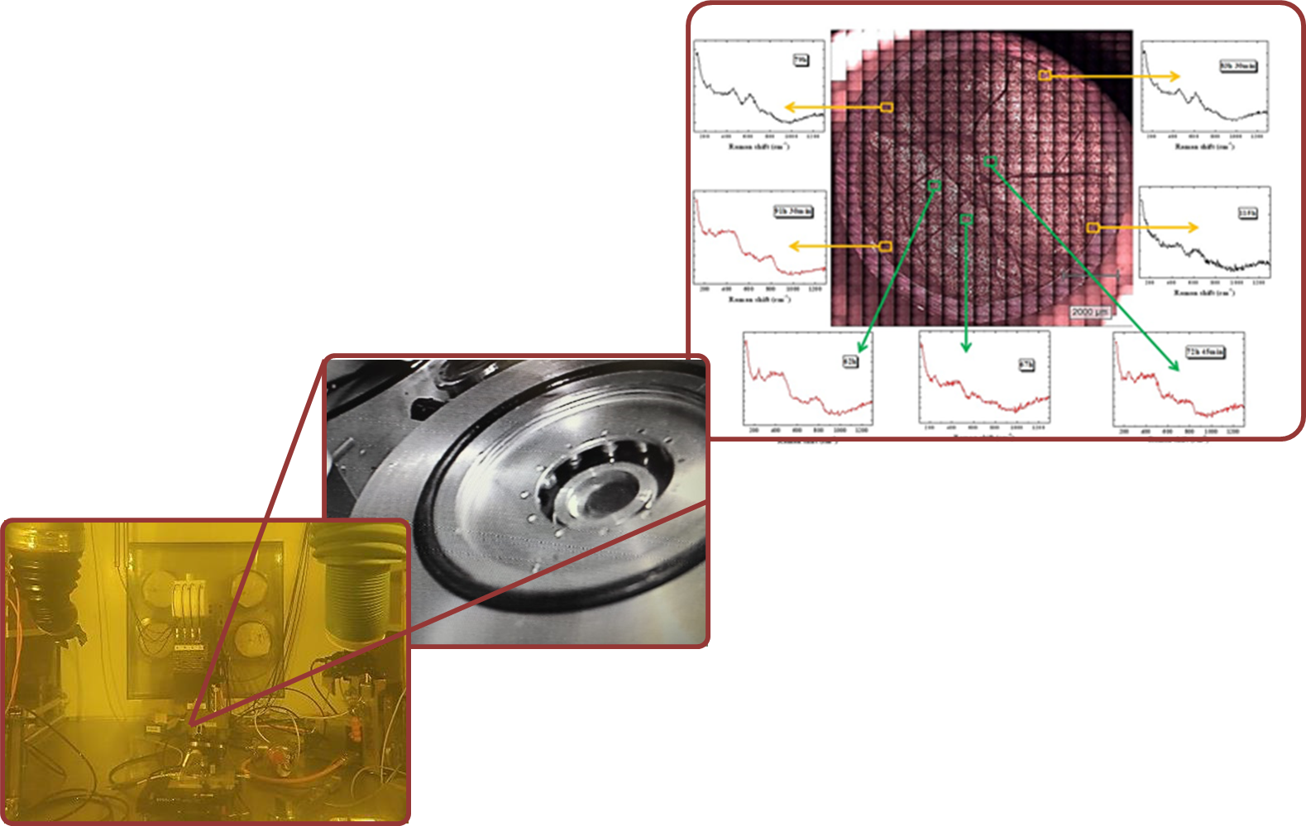
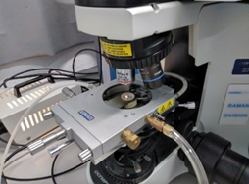
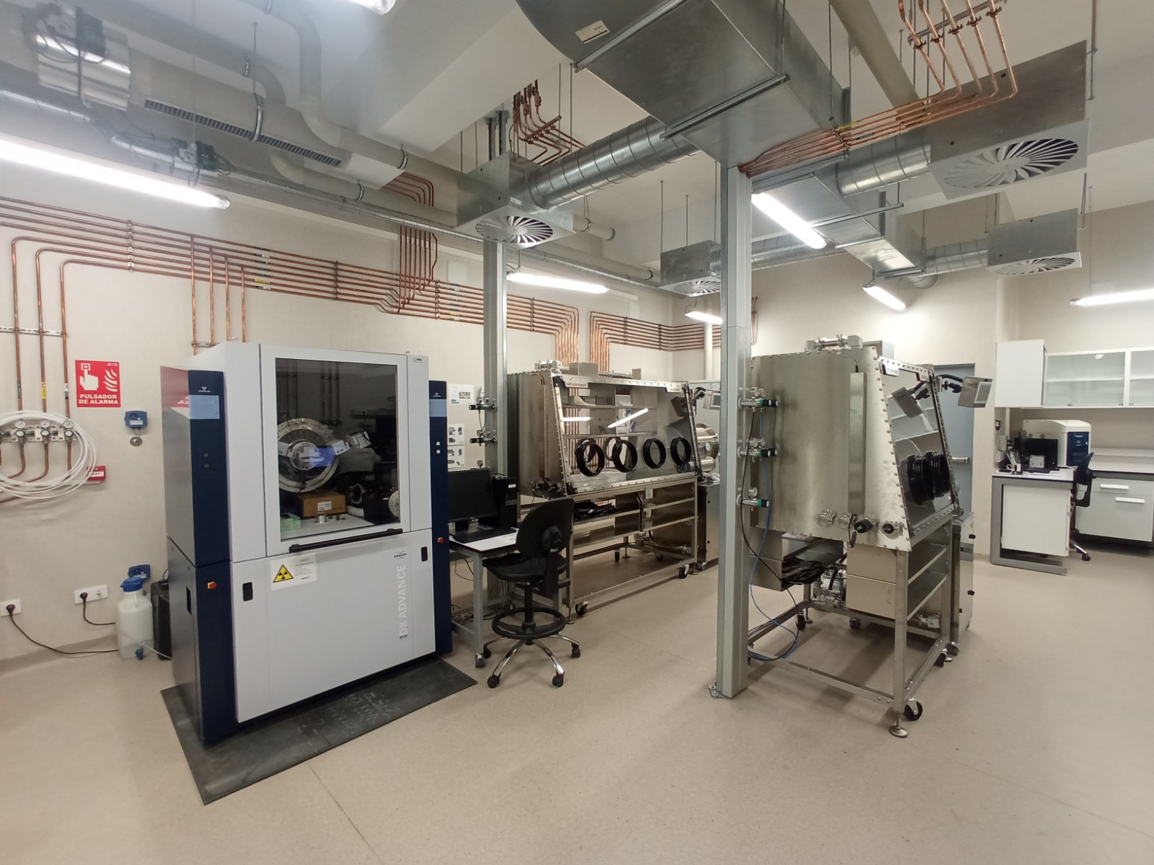
What do JRC facilities mean for HLWU?
Validation and optimization of procedures and methodologies
Isolation or coupling of individual effects
Parametrization of individual or synergic effects
Materials: ²⁴¹Am, ¹⁵²Eu, ²⁴⁴Cm, ²³⁸Pu, etc, spiked solutions; UO₂, UO₂ doped (Ce, Gd, Zr, Cr, Eu) and SIMFUEL.
Surrogate materials Spiked solutions
JRC facilities (hot cells)
  Verification with real material
CIEMAT HLWU facilities
Implementation of methodologies and devices
Research on irradiated fuel (SNF) and HLRW
    UO₂ → U₄O₉ / U₃O₇ → U₃O₈
Cubic
Tetragonal
Ortho
3
Kick-off meeting JRC-CIEMAT Agreement, 4th March 2026, Madrid

Slide 4
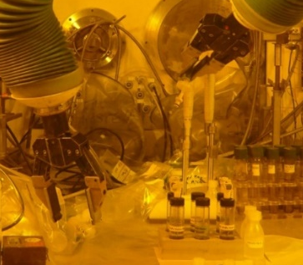
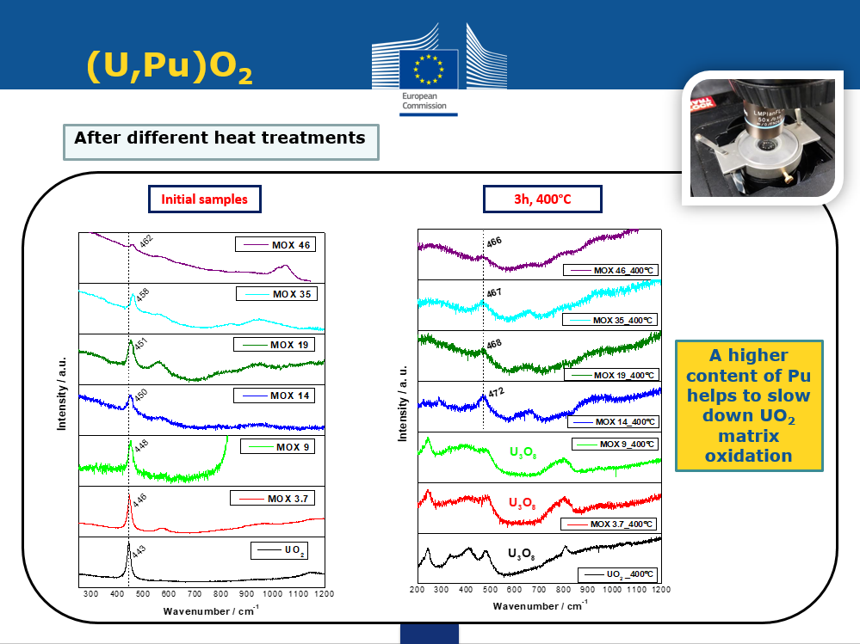
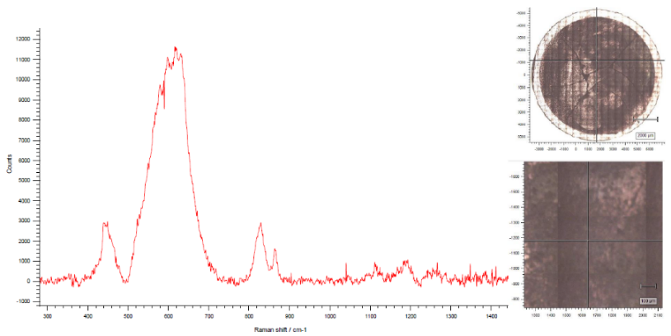
Some precedents of collaboration with JRC G.I.3 and G.I.5 units
  2008 Evaluation of the stability of advanced nuclear fuels (Th/Pu MOX) under deep geological repository conditions. Collaboration agreement: 30641. Collaboration with former Nuclear Fuel Safety Unit.
Leaching experiments of (Th,Pu)O₂ fuels in JRC hot cells
Nieves Rodríguez-Villagra stay at JRC. JRC supervisors: Dr. Daniel Serrano Purroy and Dr. Laura Aldave de las Heras
Funding through European grant the project of FP7-EURATOM
2016 Raman spectroscopy study of UO₂ matrix oxidation under different conditions and as a function of transuranium elements content within the matrix. Collaboration with former Nuclear Fuel Safety Unit.
Jone M. Elorrieta stay at JRC. JRC supervisor: Dr. Dario Manara
Funding through European grant the project GENTLE project of FP7-EURATOM (ID:323304)
2021 Modern Spent Fuel Dissolution and Chemistry in Failed Container Conditions. Collaboration with Unit G.I.3 – Safety of the Nuclear Fuel Cycle.
Abel Milena Pérez stay at JRC. JRC supervisor: Dr. Daniel Serrano Purroy
Funding through European grant the project H2020 DisCo (ID: 755443)
4
Kick-off meeting JRC-CIEMAT Agreement, 4th March 2026, Madrid

Slide 5
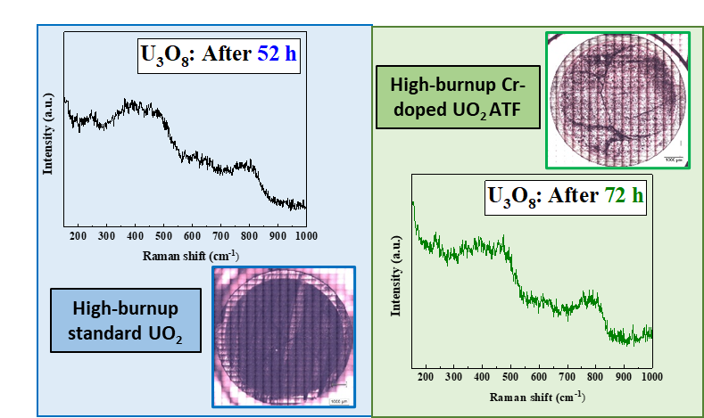
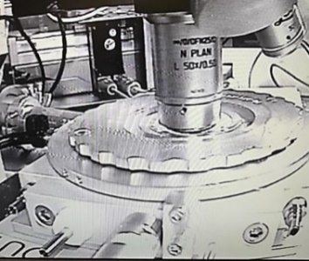
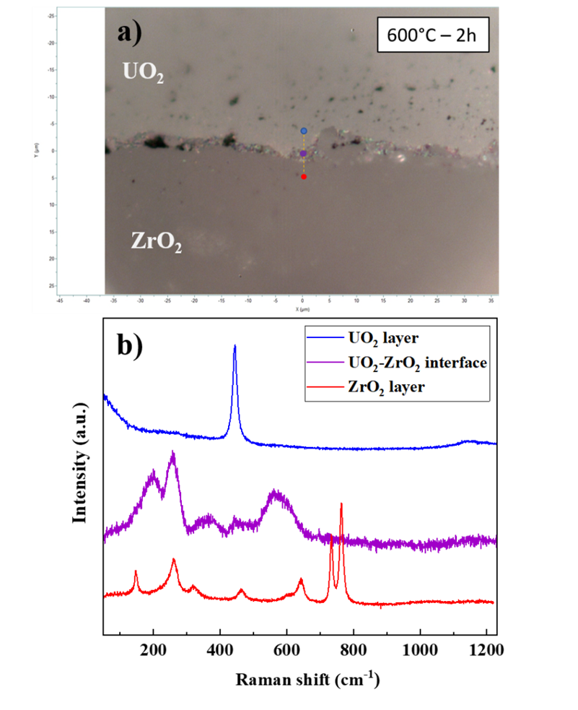

Some precedents of collaboration with JRC G.I.3 and G.I.5 units
2022-2023 Characterization of Irradiated Accident-Tolerant Fuels with RAman Spectroscopy. Collaboration with Unit G.I.3 – Safety of the Nuclear Fuel Cycle.
Abel Milena Pérez stays at JRC. JRC supervisor Dr. Daniel Serrano Purroy
Funding: 2022-1-RD-ActUsLab-HC-KA, User Access Project AUL-253 “CIATFRAS”
      2024 Obtention and Characterisation of a Reliable Analogue for Pellet-Cladding Interaction. Collaboration with Unit G.I.5 – Nuclear Science and Innovation for Energy and Health.
Jone M. Elorrieta stay at JRC. JRC supervisor Dr. Marco Cologna
Funding: 2024-1-RD-ActUsLab-FMR-KA, User Access Project AUL-279 "OCRAPCI”
2025-2028
Spanish National project proposed by CIEMAT
Marco Cologna (JRC) (Specific Actions talk)
Scientific coordinators Jone M. Elorrieta and Iván Sánchez-García
2026-2029
Two new proposals under JRC-CIEMAT Agreement (Specific actions talks)
Daniel Serrano Purroy (JRC), Abel Milena (CIEMAT) and Iván Sánchez García (CIEMAT)
5
Kick-off meeting JRC-CIEMAT Agreement, 4th March 2026, Madrid

Slide 6
Scientific production from the collaborations
Publication of scientific articles derived from these collaborations:
  J. M. Elorrieta, D. Manara, L. J. Bonales, J. F. Vigier, O. Dieste, M. Naji, R. C. Belin, V. G. Baonza, R. J. M. Konings, J. Cobos, “Raman study of the oxidation in (U, Pu)O₂ as a function of Pu content”, J. Nucl. Mater. (2017)
  M. Naji, N. Magnani, L. J. Bonales, S. Mastromarino, J.-Y. Colle, J. Cobos, D. Manara, “Raman spectrum of plutonium dioxide: Vibrational and crystal field modes”, Phys. Rev. B (2017)
  D. Manara, M. Naji, S. Mastromarino, J. M. Elorrieta, N. Magnani, L. Martel, J. -Y. Colle, “The Raman fingerprint of plutonium dioxide: Some example applications for the detection of PuO₂ in host matrices”, J. Nucl. Mater. (2018)
  J. M. Elorrieta, L. J. Bonales, M. Naji, D. Manara, V. G. Baonza, J. Cobos, “Laser-induced oxidation of UO₂: A Raman study”, J. Raman Spectrosc. (2018)
  J. M. Elorrieta, A. Milena-Pérez, J. F. Vigier, L. J. Bonales, N. Rodríguez-Villagra, “New insights into the structural transition from UO_{2+x} to U₃O₇ by quantitative Raman spectroscopy”, Phys. Chem. Chem. Phys. (2022)
  J. M. Elorrieta, A. Milena-Pérez, J. F. Vigier, L. J. Bonales, “The Raman fingerprint of U₃O₇”, J. Nucl. Mater. (2024)
  A. Milena-Pérez, L.J. Bonales, L. Emblico, D. Serrano-Purroy, N. Rodríguez-Villagra, “Spent Nuclear Fuel oxidation under dry storage controlled conditions for studying its radial oxidation behaviour”, J. Nucl. Mater. (2024)
  A. Milena-Pérez, J. M. Elorrieta, L. Emblico, L.J. Bonales, D. Serrano-Purroy, N. Rodríguez-Villagra, H. Galán, “Oxidation resistance of high-burnup Cr-doped UO₂ accident tolerant fuel and comparison with irradiated UO₂”, J. Nucl. Mater. (2025)
  Publication of technical reports derived from these collaborations:
  J. M. Elorrieta, J. Manaud, W. Bonani, J. Boshoven, L. Commin, J. -Y. Colle, M. Cologna, “OCRAPCI - Obtention and Characterisation of a Reliable Analogue for Pellet-Cladding Interaction”, JRC (2026)
  A. Milena-Pérez, D. Serrano-Purroy, “Characterization of Irradiated Accident-tolerant fuels with Raman Spectroscopy”, JRC (2023)
The new agreement, as it reinforces scientific collaboration, promotes the exchange of personnel in both directions and provides access to unique infrastructures.
6
Kick-off meeting JRC-CIEMAT Agreement, 4th March 2026, Madrid

Slide 7
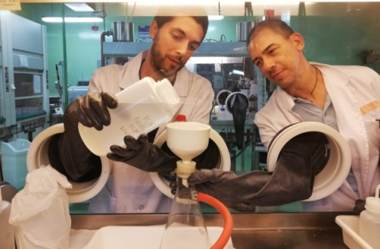
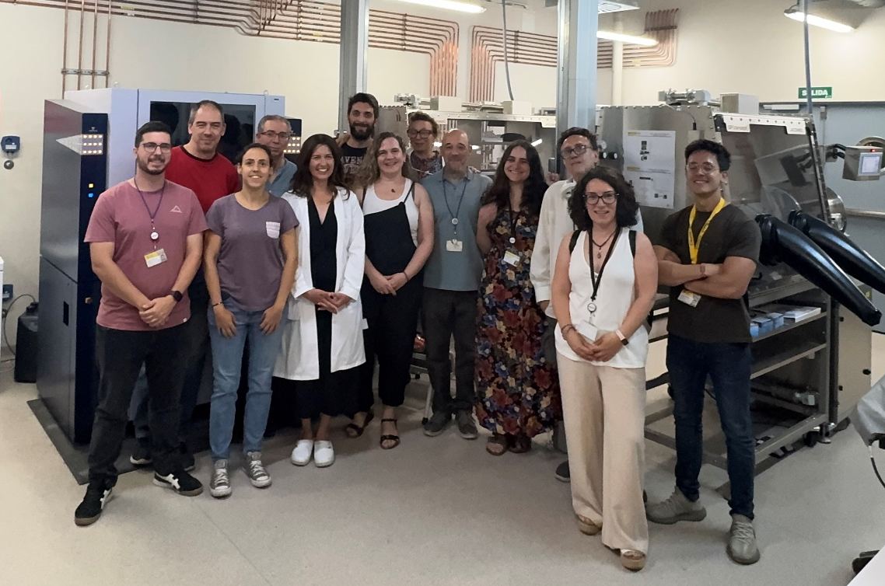
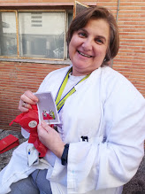
High Level Waste Unit
Nuclear Fission Unit
Thanks for you kind attention
http://rdgroups.ciemat.es/web/hlwu/home
Hitos.galan@ciemat.es
Kick-off meeting JRC-CIEMAT Agreement, 4th March 2026, Madrid

Slide 8
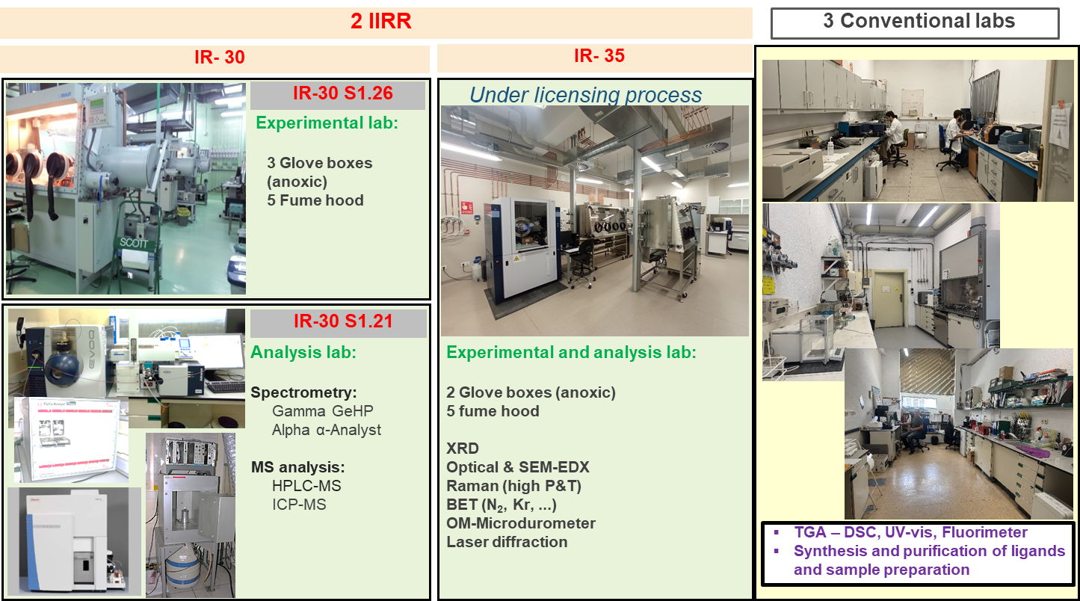
HLWU facilities
8
Kick-off meeting JRC-CIEMAT Agreement, 4th March 2026, Madrid

