Slide 1
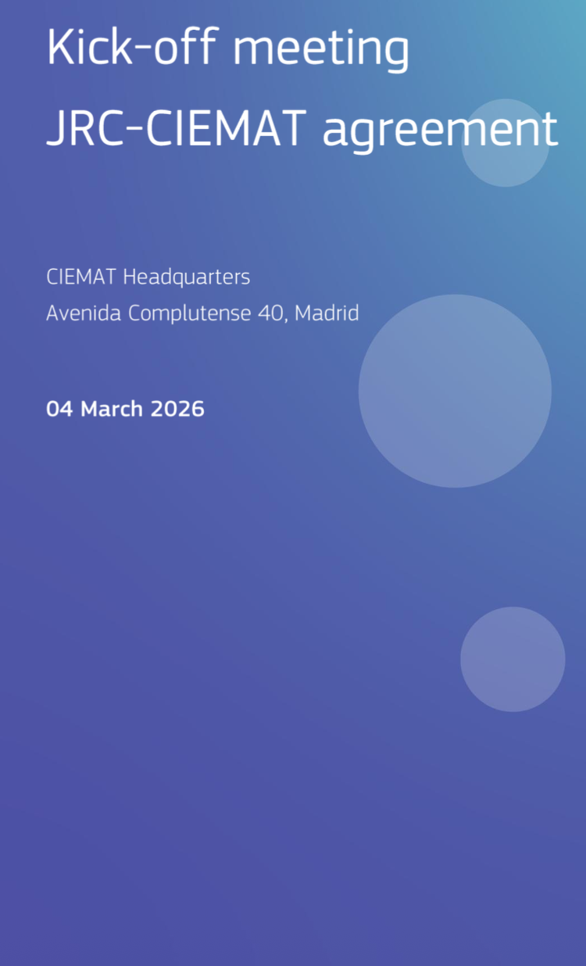


Department of Technology
Jose Manuel Perez

Slide 2
  Department of Technology
R&D lines and Technological capabilities
  R+D Lines
  R&D Support Infrastructures
Renewable Energies | Solar Thermal and Photochemical Technology
 | Renewable Energy Generation and Energy Efficiency
 | Bioenergy, Bioproducts and Waste
 | Hydrogen Technologies
 | Energy Storage
Fission | Fission Science and Technology
Fusion | Science and Technology for Fusion Energy
Environment | Environmental Hydrogeosciences
 | Radiation measurement and environmental impact
 | Soils, agriculture and the environment
 | Climate Change and Air Quality
 | Environmental socio-technical research
Technology | Particle Accelerators & Electric Drives
 | Medical Applications of Ionizing Radiation
 | Materials and Chemistry for Energy
 | Scientific Computing
Particle Physics | Particle Physics and Astrophysics
Biomedicine | Biomedical innovation
Technical Resources | Electronics Unit
 | Machining Workshops
 | LMRI (Metrology Rad. Ionizing)
 | ICT
R+D Management Resources | OTRI
 | OPE
 | Legal Office
 | Quality
 | Prospective
 | Disclosure
2

Slide 3
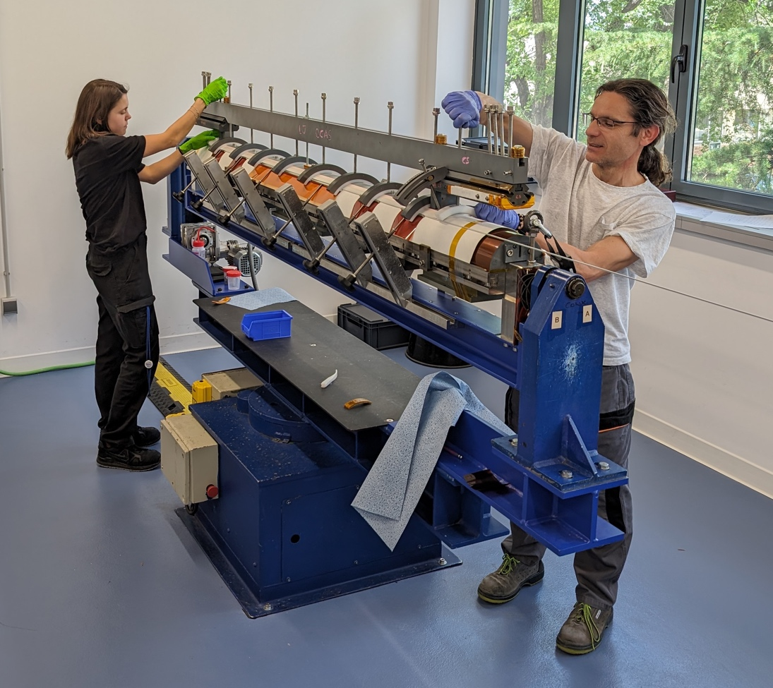
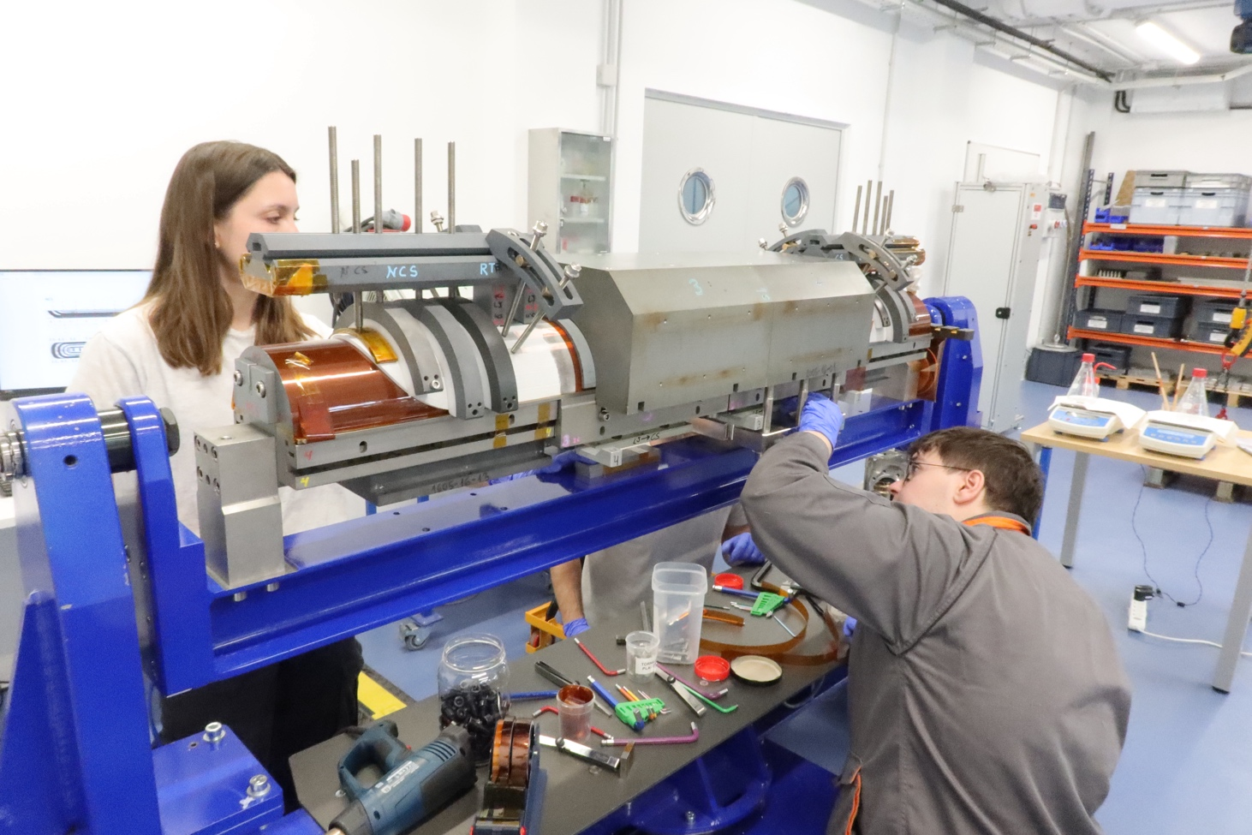
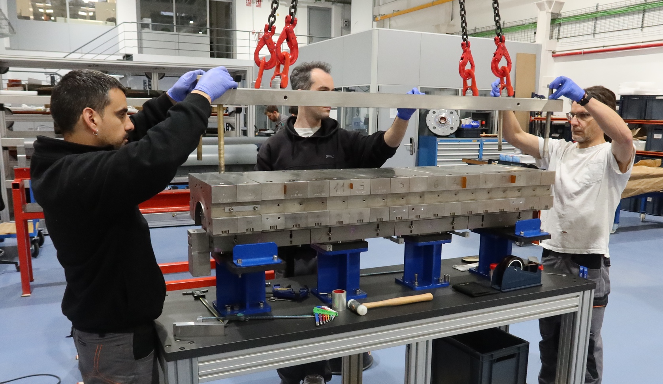
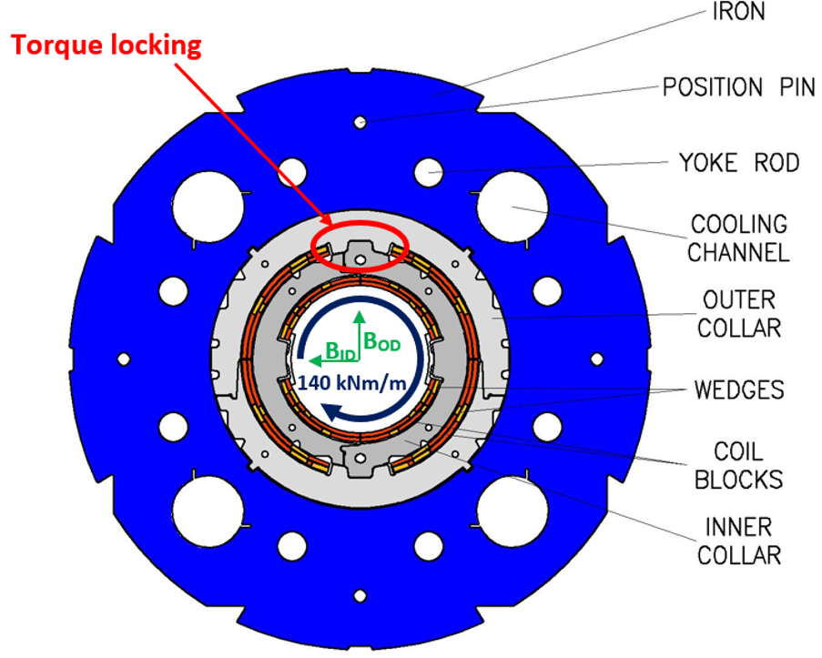
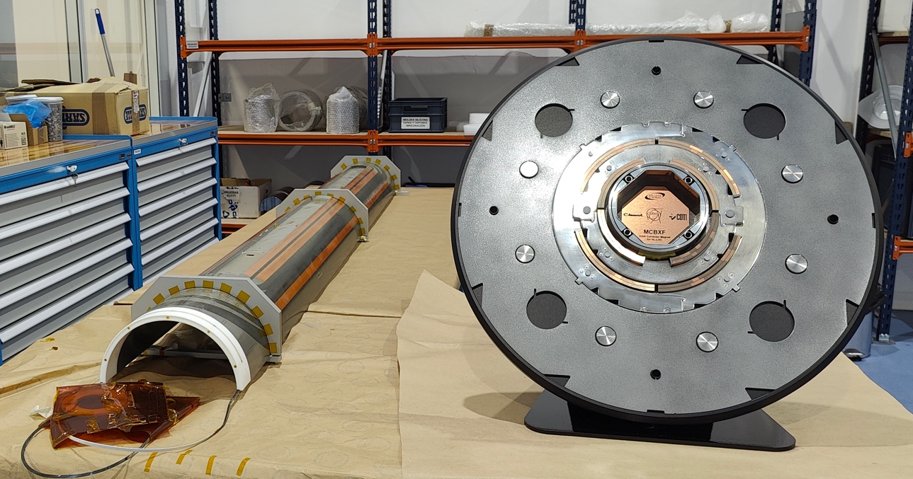
  Department of Technology
R&D&I on Accelerator components
Example: Development and manufacture of the nested orbit correctors (MCBXF) for the HL-LHC-CERN.
Winding
Binder
Impregnation
First nested superconducting accelerator magnet with mechanical torque locking.
Up to 140 kNm/m
Assembly being done at CERN.

Slide 4

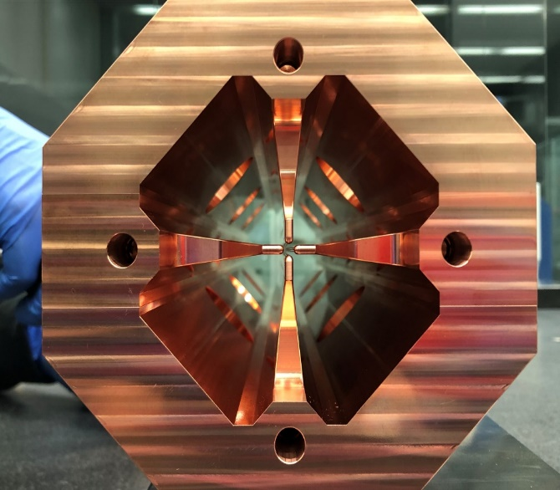
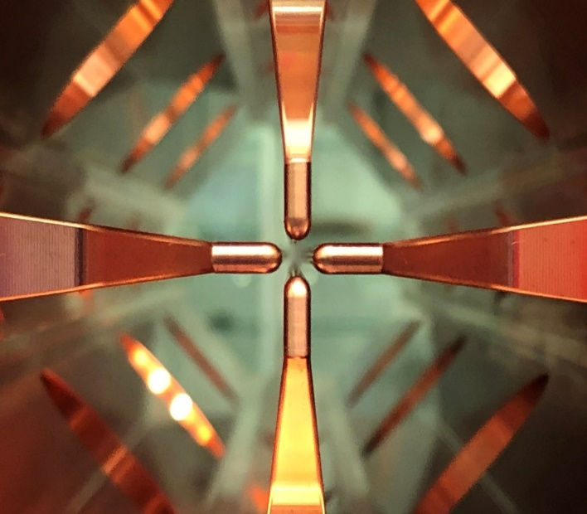
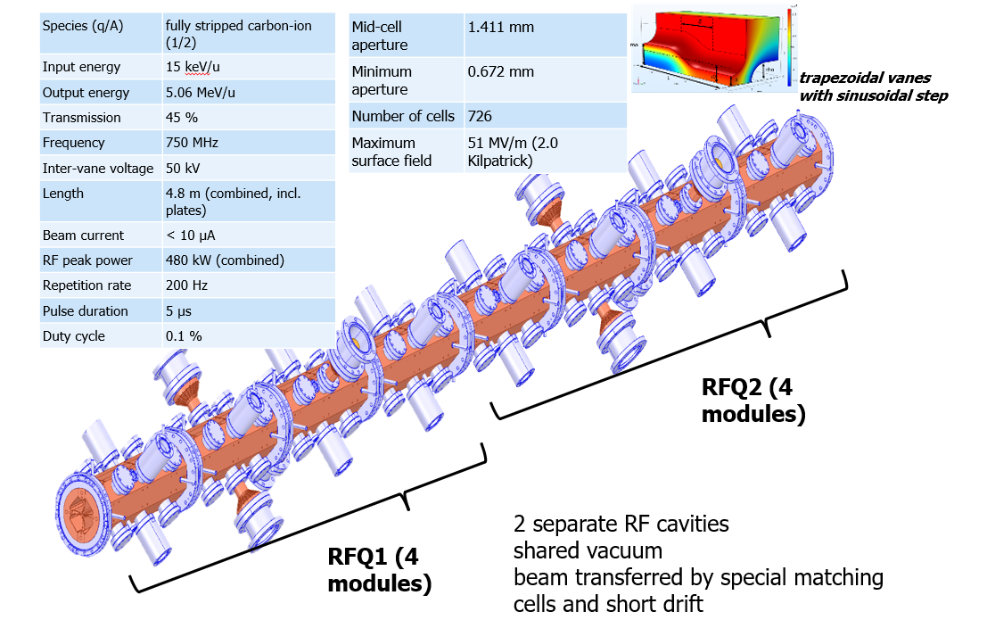
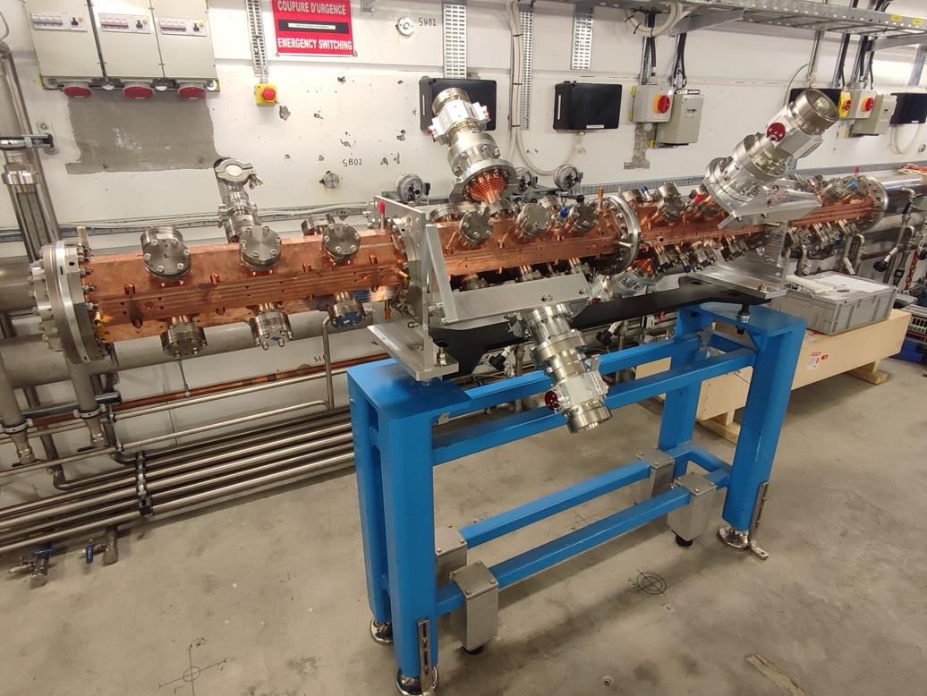
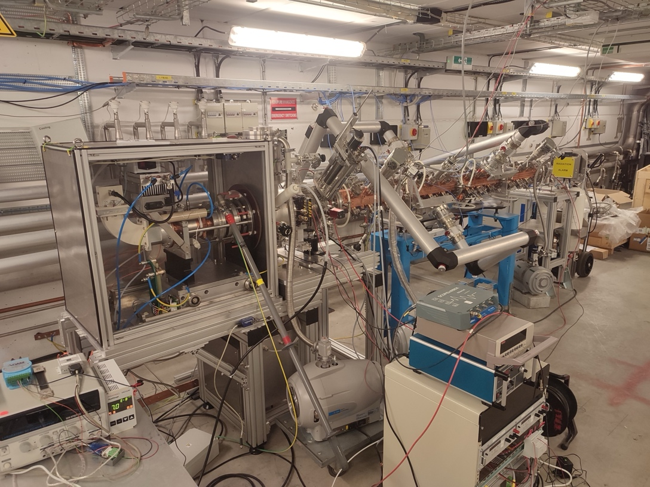
  Department of Technology
R&D&I on Accelerator components
Example: C6+ ion beam injector: INITAL-LINAC6+ project
RFQ:
  High-Frequency 750 MHz Carbon RFQ, composed by 2 segments (approx. 4.6 m)
  Compact design by a novel beam dynamics design by CERN
  Manufacturing: EGILE S.L.
  First segment manufactured, assembled, low power RF tested and currently under conditioning at CERN
RFQ at CERN facilities

Slide 5
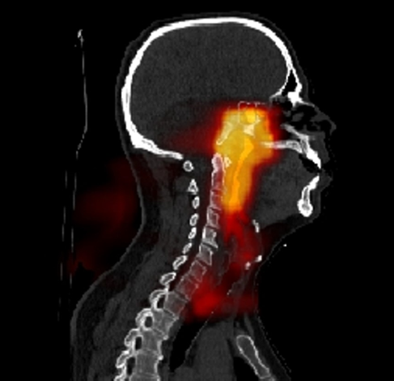
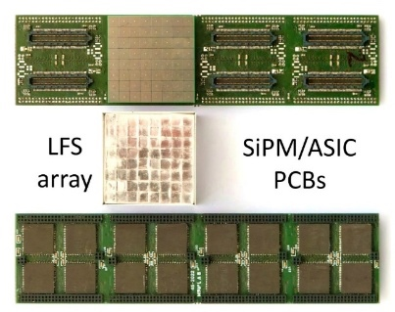
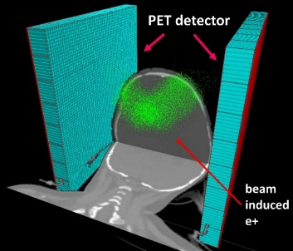
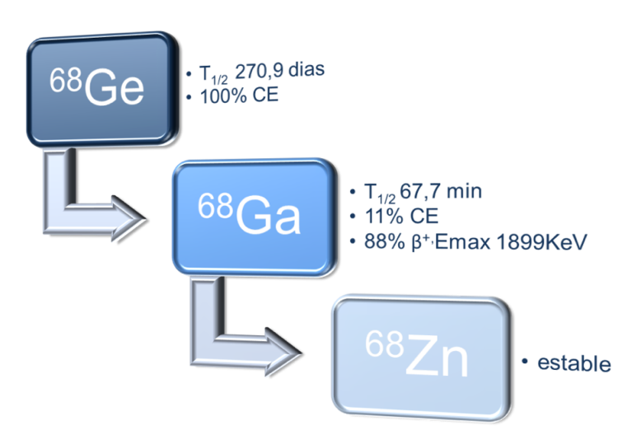
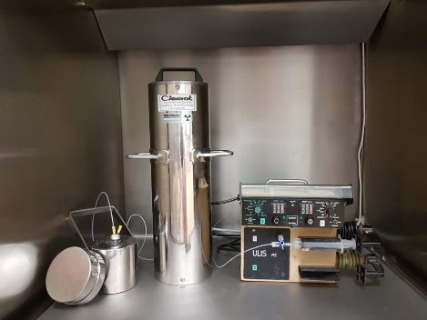
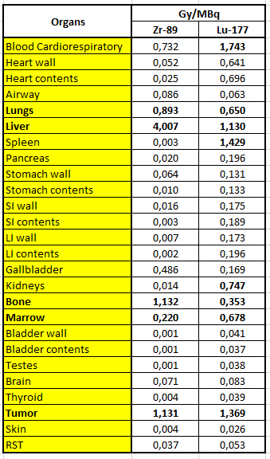
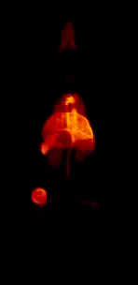
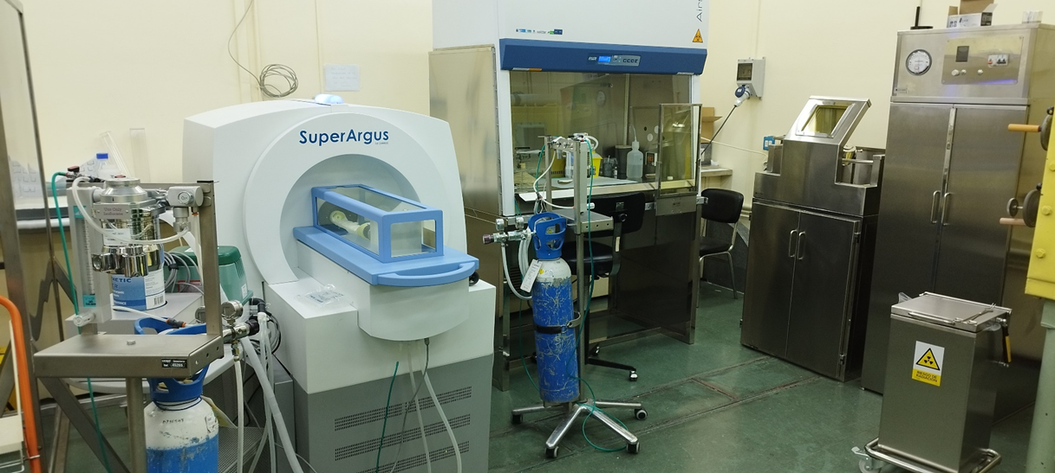
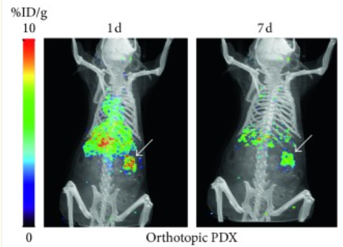
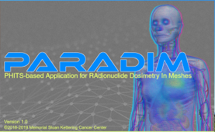
  Department of Technology
Medical Applications of Ionizing Radiation
Radionuclide and Radiopharmaceuticals. Biomedical applications
Monte Carlo in Proton Therapy
Preclinical Dosimetry
PET/CT Preclinical Molecular Imaging

Slide 6
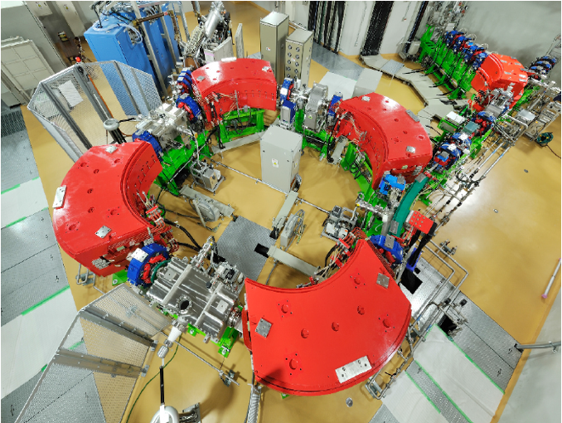

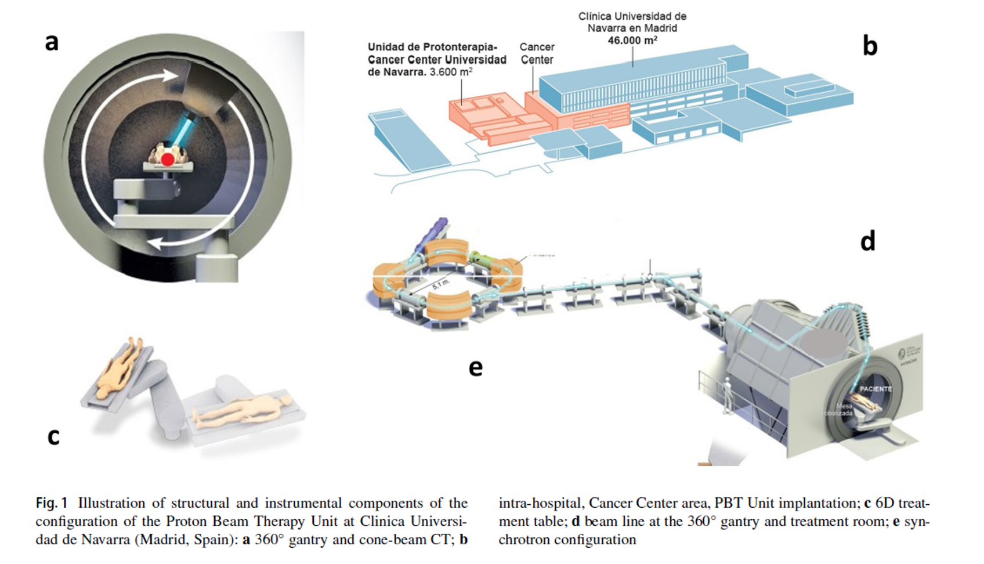
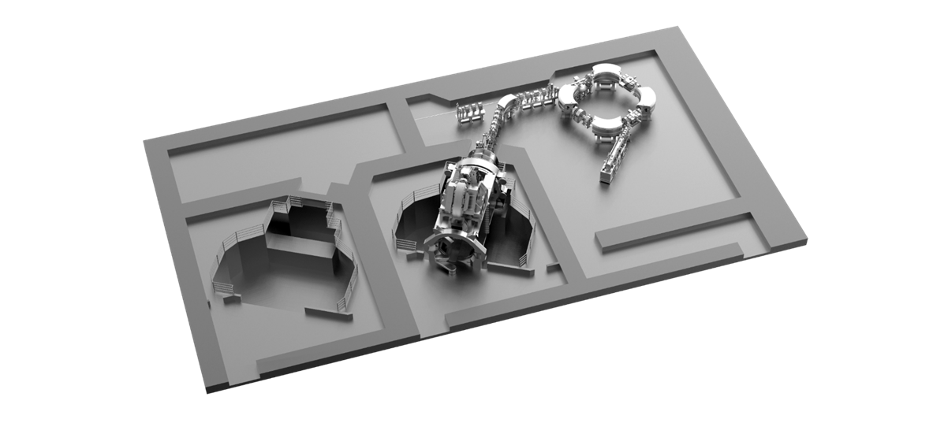
  Department of Technology
Medical Applications of Ionizing Radiation
Since 2015, our Medical Application Program is bound to large hospitals in Spain:
  Example: Radiobiology: CUN Clinic Hospital, Madrid
6

Slide 7
Materials and Chemistry for Energy:
Addresses the behaviour of materials in energy production, storage and conversion systems, from the point of view of
  understanding their degradation processes
  the consequent estimation of their useful life and
  the identification of paths for their optimization, or their replacement with novel materials
CAPABILITIES: Characterization & diagnosis
Chemistry
Structural Integrity
Microstructure
Materials for nuclear -> [Fission & Fusion]
Analytical Chemistry
R&D sublines
Materials for extreme environments
Materials for storage, conversion

Slide 8
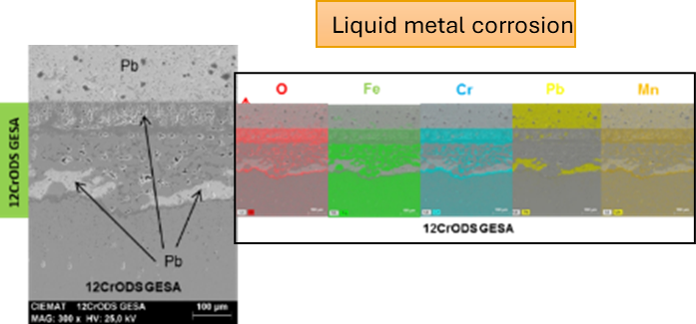
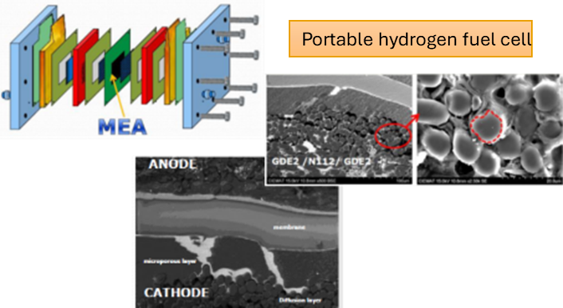
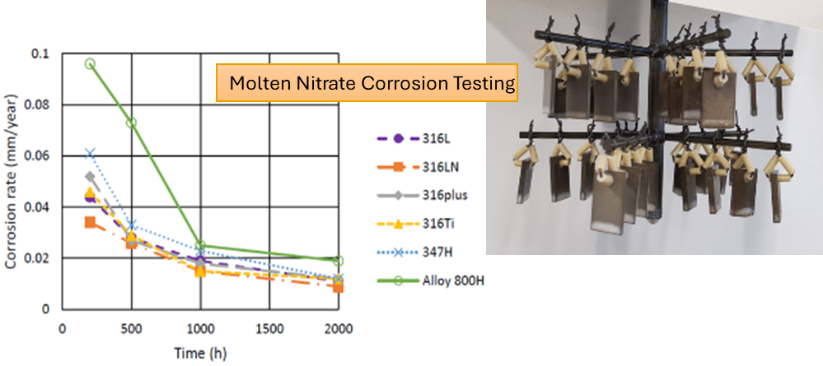
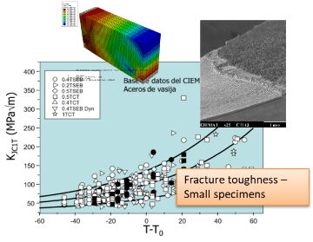

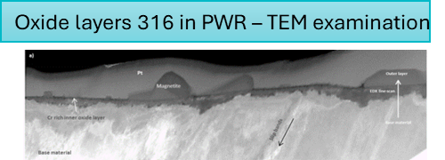
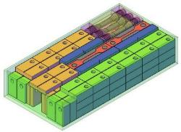
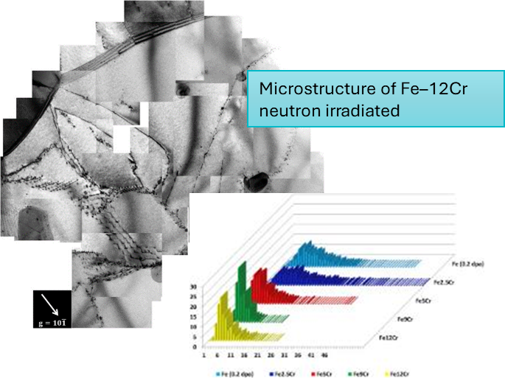
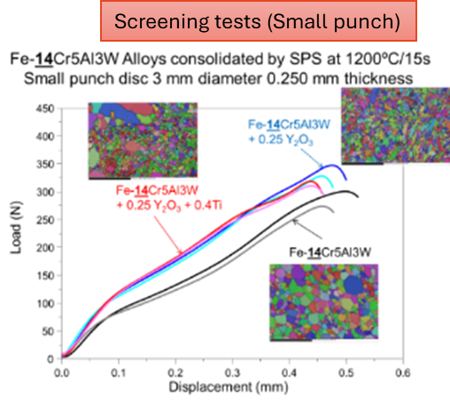
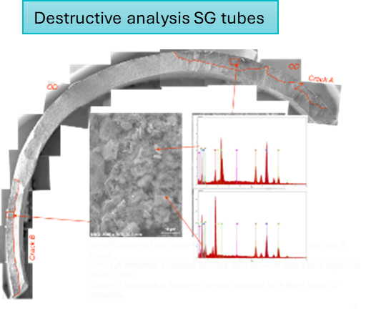
Core competences
Environmental degradation
Small specimen tests techniques
Advanced characterization

Slide 9





JRC-CIEMAT materials - collaborations
European & International associations
Existing technical collaborations (2022-2028)
https://cordis.europa.eu/project/id/101061241
Tools and databases
Online Data & Information Network for Energy (ODIN)
https://cordis.europa.eu/project/id/101164810
Qualification of additive manufactured components
Qualification of advance materials
Open access User & member of the evaluation committee
Upcoming technical collaborations (2026-2029)
JRC Petten laboratories
CONNECT-NM ROBIN-HUB ROund roBIN tests, guidelines & data management for an HLM materials testing HUB 2026-2029
CONNECT-NM EXTEND-LTO Exploitation of existing data and investigation of irradiation damage and recovery mechanisms in LWR RPV steels containing high Ni and Mn for extended LTO 2026-2029
More than 15 European projects (last 20 years)
CONNECT-NM ASSIST Advanced platform for Stainless Steel agIng and cracking aSsessmenT 2026-2029

Slide 10
CIEMAT Scientific Computing R&D&I
7 researchers + 5 technical support staff
  4 senior scientists + 3 PhD students
  Coordinated with HPC CIEMAT infrastructures (leading from the Scientific stragegy viewpoint)
Main lines of research comprise both computer and computational sciences
  AI, ML
    Application to fusion, fission, materials, biomedicine…
    Agnostic resolution of PDE and ODE systems, and algebraic solvers
  Continuum computing
    Computational efficiency
    Application to data-driven workflows in HEP, materials, smart grids…
  Success rate of ~45% in H2020 and HE Programmes
  Share funding of ~2.7M€ in the last 5 years
Activity and collaborations
  Coordination with other CIEMAT research lines
  Node of RES (Spanish e-Science Network)
  Representation of CIEMAT at Spanish Quantum Alliance, Spanish Citizen Science Initiative…
  Coordination of the EERA tJP ‘Digitalisation for Energy’
  Coordination of R&D activities on ICT in the Ibero-American Programme CYTED

Slide 11
Thank you

Slide 12
CIEMAT & RES
The CIEMAT participation is structured through 2 nodes and 3 facilities
  Connected through a 100 Gbps network
  CIEMAT node, Xula and Turgalium supercomputers
    Xula, 465 Tflops (HPC calls)
    Turgalium, 465 Tflops (HPC calls) & 15,8 Pflops tensor core (4 Nvidia H100, AI calls)
  PIC node, storage capacity
    1 PB fully dedicated to the RES
Total capacity
  Xula supercomputer, 1,38 Pflops – IB HDR200 – 256, 512 and 1024 GB/node
  Turgalium supercomputer, 716 Tflops & 35 Pflops tensor cores – IB EDR100 – 256 and 1024 GB/node
  PIC, 55 PB storage & 10,000 HTC cores

Slide 13
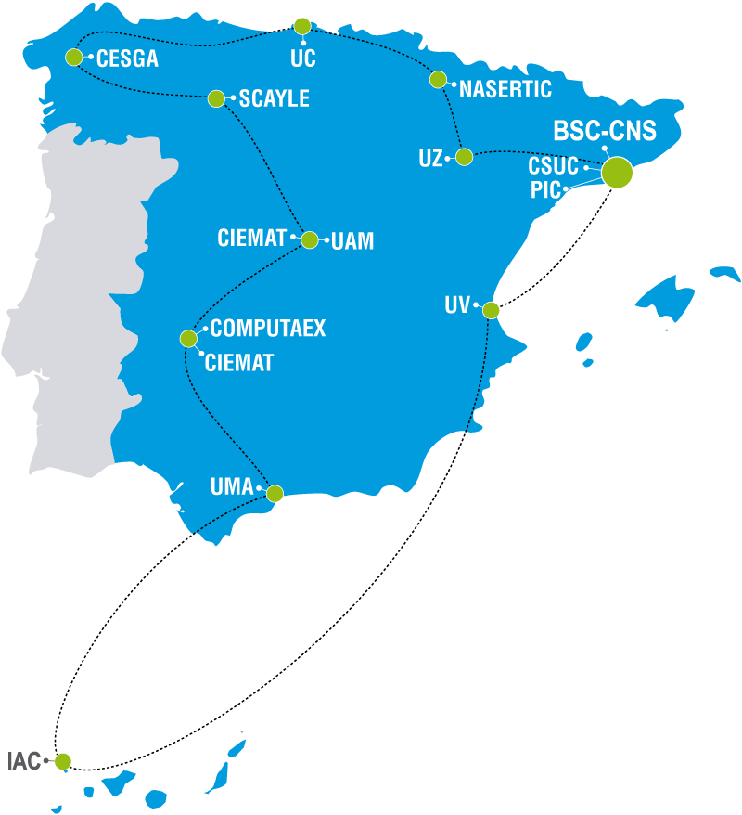
RES
The Spanish Supercomputing Network (RES) is one of the main national research infrastructures (ICTS)
Formed by 14 nodes, it provides HPC, data, and AI resources to the Spanish community through periodic
competitive calls
Committed resources
BSC-CNS, Mare nostrum V 314 PFlops
SCAYLE, Caléndula 6,7 PFlops
UMA, Picasso 4,34 PFlops
CESCGA, Finisterrae III 4,3 PFlops
CSUC, Pirineus III 2 PFlops
UV, Tirant 1,17 PFlops
BIFI, Agustina 1 PFlops
CIEMAT, Xula y Turgalium 929 TFlops
IAC, La Palma 929 TFlops
UAM, Cibeles 565 TFlops
Computaex, Lusitania III 465 TFlops
Nasertic, Urederra 487 TFlops
UC, Altamira 325 TFlops
PIC 1 PByte for data

Slide 14
CIEMAT Scientific Computing R&D&I
7 people
  4 senior scientists + 3 PhD students
Main lines of research comprise both computer and computational sciences
  AI
    Application to fusion, fission, materials, biomedicine…
    Agnostic resolution of PDE and ODE systems, and algebraic solvers
  Continuum computing
    Computational efficiency
    Application to data-driven workflows in HEP, materials, smart grids…
  Success rate of ~45% in H2020 and HE Programmes
  Share funding of ~2.7M€ in the last 5 years
Institutional representation
  Coordination of the CIEMAT’s line of research
  Representation of CIEMAT at RES, Spanish e-Science Network, Spanish Quantum Alliance,
  Spanish Citizen Science Initiative…
  Coordination of the EERA tJP ‘Digitalisation for Energy’
  Coordination of R&D activities on ICT in the Ibero-American Programme CYTED

Slide 15







Some international collaborations

Slide 16
JRC-CIEMAT materials - collaborations
European platforms
TWG2 Technology and R&D&I
– Material and fuels subgroup leader
SCWR materials
Partnership coordinator
Tools and databases
Online Data & Information Network for Energy (ODIN)
Nuclear safety and skills
JRC Petten
JRC Petten laboratories
User & member of the evaluation committee
SMPA: Structural Materials Performance Assessment Laboratories
AMALIA Laboratory for materials ageing in light water reactor environments
MCL Micro-Characterization Laboratory
LILLA Liquid Lead Laboratory

Slide 17
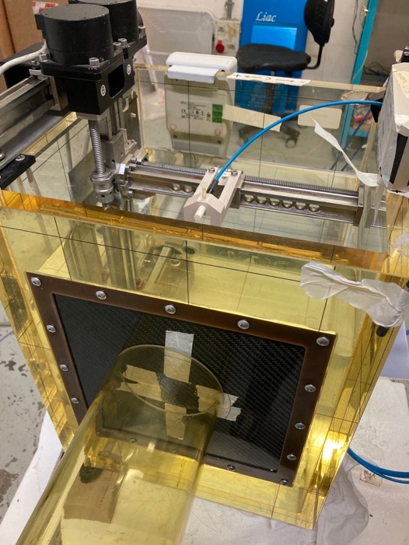
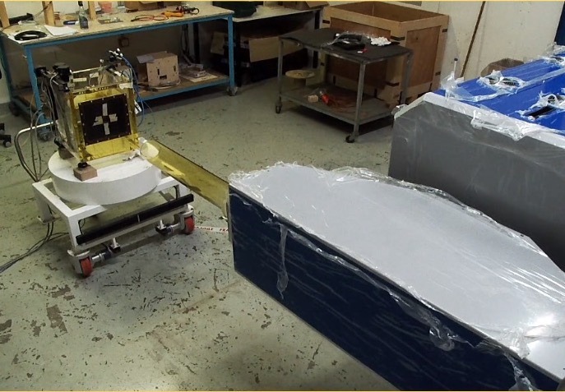

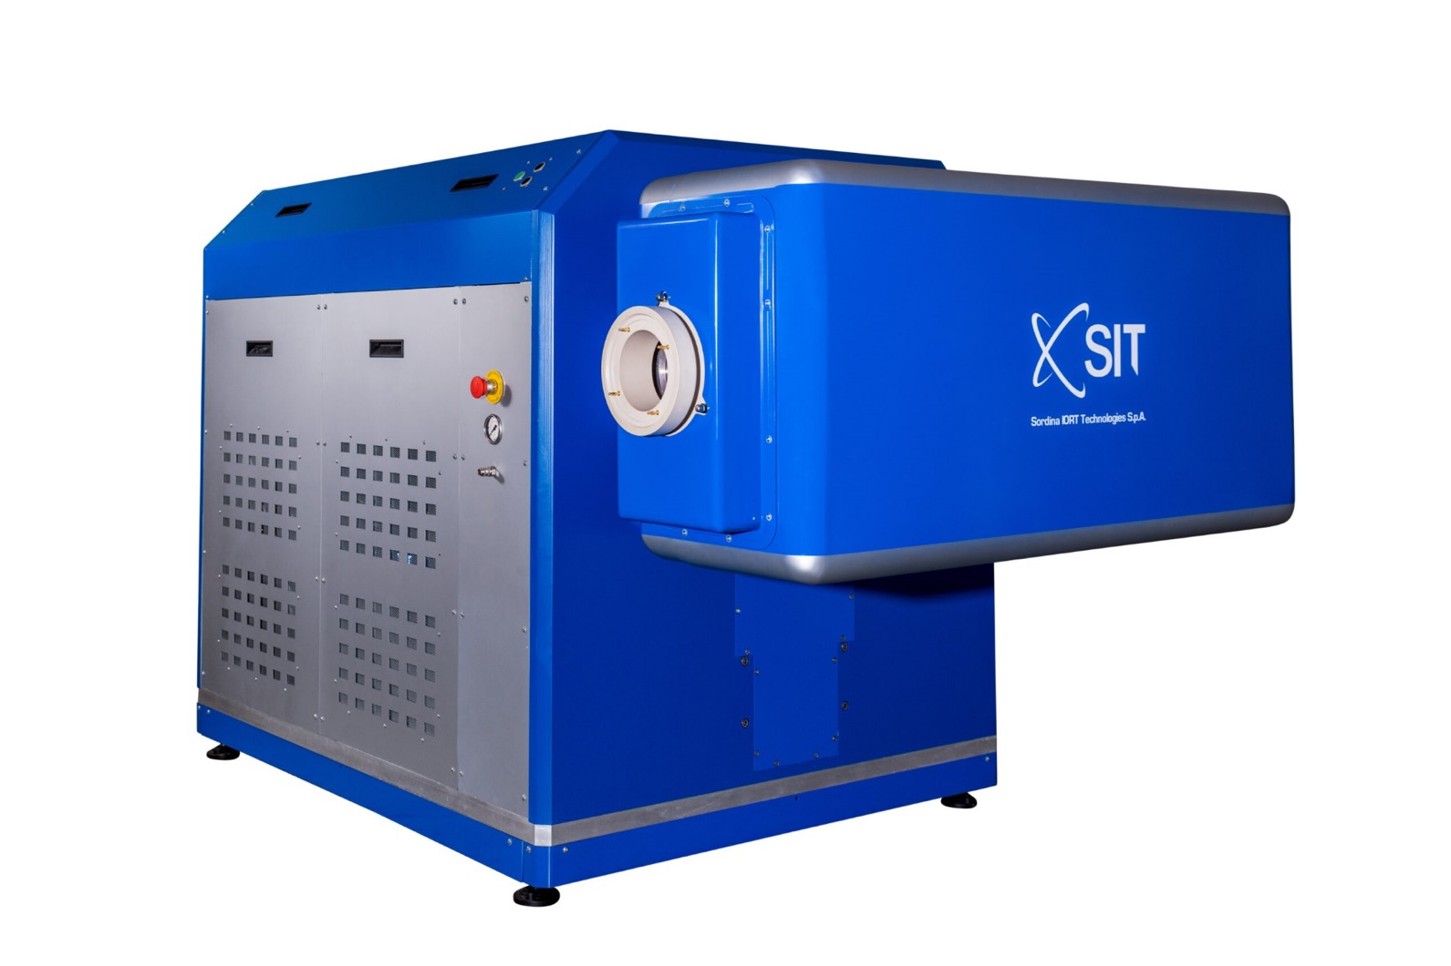
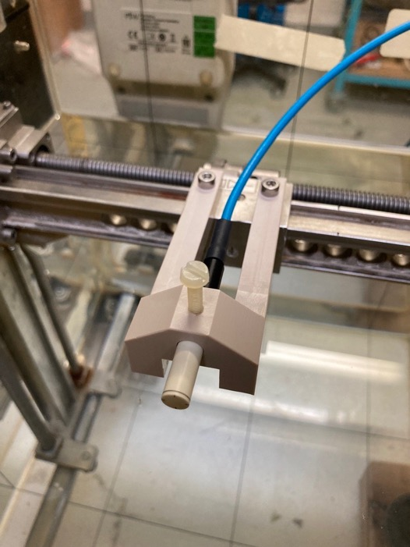
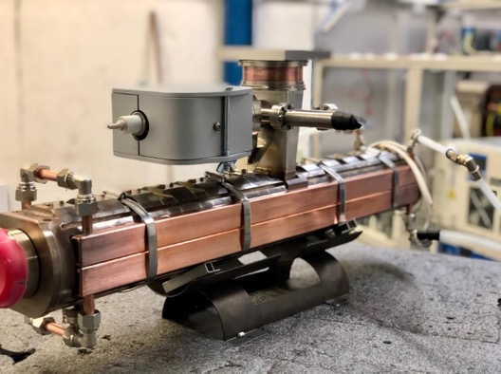
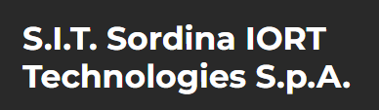
  Department of Technology
Medical Applications of Ionizing Radiation
Since 2015, our Medical Application Program is bound to large hospitals in Spain:
  Radiobiology: Electron Flash, HGUGM
Commercial electron FLASH in CIEMAT
Energy: 7 y 9 MeV
Dose rate: 0,005 – 10.000 Gy/s
    Pulse length (0,2-5 µs)
    PRF: 1-350 Hz

