Slide 1
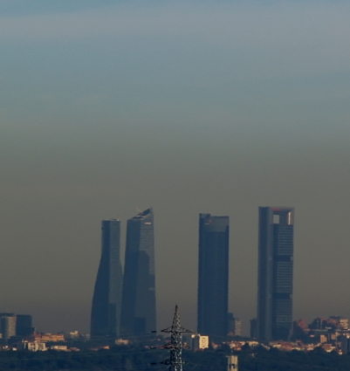

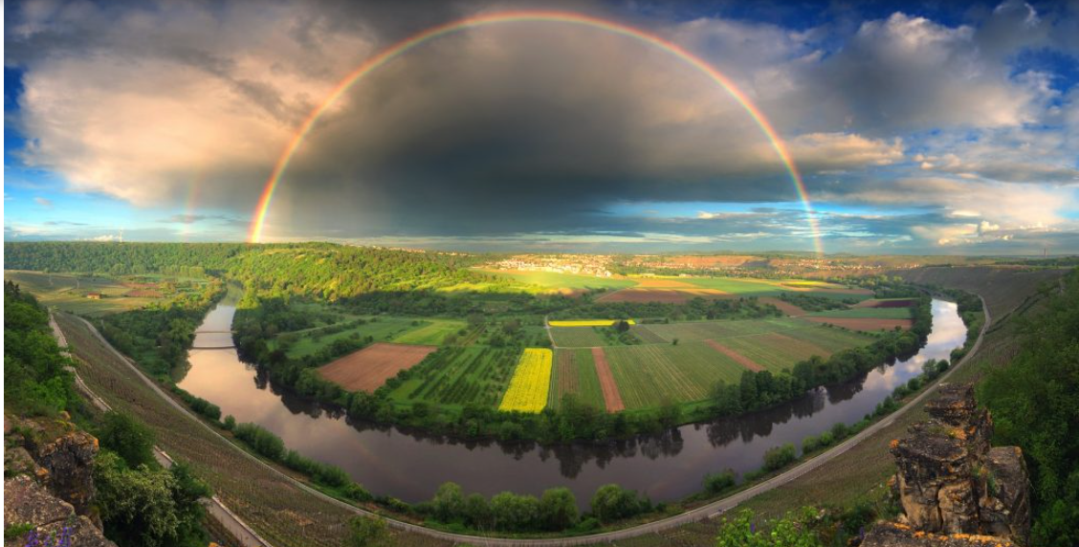
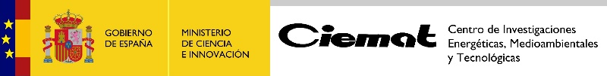
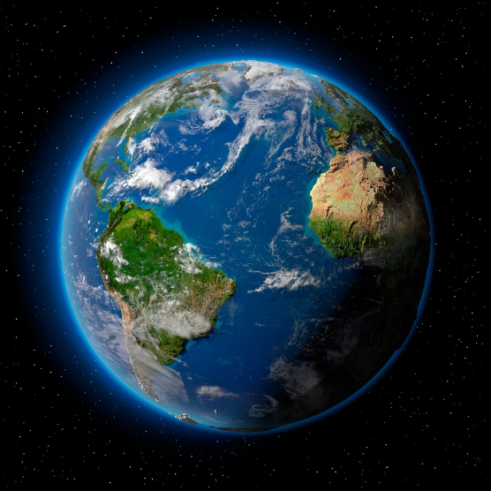

ENVIRONMENT
DEPARTMENT
Dr. Begoña Artíñano. Department of Environment
b.artinano@ciemat.es
04.03.2026

Slide 2
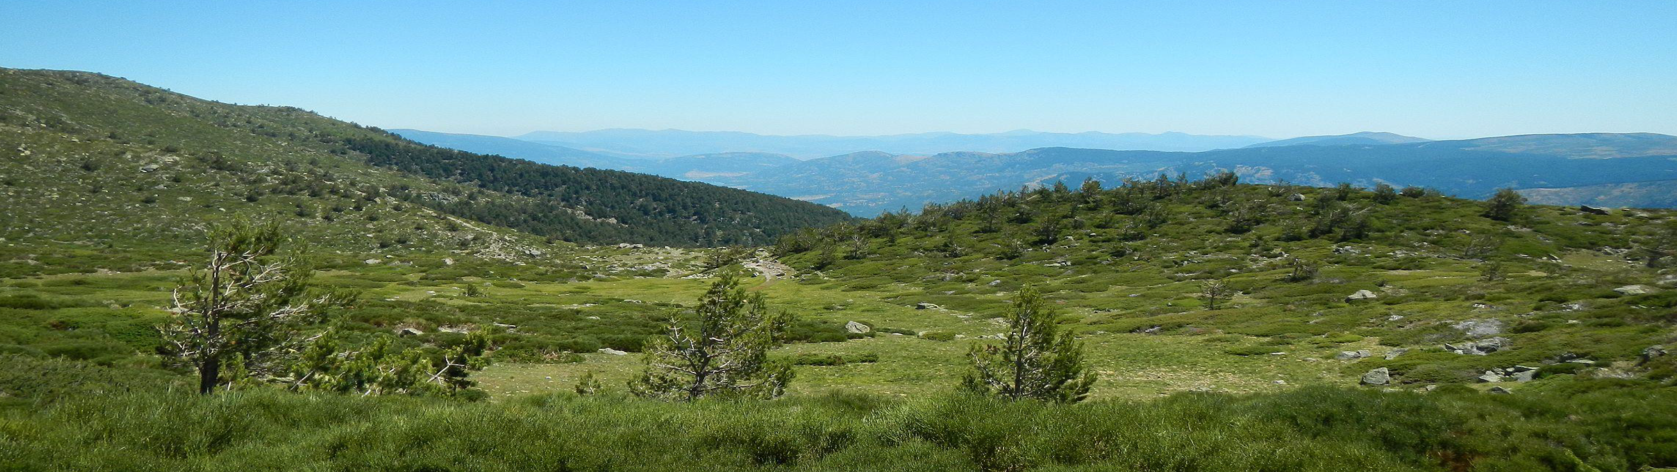
Department of Environment
Research Lines
Air Quality and Climate Change
Soils and Climate Change
Applied environmental hydrogeosciences and environmental risks
Measurement and evaluation of ionizing radiations
Sociotechnical and environmental law Studies

Slide 3
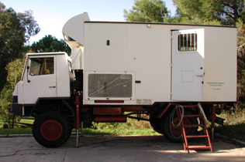
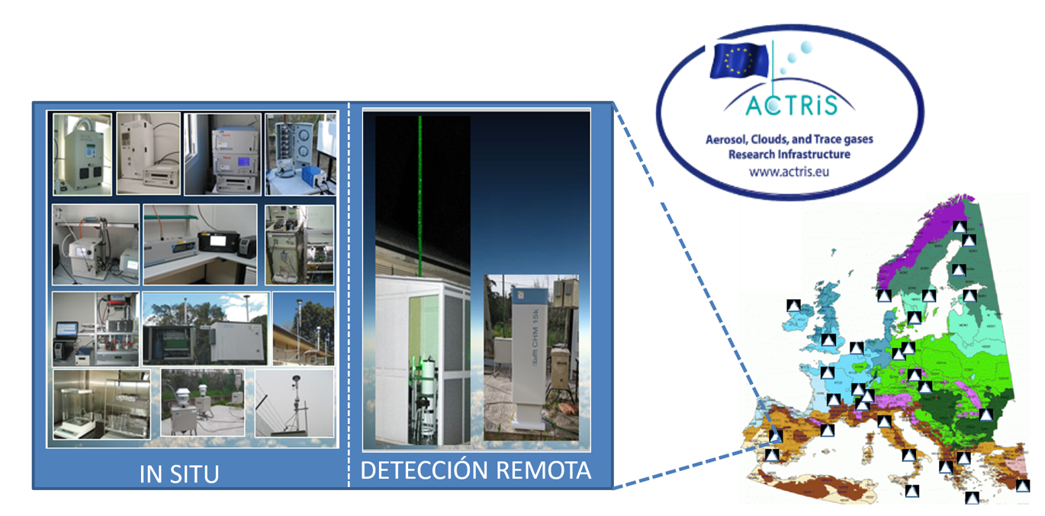
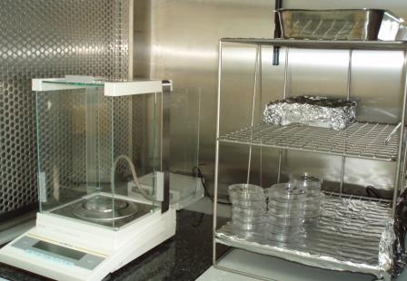

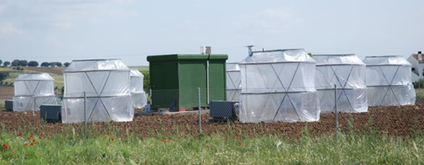
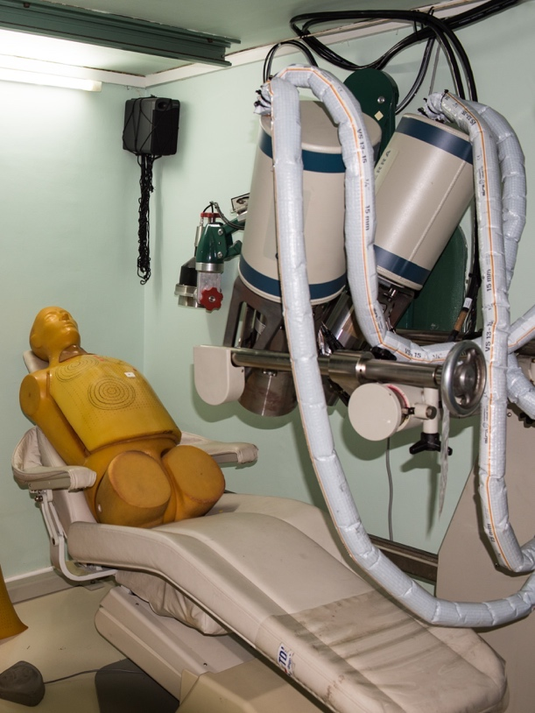
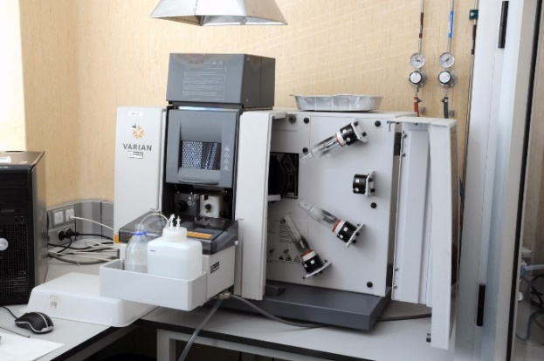
Department of Environment
01. El Departamento de Medio Ambiente
SCIENTIFIC FACILITIES
Laboratories for analysis and measurement of parameters and pollutants in environmental samples
REMOTE SENSING
Laboratories and facilities for radionuclides and radiation exposure
Mobile units, stations and sites, experimental platforms

Slide 4

Potential Areas for Collaboration under the
JRC–CIEMAT Framework Agreement
Department of Environment
February 2026
Air pollution & Climate Change
Soils and ecosystems
Sociotechnical Research

Slide 5
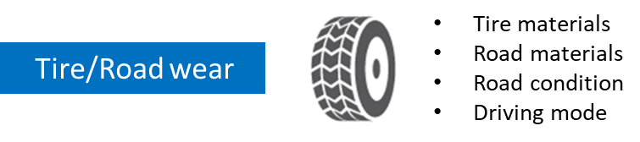


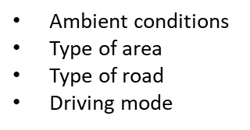
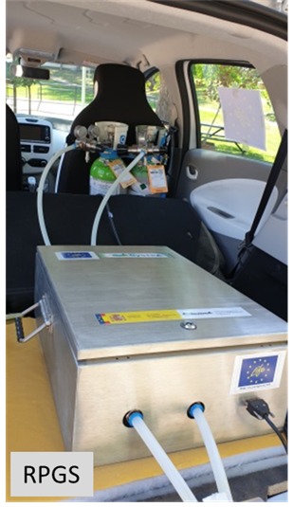
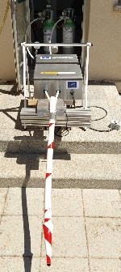
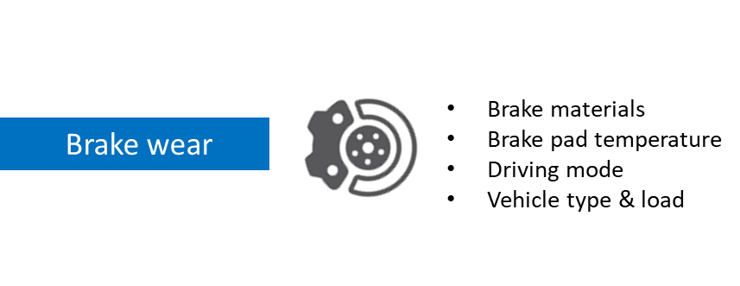
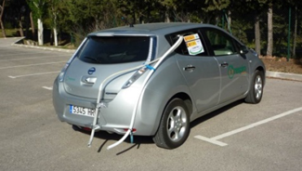

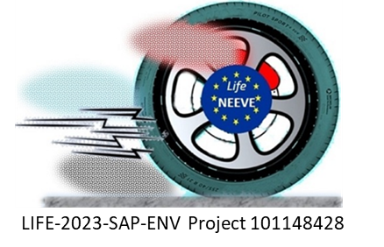
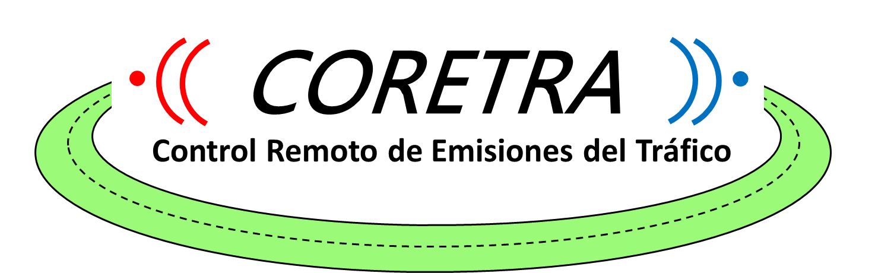
Air Pollution and Climate Change
Atmospheric impacts of transport sector: Road transport
Road transport emissions
Exhaust emissions & Non-exhaust emissions
Harmonization of Remote Sensing emission measurements
Fleets performance surveillance (High emitters detection)
Development of measurement standards (PTI, on road, etc.)
Real effects of LEZ in European cities
Development of experimental methodologies
Emission Factors
Research on real enviromental effects

Slide 6
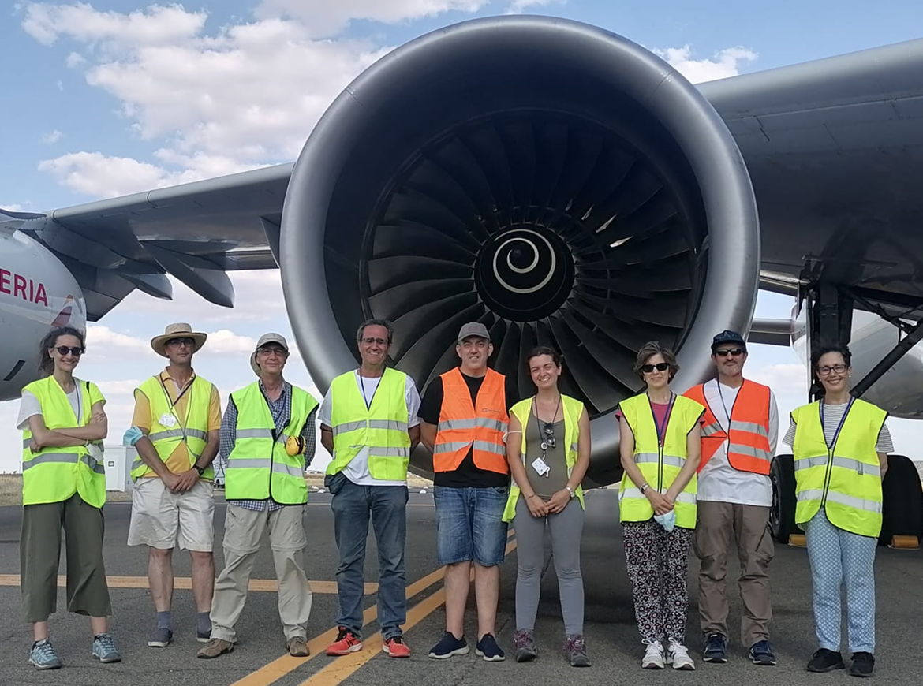
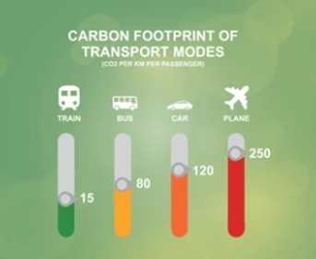


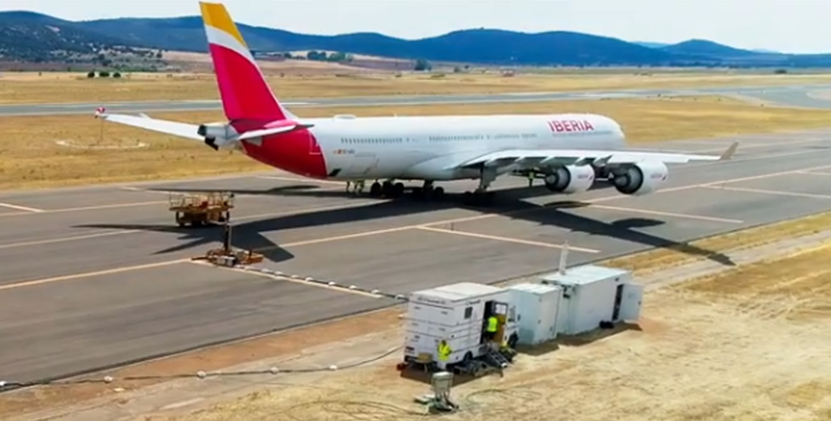

Air Pollution and Climate Change
Atmospheric impacts of transport sector: Road transport
Atmospheric impacts of aviation emissions
In progress

Slide 7
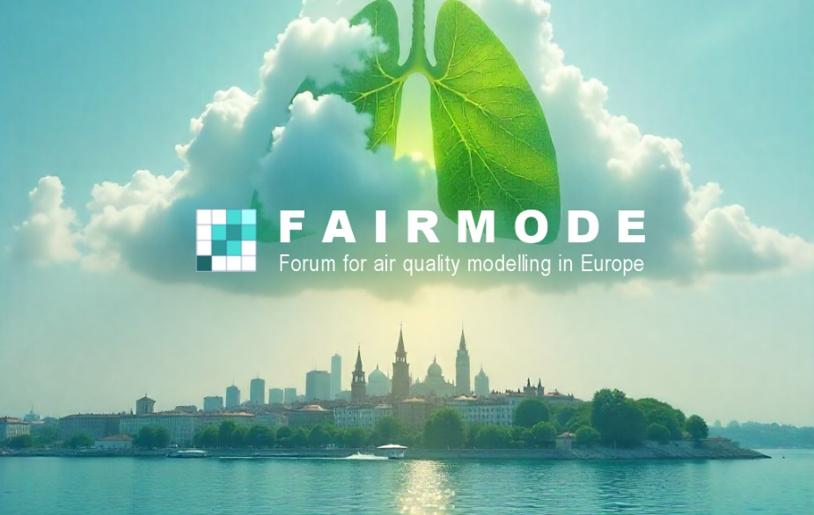
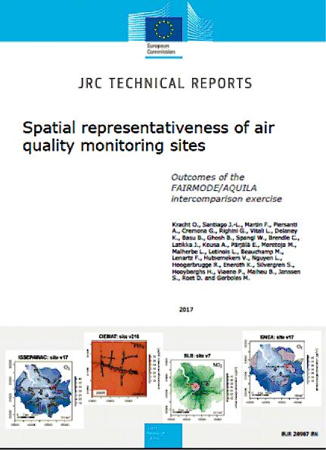
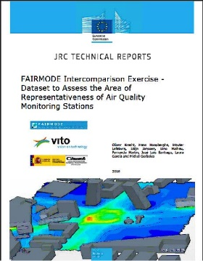
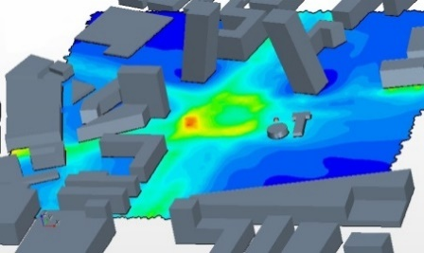
Air Pollution and Climate Change
Atmospheric impacts of transport sector: Road transport
Atmospheric Modelling
Present:
Active participation in Forum for Air Quality Modelling in Europe (FAIRMODE), more than 20 years.
Currently, two researchers serve as the National Focal Points.
CIEMAT leads the WG4 (Microscale assessment and planning) and actively participates in the other WPs.
Potential collaboration:
spatial representativeness of monitoring stations,
micro-scale modelling,
harmonization of advanced techniques to ensure regulatory compliance.

Slide 8
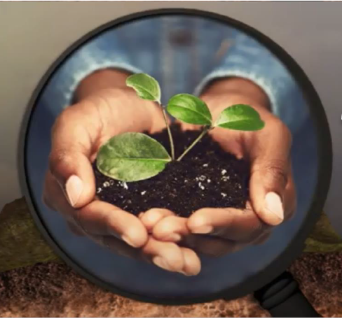
Soils and Ecosystems
1. Soils and agriculture
Environmental technologies and recovery of contaminated sites
Agrosystems, circular economy and sustainability
2. Atmospheric pollution & Climate Change adaptation Ecotoxicology.
Effects of environmental Global Change on ecosystems (agrosystems, natural and vulnerable ecosystems: wetlands, mountain areas, Antarctica…)
Response of Mediterranean vegetation to atmospheric changes.

Slide 9
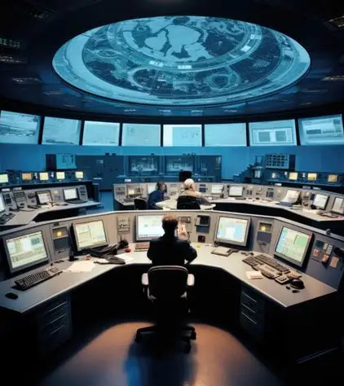

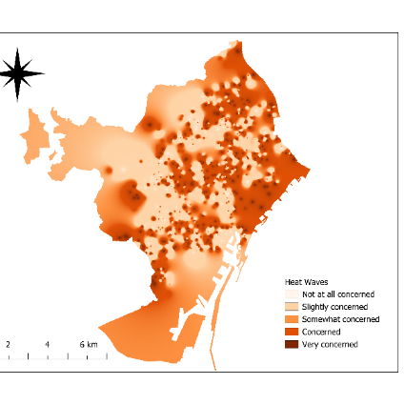
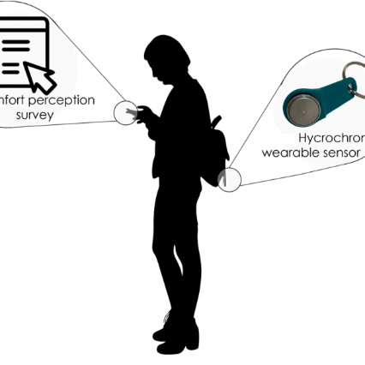
Sociotechnical Research
1. Nuclear domain: safety and risk in complex systems
  Organizational and safety culture
  Decommissioning challenges
  Cybersecurity and resilience
2. Air pollution, sustainability and climate: social research in sustainability and environmental risks
  Urban air quality: risk perception and policy acceptance
  Environmental justice and climate vulnerability
  Public participation and citizen science

Slide 10
THANKS!
Dr. Begoña Artíñano. Department of Environment
b.artinano@ciemat.es
04.03.2026

