Slide 1
G.3 Safety of the Nuclear Fuel Cycle
Overview of activities
Kick-off meeting JRC-CIEMAT collaboration agreement Jaroslava Pravdová
March 4th, 2026
Notes:
Cover slide

Slide 2
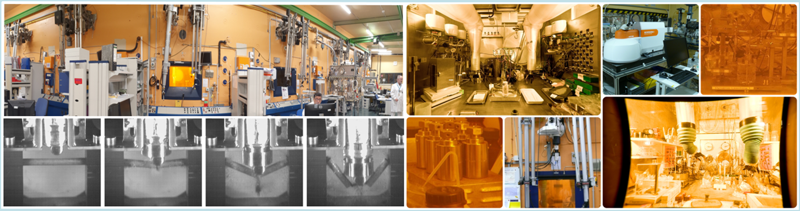
Areas covered / 1
Spent fuel corrosion studies
For a safe radioactive waste management
Spent fuel interim storage studies
For support to EU Member States in defining licencing criteria for spent fuel transport and storage
2

Slide 3
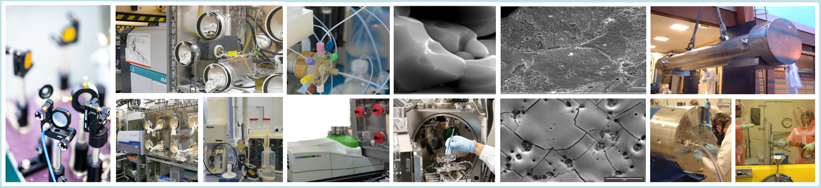
Areas covered / 2
Innovative radionuclide assay
For characterisation process in radioactive waste management and decommissioning activities
3

Slide 4
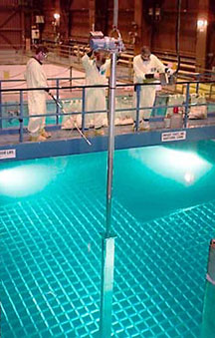
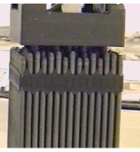
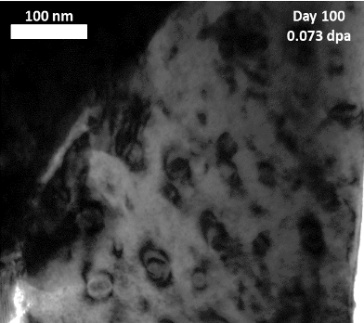
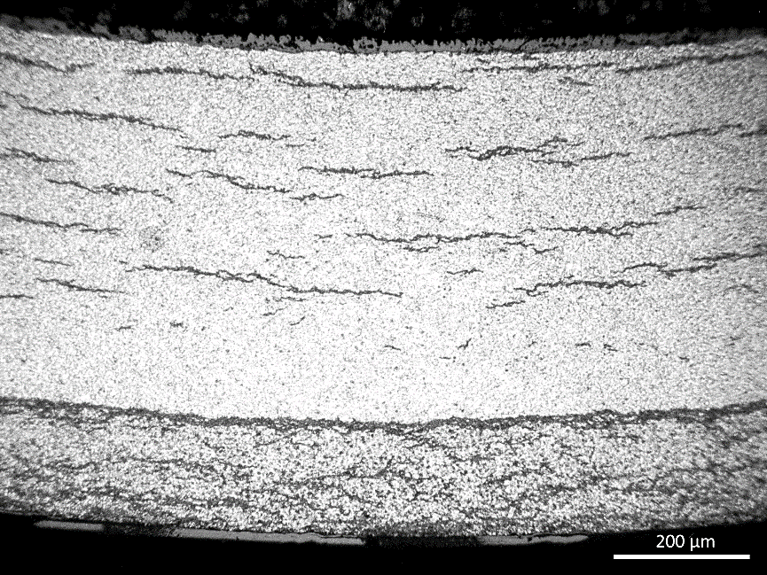
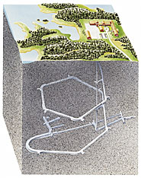
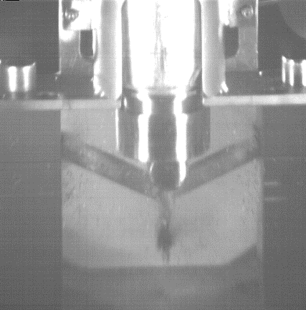
Waste (spent fuel) management studies assess SF/waste form properties and ability to fulfil its expected function over long-term
Repository
Pools, handling, transport, storage, retrieval, disposal
SF characterization, NDA
Accident conditions:
corrosion, loss of cooling; damaged SF, corium, debris properties
Mechanical load resistance: impact, bending tests
Extended interim storage
Radionuclides containment, rod retrievability (≥100 y?)
Potential spent fuel rod mechanical degradation during storage
Cladding (hydrides)
Fuel (decay damage, He accumulation)
Geologic Disposal
Reduce uncertainties on release of long-lived radionuclides over an open-ended disposal timescale
Radionuclides “Source Term”, “Instant Release”.
Matrix corrosion: effects of spent fuel properties and local environment
Convey experimental data into models and codes (predictions)

Slide 5
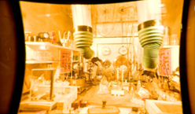
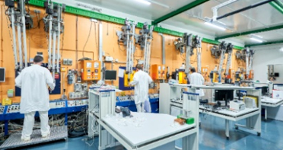
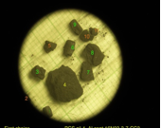
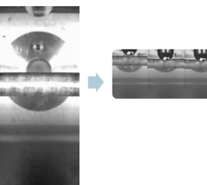
JRC.G.3 and its R&D activities
Multi-disciplinary expertise available in G.3
unique infrastructure for spent fuel and highly radioactive materials testing
combined experiments on commercial spent fuel and analogues (separate effects)
adapted/newly developed measuring devices and experimental set-ups
The knowledge and expertise gained is used to support Member States and EU policies

Slide 6
Some irradiated fuels available at JRC for a possible valorisation in new studies related to SMR / AMR
Pressurized Water Reactors:
  LEU fuel (3-5% U-235),
  HALEU up to 20% enrichement => extended operational cycles (e.g. 15–20 years)
High-Temperature Gas-Cooled Reactors (X-Energy Xe-100 and HTR-PM):
  TRISO (Tri-structural Isotropic) fuel particles
  Nitride fuels
Sodium-Cooled Fast Reactors (TerraPower Natrium reactor):
  Metallic fuel (e.g., uranium-zirconium)
  MOX (Mixed Oxide) fuel
  Spent fuel from traditional reactors or depleted uranium.
  Nitride fuels

Slide 7
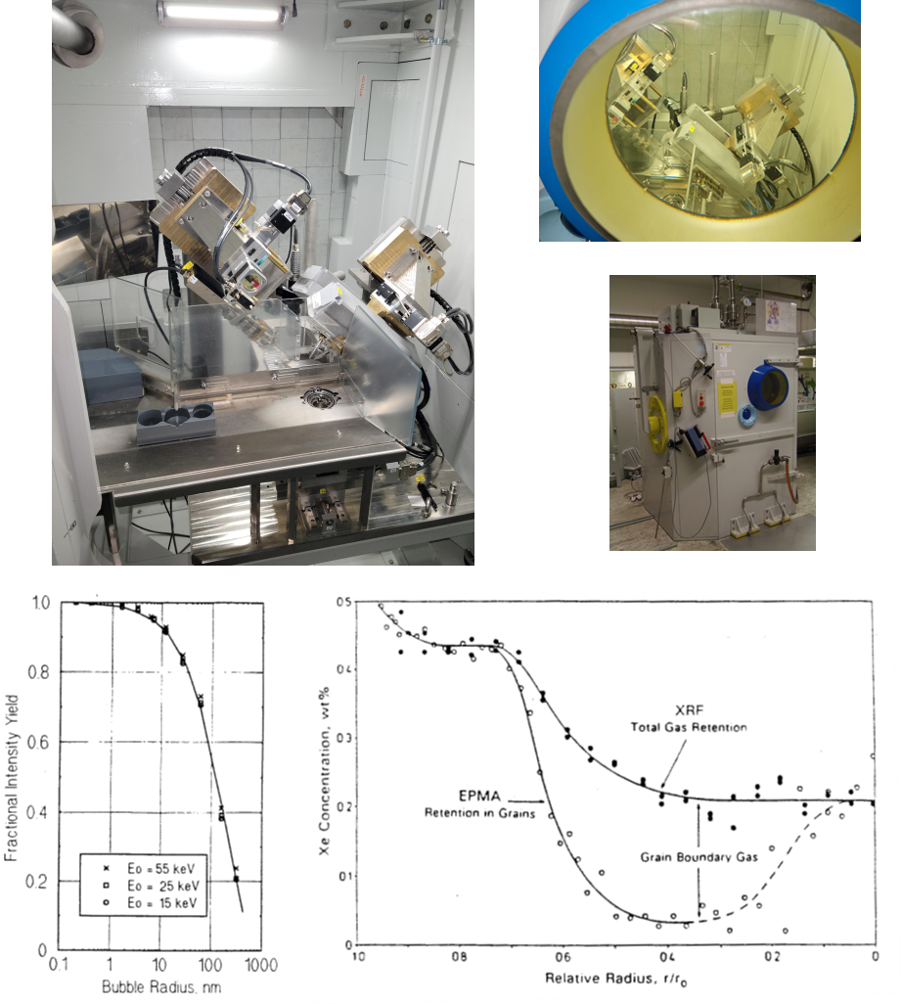
Micro-X-ray-flluorescence (µ-XRF)
For safety of nuclear fuels
the exact quantity and location of fission gas in irradiated fuel is still under investigation
Quantitative analysis of fission gas Xe and Kr in irradiated nuclear fuel
Complementary technique to EPMA, detects retained fission gas in larger gas pores and at grain boundaries
High spatial resolution, analysis of radial distribution in fuel cross sections
Extremely low detection limits of 1000 ppm for Xe and 100 ppm for Kr
Worldwide unique

Slide 8
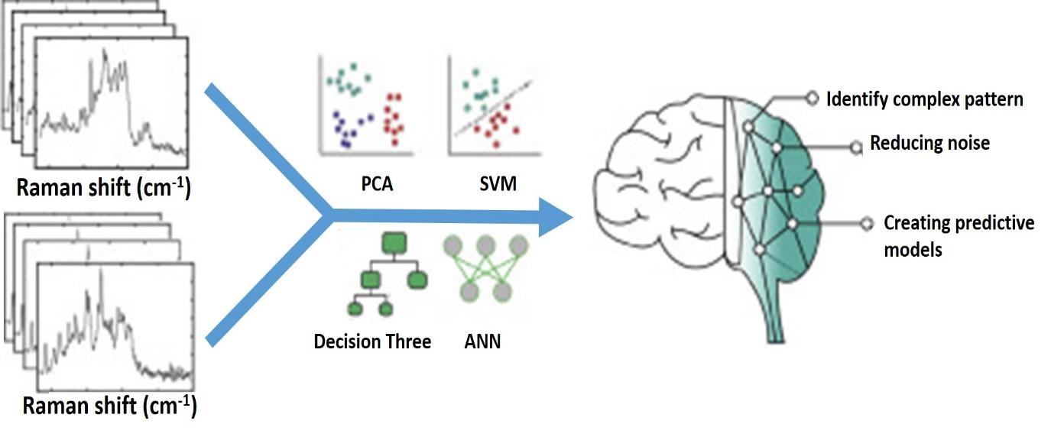

Use of Artificial Intelligence
AI based approach for data analysis and modelling of Raman spectra
Large Language Models for nuclear waste knowledge management

Slide 9
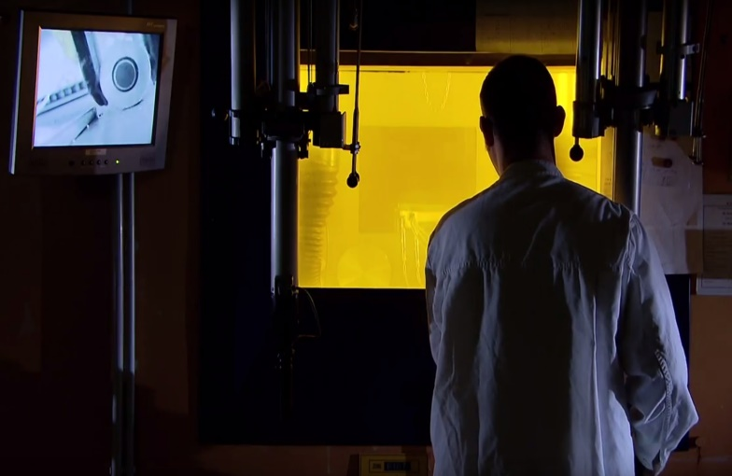
HOT CELLs EVENT
17-18 November 2026
JRC Hot Cells: Shaping the Future of Nuclear Science and Technologies
Perspectives after Six Decades of European Nuclear Safety Research
1
Honoring the past
Emphasize the importance of the hot cells' history and achievements
2
Shaping the future
3
Future support
Highlighting the need for continued advancement in nuclear safety research
Motivate future support of hot cells activities which enable the safe and detailed analysis of highly radioactive materials

Slide 10
Thank you
Notes:
Update/add/delete parts of the copy right notice where appropriate.
More information in the Reuse guidelines: eceuropaeu.sharepoint.com/sites/intellectual-property/SiteAssets/Forms/AllItems.aspx?id=%2Fsites%2Fintellectual-property%2FSiteAssets%2FSitePages%2FGuides-and-Manuals%2F2019_Reuse-guidelines%28CC-BY%29_Jan2022%2Epdf&parent=%2Fsites%2Fintellectual-property%2FSiteAssets%2FSitePages%2FGuides-and-Manuals

