Slide 1
CIEMAT-JRC Collaboration
Nuclear data and measurement standards
Measurements matter: Nuclear measurement expertise for EU policies
Arjan Plompen, Carlos Paradela Dobarro
Directorate G – Nuclear Safety & Security
Unit G.6 – Nuclear Data and Measurement Standards
Notes:
Welcome to GELINA, the Geel electron linear accelerator facility. We are part of the directorate for nuclear safety and security. Let us see what we do and why.

Slide 2
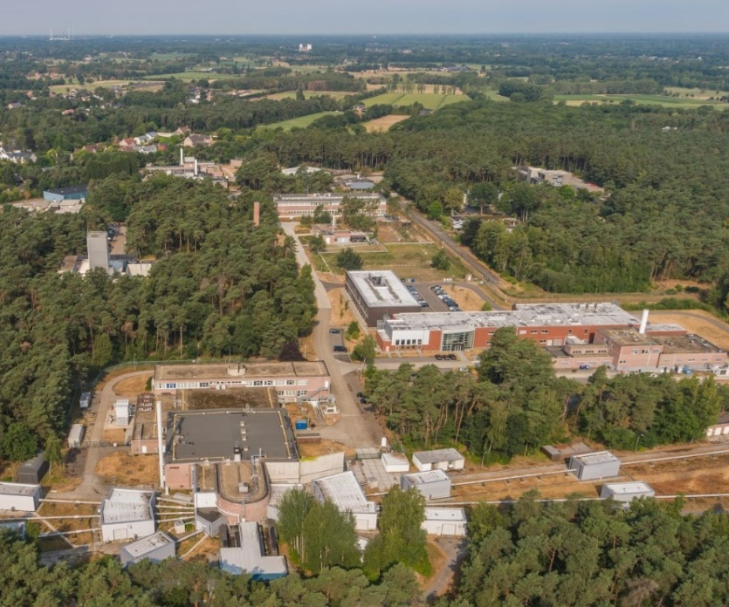




Unit Nuclear Data and Measurement Standards
Nuclear data for nuclear safety
Reference materials for nuclear safeguards and non-proliferation
Harmonisation of measurements of radioactivity in the environment
Open Science
Science networking and partnering
Scientific excellence
Knowledge transfer

Slide 3

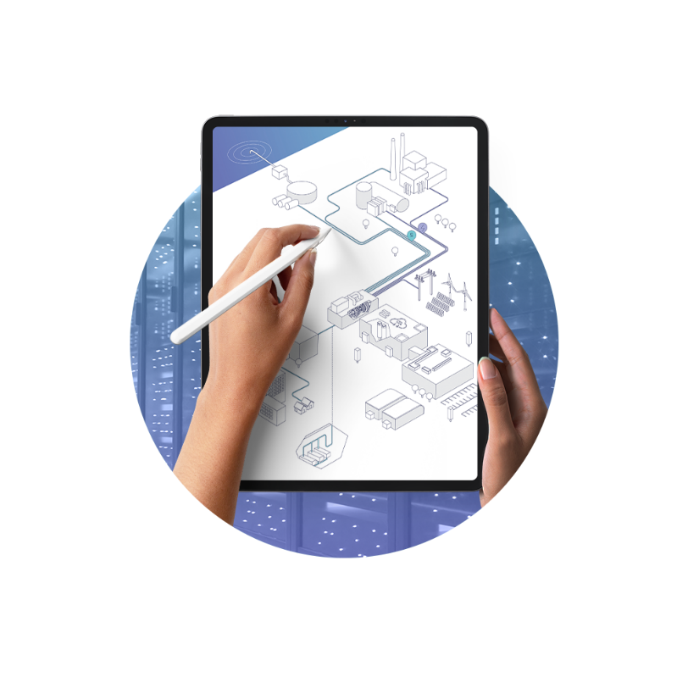

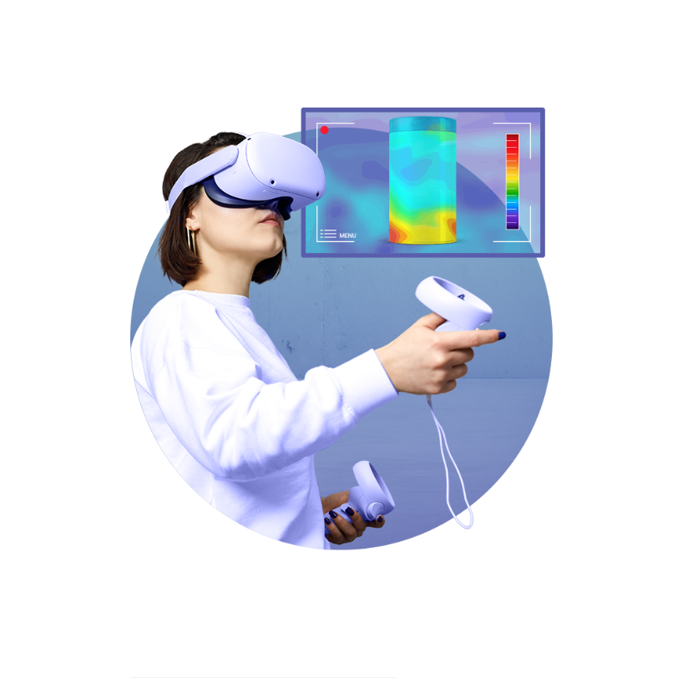
JRC portfolios to which the unit contributes
PF4
Nuclear safety: technology and skills
PF5
Small modular reactors and innovative reactor systems
PF14
Societal resilience, systemic disruptive events and risks: enhancing anticipation, preparedness and response
PF16
Nuclear safeguards

Slide 4
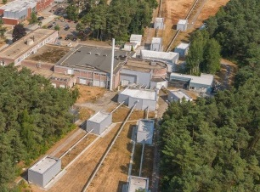
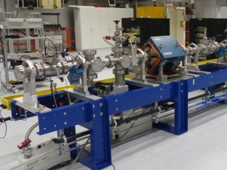
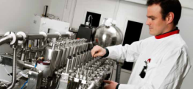
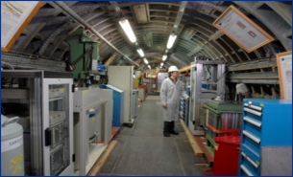
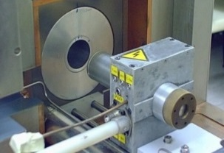
Unit Nuclear Data Measurements and Standards
GELINA
neutron time-of-flight facility for high-resolution
neutron measurements
MONNET
tandem accelerator based fast neutron source
TARGET
nuclear target preparation laboratories
METRO
nuclear reference material and measurement facility
HADES
low-level gamma-spectrometry laboratory
RADMET
laboratories for standardisation of radionuclide
activity

Slide 5

Sharing our laboratories and expertise
European Union Member States
Structured voluntary collaboration (OECD-NEA, IAEA)
European projects
Collaboration agreements
Open access
40 external users/year, 7 PhD + MSc students/year through open access
Workshops and training activities
IAEA
OECD-NEA
Int. partners

Slide 6
Summary
Strong leadership CIEMAT in European Nuclear Data projects (APRENDE, SANDA, CHANDA, ANDES, NUDATRA, slides Daniel Cano Ott, CIEMAT) and a strong involvement of JRC.
Strong direct collaboration between JRC and CIEMAT through
  JRC Open Access
  JRC Target preparation laboratory
  n_TOF project
  OECD-NEA Databank Joint Evaluated Fission and Fusion nuclear data library project (JEFF project).
  IAEA Coordinated Research Projects and the International Nuclear Data Evaluation Network (INDEN)
    IAEA GC Side Event Providing the best nuclear data for tomorrow’s nuclear solutions (26-9-2023); Opening talk by CIEMAT Director General, Y. Benito; moderated by JRC Dir.G U. Engelmann.
  Potential for further collaboration in radionuclide metrology and environmental radioactivity
Based on the exchange of expertise, staff, samples/targets, unique infrastructure and cutting-edge equipment – CA will facilitate further collaboration (exchange of staff, equipment, targets).
Based on a shared interest to offer best science for societal interests (innovation and safety of nuclear energy) and an independent source of expertise on nuclear data for applications.

Slide 7

Thank you and keep in touch
© European Atomic Energy Community, 2026
Unless otherwise noted the reuse of this presentation is authorised under
the CC BY 4.0 license. For any use or reproduction of elements that are not
owned by the EU, permission may need to be sought directly from
the respective right holders.
EU Science Hub
Joint-research-centre.ec.europa.eu
Notes:
Update/add/delete parts of the copy right notice where appropriate.
More information: https://myintracomm.ec.europa.eu/corp/intellectual-property/Documents/2019_Reuse-guidelines%28CC-BY%29.pdf

Slide 8
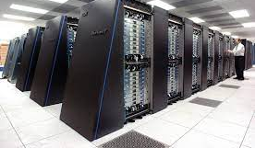
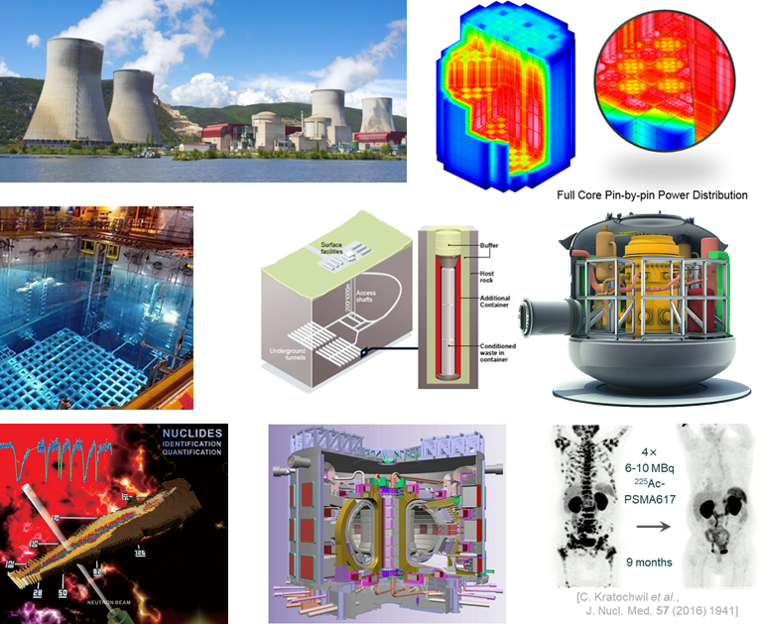

Role of nuclear data for tomorrow’s solutions
Modelling is needed at every step of nuclear development:
  Scoping, design, testing, operation, safety analyses, waste and spent fuel management
Allows savings and shortening of development, less testing
Good data are essential to good modelling
Require reliable measurements
Drive data-based development, machine learning, the AI revolution

Slide 9
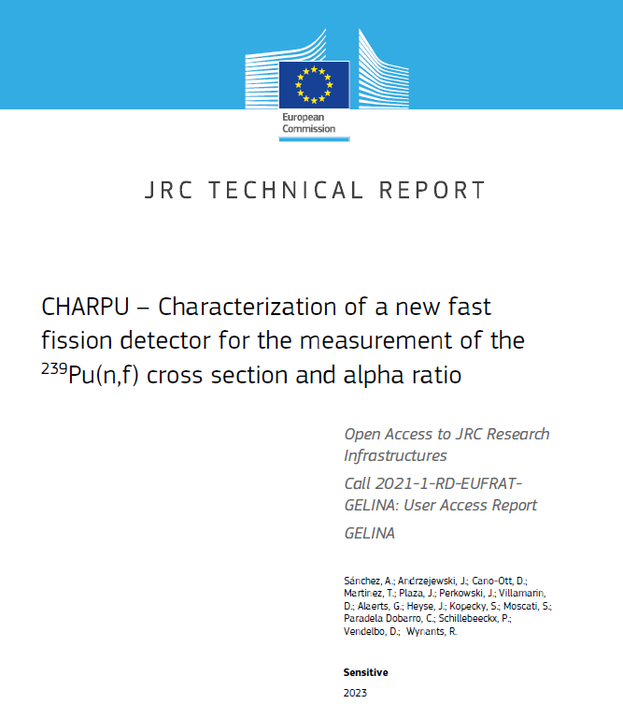
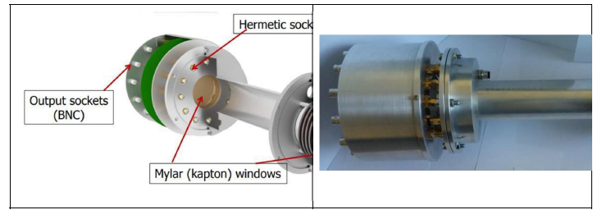
Open Access to JRC Research Infrastructures
  JRC-Geel hosts the accelerator-based neutron sources GELINA and MONNET for nuclear data production
  CHARPU proposal lead by CIEMAT :
    Test of detectors at GELINA prior to installation at n_TOF
    ²³⁹Pu targets manufactured at JRC actinide target preparation labs
    a new compact multi-plate fission chamber was tested for ²³⁹Pu(n,f) and (n,γ) measurements at n_TOF CERN
    Fission cross section measurement at GELINA planned for 2027
    Lead_GELINA proposal
  4-month visit of a CIEMAT PhD student for data analysis on ²⁰⁶Pb transmission experiments

