Slide 1

THOXAM
THermal stability and Oxidation of highly Active Materials
D. Serrano Purroy, A. Milena Pérez
Kick-off meeting JRC-CIEMAT, Madrid, 4th March 2016

Slide 2
THOXAM – THermal stability and Oxidation of highly Active Materials
2026 JRC/CIEMAT Call for Proposals
Duration: 4 years
Coordinators:
    D. Serrano Purroy (JRC) A. Milena Pérez (CIEMAT)
Core Scientific Team:
  Joint JRC-CIEMAT expertise in fuel degradation, Raman spectroscopy and high-temperature actinide behaviour
Main Objective:
  Establish a robust experimental framework to understand and predict thermal behaviour in corium and spent nuclear fuel

Slide 3
THOXAM – Background & Strategic Evolution
Long-standing JRC-CIEMAT cooperation in nuclear fuel cycle safety
Since 2021: Joint work on Raman characterisation of SNF and secondary phases supported by mobility exchanges
  2021 - DISCO (Horizon 2020 mobility program): Raman characterisation of SNF samples and identification of secondary phases
  2022-23 - CIATFRAS (ActUslab): High temperature oxidation studies of SNF and ATF
Scientific Gap Identified
  Limited understanding of oxidation behavior of highly active corium materials and MOX
  Insufficient data on long-term structural evolution under thermal stress

Slide 4
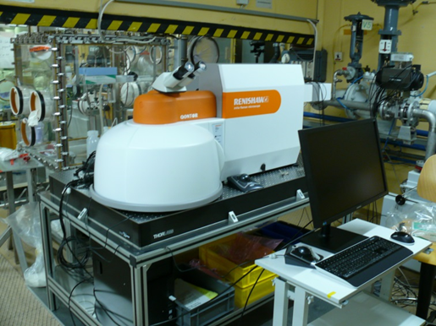
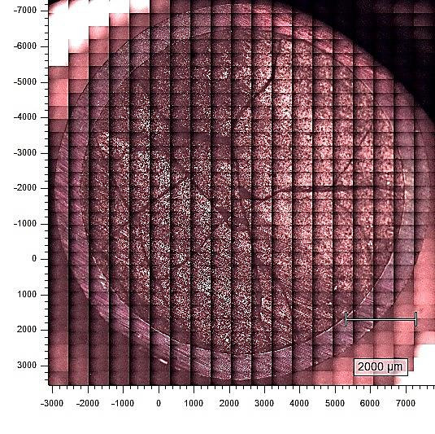
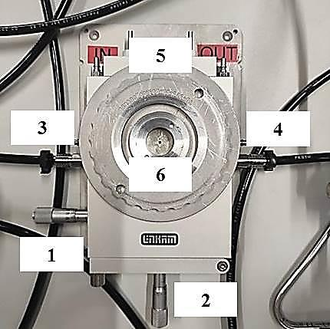
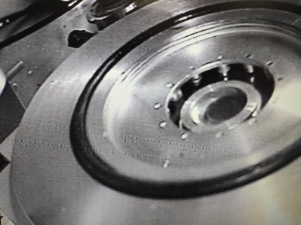
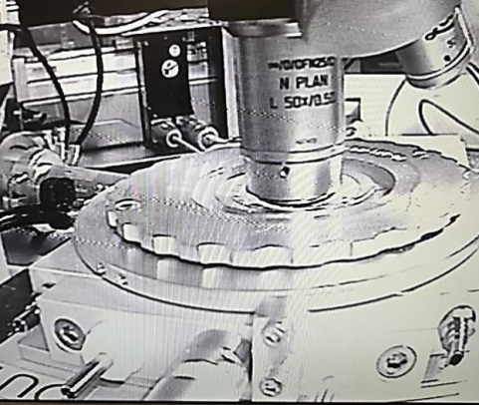
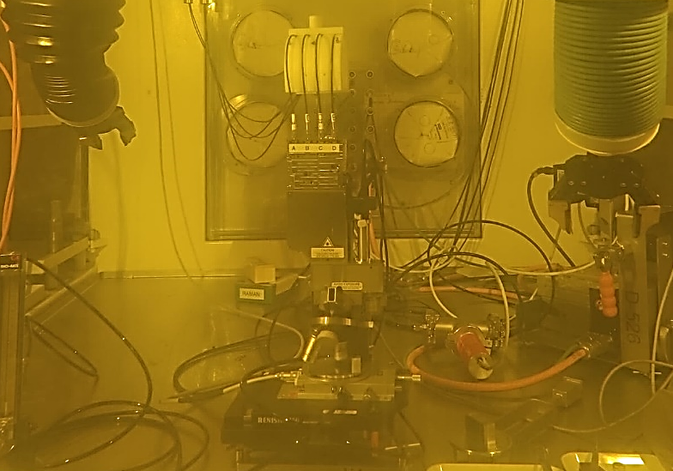
Scientific Foundations of THOXAM – Raman Characterisation of SNF
BU | 63 MWd/kgU
Temperature | 350 ºC
Heating rate | 50 ºC/min
Atmosphere | Air (80 mL/min)

Slide 5
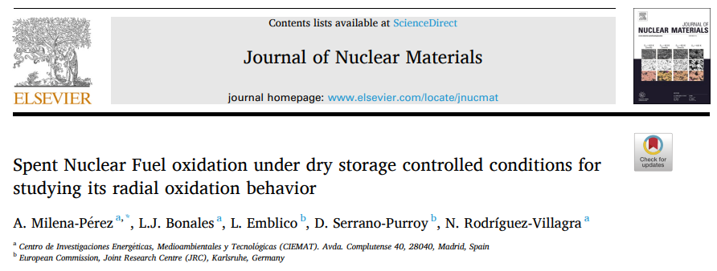
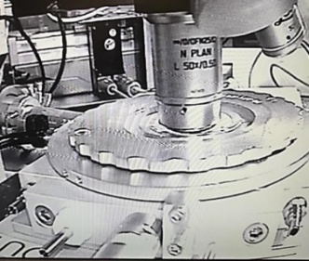
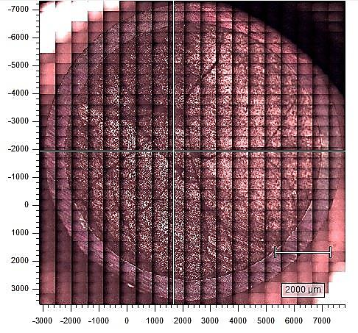
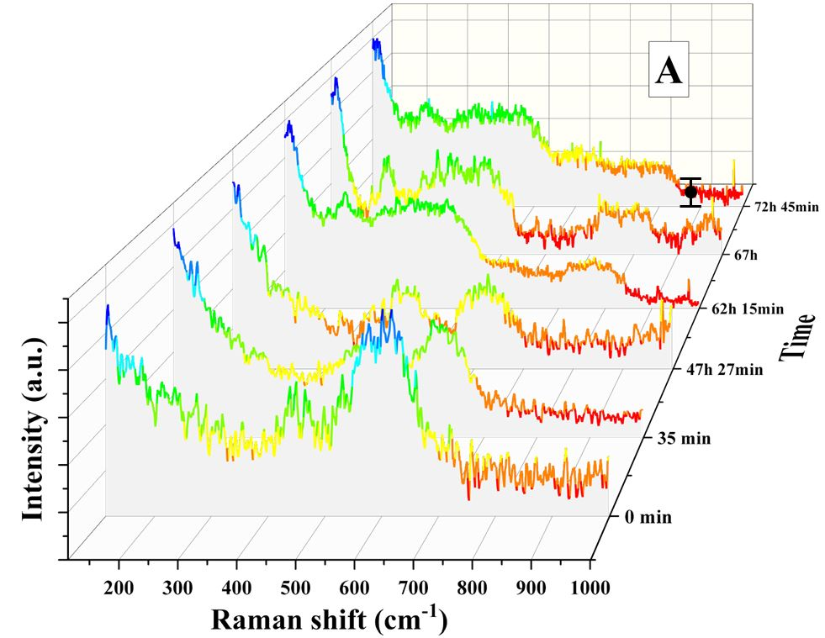

Scientific Foundations of THOXAM – High-Temperature Oxidation of SNF
Pellet centre
U₃O₈ detected after 62h
Homogeneous oxidation
T=350 ºC

Slide 6
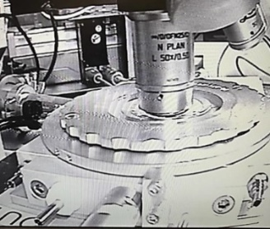
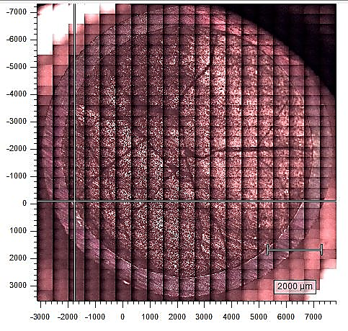
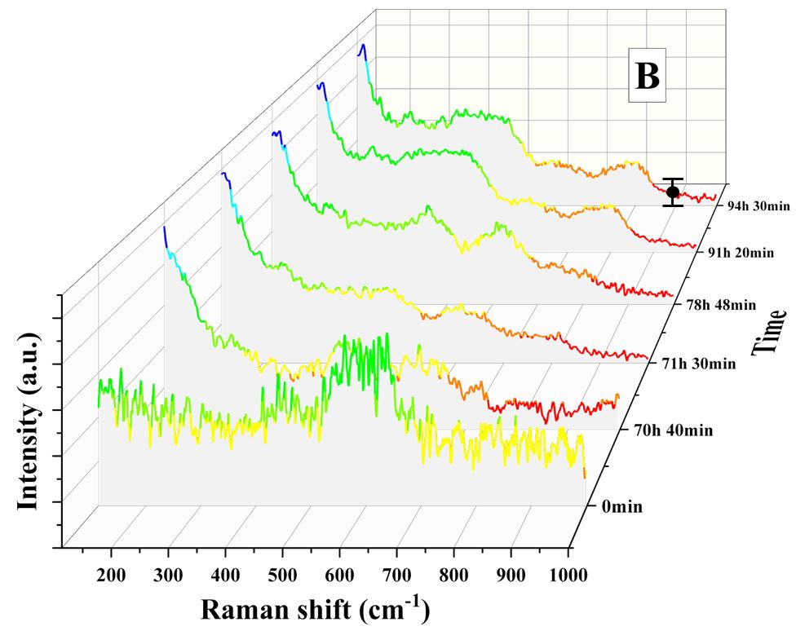

Scientific Foundations of THOXAM – High-Temperature Oxidation of HBS
Pellet rim
U₃O₈ detected after 92h
Heterogeneous oxidation
Oxidation delayed at the rim
T=350 ºC

Slide 7
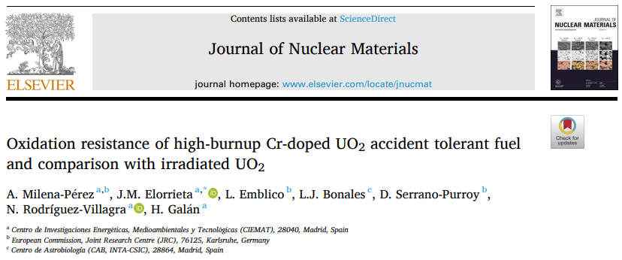
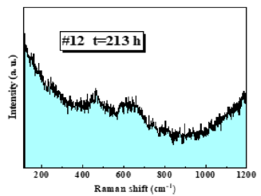
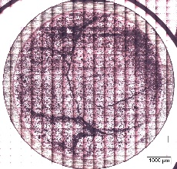
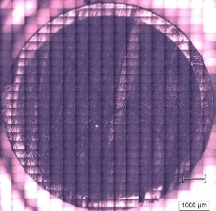
Scientific Foundations of THOXAM – ATF under Thermal Stress
 | Standard UO₂ | Cr-doped UO₂
Reactor type | PWR | PWR
BU | ~60 MWd/kgU | ~60 MWd/kgU
Grain size | - | ~60 µm
Cr content | - | ~0.2 wt.%
T=350 ºC
ATF sample tested at 400 ºC for extra 200 h and still finding U₄O₉ at both the centre and the rim
High-burnup Cr-doped UO₂ ATF
T=400 ºC
High-burnup standard UO₂
Greater oxidation resistance of the Cr-doped UO₂ fuel (compared to undoped)
Greater oxidation resistance at the pellet rim (compared to the centre)
→ Potential benefits of ATFs and high burnup

Slide 8

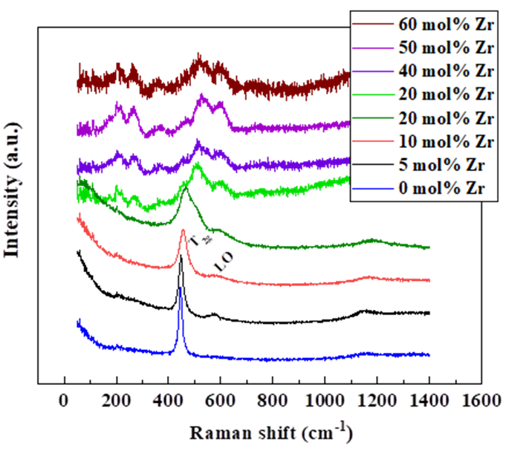
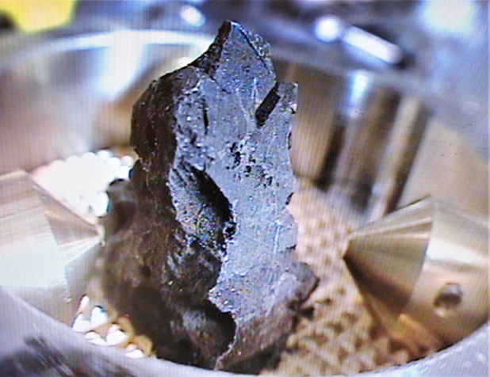
Scientific Foundations of THOXAM – Knowledge gaps and Open Questions
Study corium thermal stability and phase evolution following the same protocol by Linkam-Raman
Characterize crystalline phases of corium to analyse their role as potential reservoirs of radionuclides present in SNF, avoiding its release
Comparison with (U,Zr)O₂ reference samples, already fabricated and characterized at JRC (G.5)
TMI-2 Sample
2023-1-RD-ActUsLab-FMR, carried out by J.M. Elorrieta

Slide 9
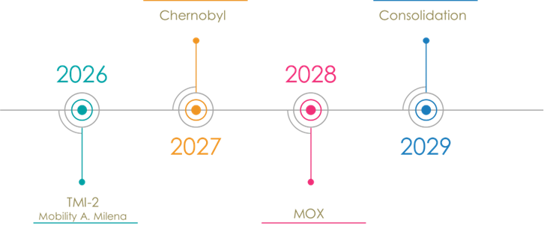
THOXAM - Objectives
Scientific Objectives
  Characterize oxidation-driven phase transformations in corium (TMI-2, Chernobyl)
  Quantify thermal stability and structural degradation mechanisms
  Extend methodology to SNF and MOX systems
  Generate experimental data supporting safety case development

Slide 10
THOXAM - Milestones & Expected Deliverables
Milestones
Key Deliverables
Strategic Impact
Strengthens institutional integration and advances European radioactive waste management research
M1 – Harmonised protocol (M2)
M2 – Corium dataset (M24)
M3 – Comparative assessment (M36)
M4 – Consolidated framework (M48)
Joint JRC–CIEMAT oxidation database
High-impact peer-reviewed publications
Technical reports supporting disposal safety
Contribution to European safety assessment performance studies

Slide 11


Thank you
HLW^{U}
Notes:
Update/add/delete parts of the copy right notice where appropriate.
More information: https://myintracomm.ec.europa.eu/corp/intellectual-property/Documents/2019_Reuse-guidelines%28CC-BY%29.pdf

