Slide 1

ARANA
Application of Raman spectrometers for radionuclide ANalysis in Advanced nuclear reprocessing
D. Serrano Purroy, I. Sánchez García
Kick-off meeting JRC-CIEMAT, Madrid, 4th March 2016

Slide 2
ARANA – Application of Raman spectrometers for radionuclide ANalysis in Advanced nuclear reprocessing
2026 JRC/CIEMAT Call for Proposals
Duration: 4 years
Coordinators:
    D. Serrano Purroy (JRC) I. Sánchez García (CIEMAT)
Core Scientific Team:
  Joint JRC-CIEMATexpertise in Raman spectroscopy, radiolysis and solvent degradation and advanced aqueous reprocessing chemistry
Main Objective:
  Establish and validate a Raman-based methodology for monitoring extraction performance and solvent stability under irradiation, contributing to safer and more efficient advanced European fuel cycle strategies

Slide 3
ARANA – Background & Strategic Evolution
European context
Technical Challenge
Analytical Gap
PUREX reprocessing
Radiolytic solvent degradation
No real-time monitoring in active systems
Minor Actinide Sepration strategies in Europe (AmSel/ GANEX)
Loss of separation efficiency
Limited Raman use in hot-cell environment
Formation of secondary degradation products
Lack of molecular level irradiation tracking
Selective ligands (TODGA, BTBP...)

Slide 4
ARANA – Background & Strategic Evolution
Advanced
nuclear
fuel cycles
Key Challenges
Scientific Gap
PUREX-based reprocessing
Development of minor actinide separation strategies
Selective organic ligands (e.g. TODGA, mTDDGA, BTBP derivatives)
Radiolytic degradation of solvents
Loss of separation efficiency
Formation of secondary products affecting extraction performance
Lack of real-time, non-destructive monitoring in active systems
Limited application of fluorescence analysis by Raman equipment for quantifying lanthanides in hot-cell environments
Insufficient molecular-level monitoring of solvent degradation during extraction

Slide 5
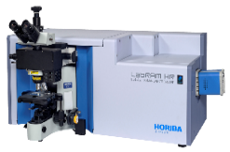
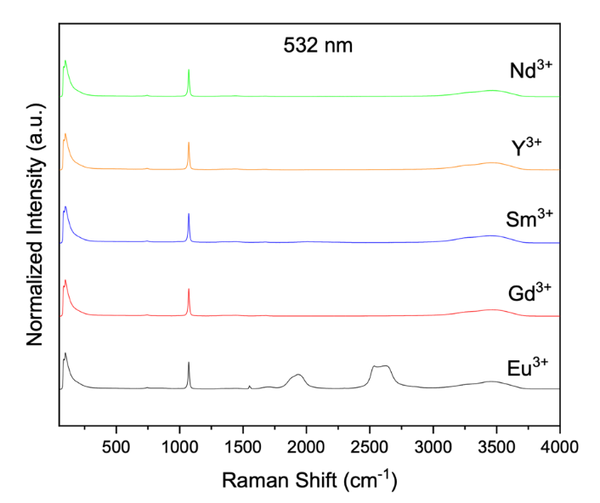
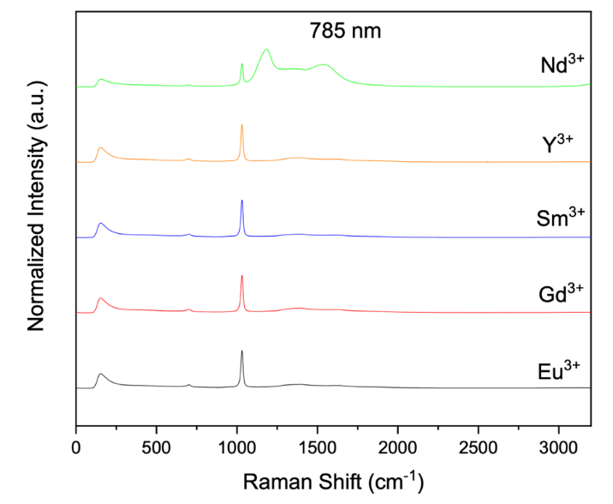
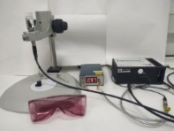
Analysis of radionuclides by using Raman spectrometers at CIEMAT
ARANA – Background
Qualitative analysis of fluorescence of different lanthanides using Raman spectrometers
LabRam HR Evolution 532nm
BWtec 785 nm
Nd Fluorescence observed using 785 nm laser
Eu Fluorescence observed using 532 nm laser
With Raman spectrometers it is posible to monitor Nd and Eu analyzing its fluorescence signals

Slide 6
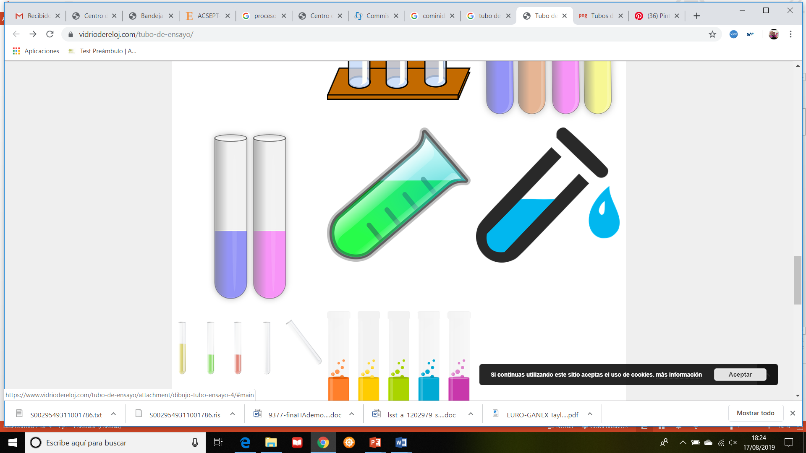
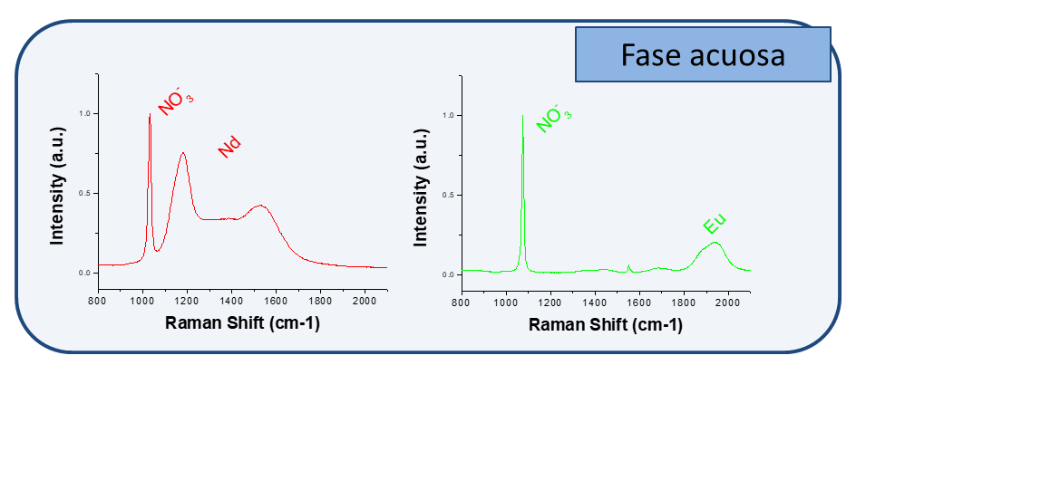
Analysis of radionuclides by using Raman spectrometers at CIEMAT
ARANA – Background
Monitoring of hydrometallurgical extraction
785 nm
532 nm
Org. Phase
After extraction
Fluorescence bands in the org. phase
OK,
TODGA 0.2M
OK,
TODGA 0.2M
Eu and Nd
HNO₃ 3M
6 mM Eu and Nd
HNO₃ 3M
Aq. phase
Before extraction
Fluorescence bands in the aq. phase
Methodology able to detect the Nd and Eu fluorescence in both phases and quantify them

Slide 7
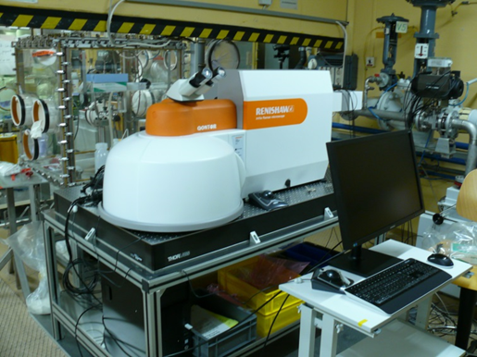
Analysis of radionuclides by using Raman spectrometers at JRC-Karslruhe
ARANA – Background
Test of the methodology developed at CIEMAT in JRC-Karlsruhe using Raman spectrometer in the Hot Cell during a three-day visit in January 2025.
785 nm
532 nm
OK,
TODGA 0.2M
Eu and Nd
JRC Raman in HC
Methodology valid using Raman spectrometer in HC in JRC!
CIEMAT instruments
LabRam HR Evolution 532nm
BWtec 785 nm

Slide 8

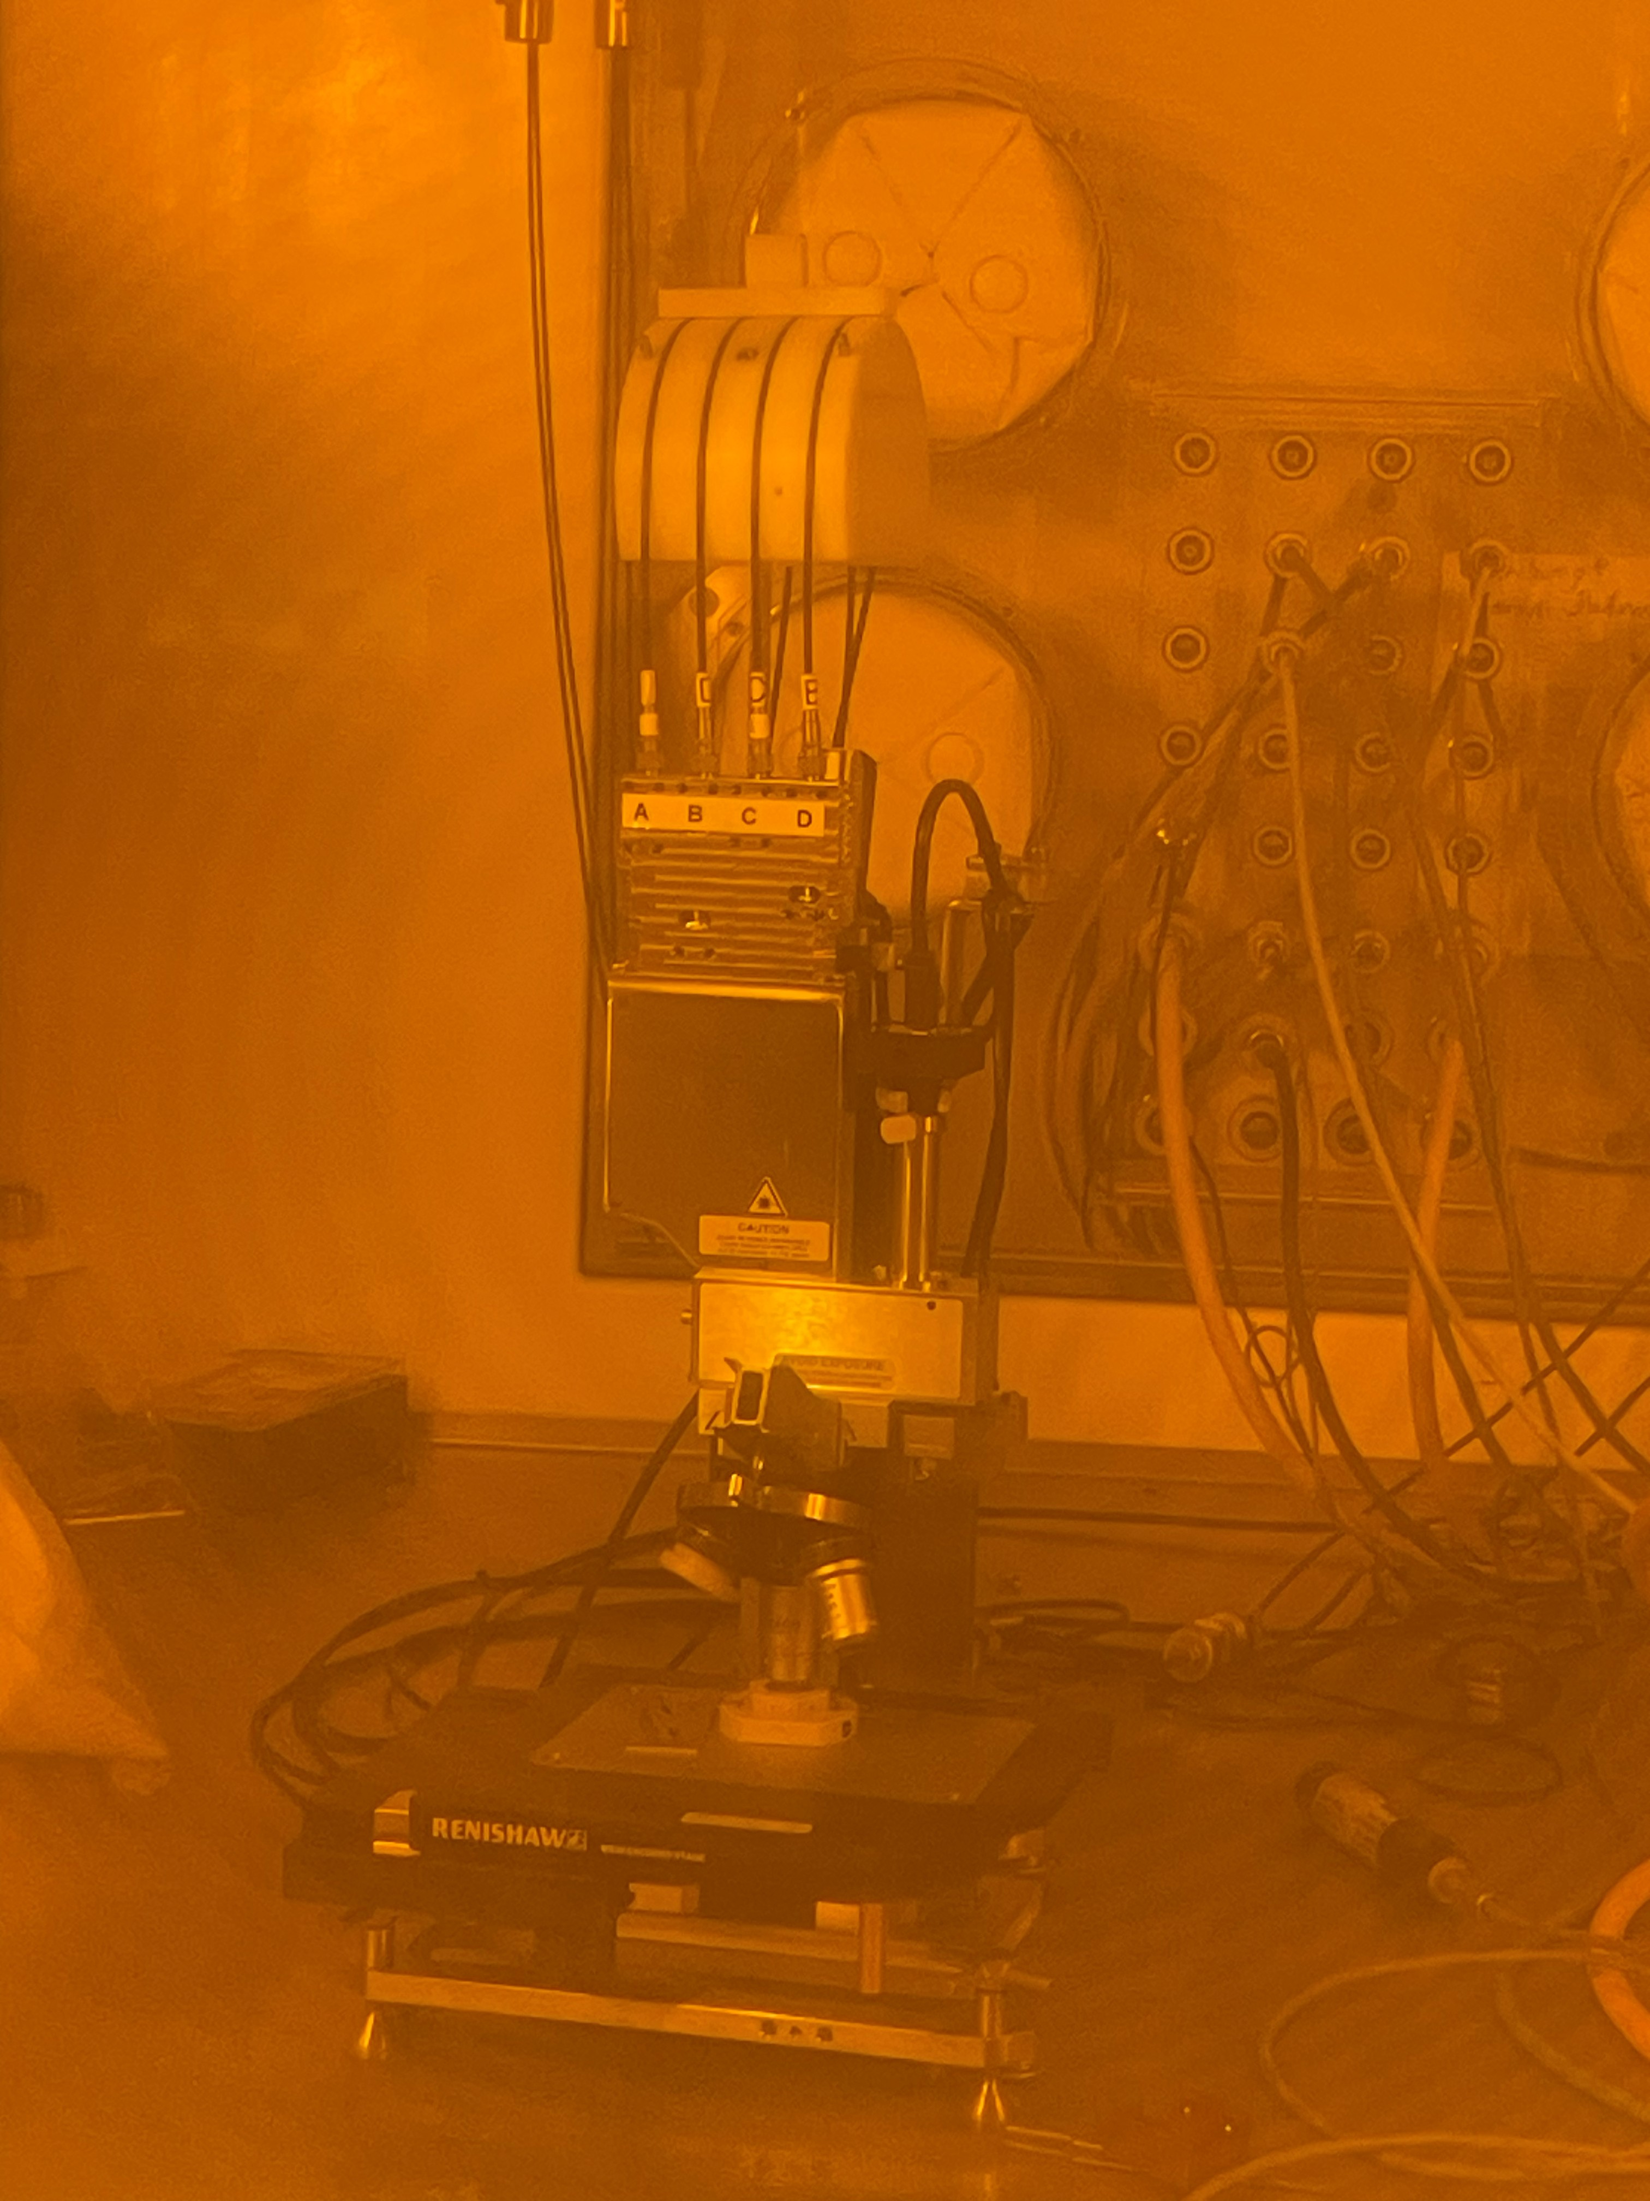
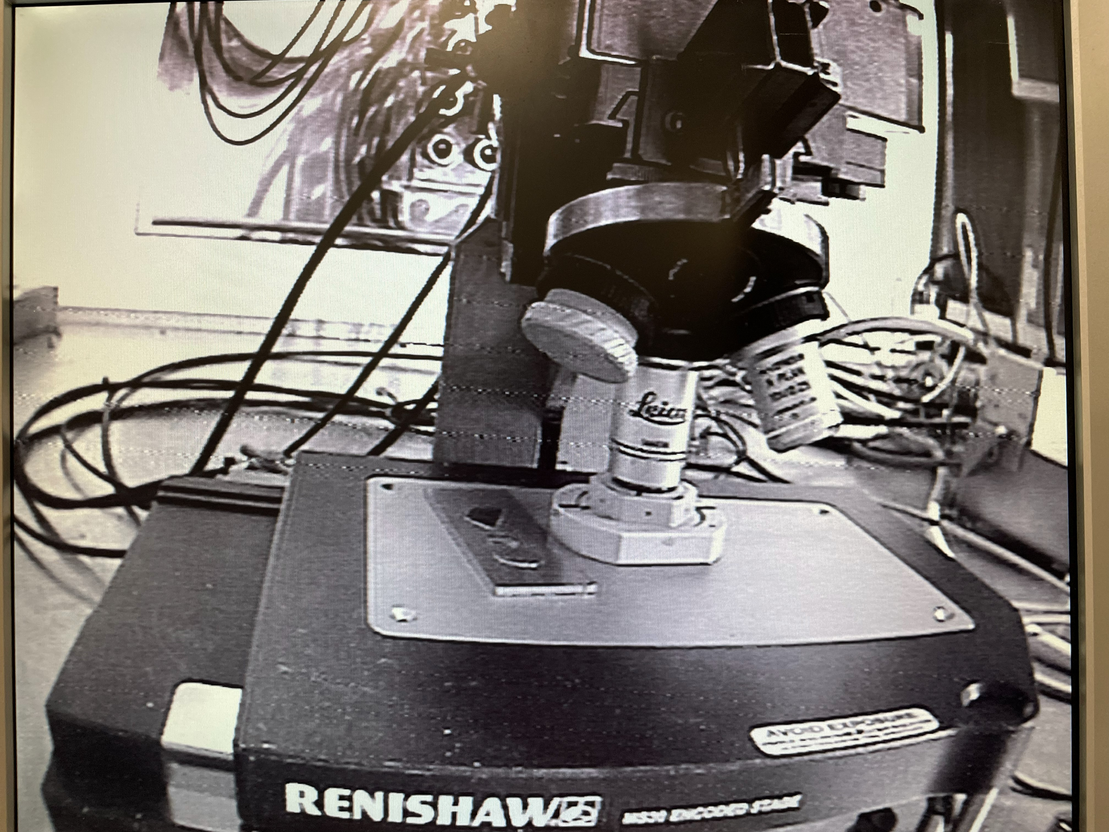
Analysis of radionuclides by using Raman spectrometers at JRC-Karslruhe
ARANA – Background
Test of the raffinate solutions in JRC-Karlsruhe to select the appropriate solutions
Solutions | PUREX raffinate |  |  | DIAMEX raffinate
 | Dose rate (mSv/h) | Nd | Eu | Dose rate (mSv/h) | Nd | Eu
2nd dilution | 0.29 | X | X | 0.30 | X | X
1st dilution | 1.17 | X | X | 0.31 | X | X
Without dilution | 1000 |  | X | * |  | X
* As DIAMEX raffinate does not contain FPs, the dose rate will be lower than PUREX raffinate.
Only it is posible to analyze Nd in raffinate solutions without dilution

Slide 9
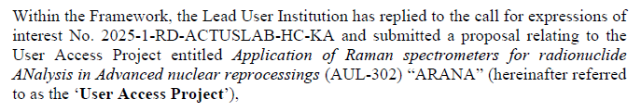
2025-1-RD-ActUsLab-HC-KA (ARANA)
ARANA – ActUsLab
Research stay at JRC-Karlsruhe of Iván Sánchez: January 2025 (3 days) and in 2026 (2 weeks)
Expected dates: 9th-20th November 2026
Project: 2025-1-RD-ActUsLab-HC-KA, User Access Project AUL-302 “ARANA”.
Funding: CIEMAT
Project: Application of Raman spectrometers for radionuclide Analysis in Advanced nuclear reprocessings
Goal: Analysis of Nd in active raffinate solutions from PUREX and DIAMEX process using Raman spectrometers
  Evaluation of the extraccion process using this novel methodology using real solutions of SNF
  Assessment of the stability of the ligands used for the extraction experiment performing analysis as a function of time.
TODGA
Raffinate solutions

Slide 10
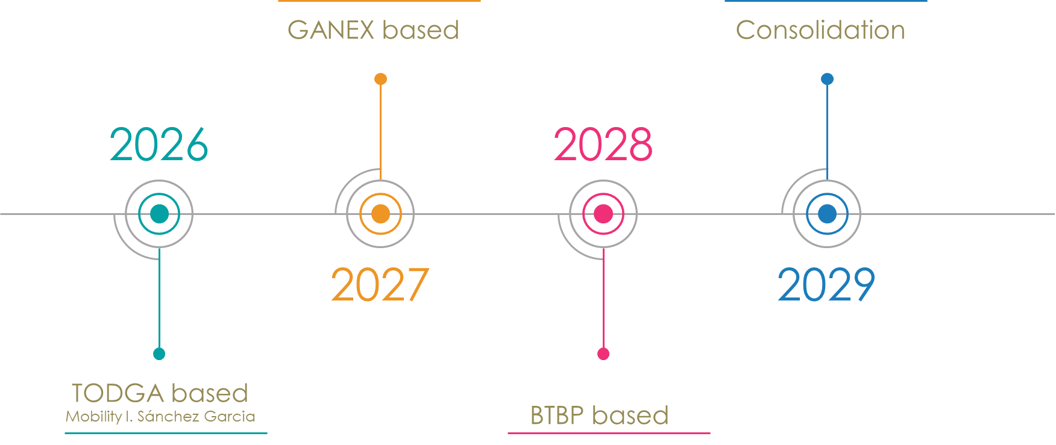
ARANA - Objectives
  Validate Raman spectroscopy for quantitative Nd monitoring
  Evaluate extraction efficiency using selective ligands (TODGA, BTBP, mTDDGA...)
  Perform extraction experiments using real spent fuel solutions
  Assess solvent degradation under irradiation using time-dependent Raman monitoring
  Demonstrate feasibility of near-online monitoring in reprocessing streams

Slide 11
ARANA - Milestones & Expected Deliverables
Milestones
Key Deliverables
Strategic Impact
Contributes to safe and sustainable European closed cycle strategies
M1 – Selection of optimal raffinate solutions (M2)
M2 – Establishment of Raman protocol (M6)
M3 – Extraction tests (M12, 24, 36, 48)
M4 – Time-dependent degradation study (M48)
Identification of ligand degradation effect on performance
High-impact peer-reviewed publications
Technical basis for future online monitoring implementation

Slide 12


Thank you
HLW^{U}
Notes:
Update/add/delete parts of the copy right notice where appropriate.
More information: https://myintracomm.ec.europa.eu/corp/intellectual-property/Documents/2019_Reuse-guidelines%28CC-BY%29.pdf

