Slide 1
Collaboration on the development and application of the TRANSURANUS code
Pau Aragón, Unit G.5 - Nuclear Science and Innovation for Energy and Health (JRC-Karlsruhe)
Bilateral meeting between the JRC and CIEMAT
Madrid, 4th March 2026

Slide 2
The TRANSURANUS code
Fuel performance code developed at JRC-Karlsruhe for the thermal and mechanical analysis of a cylindrical fuel rod

Slide 3

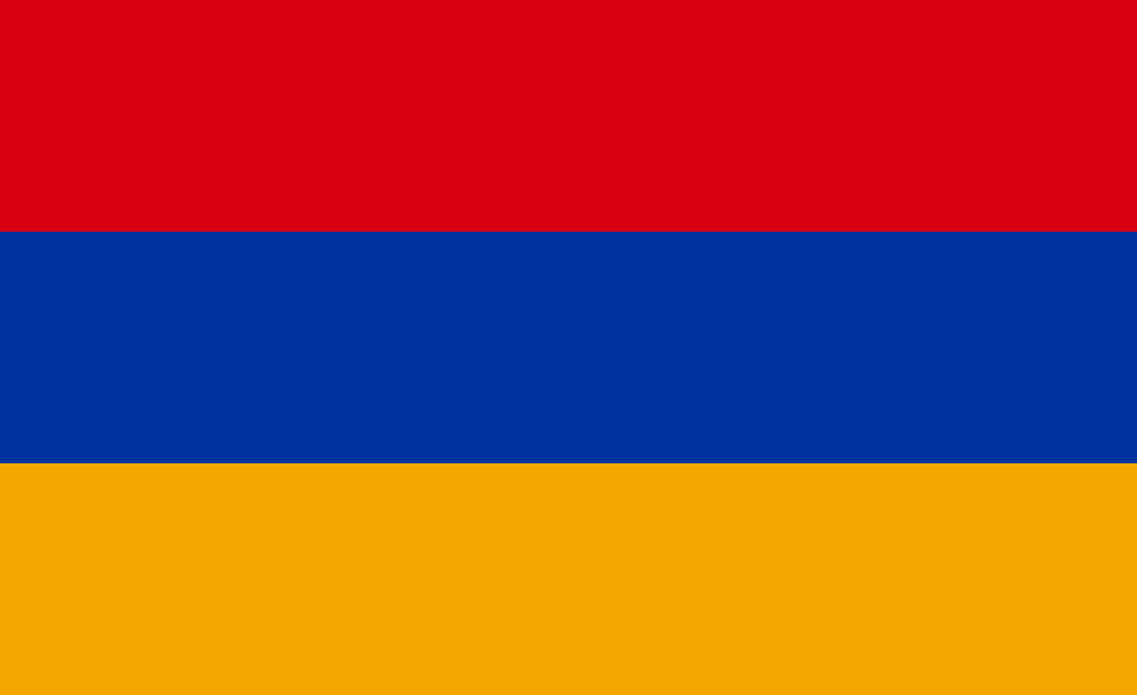




Active users network
Network of +50 organizations worldwide
  In 16 EU Member States (MS)
  + AM – UA – CH – TR – UK – US
Safety authorities
Spent fuel operators
Plant operators
CIEMAT holds a TRANSURANUS R&D license since 2022, valid until November 2026
R&D
Reactor and fuel designers (SMR/AMR)

Slide 4
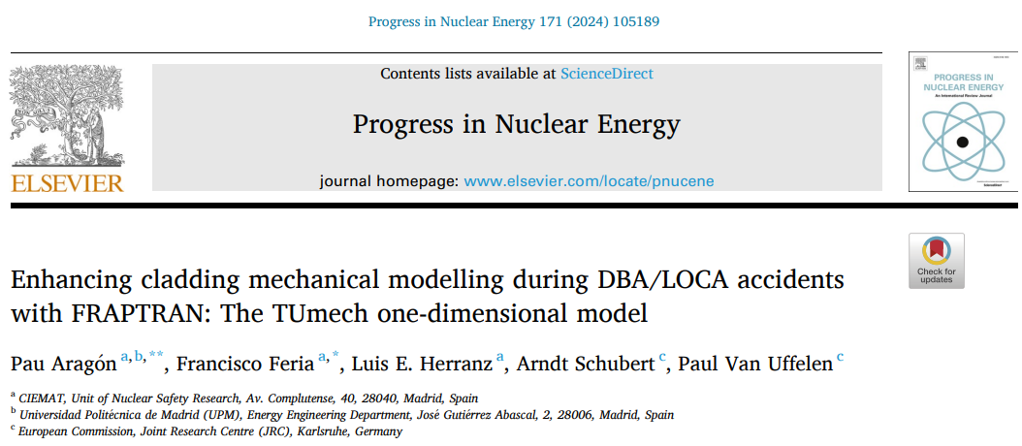
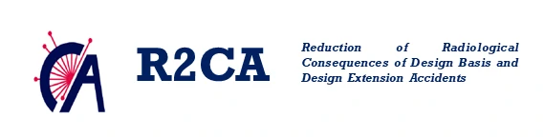
Collaboration in the frame of EU-funded projects
JRC-Karlsruhe hosted a CIEMAT PhD student for 3 months (Feb-Apr 2023) to carry out several tasks within the framework of the R2CA project:
  Improvement of the cladding mechanical model in FRAPTRAN under LOCA conditions, based on the corresponding model in TRANSURANUS (TUmech)
  Coupling of the HYDCLAD model (detailed model for hydrogen diffusion, precipitation, and radial reorientation of hydrides in the cladding) with TRANSURANUS

Slide 5
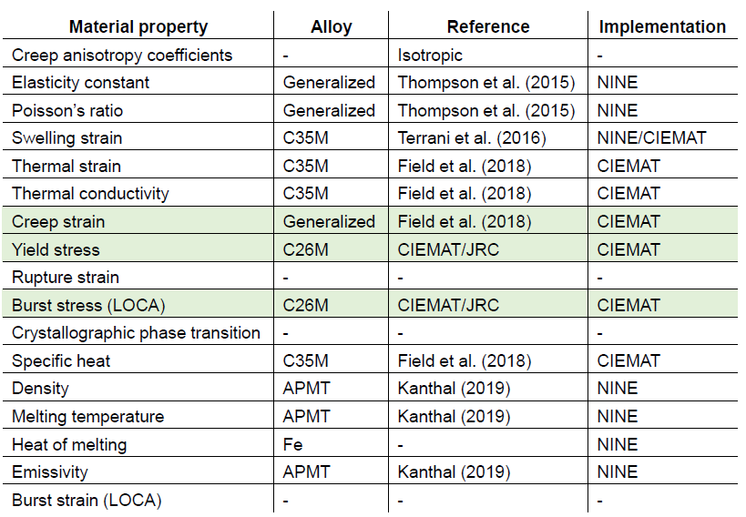
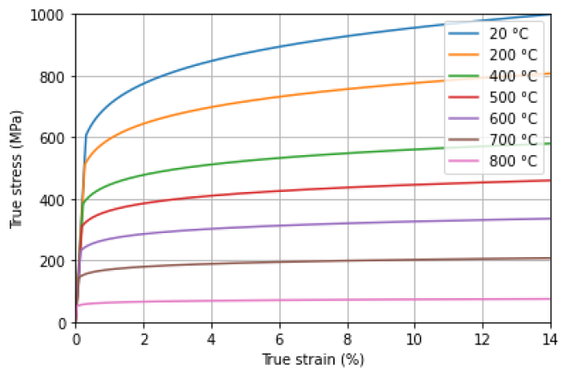
Collaboration in the frame of EU-funded projects
The 3-month stay also enabled the development and implementation of several material property models and correlations for advanced cladding concepts in TRANSURANUS, with a focus on FeCrAl cladding
Plasticity model for FeCrAl cladding

Slide 6
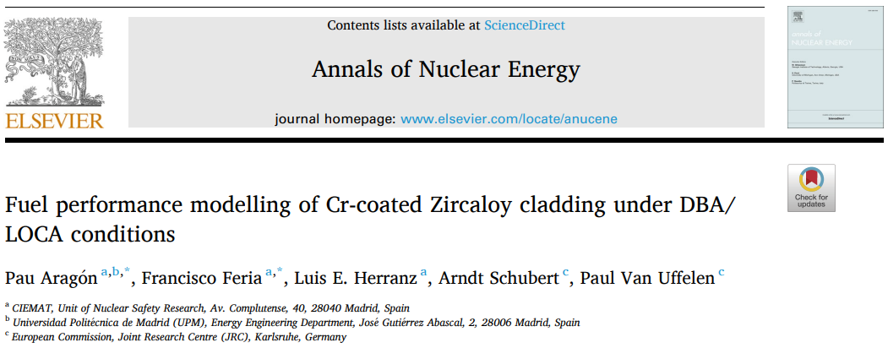

Collaboration in the frame of EU-funded projects
Joint developments continued within the framework of the OperaHPC project, during which TRANSURANUS was extended to simulate coated claddings (e.g., Cr-coated Zircaloy)
This extension provides TRANSURANUS users in both academia and industry with enhanced capabilities to perform safety evaluation of this near-term advanced cladding

Slide 7


Collaboration in the frame of NEA activities
CIEMAT actively participates in the Task Force IFPE (International Fuel Performance Experiments database) of the OECD/NEA, led by JRC.
Within this framework, CIEMAT contributes to the preparation and evaluation of Halden Reactor Project datasets for inclusion in the IFPE database
These activities directly support the integral assessment of the TRANSURANUS code

Slide 8
Co-supervision of master’s thesis
Starting in April 2026, staff from CIEMAT and JRC will jointly supervise a master’s thesis by a student of the Máster Interuniversitario en Física Nuclear (Spain).
The work will focus on “Advanced code assessment for the thermo-mechanical modelling of nuclear fuel under loss-of-coolant accident conditions” and will involve the use of TRANSURANUS

