Slide 1

Especific actions
Nuclear Structural material
Marta Serrano (CIEMAT)
Concetta Fazio (JRC)

Slide 2


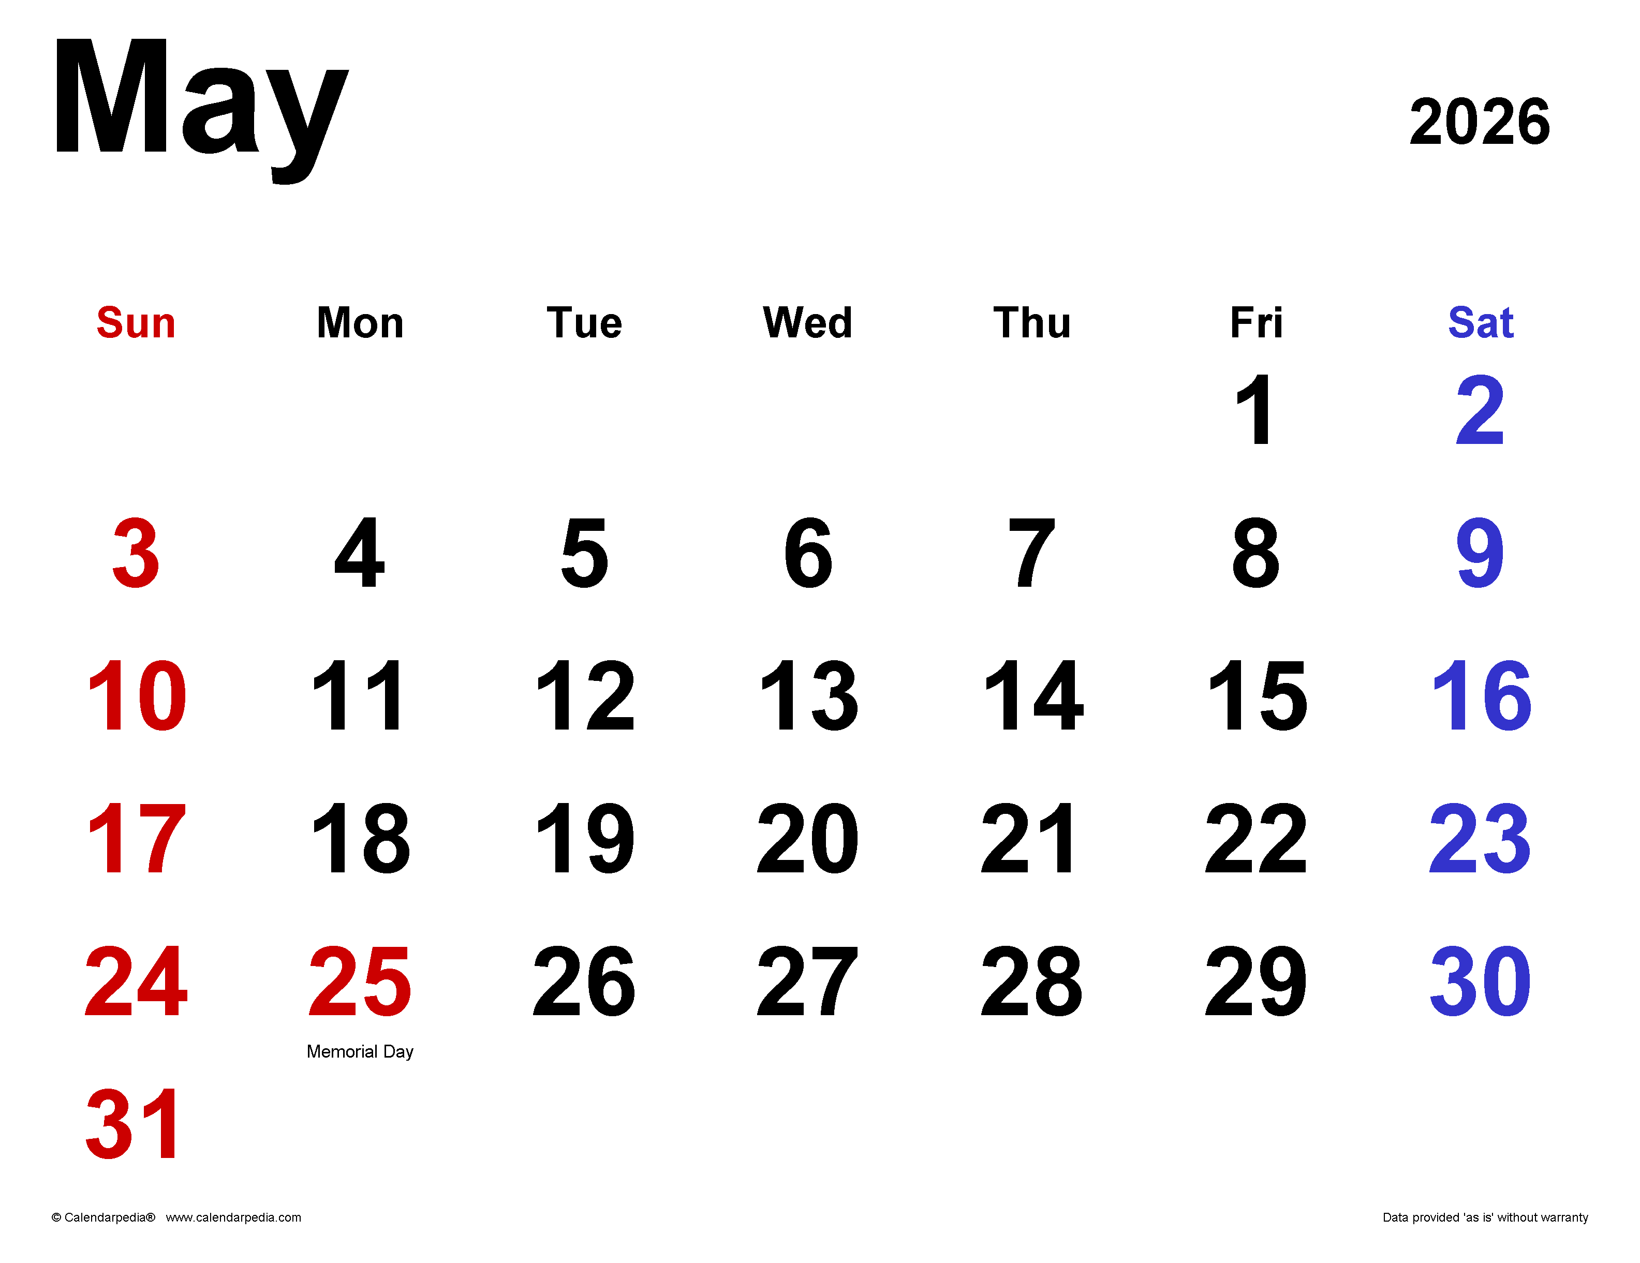

Areas of collaboration
Complementary facilities at CIEMAT-JRC Petten
Environmental degradation
EMMA RI
AMALIA Supercritical water loops
MXE LWR loops; liquid metals and molten salt autoclaves
Next meeting at Petten 12 May 2026
Advance characterization
The Micro-Characterization Laboratory (MCL)
MXE HRTEM JEOL 200 V- EDX
Radioactive facility
Plasma Focussed Ion Beam (Pfib)
Small specimen tests techniques
EMMA RI
SMPA Small punch and small punch creep
MXE Small punch and small punch creep (planned liquid metal embrittlement)

