Slide 1
JRC Research in the field of Sustainable, Smart and Safe Mobility
Kick-off Meeting JRC-CIEMAT Agreement
Madrid, 04/03/2026
Biagio Ciuffo
Deputy Head of Unit
Sustainable, Smart and Safe Mobility

Slide 2
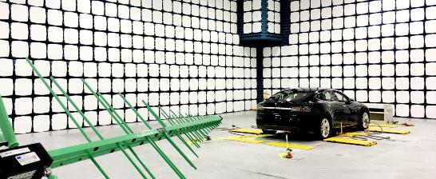
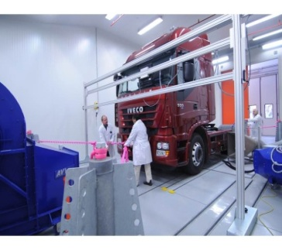

Some numbers first (JRC.C.4)
80 internal staff members (50% permanent and 50% temporary)
20 external service providers (on- and off-site)
10 M€ annual budget
Several major research infrastructure and information systems

Slide 3

Mission
Provide comprehensive expertise in the transport sector, for both passengers and freight and for different modes.
Anticipate solutions and support the development of policies for decarbonizing transport and moving towards smarter, safer, cleaner, fairer and energy-efficient mobility systems.
Produce and harvest knowledge and data to assess effectiveness and societal impacts of policies and technologies applied to transport.

Slide 4





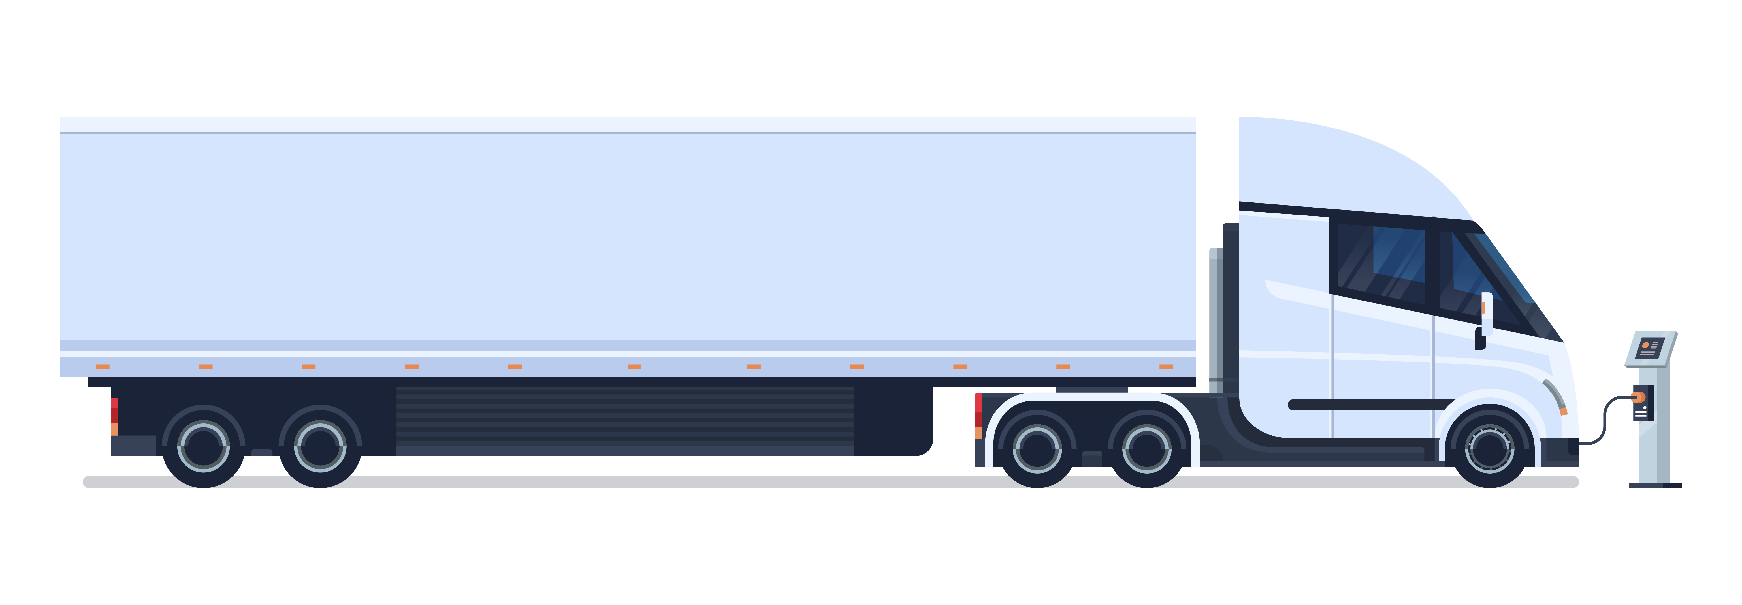
Main activities in a nutshell
Vehicle Standards and Market Surveillance
Standards for vehicle type approval (environmental and safety performance)
Automated and Connected Vehicles
Market surveillance (Regulation 2018/858)
Decarbonization of transport
CO2 standards for LDV and HDV - Life Cycle Analysis
Heavy duty vehicle certification (VECTO)
Non-road modes (maritime and aviation) and socio-economic aspects
Research, Innovation and EU Competitiveness in Transport
Monitoring of EU funded research programs (TRIMIS)
Observatory of the CCAM Industrial Ecosystem

Slide 5















Stakeholders
All relevant Policy DGs (GROW, CLIMA, MOVE, RTD, CNECT, ENER, INTPA)
National Authorities, Standardization bodies and technical committees
at EU and International level (e.g. UNECE, ISO, CEN/CENELC, etc.)
Research and Academia (PhD Programs, Horizon Europe, OpenData)
Citizens (via surveys and focus groups)

Slide 6
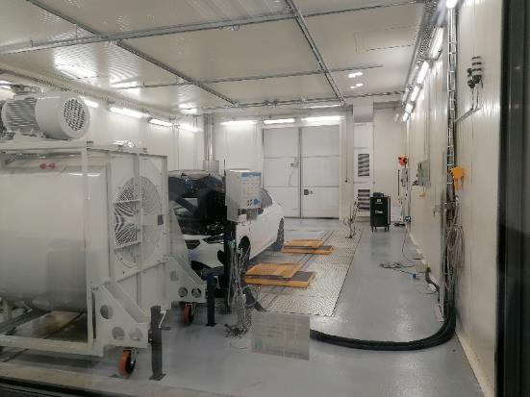
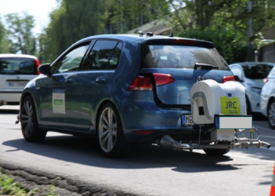
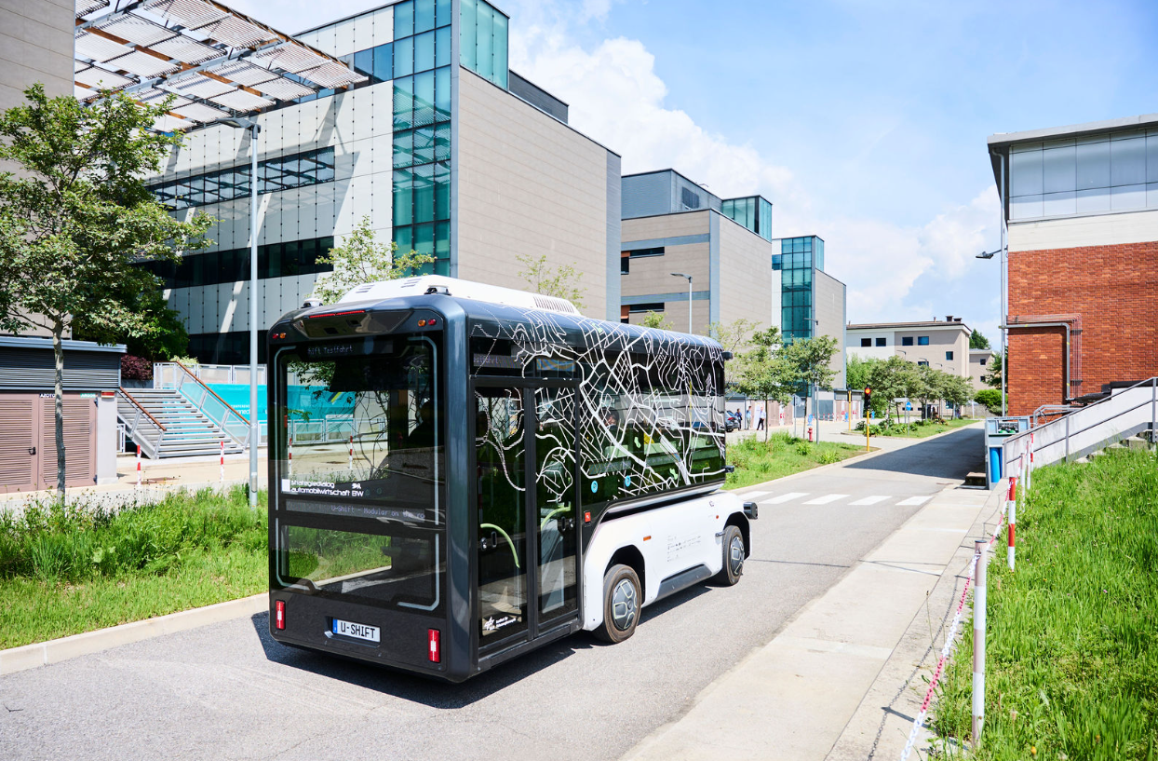
Vehicle Testing Facilities
Vehicle Emissions & Market Surveillance Laboratories
Test cell 1 (-10 /+50 C altitude simulation)​
Advanced Vehicles Testing Facilities and Urban Proving Ground
Notes:
Add 2 lines to notes on each facility

Slide 7
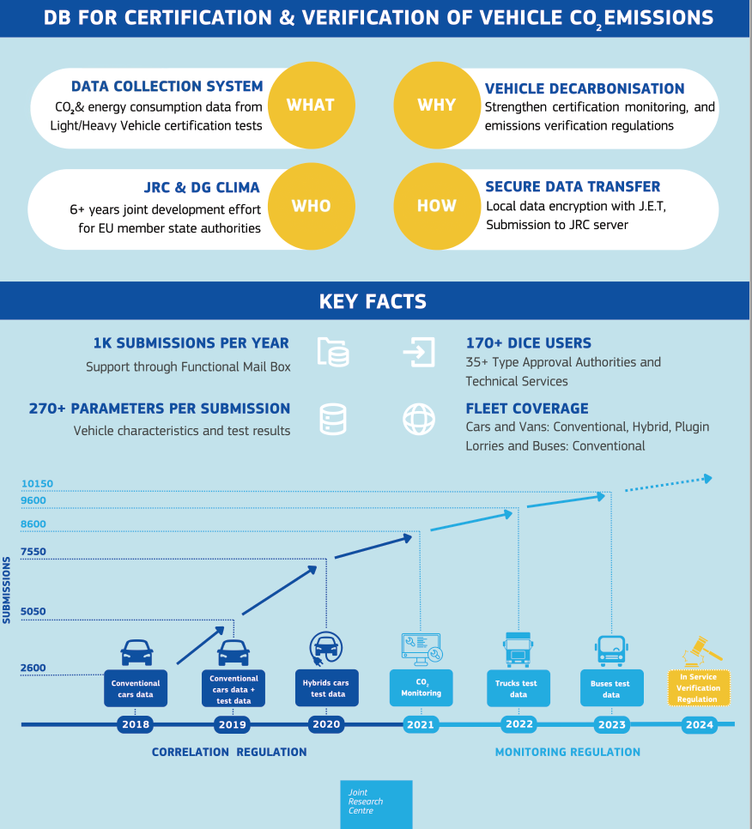
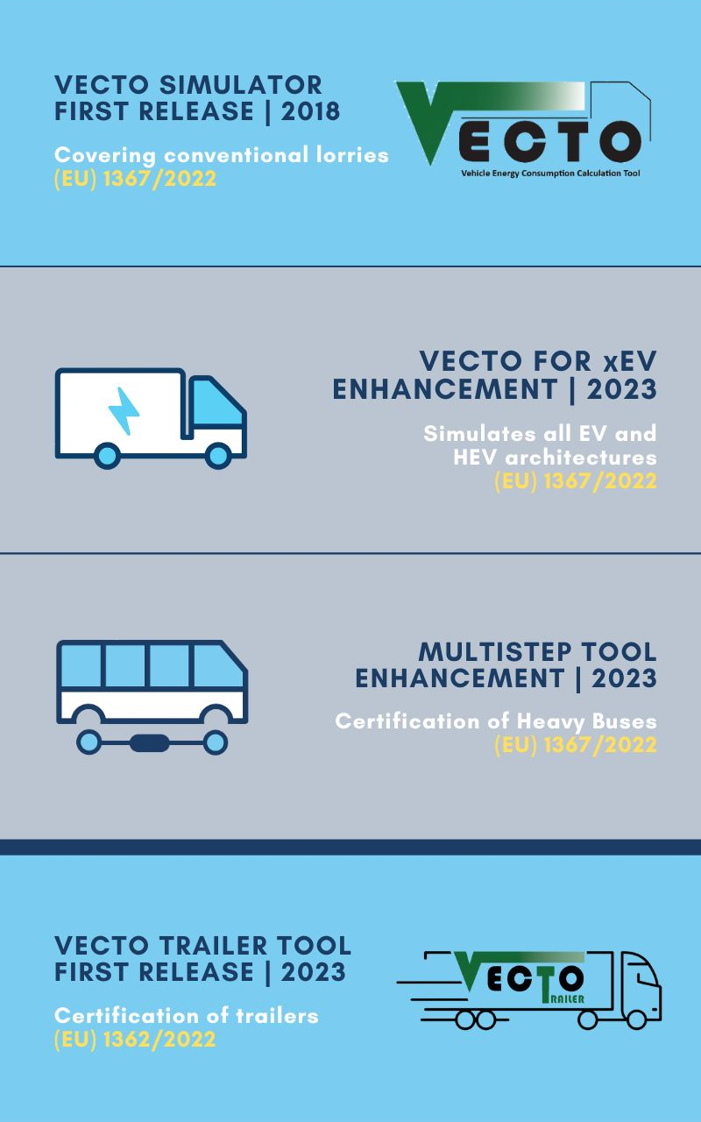
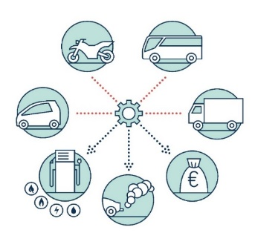
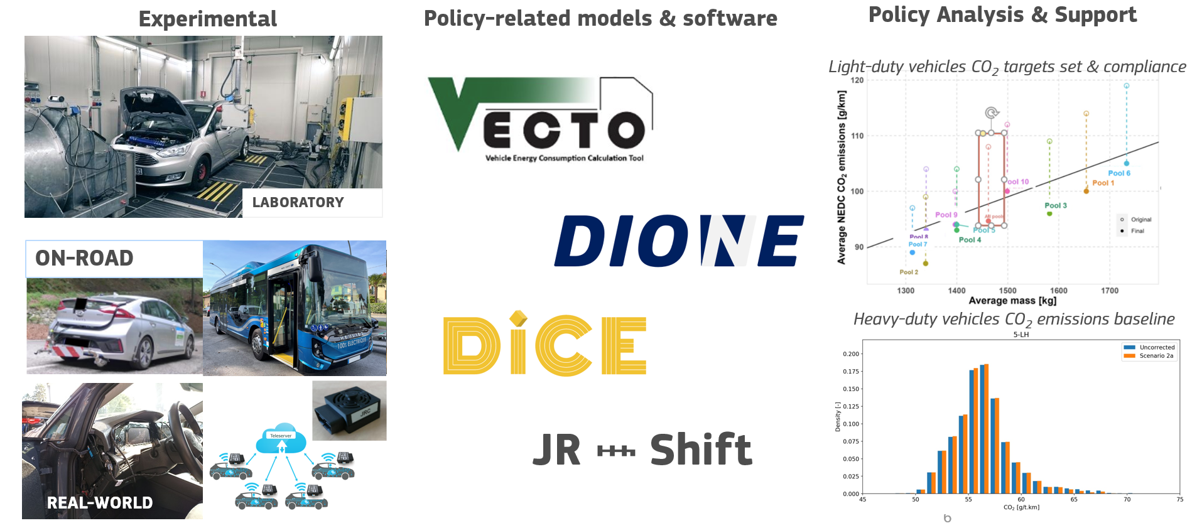

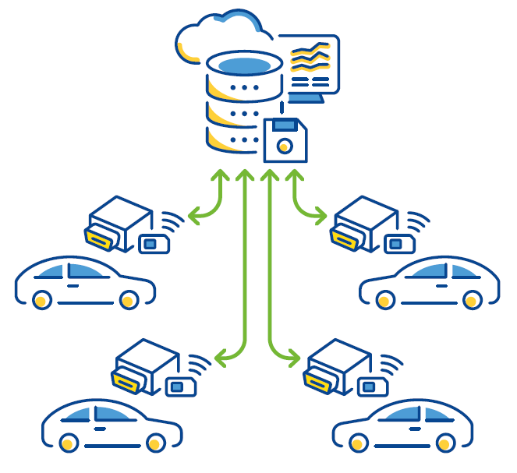
Information systems & digital assets
Policy assessment & support
Official EU tools for Emissions Certification, Verification & Monitoring
DICE
electrolyte
Transport Data Lab
Media files source: edisonenergy.com; generation180.org; statkraft.com; Ajusa, hydrogen technologies; oneclick LCA

Slide 8
A glimpse into the different activities
JRC Research in the field of Sustainable, Smart and Safe Mobility

Slide 9
Vehicles Market Surveillance
Projects overview

Slide 10
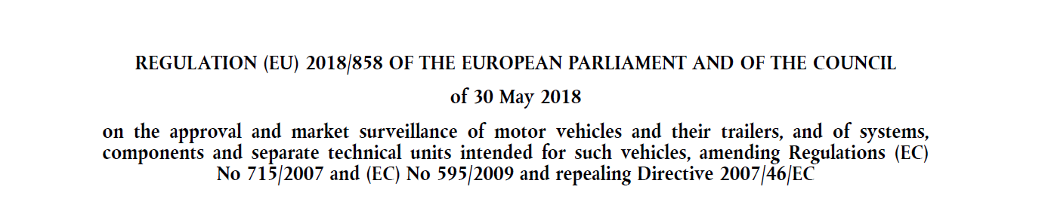
Market surveillance - Legal background
Article 9: Compliance verification by the Commission
Article 10: Assessments by the Commission
The Commission shall organise and carry out, at its own expense, tests and inspections to verify that vehicles, systems, components and separate technical units comply with the relevant requirements. (…)
The Commission shall organise and carry out assessments of the procedures (…) in particular of the procedures for granting type-approvals, for carrying out conformity of production and for the designation and monitoring of technical services. (…)

Slide 11
Market surveillance – JRC Role
The JRC is in charge of the physical testing of vehicles/components to verify their compliance with the relevant legislative requirements
This activity is carried out in close cooperation with DG-GROW which provides also the necessary funds through an Administrative Arrangement
Vehicles/componentes are tested both for the environmental and safety related performance applying the legislative test procedures and non tandards procedures to verify specific requirements
The activity includes an important research dimension aimed at establishing whether regulations and related test procedures are fit for the purpose or need modifications/updates

Slide 12
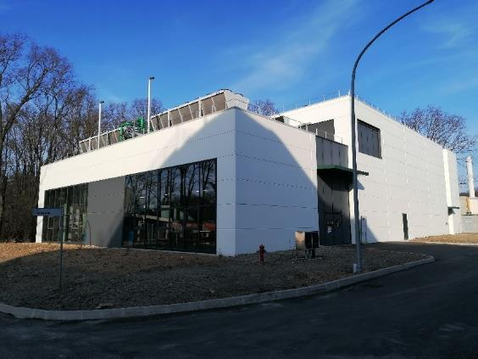
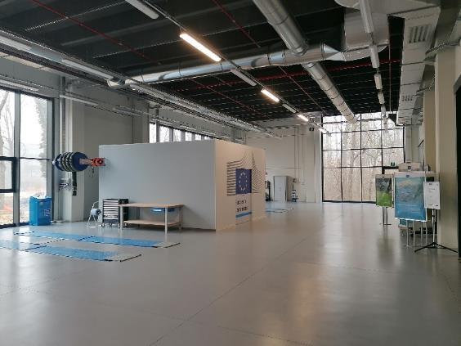
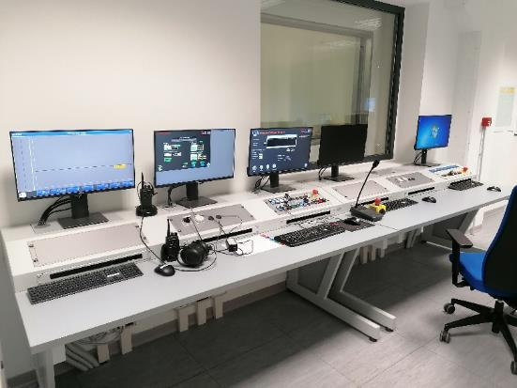
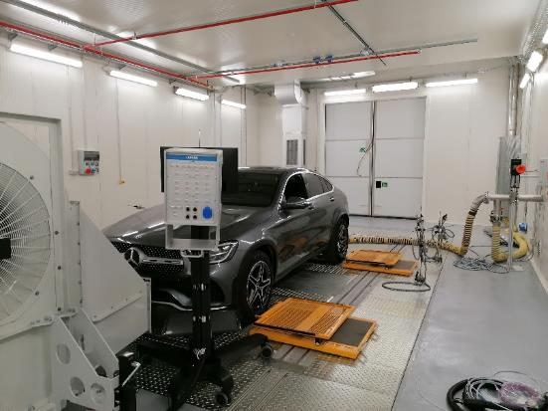
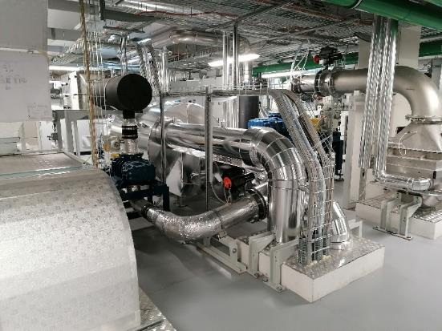
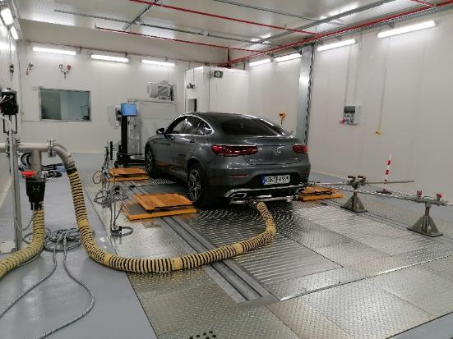
Market surveillance laboratory
External View
Workshop
Control Room
Test cell 1 (-10 /+50 C altitude simulation)
Test cell 2 (+10/+50 C)
Altitude Simulator

Slide 13
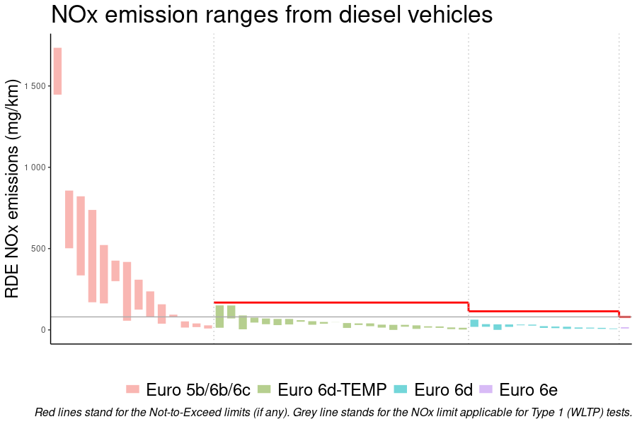
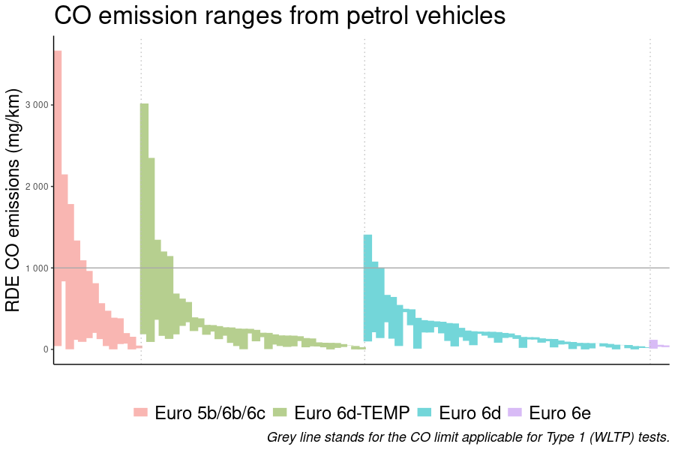
Market Surveillance Results - Emissions
Market surveillance shows: emissions are well below the limit!

Slide 14
Market Surveillance Results - Safety
Market surveillance shows: still a long way to go on safety requirements!
Selection through risk assessment
and best engineering judgement
74 Tests…
UN R79 Steering and ADAS
UN R39 Speedometer
UN R13H Braking
UN R139 Brake assist
UN R140 ESC
UN R117/R30 Tyres
Reg.2020/740 Tyre labelling
UN R100 Electric Vehicle Battery
UN R94 Frontal impact
UN R95 Lateral impact
Reg.1009/2010 Wheel guards
UN R26 External projections
UN R141/64 TPMS
UN R28 Audible warnings
Reg.2015/758 eCall
UN R130 LDW HDV
UN R131 AEBS HDV
Compliant: 13
Compliance reports uploaded in ICSMS
…on 17 vehicles
and 7 components
Non-compliant: 11
Procedure
DG GROW – TAA – OEM

Slide 15
Standards for vehicle type-approval
Projects overview

Slide 16

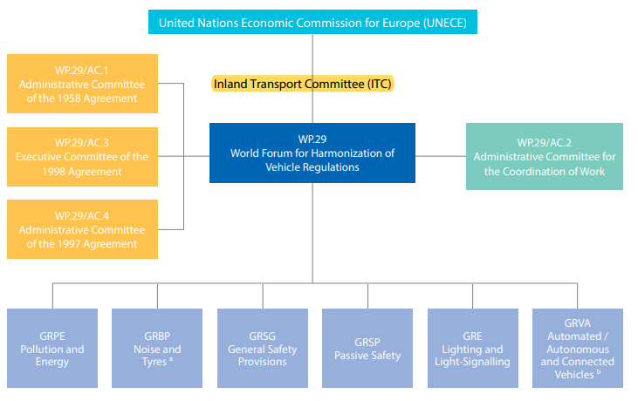

UNECE – WP29
20 years of contribution to IWGs in all UNECE - WP.29 (and EU) working parties
Contributed to the radical transformation of the automotive sector and to the harmonization of Regulations across the globe
Fostered the transition to safer, cleaner, more efficient and smarter vehicles

Slide 17




EU Emission standards
1990 | 1995 | 2000 | 2005 | 2010 | 2015 | 2020 | 2025
| | | | | | | | | | | | |
Increasingly stricter emission limits and more representative test procedures required the progressive introduction of effective aftertreatment systems in vehicles
Euro 1
Euro 3
Euro 5
Euro 7
M1
Euro 2
Euro 4
Euro 6
N1
a
b
d-temp
b
c
d
e
 | LDV | HDV
Gasoline
TWC | Euro 1 | -
GPF | Euro 6c | Euro 7 (?)
Diesel
DOC | Euro 2/3 | Euro IV
DPF | Euro 5b | Euro VI
SCR | Euro 6c | Euro V
N2, N3
Euro II
Euro IV
Euro VI
Euro VII
Euro I
Euro III
M2, M3
Euro V
A
C
D
E
B

Slide 18





JRC-CIEMAT On-going Scientific Collaboration
Ongoing PhD supervision (since Oct. 2021)
Doctorado en Energía Sostenible, Nuclear y Renovable - Universidad Politécnica de Madrid.
Supervisor: Dr. Ricardo Suárez Bertoa (JRC).
Doctoral candidate: Tawfiq Al-Wasif Ruiz (CIEMAT).
Candidate stayed at JRC, Ispra under the JRC visiting scientist scheme. May – July 2023.
Research focused on development of testing procedures for heavy-duty vehicles and the measurement of non-exhaust emissions.
2024 - Micro- and nanoplastics in the air: sources, transport & analytical methods for their determination. Publications Office of the European Union. (CIEMAT – JRC collaboration)
2025 – Direct measurement of brake wear particles from a light‑duty vehicle under real‑world driving conditions. Environ. Sci. Pollut. Res. Al Wasif-Ruiz et al.
2026 - Influence of Pad Composition on Fine Particle Emissions from Brake Wear. in prep.
Notes:
Il Progetto è il loro Progetto. Noi supportiamo perché rilevante su non-exhaust emissions
We hope the collaboration can continue beyond it. We are open

Slide 19
EU Emission standards
New systems allowing to achieve dramatic reduction in pollutant emissions from modern vehicles

Slide 20



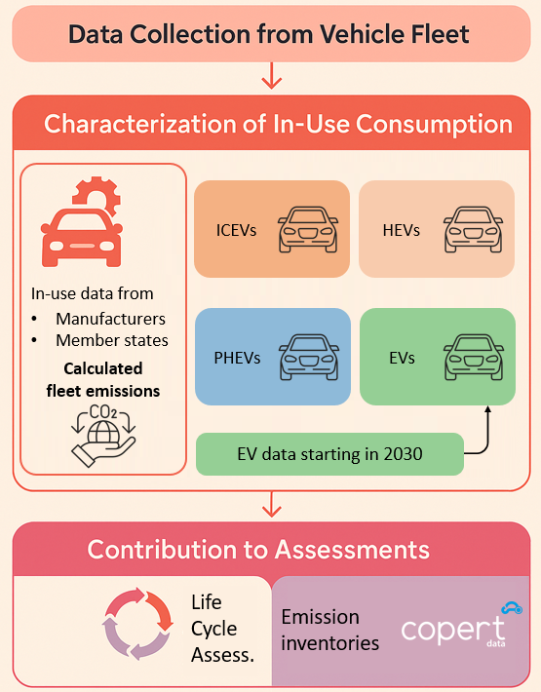

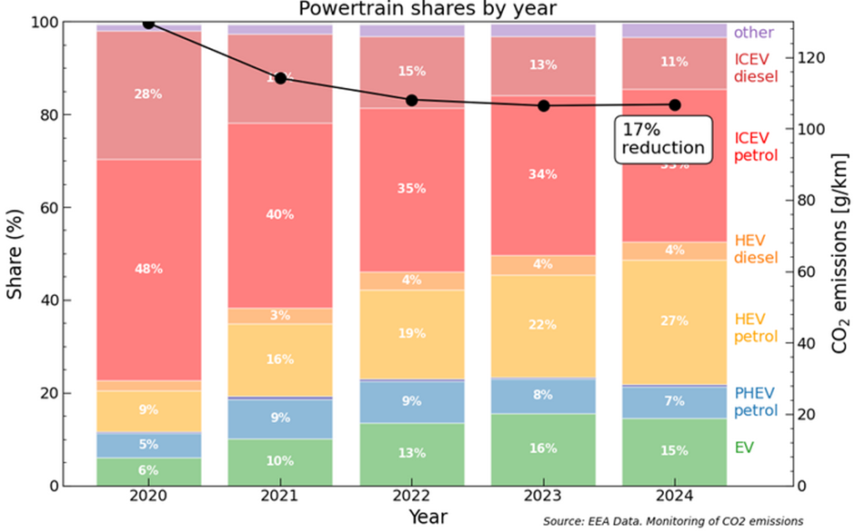
Decarbonising Light-Duty road vehicles
CO₂ emissions targets and fleet decarbonisation
On-Board Fuel and energy Consumption Monitoring (OBFCM)
Enables the collection and analysis of real-world fuel and energy consumption data from the vehicle fleet
CO₂ emissions reduction targets
  by 2025 → 15 % reduction
  by 2030 → 55% reduction for cars and 50% for vans
Growing adoption of electrified vehicles
(hybrid and full electric)
EU Reg.
2019/631
Shares of vehicle types in new car sales (M1)
22.8 g/km
reduction
since 2020
Guidebook
ICEV = Internal Combustion Engine Vehicle HEV = Hybrid Electric Vehicle
PHEV = Plug-in Hybrid Electric Vehicle EV = Electric Vehicle
Notes:
CO2 emissions targets and fleet decarbonisation [left]
- Significant Reduction in new vehicle CO2 emissions: Official CO2 emissions for new passenger cars in the EU (+ Norway and Iceland), dropped to 106 g/km in 2024, a 22.8 g/km reduction compared to 2020 levels.
- Growing Adoption of Electric Vehicles: In 2024, electric vehicles accounted for 15% of new car sales (against 6% in 2020). Plug-in hybrid vehicles contributed an additional 7%. For 2025, preliminary data indicates further growth of the EU electric vehicle market.
On-Board Fuel and Energy Consumption Monitoring (OBFCM) [right]
- Technology enabling to obtain real-world consumption data from the vehicle fleet, the calculation of real-world CO2 emissions and the gap from the official values.
Stable gap of Vehicle In-Use Emissions: Monitoring of vehicle real-world energy consumption has confirmed a stable gap between the in-use real-world values and the official figures. This confirms the success of regulation in stopping previous trends of ever bigger deviations and the validity of the EU regulatory approach.
The real-world data further feeds into key assessments such as Life Cycle Assessment (LCA), emission inventories and others.

Slide 21











Decarbonising freight operations in the EU
VECTO - The technical “engine” behind EU policies targeting HDV emissions
CO₂ Standards
Conventional
Open Source
Provides certified CO₂ values
Determines OEM compliance
Hybrid
Nurturing community of users and developers
Connecting scientific communities, OEMs, policy makers
Electric
Fuel Cell
Eurovignette
Supplies CO₂ metrics for toll classes
Helps fleet operators to make informed decisions based on TCO
AFIR
Global
Provides fuel and energy demand data
Charging and refuelling network planning
Interest for uptake in other markets

Slide 22
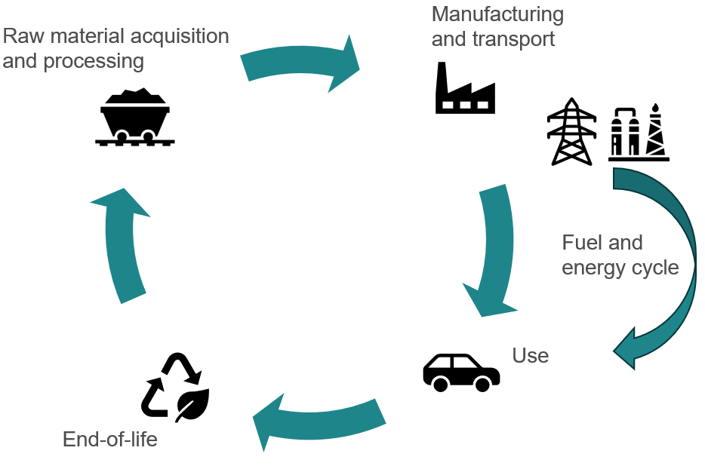
Development of holistic light-duty vehicle CO2 emission assessment methodology at EU & UNECE
Regulation (EU) 2019/631, Article 7a
By 31 December 2025, the Commission shall publish a report setting out a methodology for the assessment and data reporting of the life-cycle CO₂ emissions of cars and vans.
Informal document:GRPE-87-39-Rev.1
GRPE prioritized the development of an A-LCA methodology and created an Informal Working Group on A-LCA under GRPE (ECE/TRANS/WP.29/GRPE/86/Rev.1) aiming to deliver a proposal by Q1 2026

Slide 23
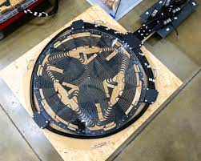
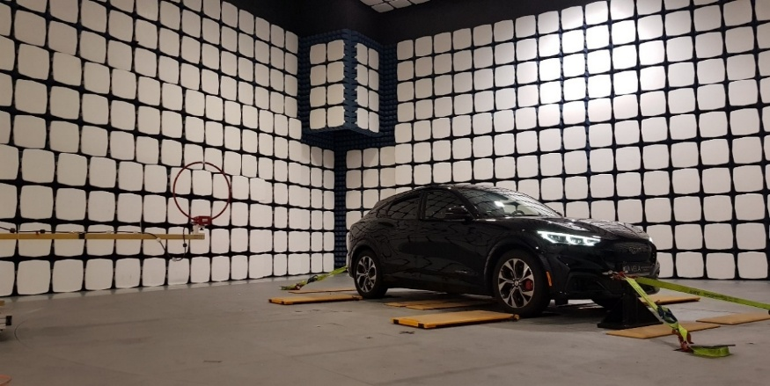
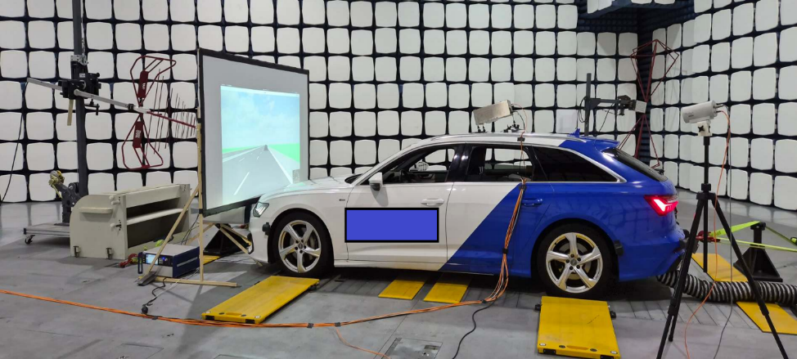
Electromobility and Electromagnetic Compatibility
Pre-normative research to support development of superfast,
bidirectional and wireless EV charging standards
Assessments of electro-magnetic fields generated by all
types of electrified vehicles and charging columns
Supporting EU standardization for the e-automotive sector
in view of new series of UNECE Regulation 10 and explore beyond
(e.g., including acceleration and recuperative deceleration, ADAS, etc.)

Slide 24
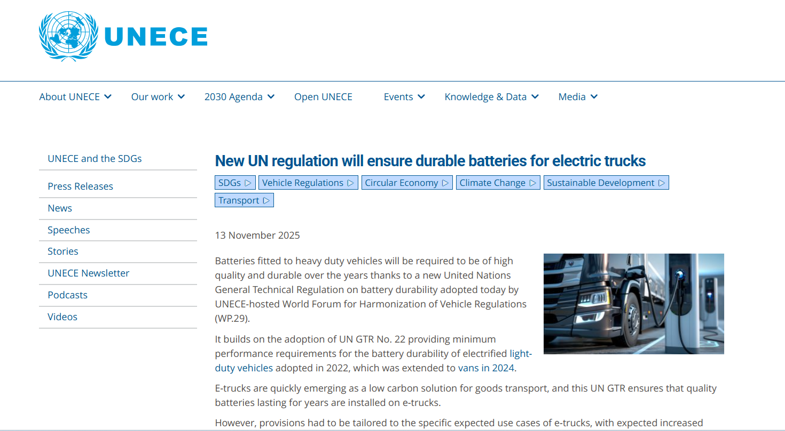
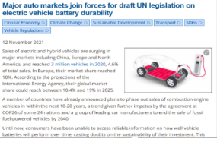
In-vehicle battery durability
The environmental performance of electrified vehicles may be affected by excess degradation of the battery system over time.
Loss of electric driving range and loss of vehicle energy efficiency are both primary concerns.
  New UN global technical regulation (GTR) No. 22 and 25 on minimum performance requirements for battery durability in light- and heavy-duty vehicle (trucks, buses and coaches).
    Prevent the use of low-quality batteries
    Long-lasting batteries help reduce the pressure critical raw materials demand, and reduce waste from used batteries.
Notes:
The environmental performance of electrified vehicles may be affected by excess degradation of the battery system over time.
Loss of electric driving range and loss of vehicle energy efficiency are both primary concerns.
The most recent remarkable achievement to which the JRC extensively contributed is the approval of the new UN global technical regulation (GTR) No.25 which establishes the minimum performance requirements for battery durability in heavy duty vehicle (trucks, buses and coaches).
This GTR is the follow up extension of the durability requirements already established for light duty vehicles (passenger cars and light commercial vehicles) with the UN GTR No. 22.
These regulations would prevent the use of low-quality batteries, ensuring that only durable batteries are installed in EVs.
Making sure each battery lasts longer would help to ease the pressure on in-demand critical raw materials needed for their production, and reduce waste from used batteries.

Slide 25
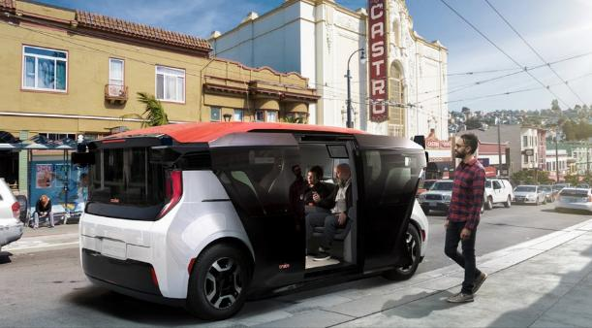


EU Type-approval framework for driving automation
UNR171
L2 DCAS
(Driver Control Assistance System)
Driver present, engaged and responsible
Wide range of operations
No vehicle series limitation
UNR157
L3 ALKS
(Automated Lane Keeping System)
Driver present not engaged
Motorways
No vehicle series limitation
Cybersecurity measures
EU 2022/1426 (UNR/GTR)
L4 ADS
(Automated Driving System)
Driver not present
Operations in specific areas
Vehicle series limitation (max. 1500)

Slide 26

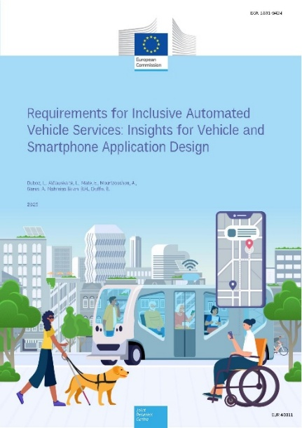
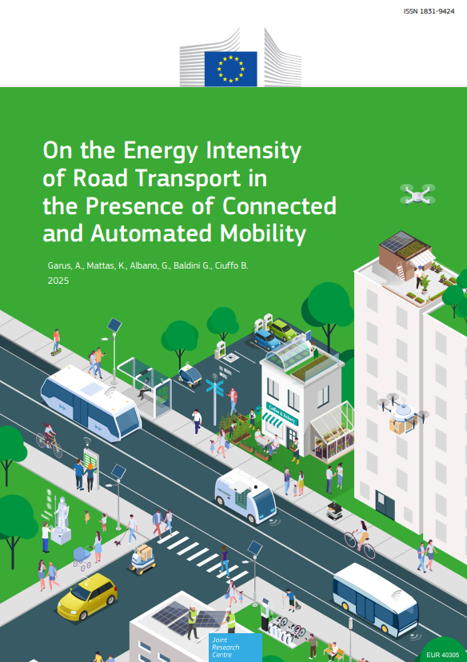
Bringing AVs to the road in the EU
Studying the energy implications of CCAM services in the EU
Defined requirements for inclusive CCAM services
Supporting the development of EU
testbeds for the deployment of AVs
Launching a CCAM Observatory to map
the evolution of its industrial ecosystem
worldwide
CCAM Observatory

Slide 27
Non-Road Mobile Machineries (NRMM) and Periodical Technical Inspections (PTI)
Additional JRC contribution to the standardization of the regulatory framework for motor-vehicles include
  In-Service Monitoring (ISM) for NRMM
  Amendments to UN Regulations No. 96 and No. 120 (Hydrogen and Methanol for NRMM and Inland Waterway Vessels)
  Revisions of Periodical Technical Inspection Directive

Slide 28
Transport R&I
Projects overview

Slide 29
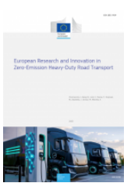
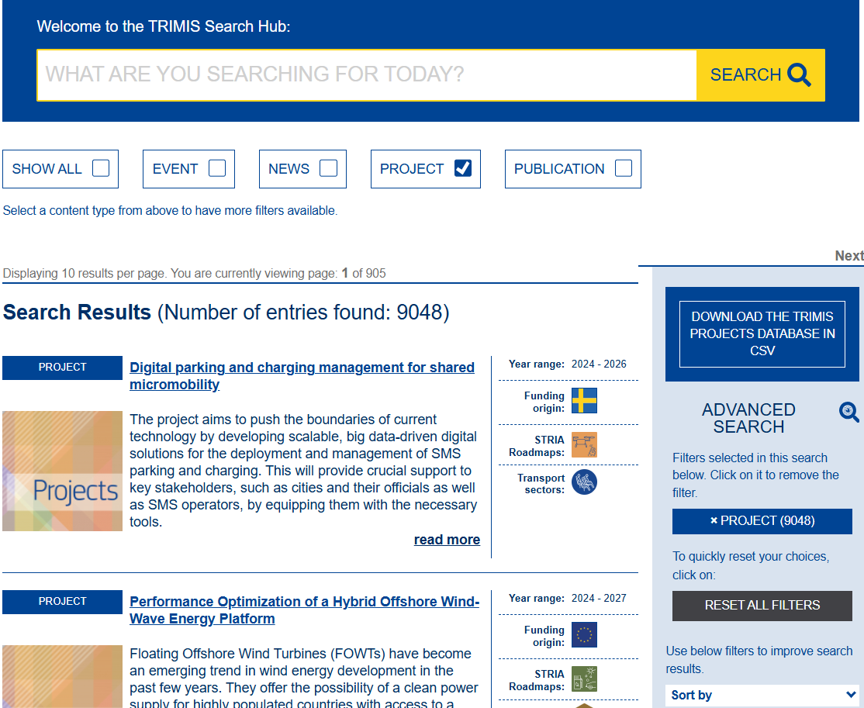






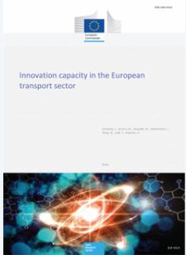
TRIMIS overview
Transport Research and Innovation Monitoring and Information System
Information
Monitoring
Monitoring
  Data collection, curation, and storage: R&I projects, member state profiles, innovation capacities
  Data analysis: Science for Policy reports and dashboard
Information
  Web portal: open access information & stakeholder contribution
  Newsletter and event participation
Portal & Database
Transport R&I
Dissemination & Engagement
Innovation capacities

Slide 30













TRIMIS Database
Database
TRIMIS database added value:
Tailored dataset:
  focus on transport & mobility
  projects additional to EU Framework Programmes (CEF, Interreg)
  for both feedback to policy and stakeholder engagement
Original data:
  transport mode
  R&I themes
  transport sectors
  technologies developed
8710 projects
4748 FP projects
2008 H2020 &
161 Horizon Europe
116 Newsletters
TRIMIS publications:
  43 Science for Policy Reports
  14 Science for Policy Briefs
  5 Technical Reports

Slide 31
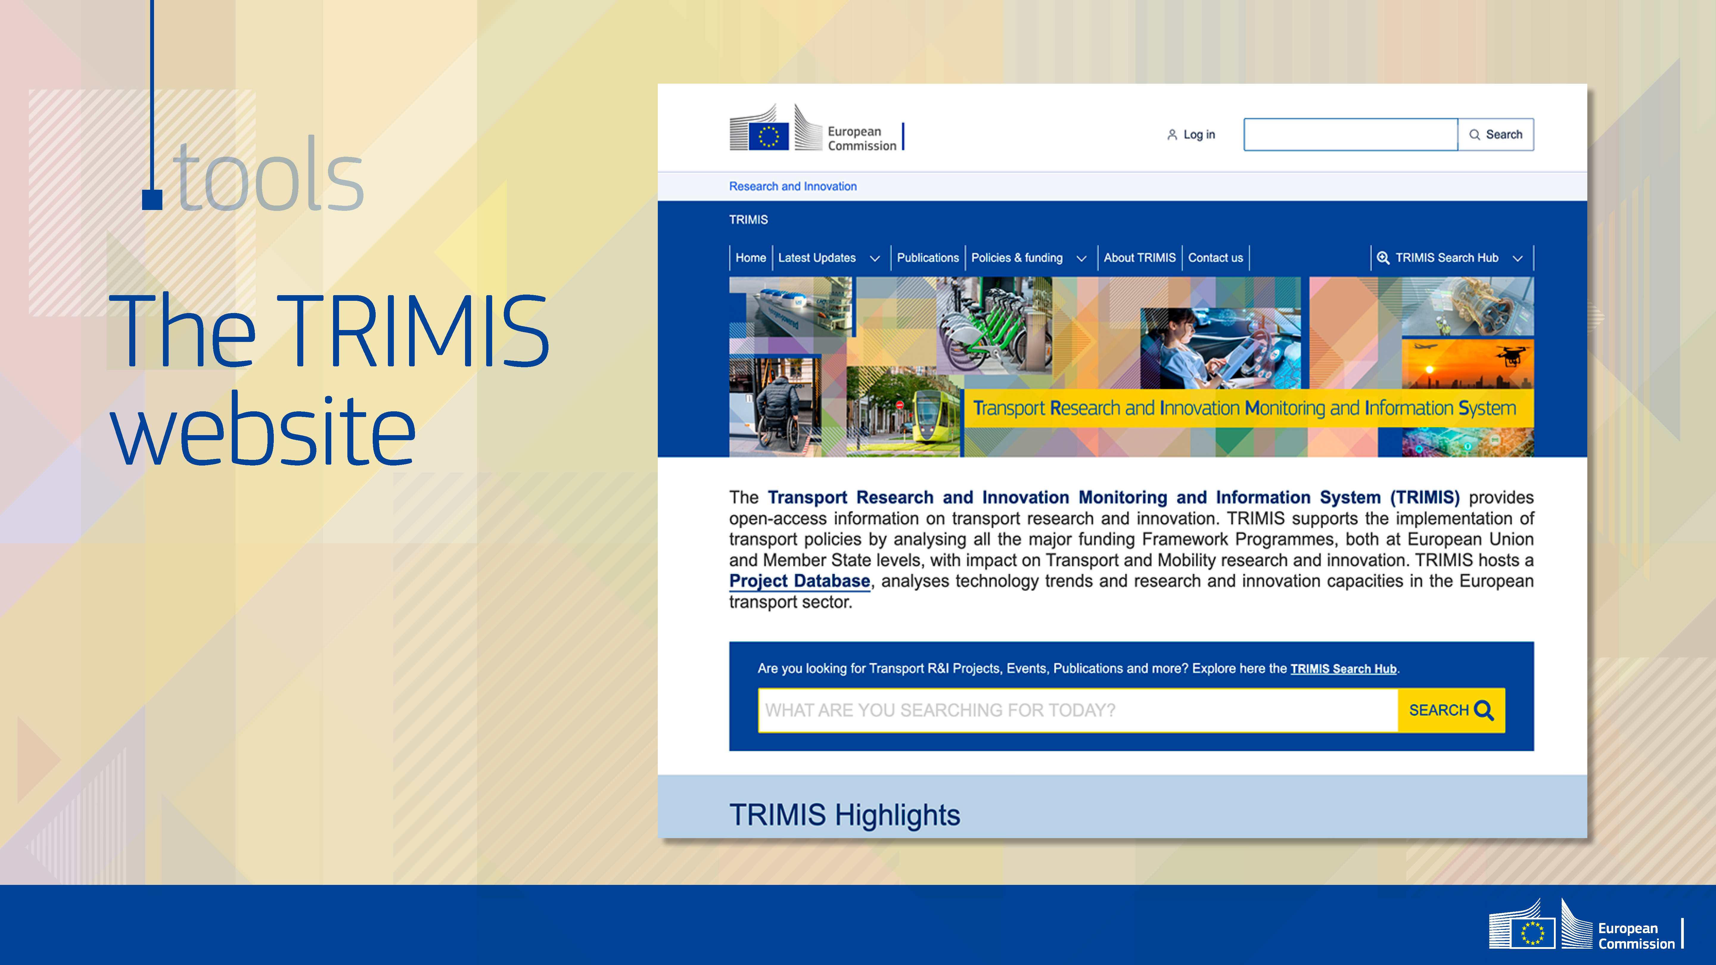
trimis.ec.europa.eu

Slide 32


Slide 33
Transport Decarbonization & Energy Efficiency
Additional activities

Slide 34
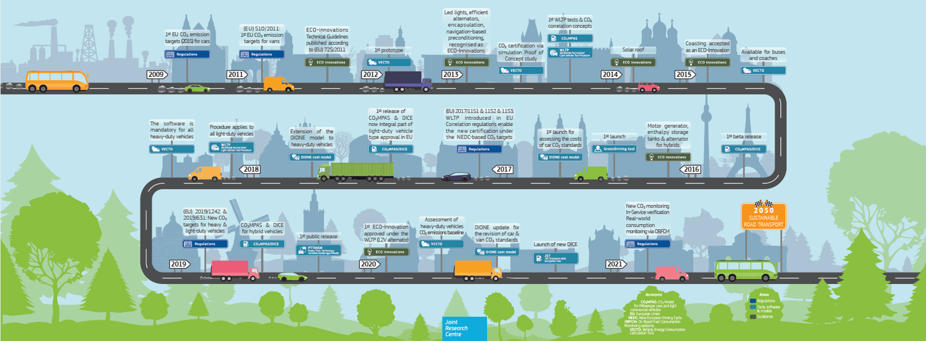
Scope and Activities
Scientific policy support for EU Climate, Green Deal targets, support for transport competitiveness
Excellence in transport energy efficiency and emissions
JRC at the forefront of:
  All light & heavy vehicle efficiency certification regulations
  Techno-economic analysis and impact assessment
  Innovation and efficiency improvement technology
  Holistic Assessment and Life-Cycle Assessment
  Digital applications

Slide 35

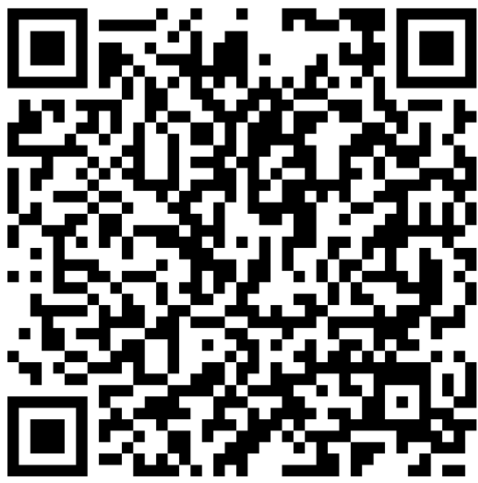

Heavy Vehicle (HDV) energy efficiency and VECTO
Basis &
Continuous development and update of VECTO suite to capture new technologies and innovations
>250 000 vehicle certifications per year
350+ registered users and 100+ stakeholders
Contribution to monitoring and compliance mechanisms for 2030+ HDV CO₂ targets.
EU 2019/1242: CO₂ standards for road vehicles > 3.5t
EU 2017/2400: Simulation-based certification with Commission provided IT tools
VECTO model launched by DG Clima & JRC
Extensive policy support through DIONE suite
Numerous laboratory and onroad tests
Action
Future
-Internationalisation of EU tools and collaborations with non-EU countries
-Emphasis on Zero Emission technologies uptake
-Support of new EU initiatives for transport decarbonisation
-Expand scientific outreach

Slide 36
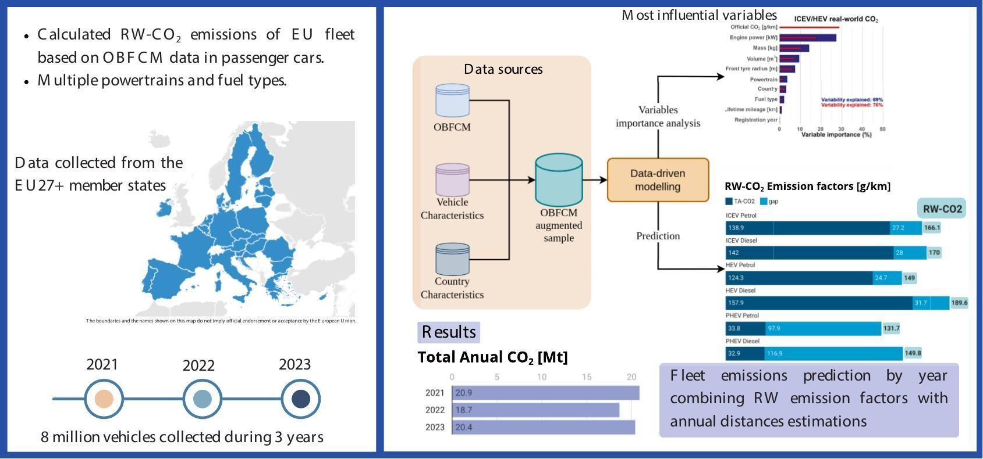
Light Vehicle CO₂ emissions & energy efficiency
EU 2019/631: CO₂ standards for road vehicles < 3.5t
Monitoring and verification under both laboratory and in-use conditions
DICE: Database for In-service CO2 emission verification developed and operated by the JRC
Extensive policy support through DIONE suite
Numerous laboratory, on-road and in use tests
Basis &
Real-world Emissions Monitoring & OBFCM analysis
Assessment of novel decarbonisation technologies
Contribution to monitoring and compliance mechanisms for 2030+ HDV CO₂ targets.
Emissions verification risk assessment report
Action
Future
-Holistic assessment and lifecycle analysis
-Low and Zero Emission technologies uptake acceleration
-Driver behaviour and user sentiment analysis
-Expand scientific outreach

Slide 37
Policy Modelling & DIONE model
Socio-economic analysis:
Cost and TCO modelling
  Fleet Composition and
  DIONE Fleet Model:
Maritime study for DG INTPA to support GGSC
    Second-hand vehicle market analysis,
    EV affordability, price parity & impact on consumers
    Support LDV/HDV standards in impact assessments
    Validation of technology assumptions and PHEV cost curves update for new EU reference scenario
    Future powertrain share prediction
    Emission impacts of fleet composition envisaged in EU member states’ reports under the AFIR
Basis &
Action
Future
Support CLIMA LDV progress reporting on ZEV cost parity and affordability.
Fleet composition: incorporate country specific economic factors
Impacts of LDV CO2 standards on air pollutant emission, air quality and health
EEA data: development of EU ZEV market
Expand DIONE for non-road transport and refine emission factors
Notes:
NIR = National Implementation Reports (NIR)
AFIR = Alternative Fuels Infrastructure Regulation
GGSC = Global Green Shipping Corridor

Slide 38

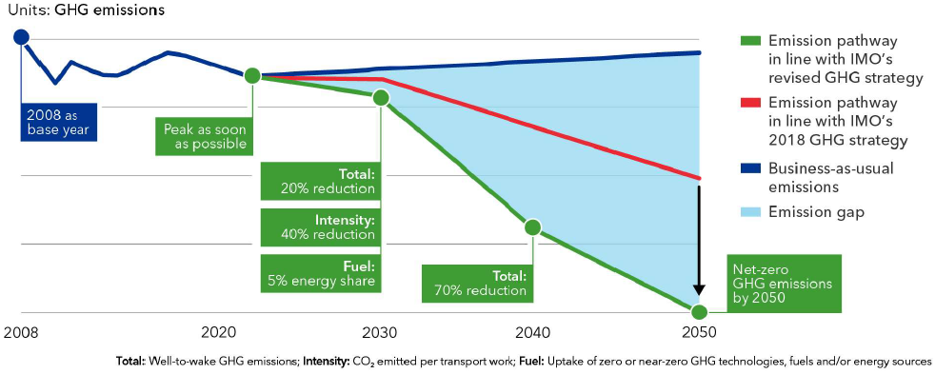
Maritime transport and its emissions
Maritime transports 80% of goods worldwide and considered as the most efficient mode of transportation.
Accounts 2,89%
of global total anthropogenic GHG emissions
5-8% of SOx emissions are produced from ships
Global PM from maritime amounts 0,9-1,7 Mton annually
15% of NOx emissions are produced from ships
  Revised 2023 IMO GHG strategy
Source: DNV. (2023b). Energy Transition Outlook 2023. Maritime Forecast to 2050.

Slide 39
Thank you
For info: Biagio.CIUFFO@ec.europa.eu
Notes:
Update/add/delete parts of the copyright notice where appropriate.
More information: https://myintracomm.ec.europa.eu/corp/intellectual-property/Documents/2019_Reuse-guidelines%28CC-BY%29.pdf

