Slide 1
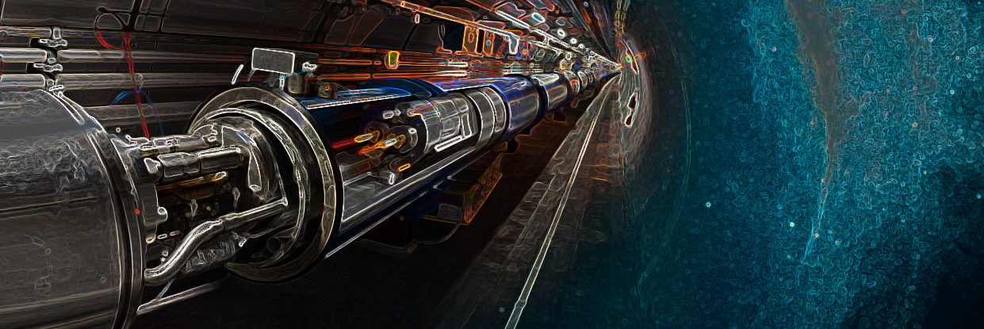


LINACs Simulation Status
M. Zampetakis
on behalf of the OPALX Developers team
OPALX Developers Retreat, Ciemat, Madrid, Spain
Thursday, 3 September 2026
michail.zampetakis@psi.ch

Slide 2
Current Status of OPALX
Accelerator elements:
Implemented: Drifts, Dipoles, Quadrupoles, Sextupoles, Multipoles, Monitors
Implemented: Standing Wave Cavities, Traveling Wave Cavities
Soon to be implemented: Transverse Deflecting Cavities
Fieldmaps:
Available: Astra1DDynamic, Astra1DMagnetoStatic, FM2DDynamic, FM2DMagnetostatic
Space-charge solver status:
FFTOpenPoissonSolver from IPPL is accessible in OPALX
Works on CPU/GPU and in multi-rank mode
Agreement with OPAL solvers is within ~3–4%
  Core simulation modeling for LINACs is largely in place!

Slide 3
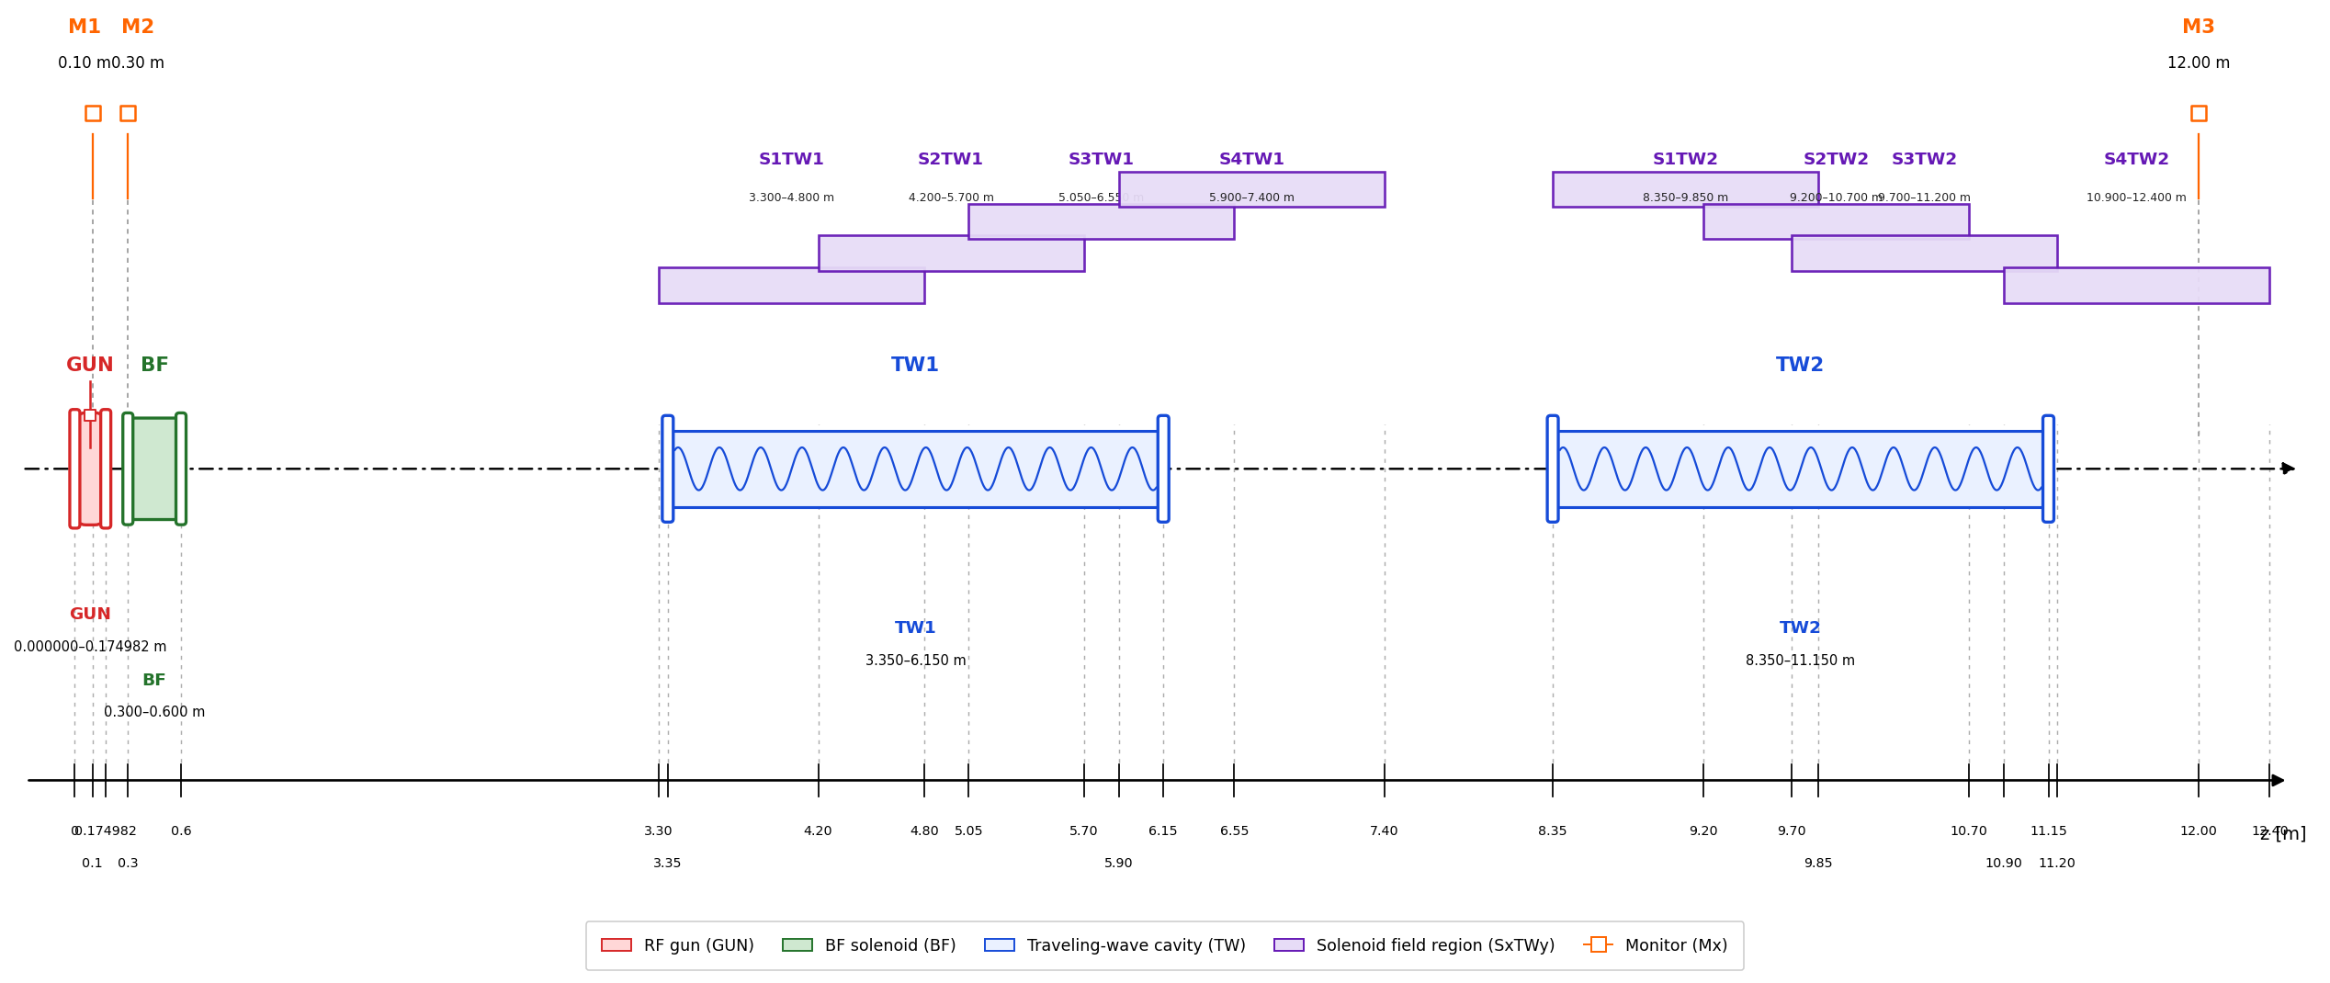
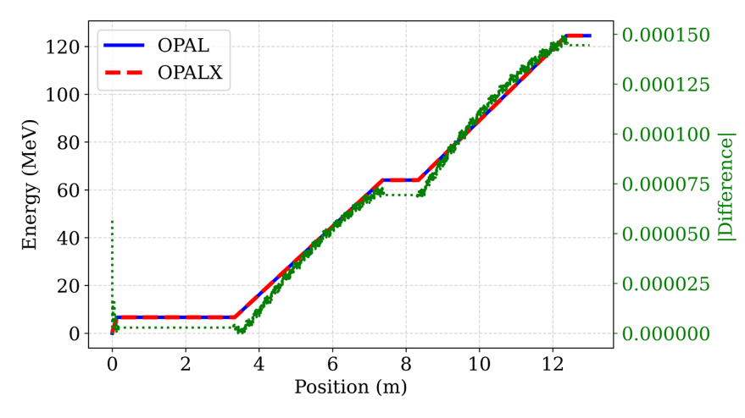
SwissFEL Booster
Effective length
Effective length
*Element position and length might not be accurate.

Slide 4
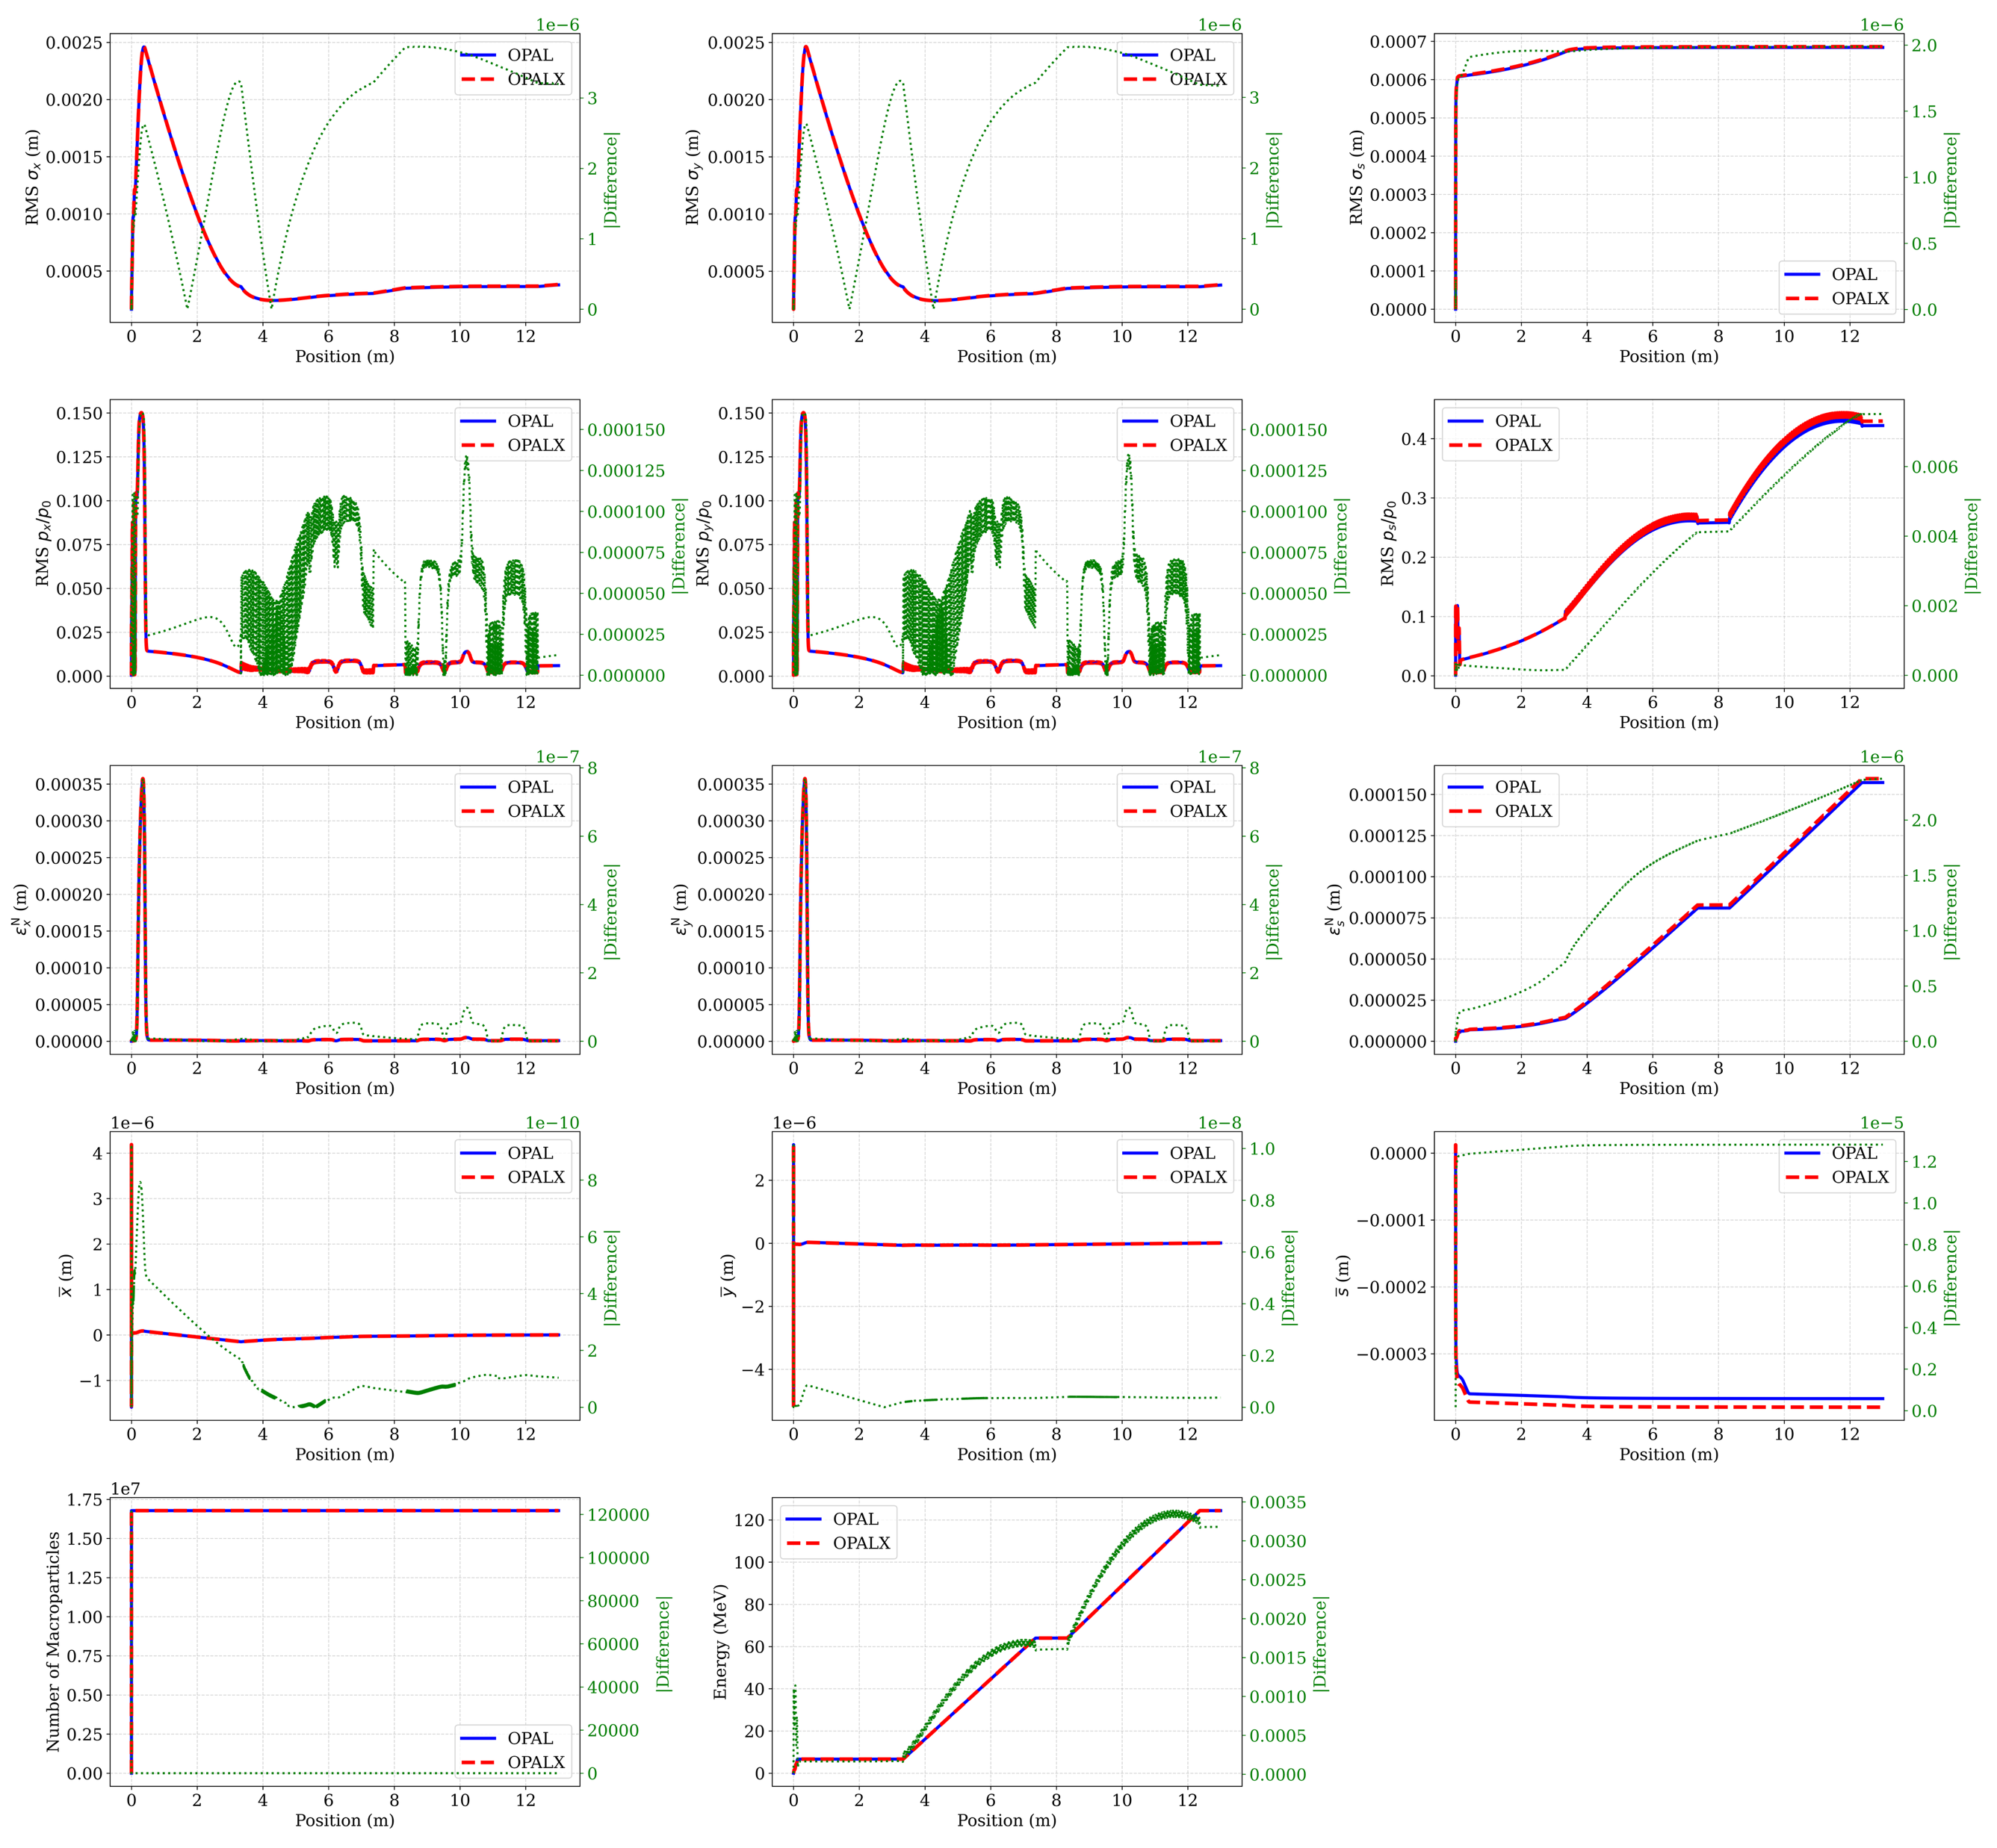
SwissFEL Booster – With Space Charge
Good agreement

Slide 5
SwissFEL Booster – With Space Charge
Very good agreement in the transverse planes
Some small discrepancies in the longitudinal plane

Slide 6
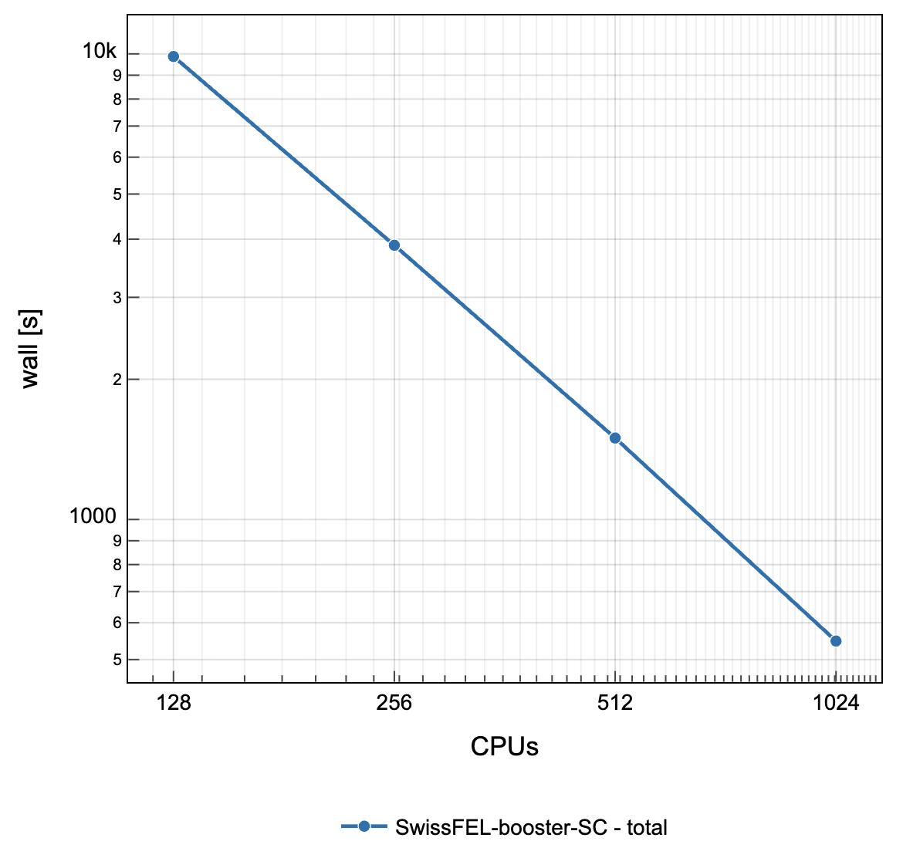
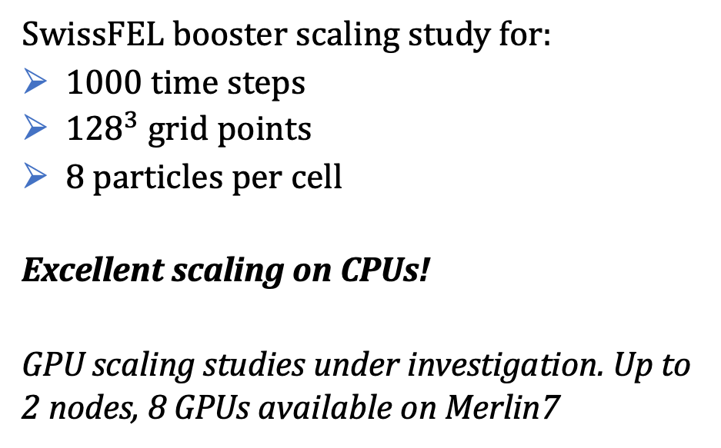
CPU Scaling Studies
SwissFEL booster scaling study for:
1000 time steps
${128}^{3}$ grid points
8 particles per cell
Excellent scaling on CPUs!
GPU scaling studies under investigation. Up to 2 nodes, 8 GPUs available on Merlin7

Slide 7
Summary
LINAC modelling is largely in place, including space charge capabilities
First CPU scaling studies look excellent
Investigation on GPU scaling study set up and options ongoing

Slide 8
Thank you!!!

