Slide 1
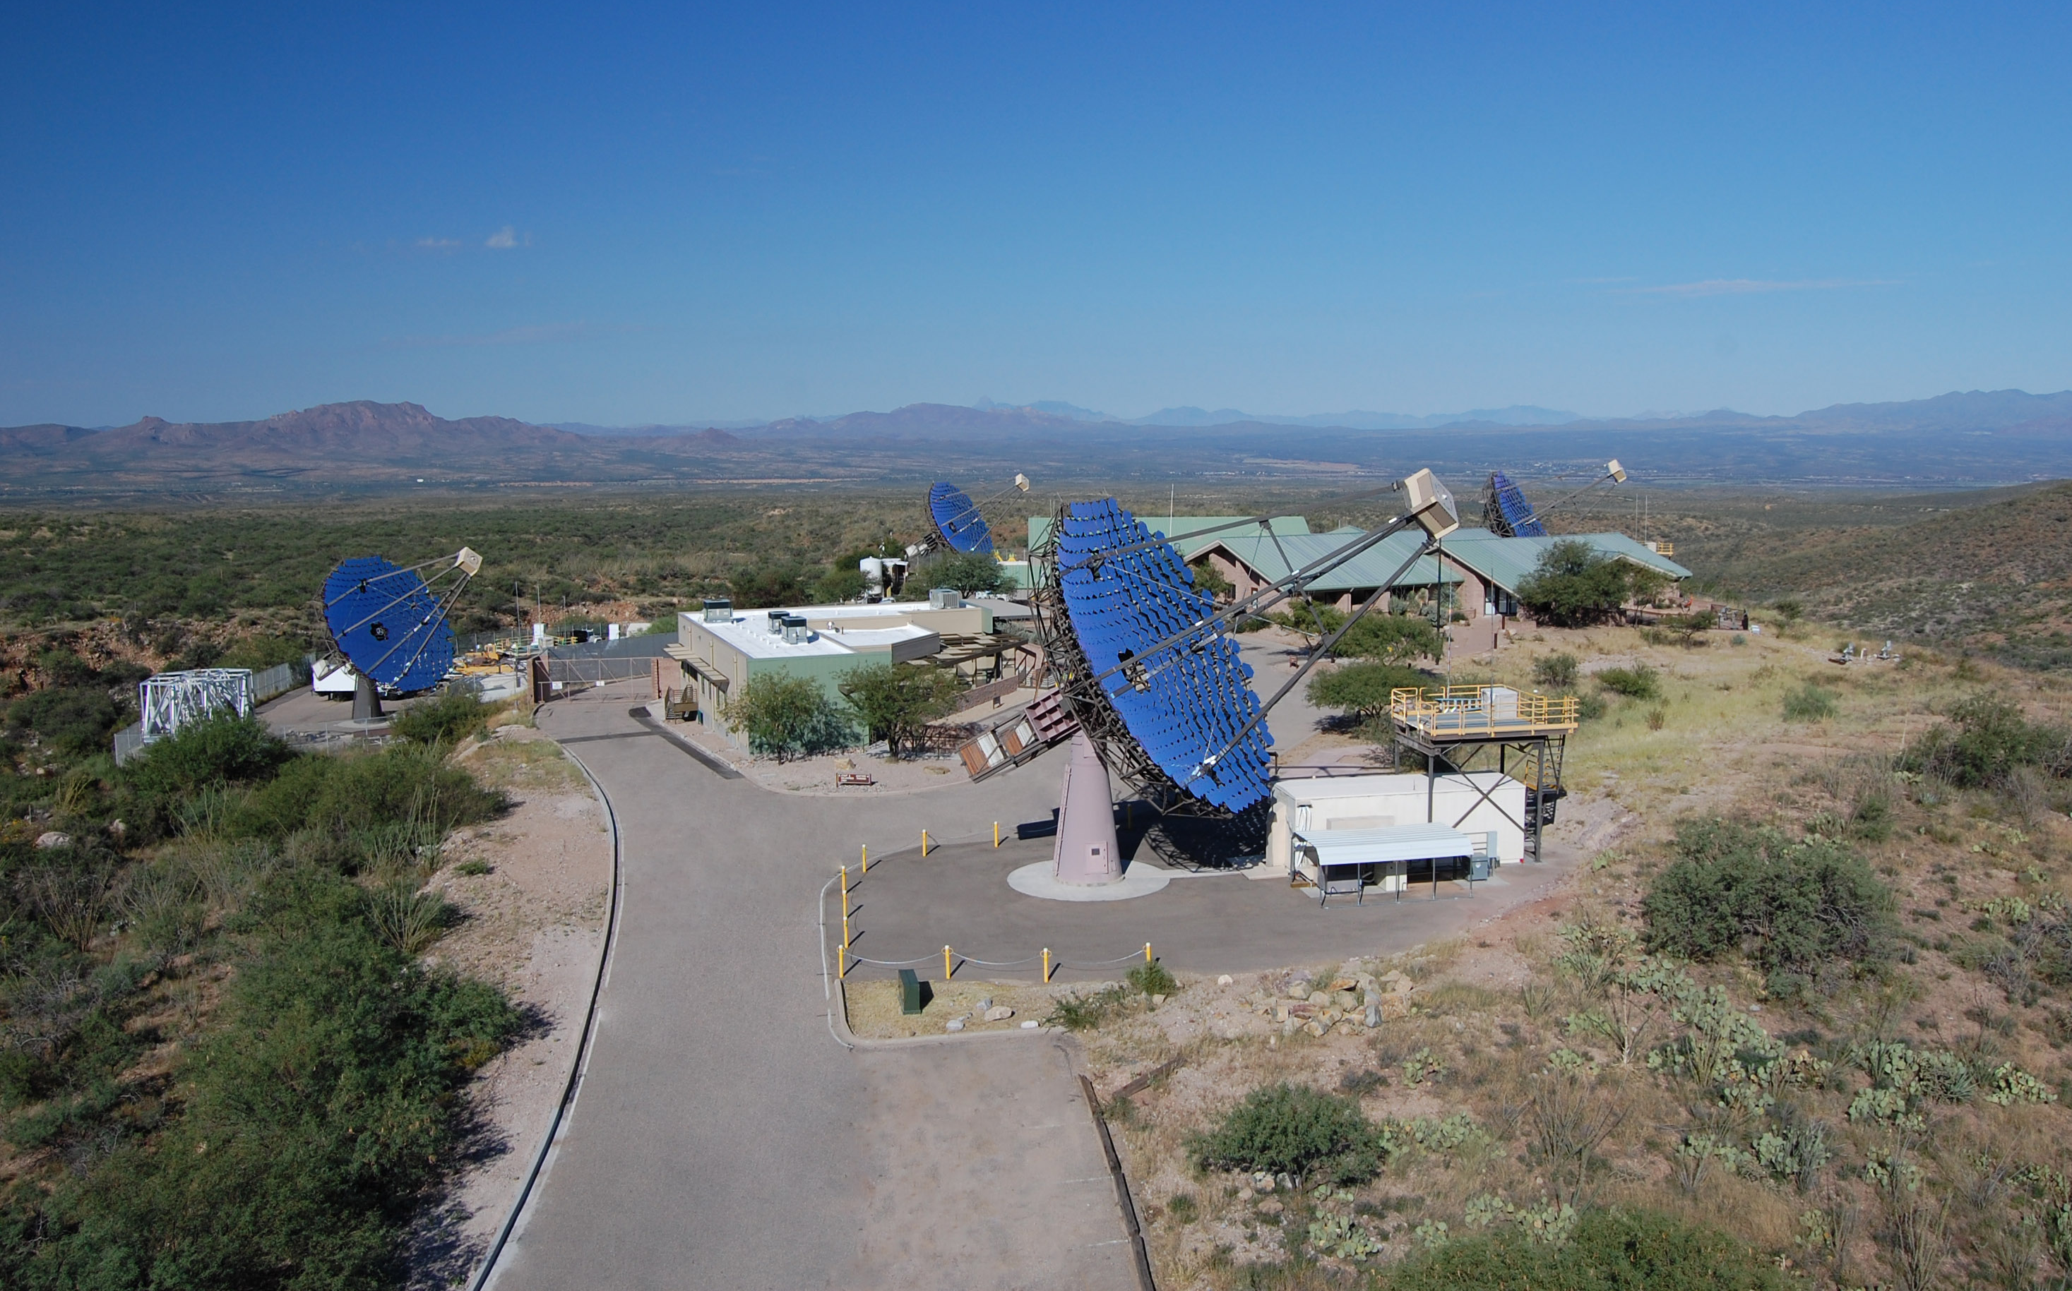
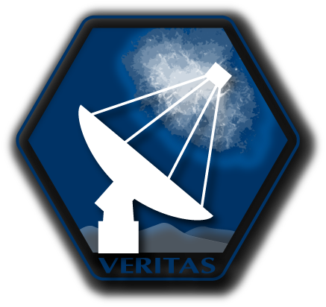

VERITAS SII OBA Star Survey & 2026-2028
CTA SII meeting
October 15, 2020
Dave Kieda
University of Utah
dave.kieda@utah.edu
VERITAS Collaboration: VSII working group
2026 Workshop
La Palma, Canary Islands
10/6/2026
Notes:
Dave Kieda
from the University of Utah
I'm presenting on Behalf of the VERITAS collaboration
on the VERITAS Stellar Intensity Interferometer
VSII is Pathfinder ultra-high resolution optical
observatory funded through an NSF RAPID grant

Slide 2
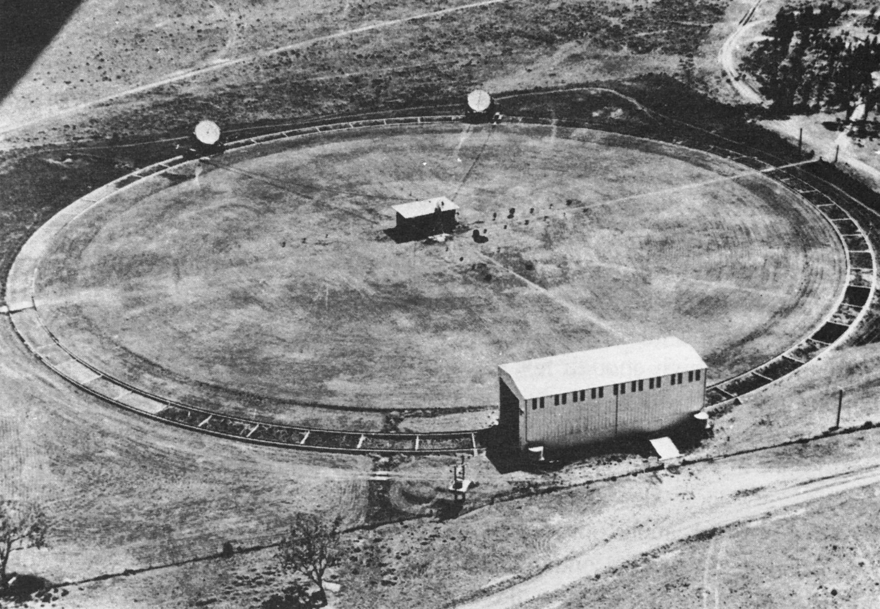
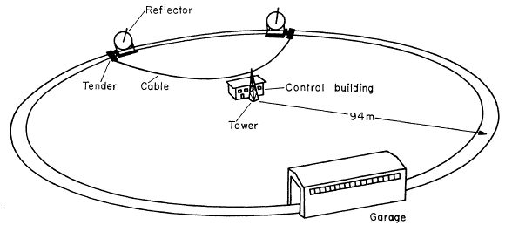
Stellar Intensity interferometry (SII) … 1956-1971
The Past
Narrabri observatory
with its circular railway track
R.Hanbury Brown: BOFFIN. A Personal Story of the Early Days
of Radar, Radio Astronomy and Quantum Optics (1991)
2

Slide 3
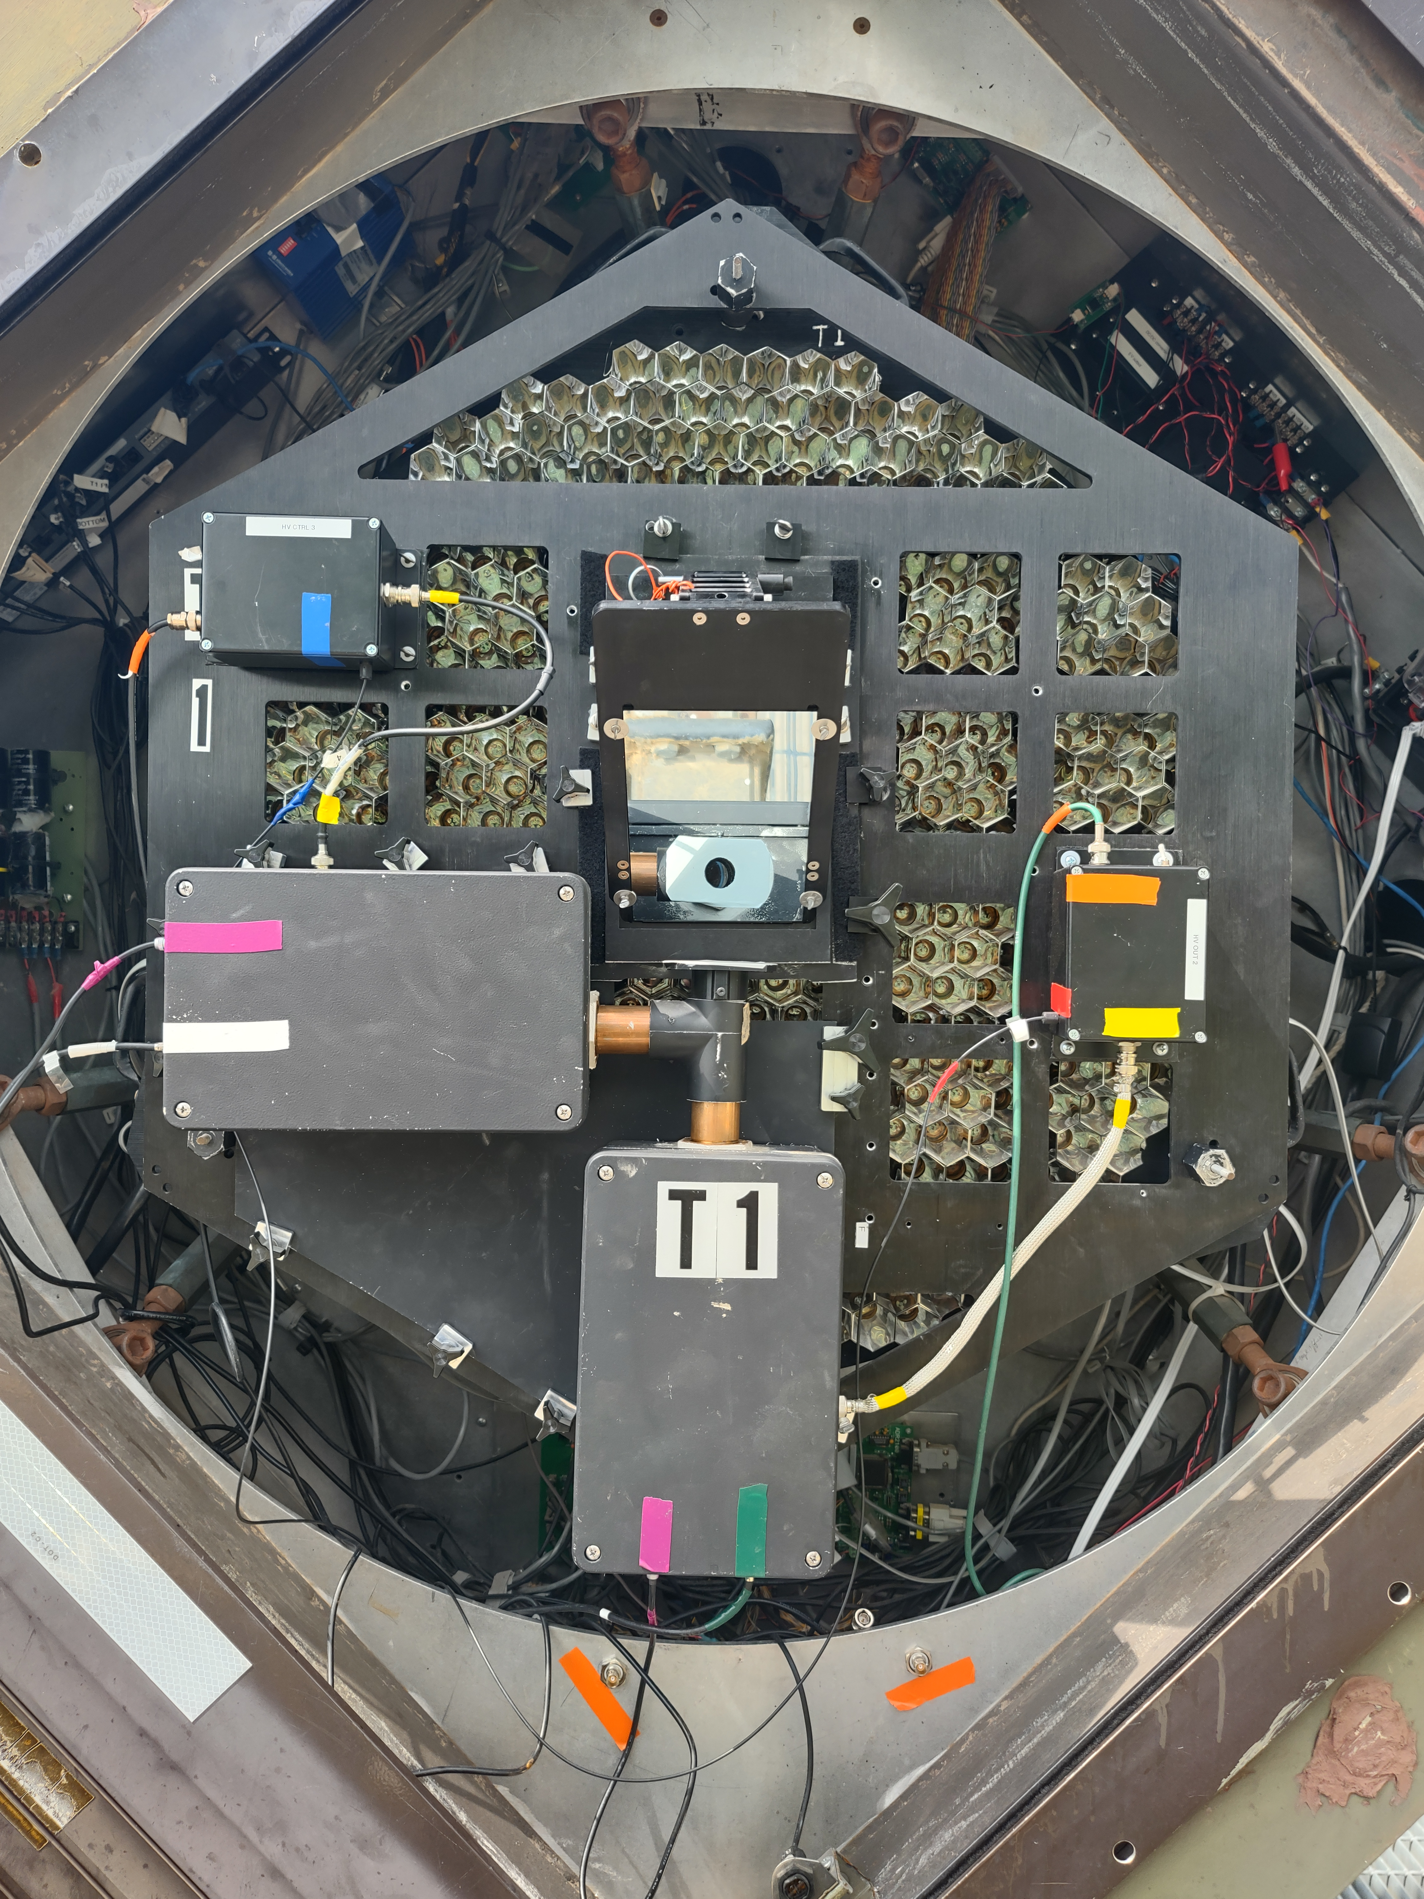
VSII
Retrospective
2019-2026
3

Slide 4
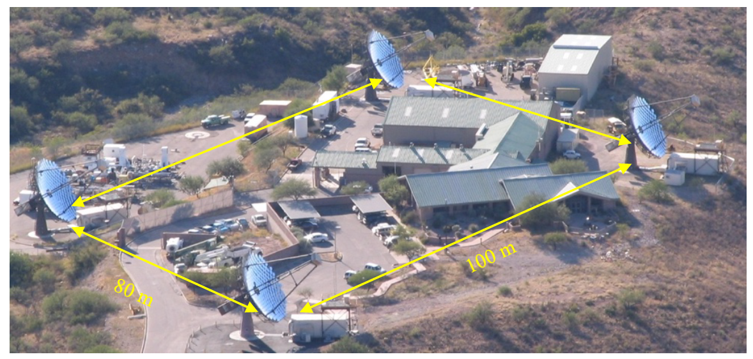
VERITAS-SII (VSII)
Excellent instrument for SII
Large photon collection area (~12 m Ø mirrors)
40 m to 150m baselines
Optically isochronous (< 4 ns)
250 Mhz photocurrent sampling
Telescope time available during Full Moon
Sub- milliarcsecond optical
resolution @ 400 nm
4
J. Holder and S. LeBohec, Ap. J. 649 (2006) 399
D. Dravins et al., New Astronomy Reviews 56, 5 (2012) 143
Notes:
10/6/26
4
4

Slide 5
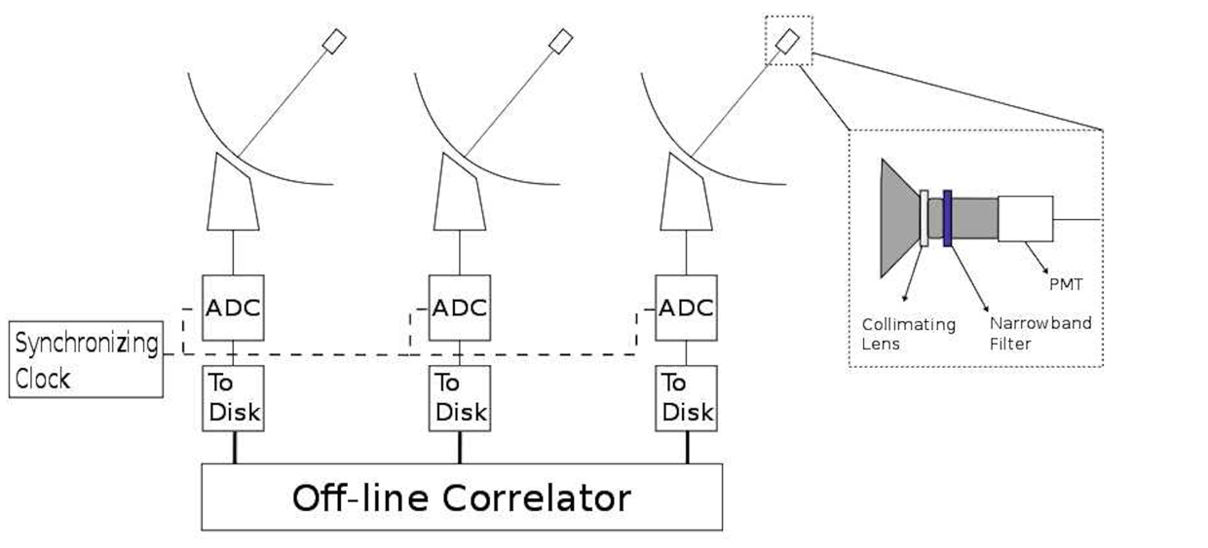
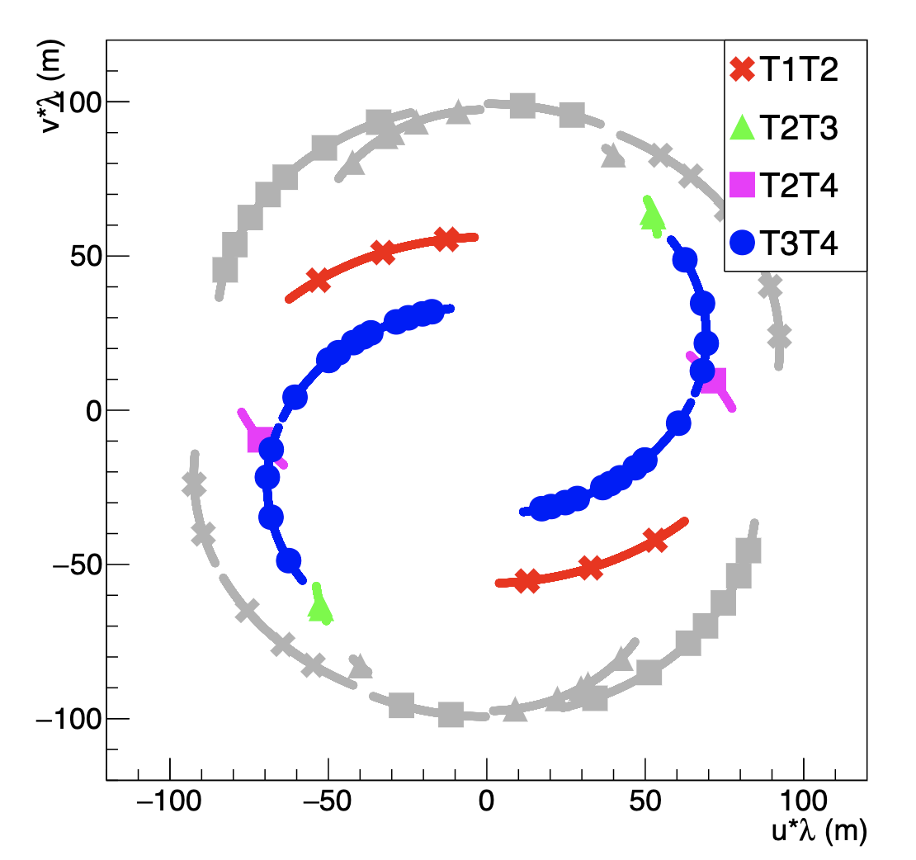
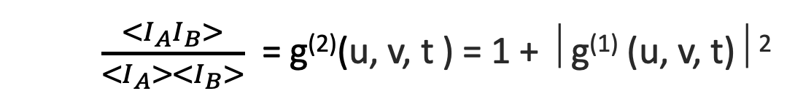
VSII Observations
$$g^{(1)}\left(u,v,0\right)=\iint{I\left(l,m\right){ e}^{−2πi\left(lu+mv\right)}dl dm}$$
5
$I\left(l,m\right)$ is the stellar image size and brightness distribution on the sky
VSII Sampling of Fourier Image Plane

Slide 6
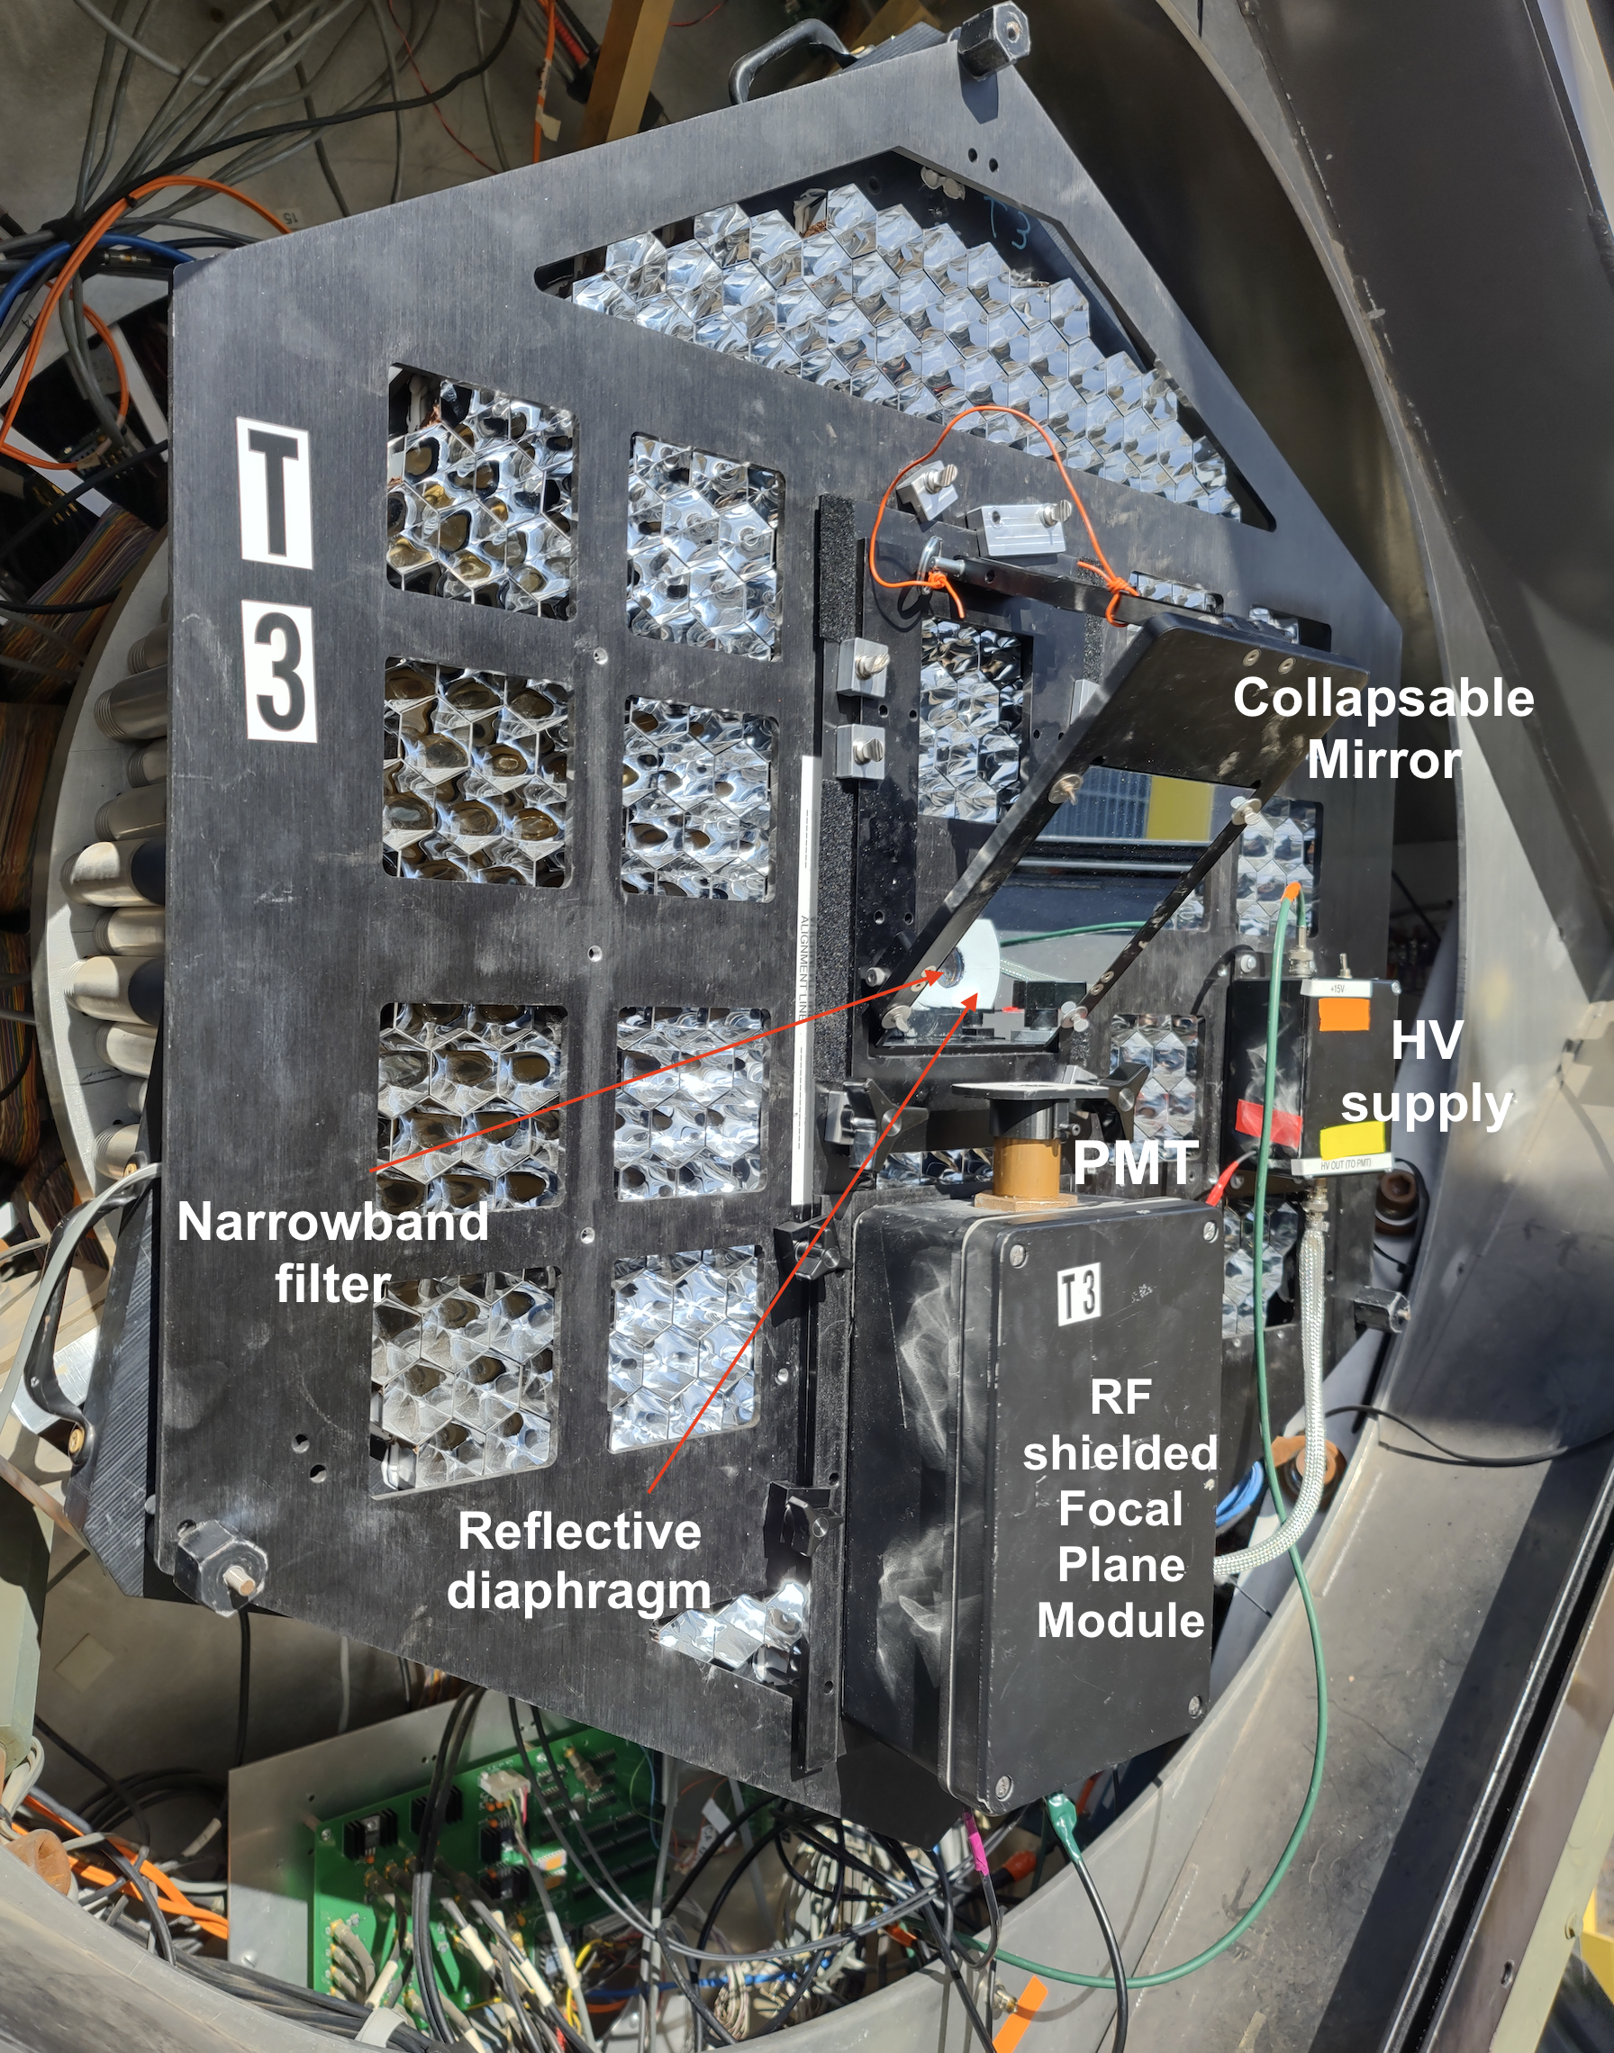
Removable SII Camera Plates
The removable SII Camera Plate
mounts in front of the VERITAS
Camera focal plane.
Observer locates the SII Plate onto each
camera at beginning of full-moon period.
Plate contains necessary focal plane
optics, HV supply, photomultiplier
and preamplifiers to perform SII
measurements.
Quick connect to cables for signal,
power, control
At end of run the SII plate is removed
and stored in dust-proof box.
About 20 minutes to install each plate
Support Rod
SII Focal Plane Plate
R10560 PMT
200 MHz
Preamp
HV
Supply
6

Slide 7
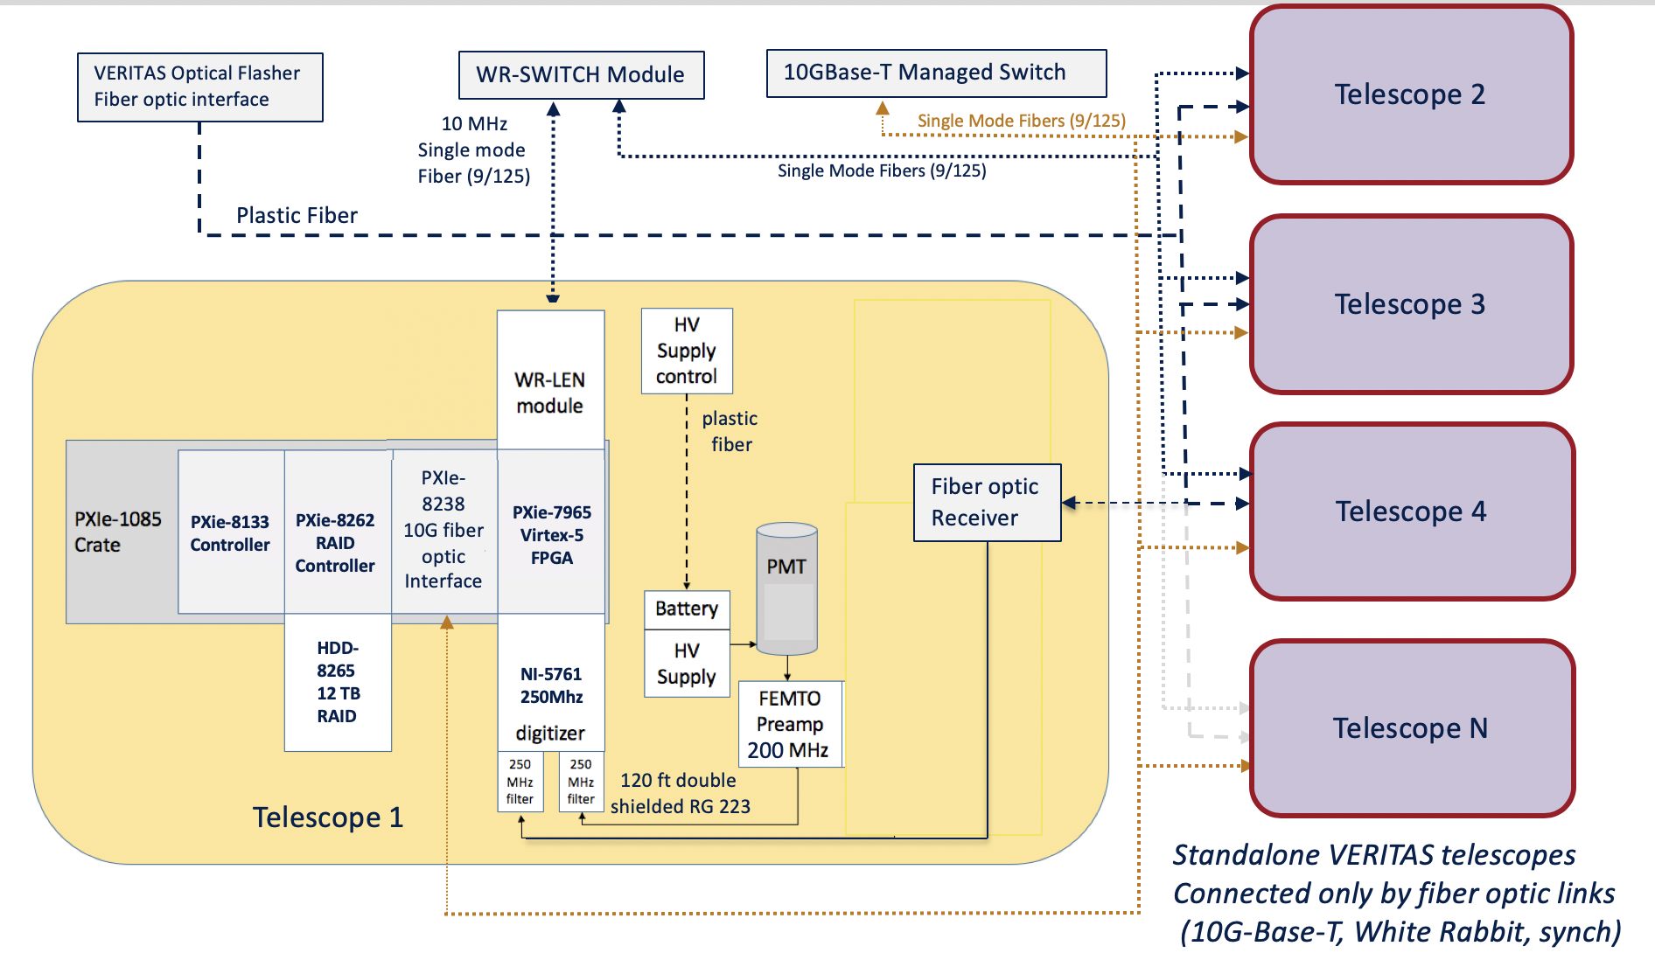
VERITAS SII DACQ system (2018-2026)
Each telescope records data independently
White Rabbit Synchronization of clocks at each telescope (Single mode fiber)
10G data transport network allows cross mounting of disk
Correlations computed offline /next day
7
Notes:
10/6/26
7
7

Slide 8
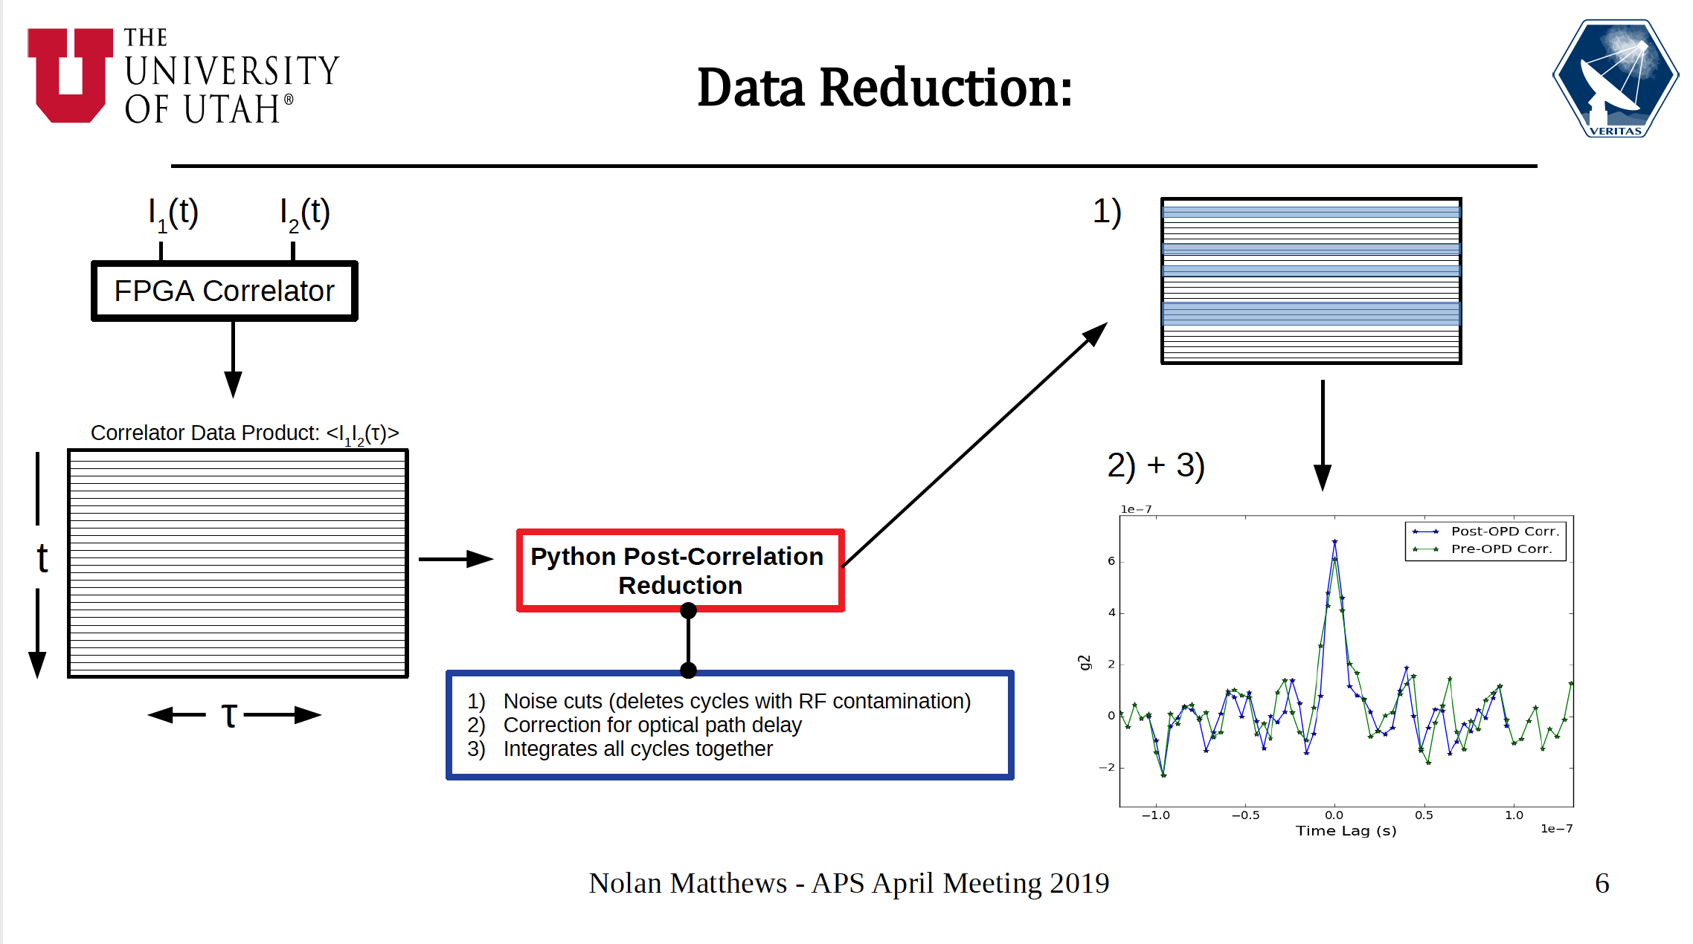
FPGA-based Data Reduction
8

Slide 9
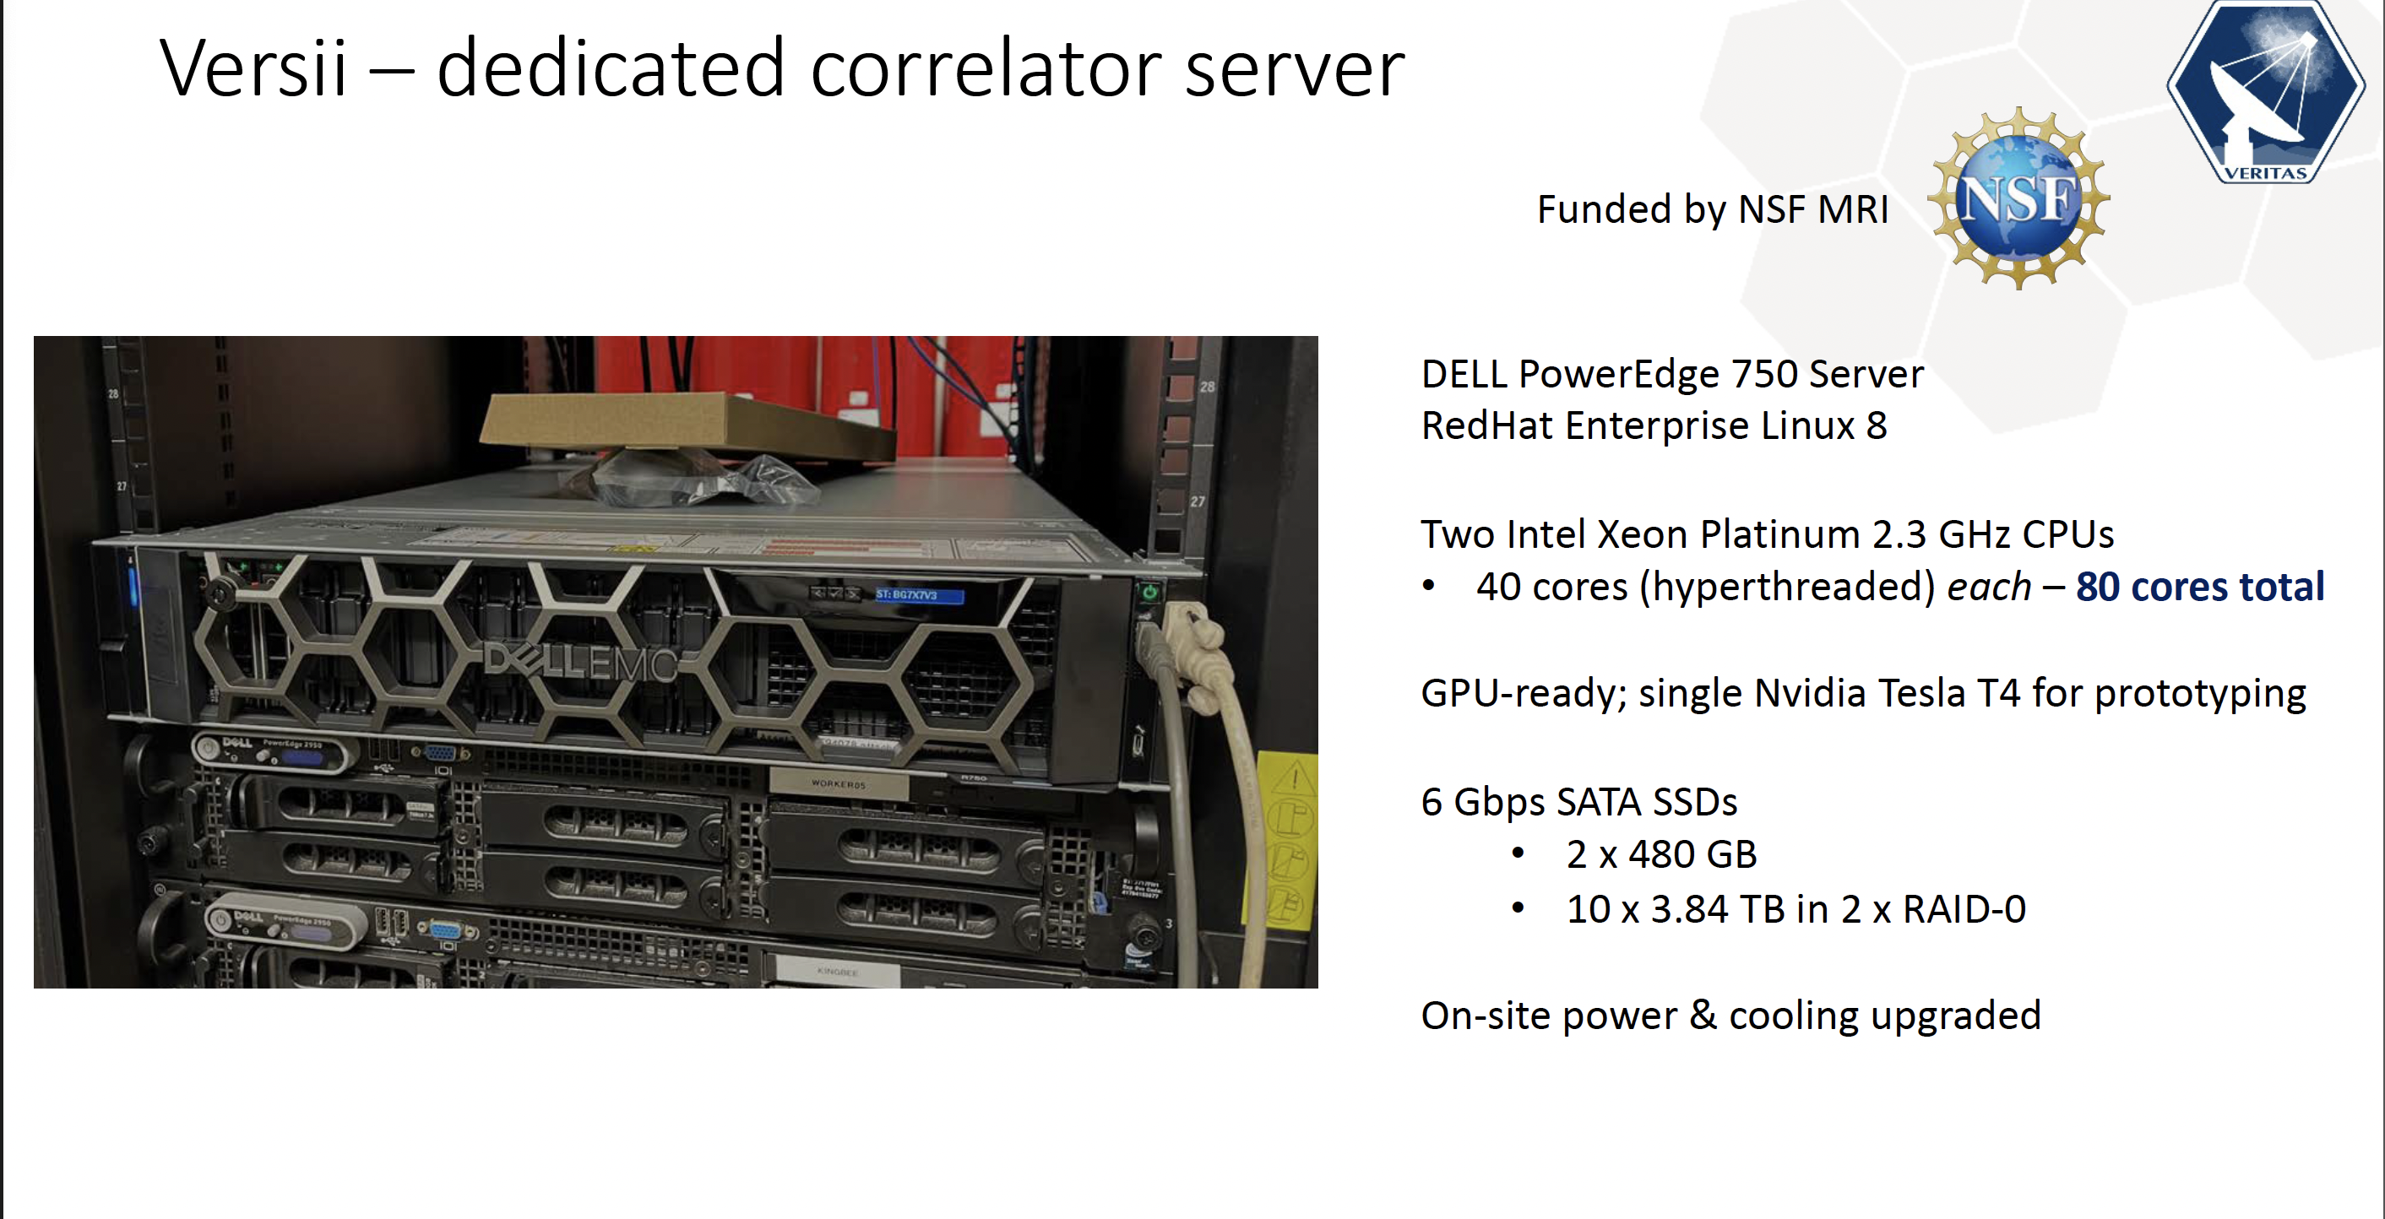
9

Slide 10
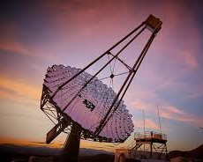
VSII
Observations
(2021-present)
10

Slide 11
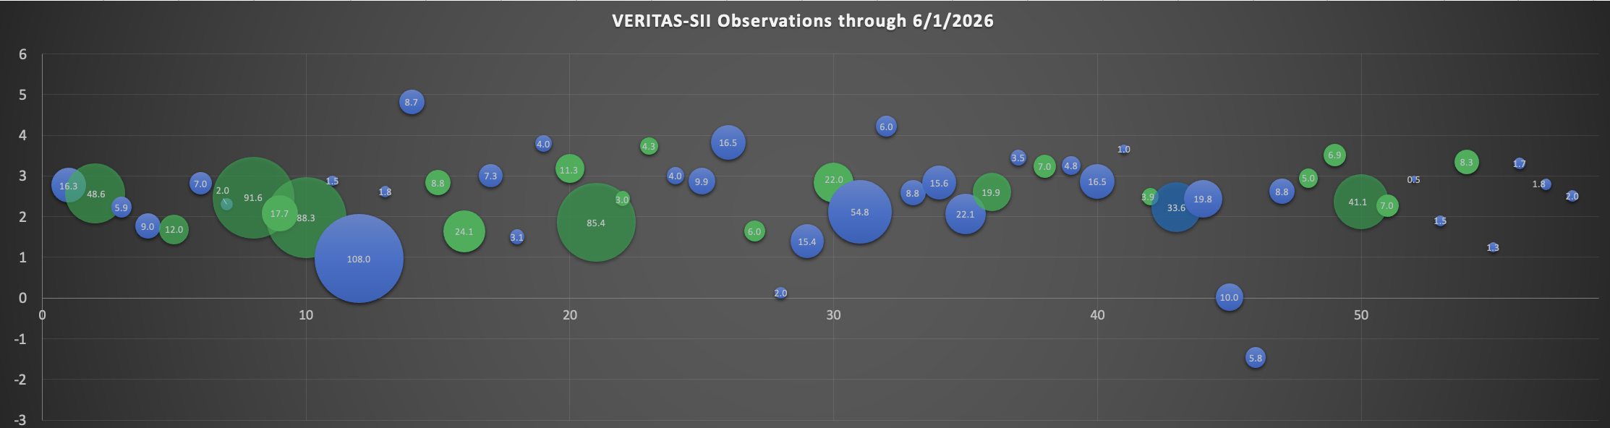
The VSII Survey Dataset (through Jun 1, 2026)
m_{V}
O9 O9.5 B0 B0.5 B1 B2 B3 B7 B8 B9 A0 A1 A2 A8
Primary star
classification
- 58 different targets
33 single
- 25 binary/multiple
Total 964 hrs exposure
88 hours 2025-2026 obs season
Circle area is the number of each star’s exposure (hrs)
(12/1/19 – 6/1/26)
Single star
Binary/multiple star
11

Slide 12
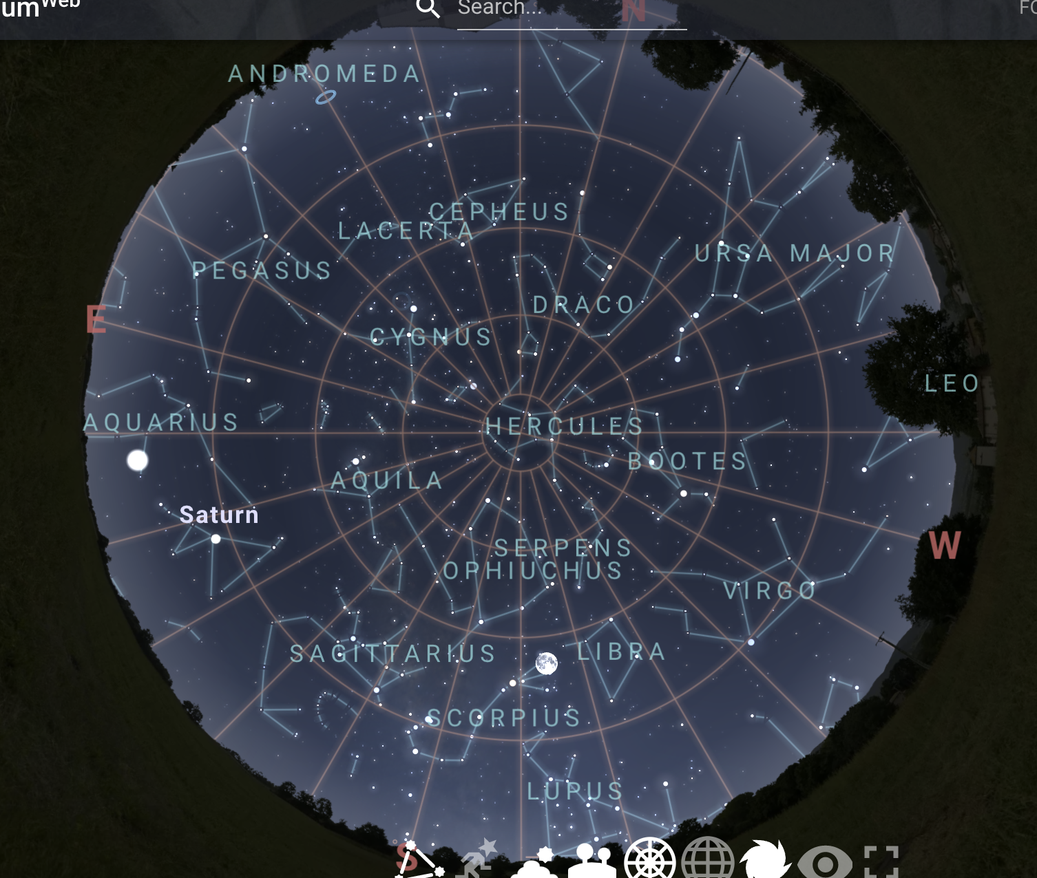
VSII Survey Observing Strategy
Moonlight is the main constraint
Atmospheric scattering of moonlight for moon angle < 30⁰
Direct light on focal plane for moon angle > 95⁰
Optimal sky darkness : moon angle ~80-90º
List of observable targets change every night
Try to select brightest targets
Prefer O, B, then A stars
Need at least 1 hour of observation
95⁰
30⁰
12

Slide 13
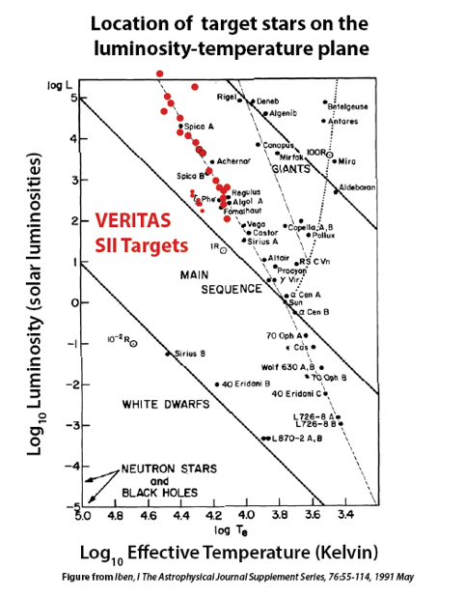
The VSII dataset
Almost 1000 hours of SII data (9/2019-present)
58 sources (33 single stars, 25 binary/multiple)
-1.46 < m_{V} < +4.82
FPGA processed data (to start)
Independent VERSII Dataset (starting 2022)
13

Slide 14
Analysis strategy
Process each observing run to assess whether a clear peak is seen or not
Characterize each run according to Signal-to-Noise
  High- clean, unambiguous peak. Multiple standard deviations above background. Error bar is simple
  Marginal- likely peak , but signal/noise is 1-3 std devs so needs some TLC to estimate error bar.
  Low- no clear peak. Might be useful for an upper limit.
Visual classification of each run (~9,000 manual scans)
14

Slide 15
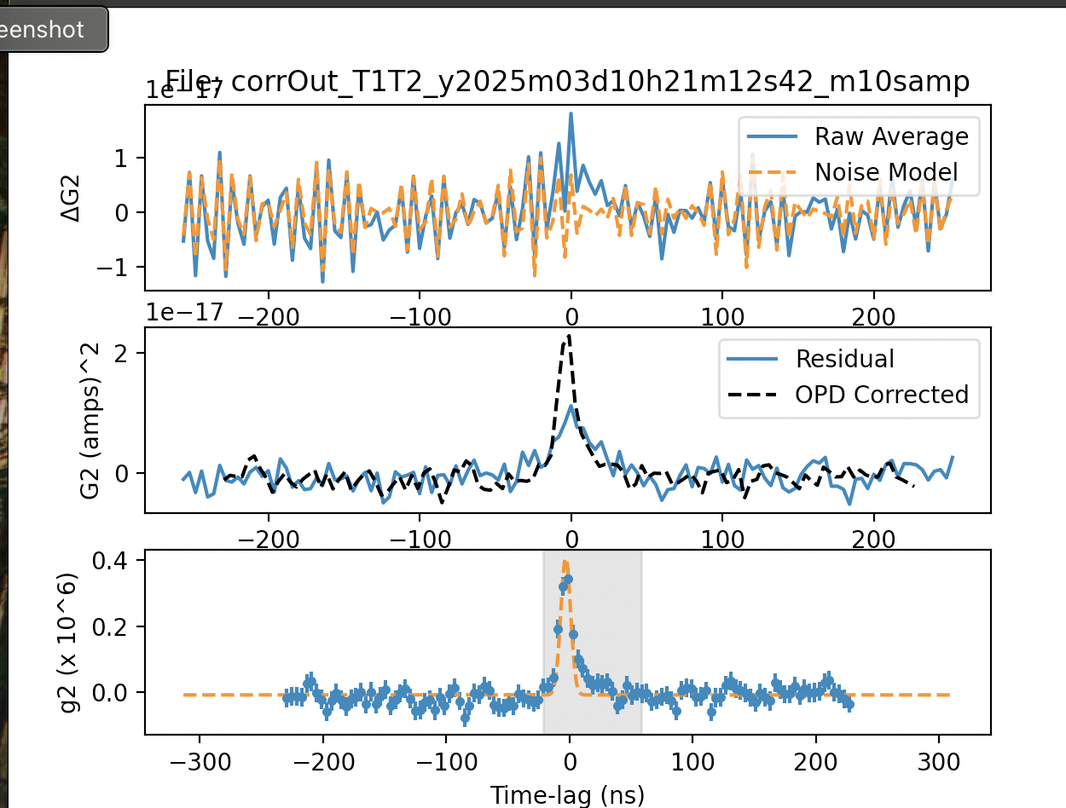
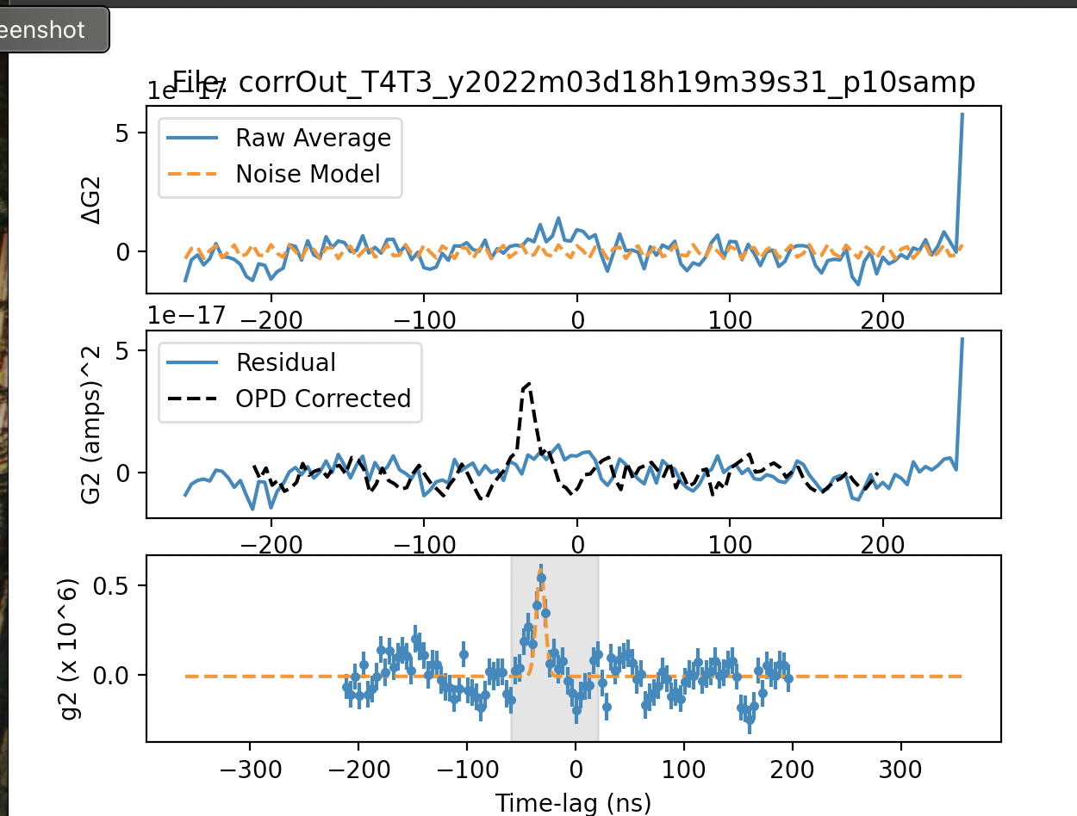
VSII Catalog: High S/N Selection
15

Slide 16
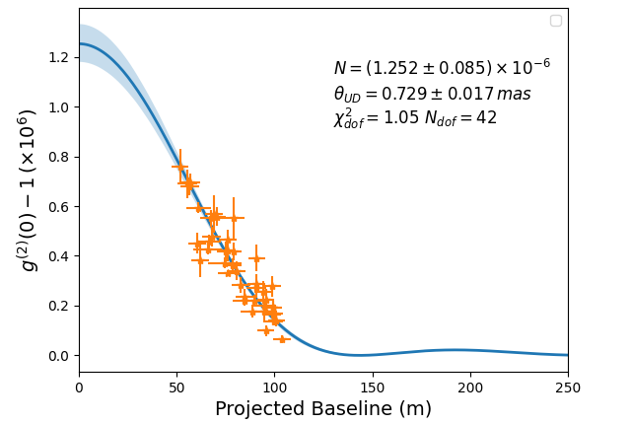
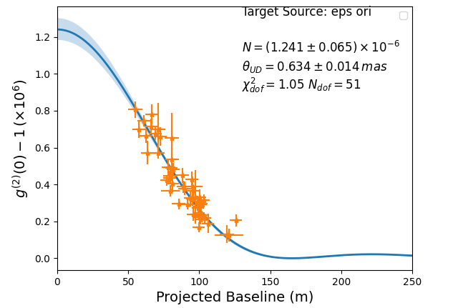
gam Ori: High S/N
Single Stars (slow rotation)
eps Ori: High S/N
16

Slide 17
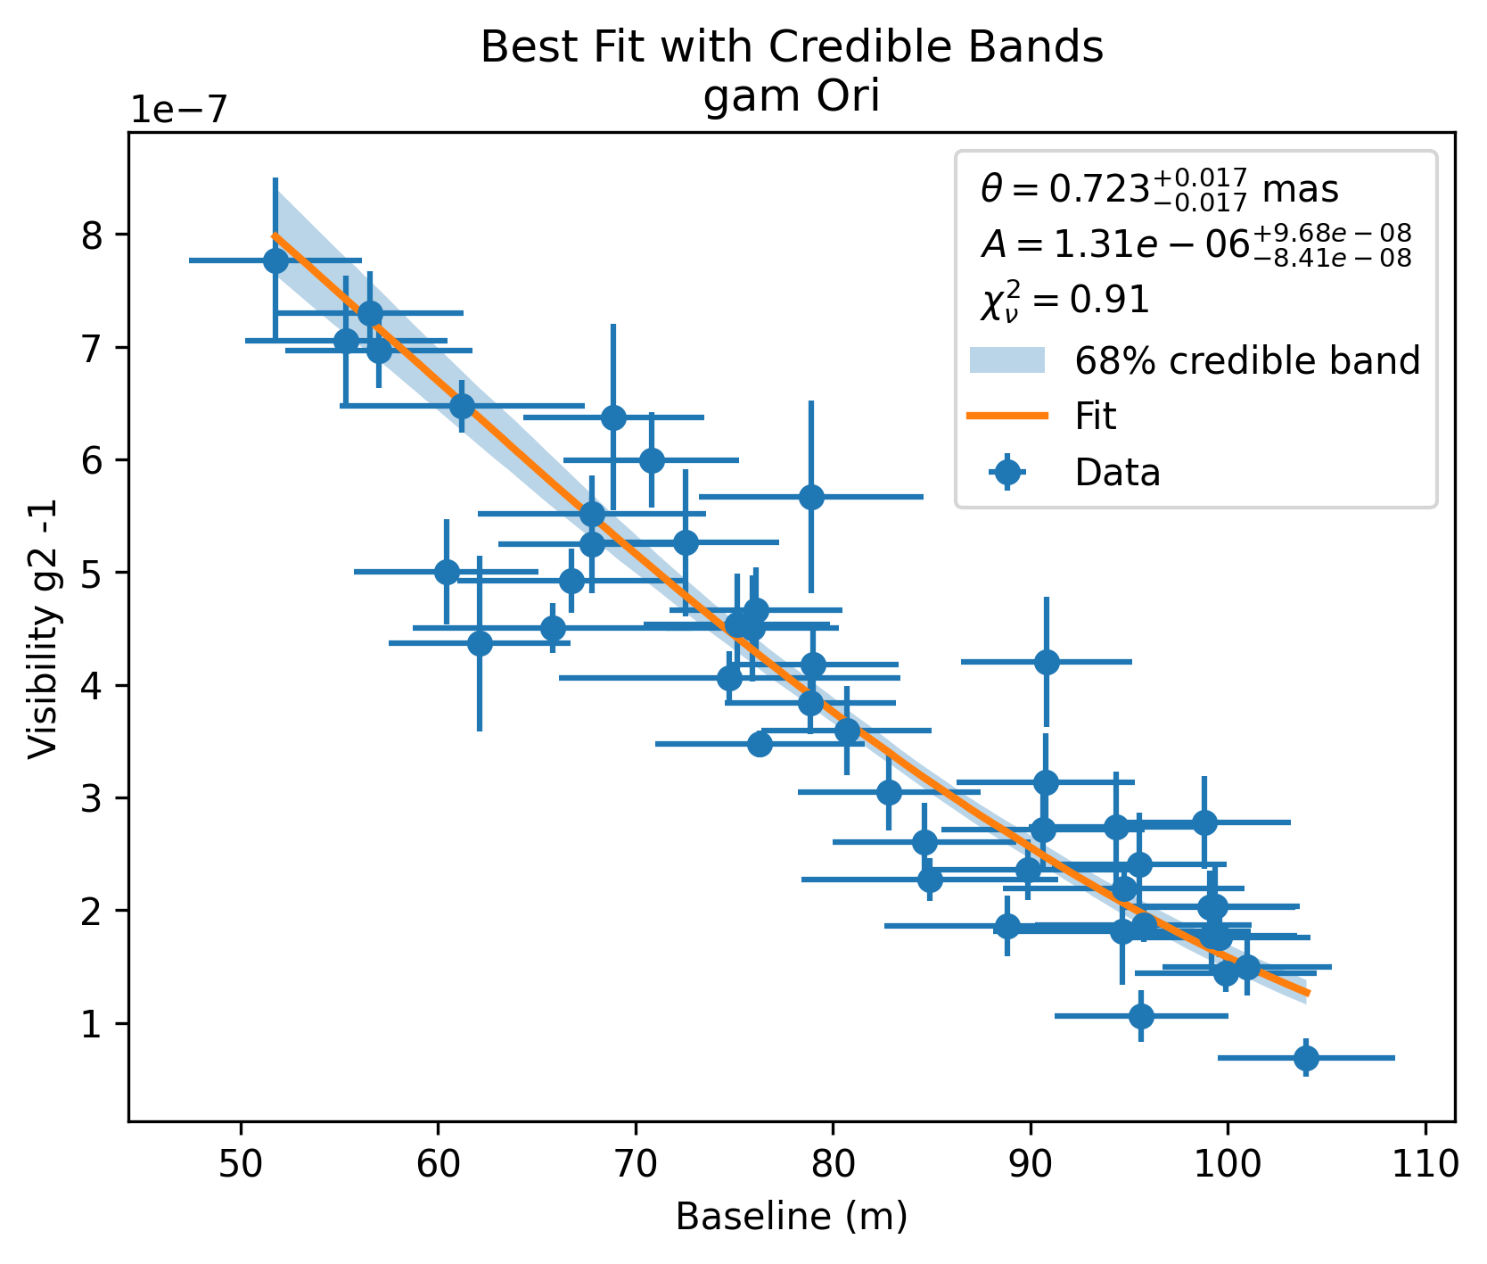
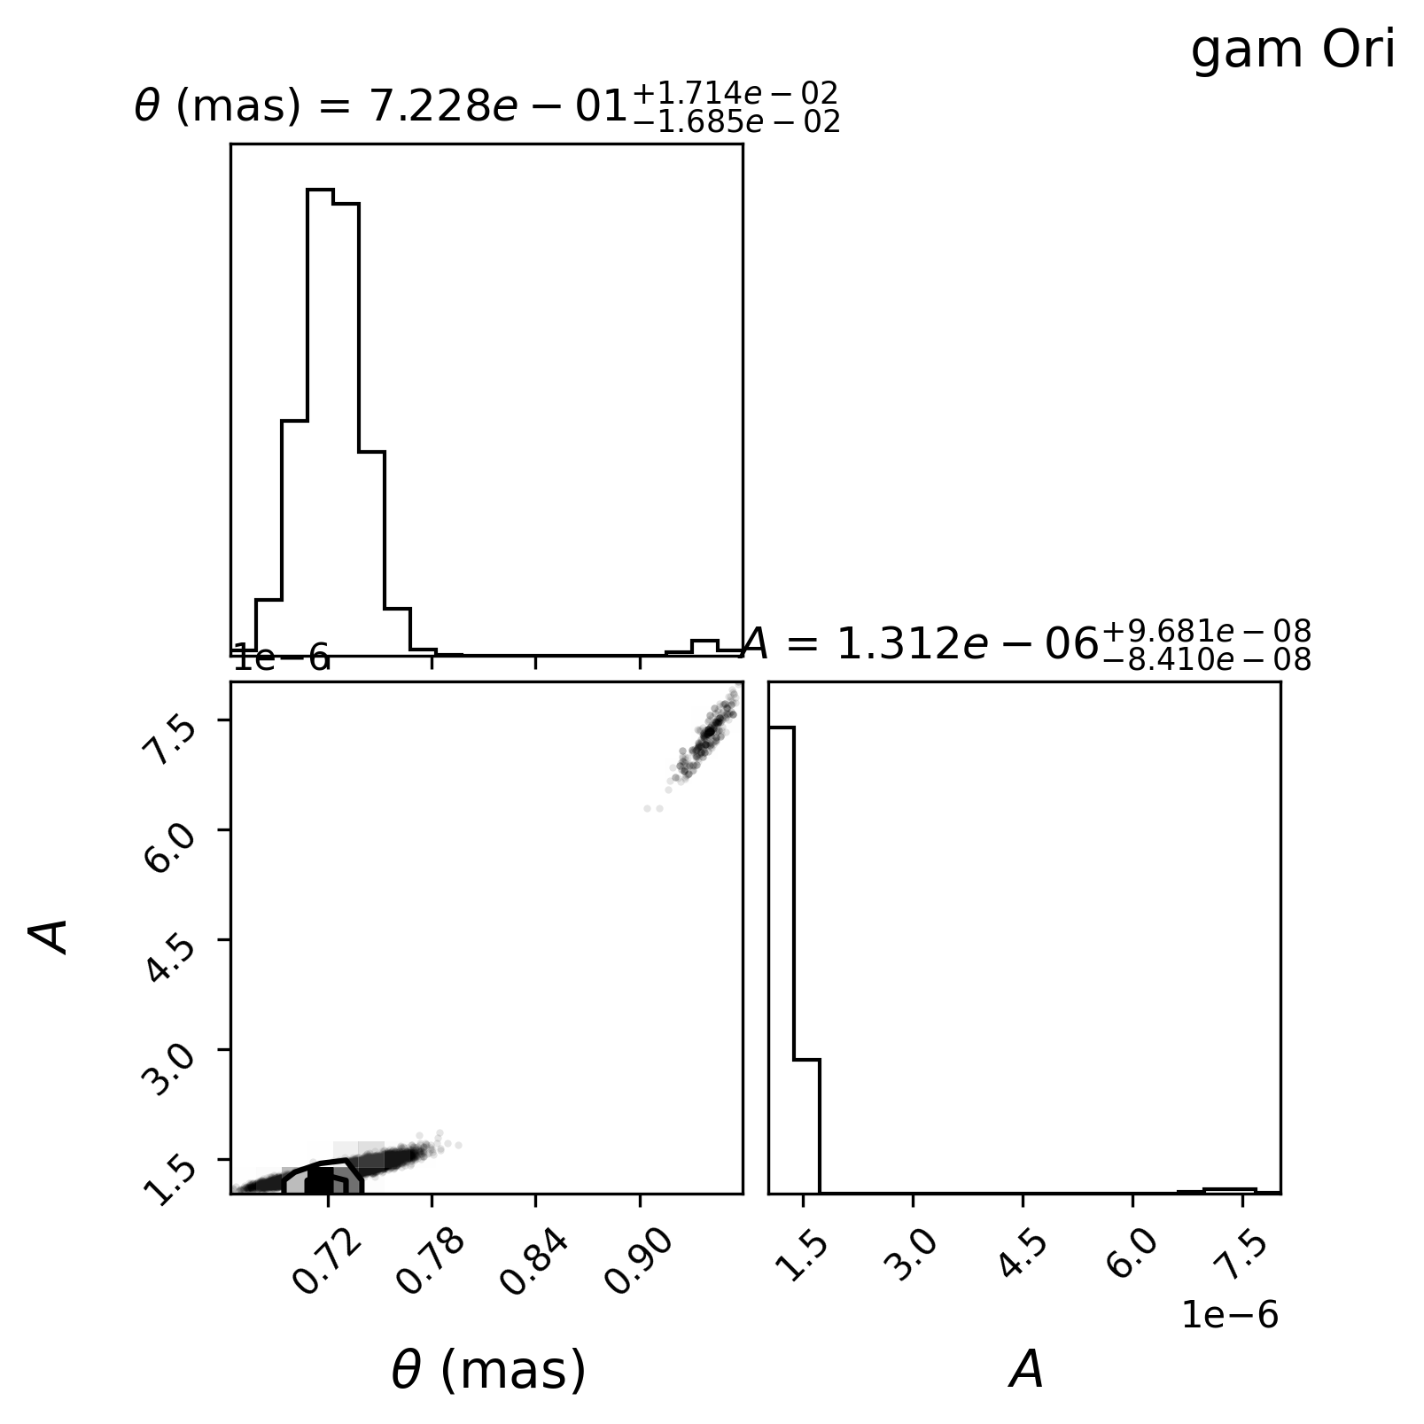
Gam Ori (Bellatrix) : high S/N
17

Slide 18
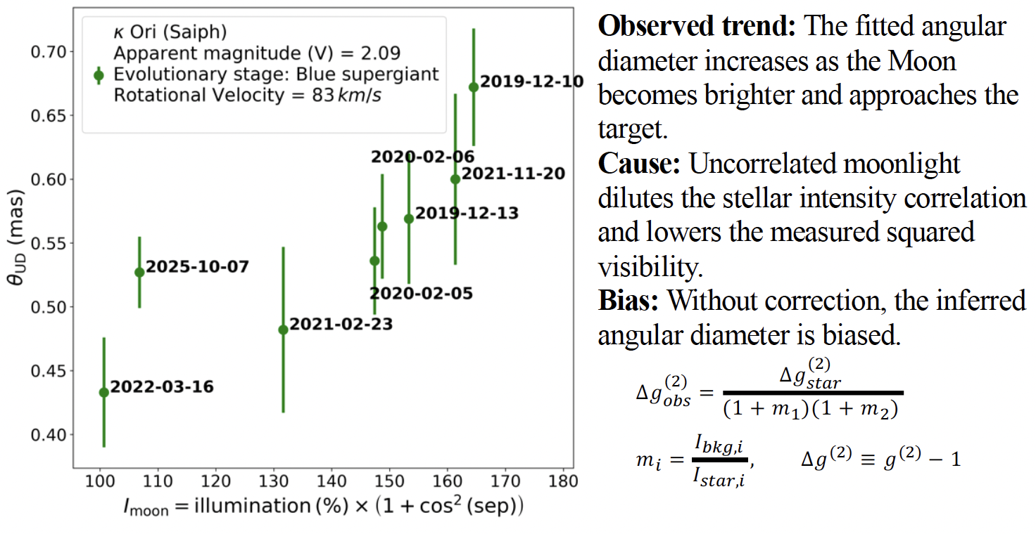
Moonlight effects on SII Obsverations
Hangzhang Zhang, University of Utah
18

Slide 19
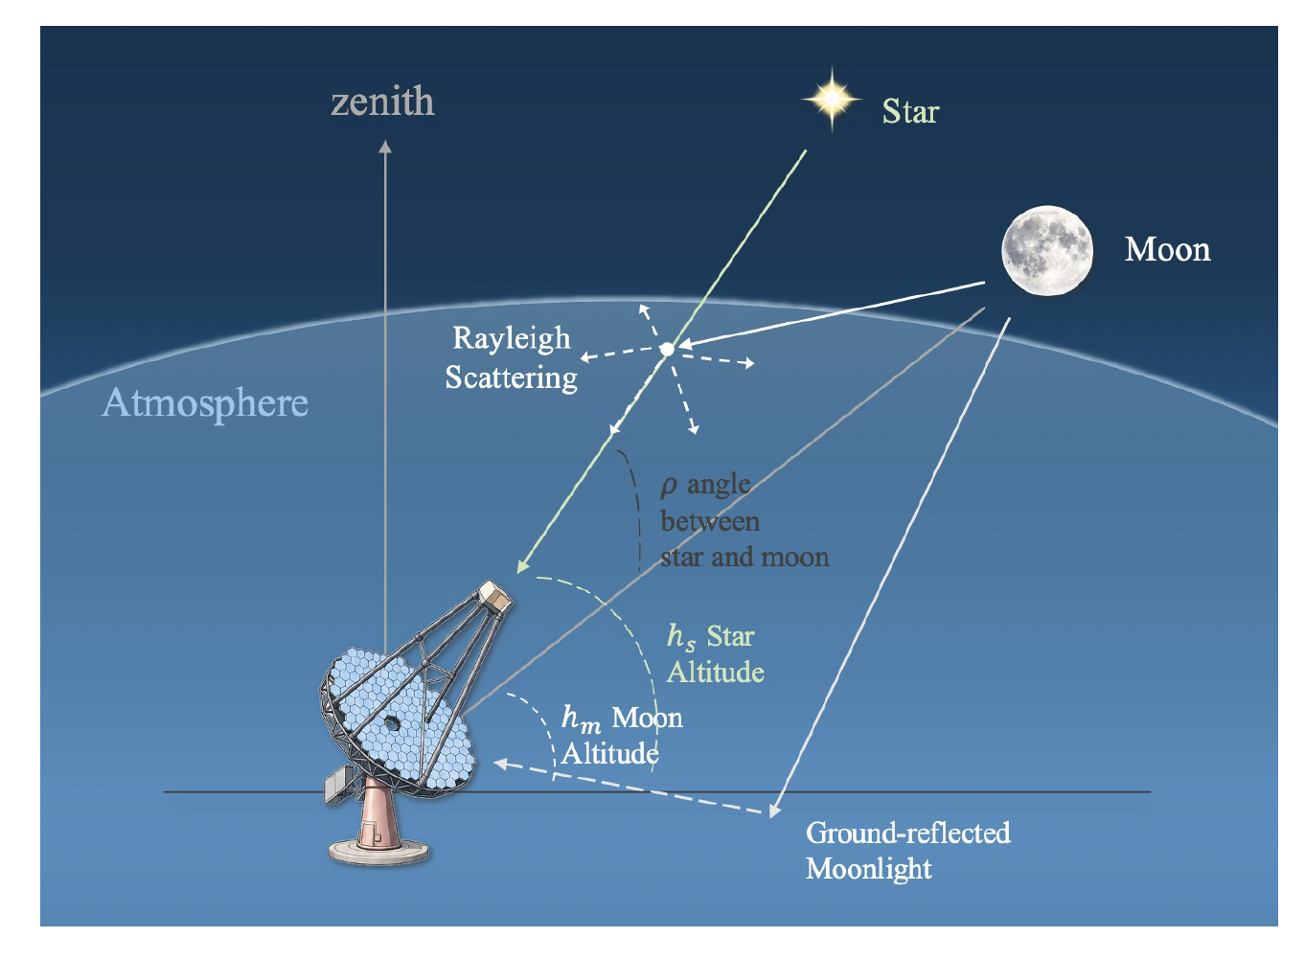
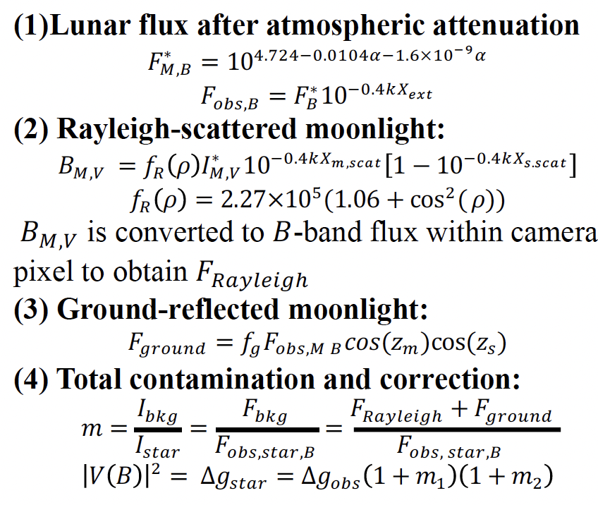
Moonlight Correction Model
Included effects:
19
Hanzhang Zhang, University of Utah

Slide 20
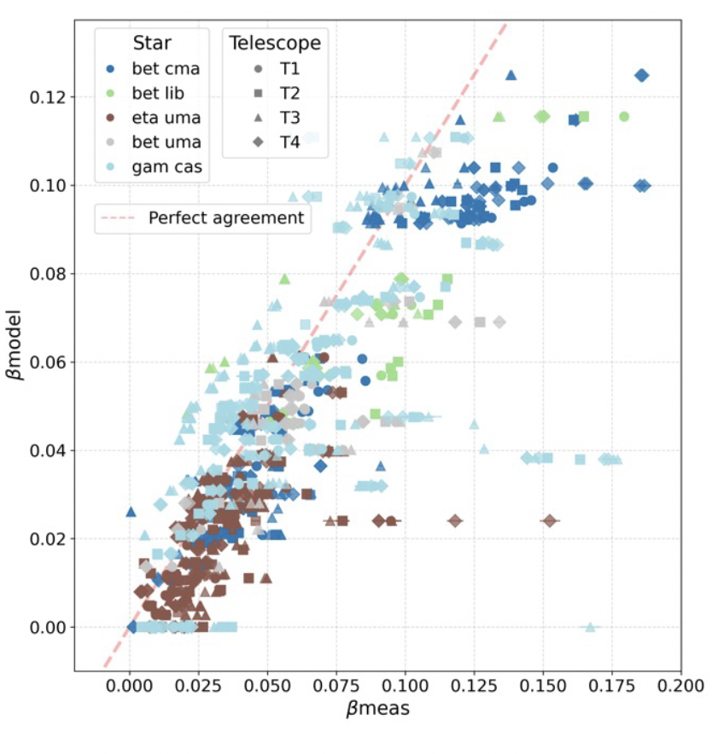
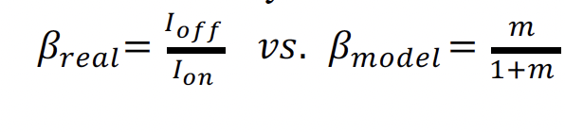
Moonlight Model Validation
Allows measurement for the ground scattering factor
F_{ground} for each telescope (each telescope is different)
Stragglers on single observing nights-----clouds scattering?
Hanzhang Zhang, University of Utah
20

Slide 21
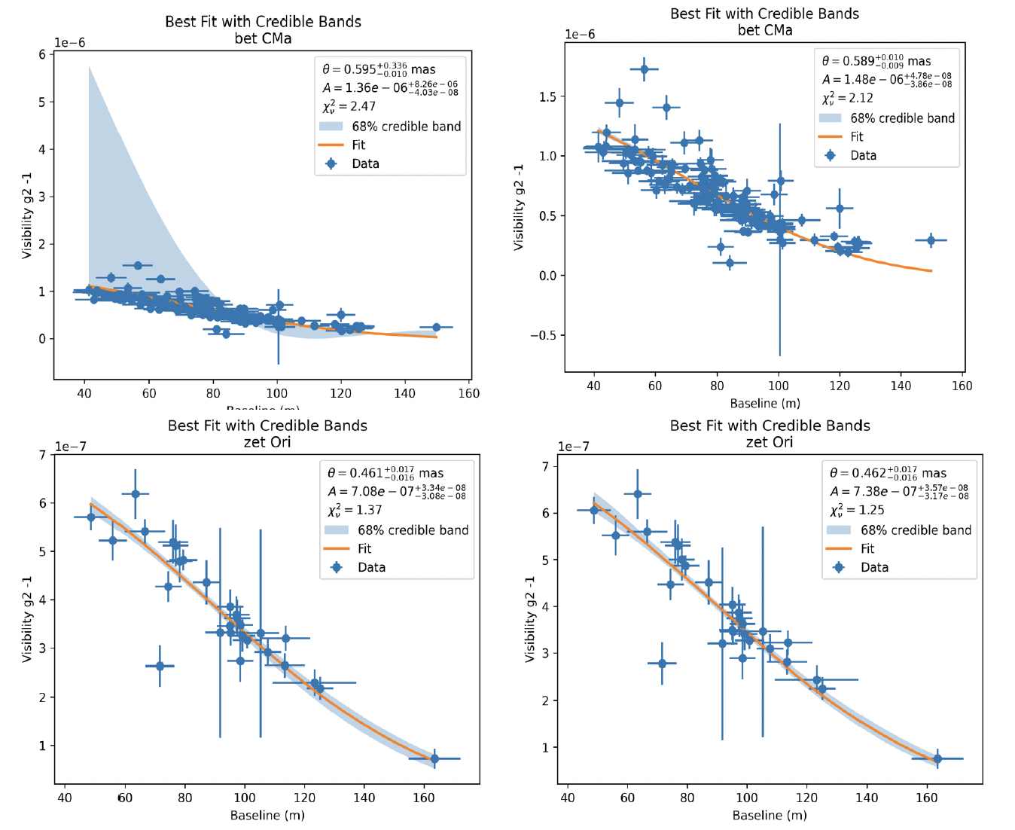
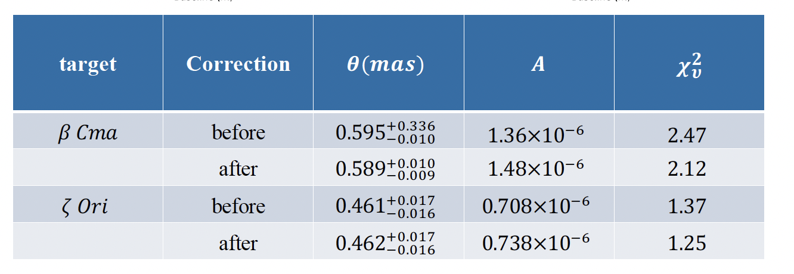
Effects on Angular Diameter Measurements
Generally improves quality of fit
Some effect on the angular diameter in certain
observations
Depends upon specific observing details
- Stellar brightness m_{V}
-moon phase
-moon elevation
-Angle to moon, etc
Hanzhang Zhang, University of Utah
21

Slide 22
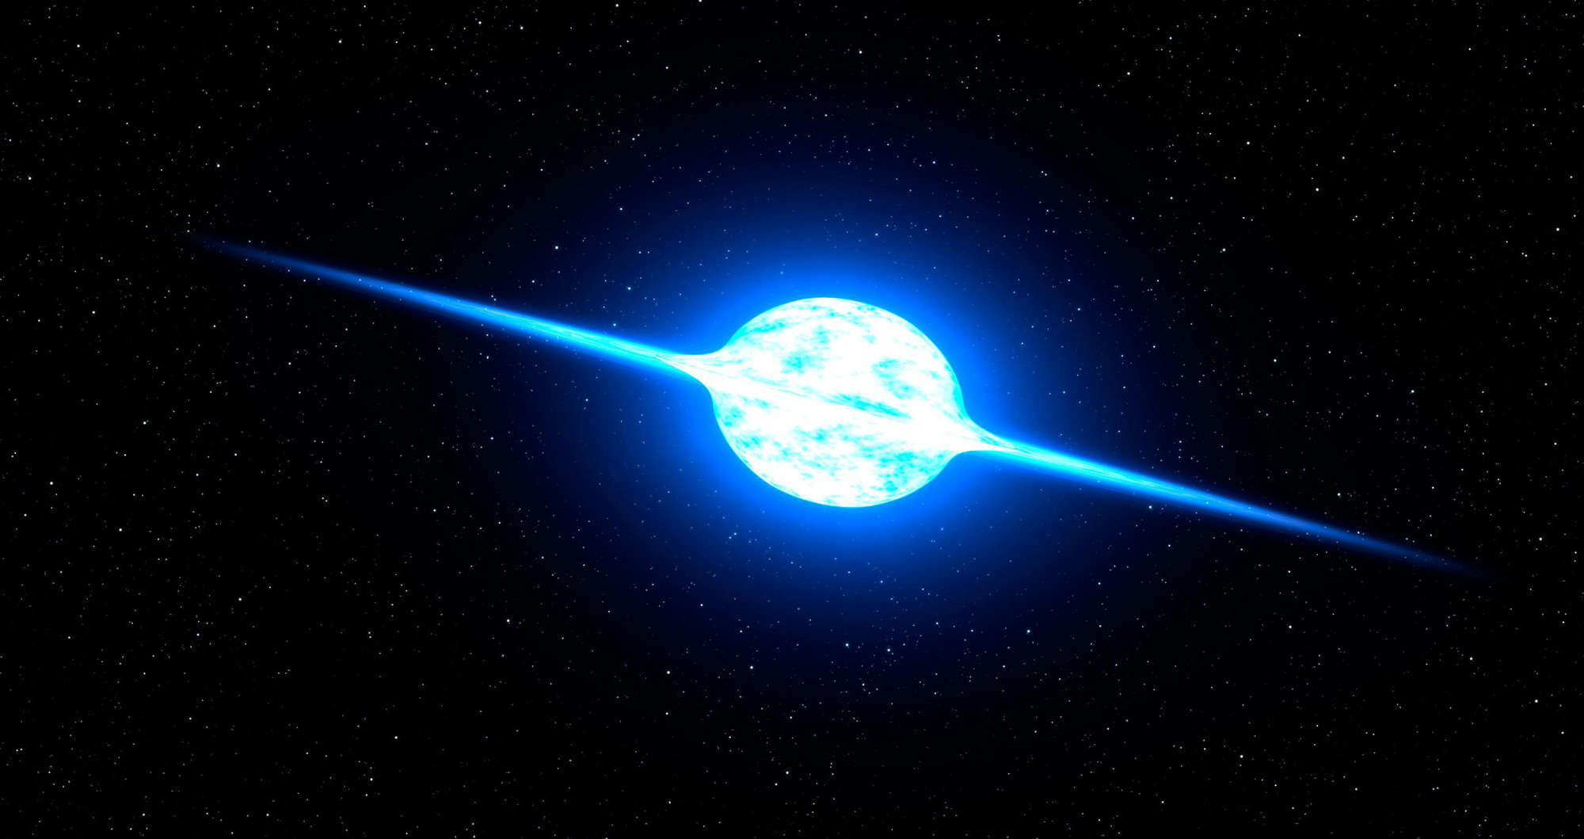
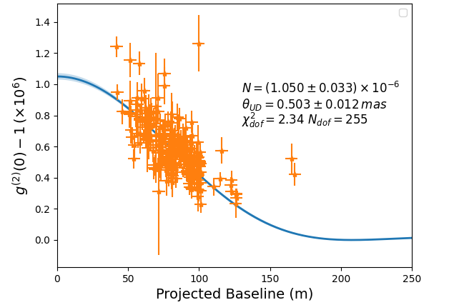
gam Cas: High S/N
Single Stars (rapid rotators)
13 M⊙ B0.5IVe Star, T = 25,000 K
Prominent Variable star (V =1.6-3.0), average V =2.47
168 pc distant, multiple star system (T_{Aa}=203 d; T_{Ac}=60 yr)
Radiation illuminates nearby gas clouds IC59/IC 63 (1 pc)
Fast rotator (v sin i = 432 km/sec)
*Quantitatively different than slow rotator curve……
22

Slide 23
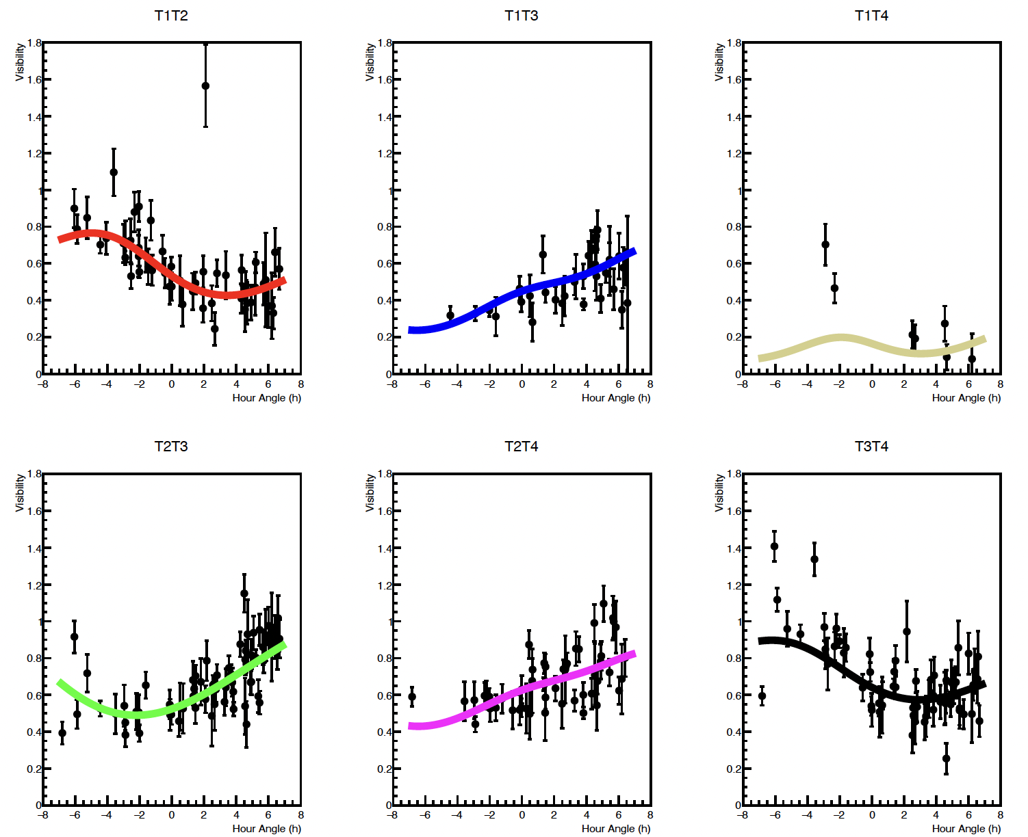
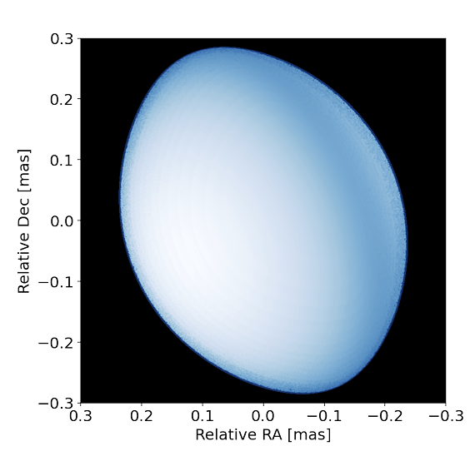



gam Cas full stellar model fit (Roche-von Zeipel)
Single Stars (rapid rotators)
23
Also see Limited VERSII data set results (VERITAS, published in Ap. J 2025)

Slide 24
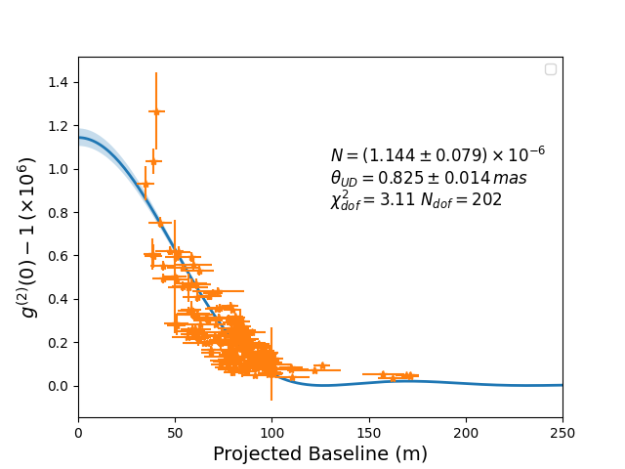
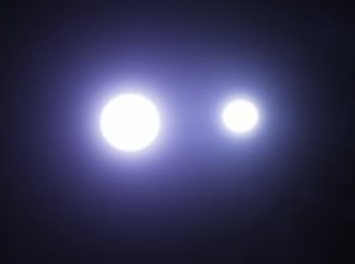
alp Vir: high S/N
Binary/ Multiple Star Systems
B1III +B2V Star Binary system
Prominent Variable star (V =0.97-1.04)
77 pc distant
4.01 day period
*Quantitatively different than single star/fast rotator curve……
24

Slide 25
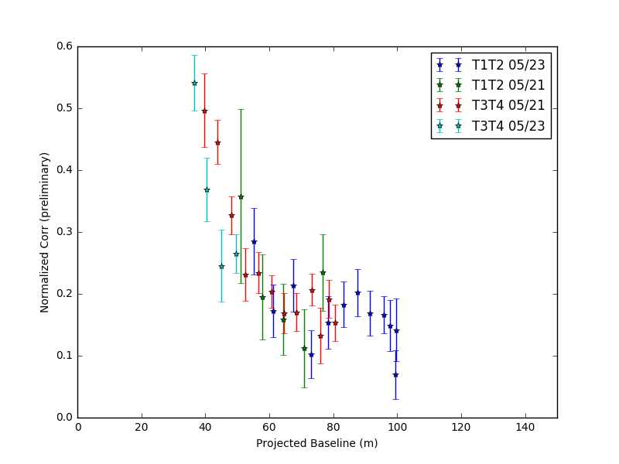
VERITAS-SII 4 Telescope Observations
‘Generic’ Binary System (May 21-23, 2019) [Spica]
Preliminary analysis:
’Standard’ T2-T3 correlations
(40-70m baselines)
‘New’ T1-T2 correlation
(40-100m baselines)
Strong evidence for
secondary interference
peak ~90m (binary system)
T1-T4 correlations: TBD
(120-150 m baselines)
Preliminary look is great!
(caveat emptor…please wait
for a full science analysis)
25 x 20 min 4-telescope observations (over 2 nights)
25

Slide 26
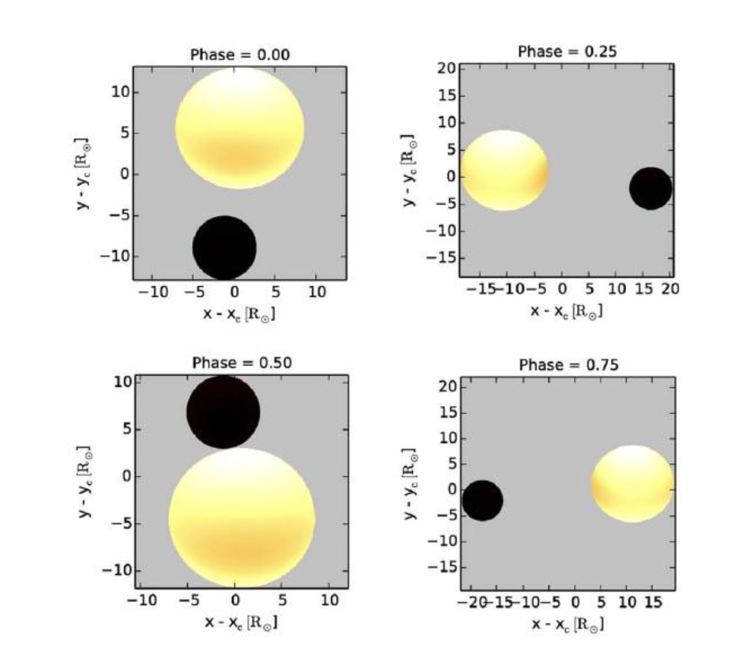
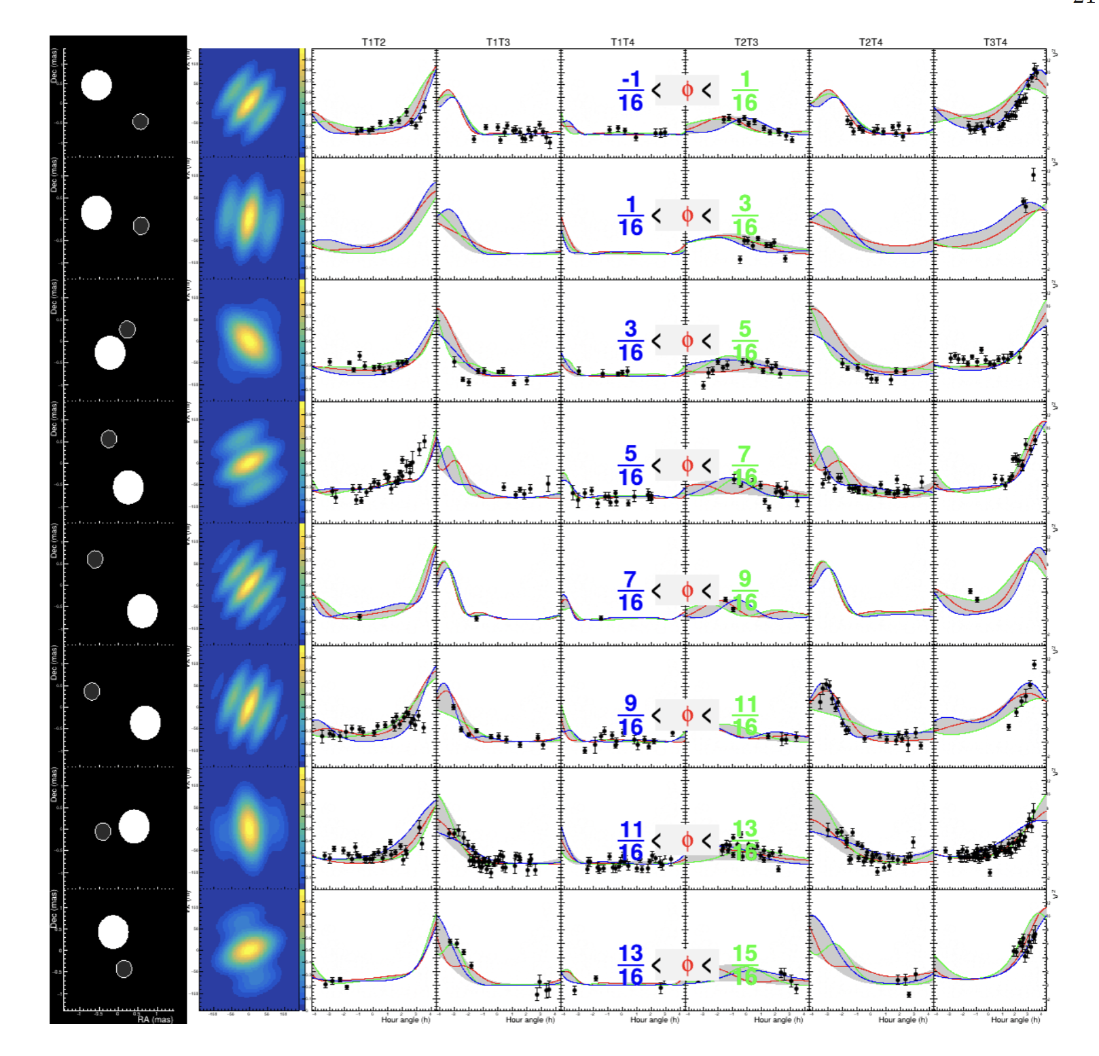
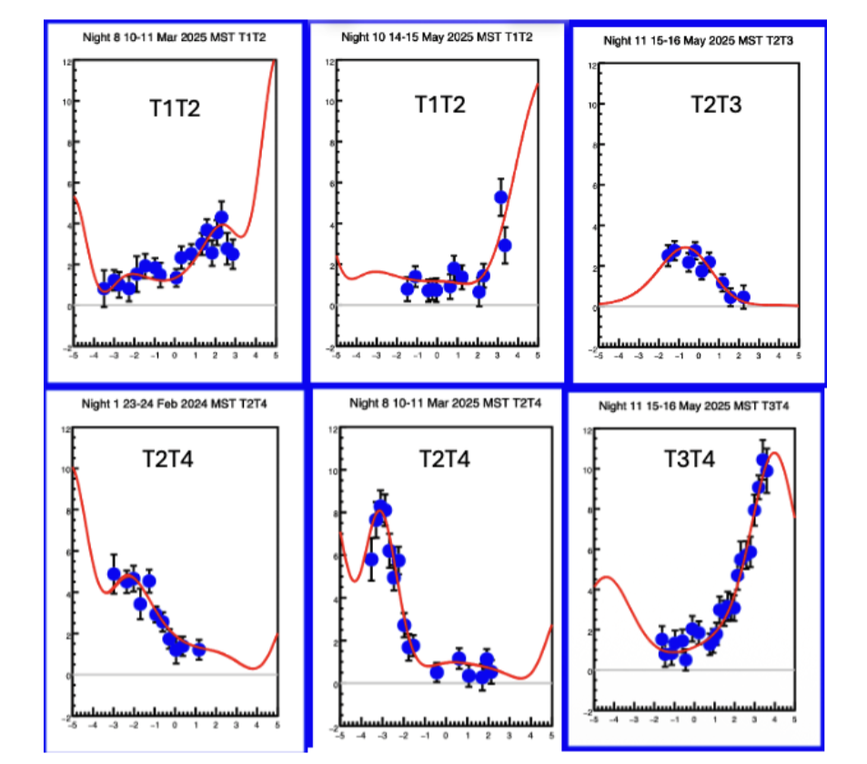
Binary System measurements
of binary alpha Vir (Spica)
Resolving visibility as a function of both
orbital phase and observational hour angle
Use SII + Spectroscopy to fit orbital parameters
See Mike Lisa’s excellent talk on Wednesday!
)
26

Slide 27
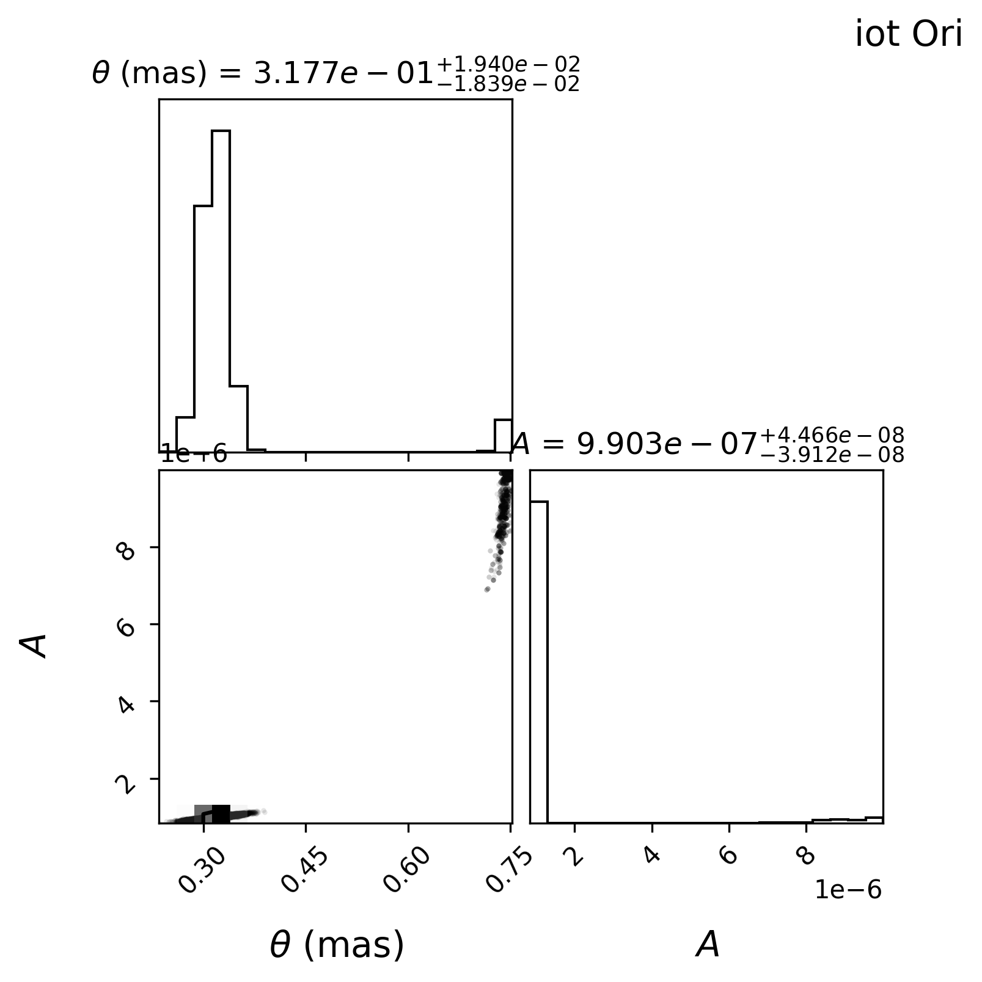
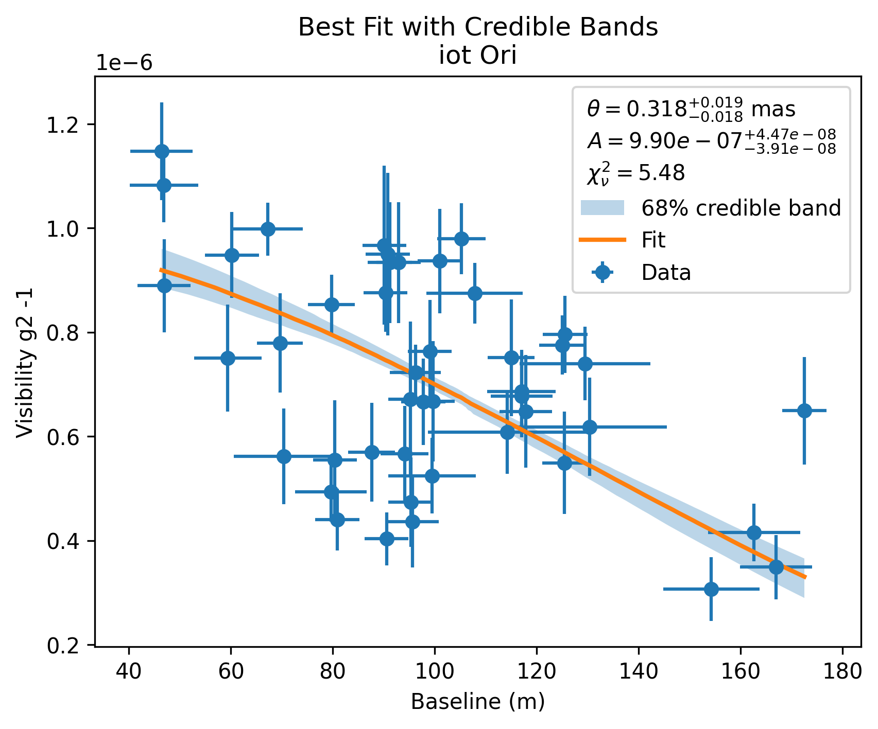
iot Ori (Na’ir al Saif) : another high S/N binary
27

Slide 28
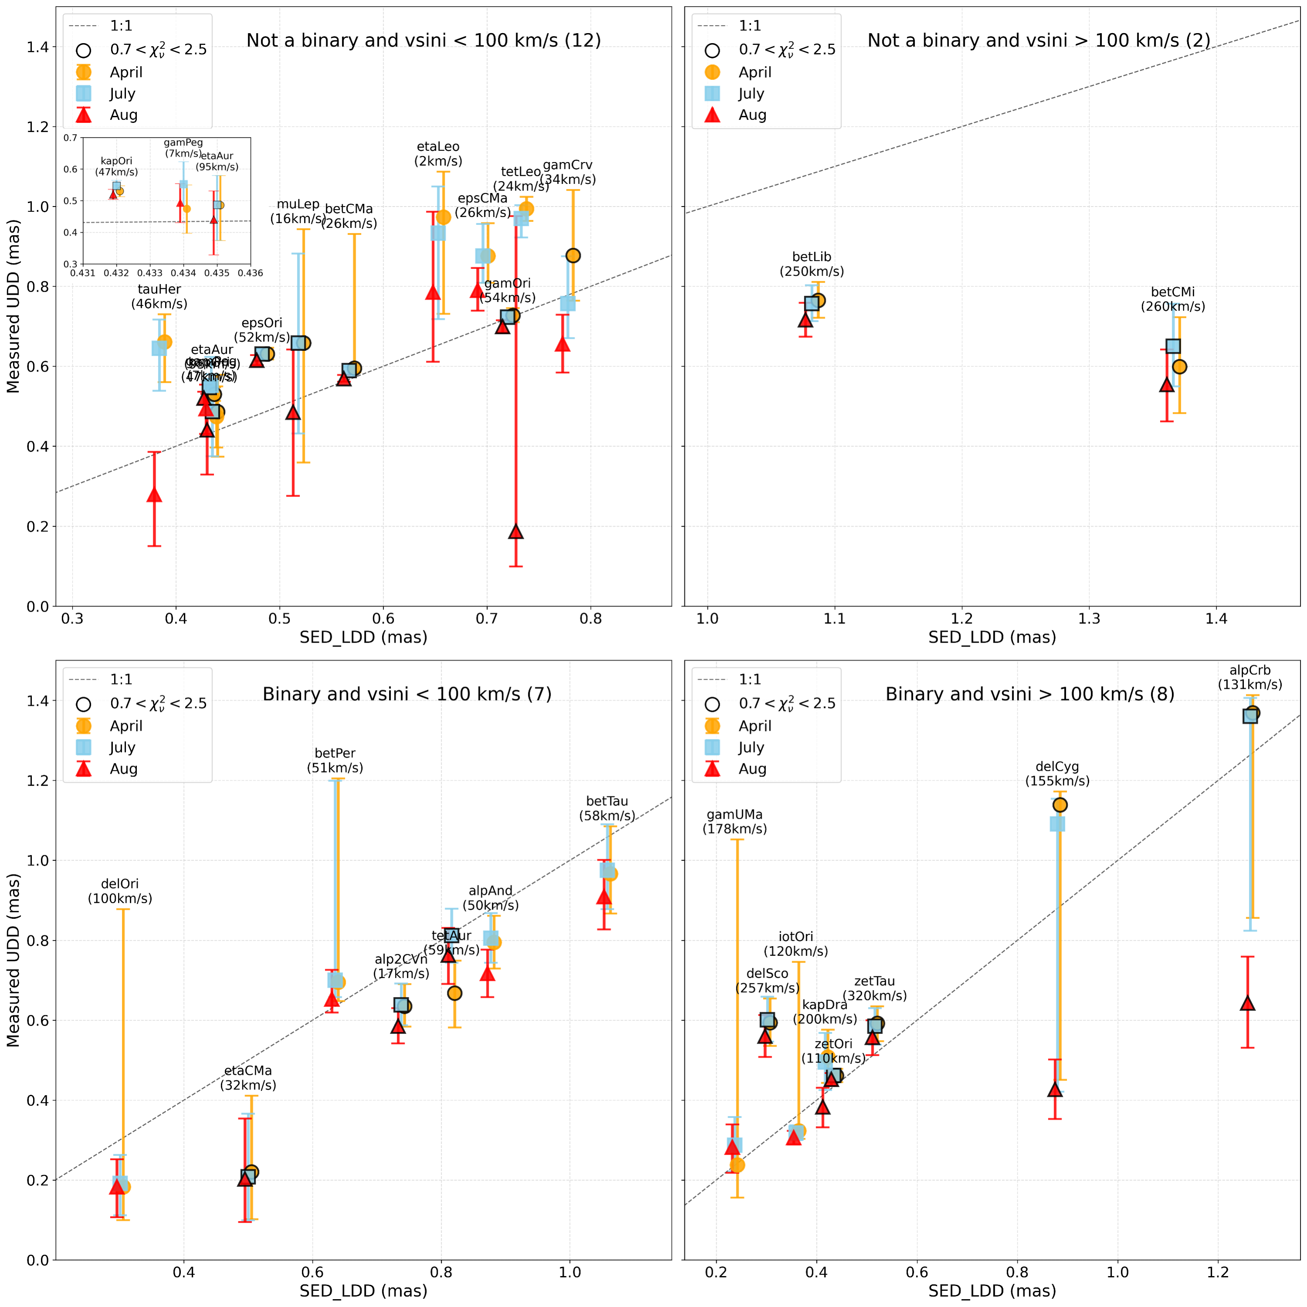
VSII OBA Survey
Quality Improvements
Getting better agreement with
Stellar modelling as Survey Pipeline
Analysis Improves
Some high S/N stars have very short exposures (< 5 hours): dominates the error in diameter measurements
Need additional observations of these sources (2026-2028) to reduce error bars.
28

Slide 29
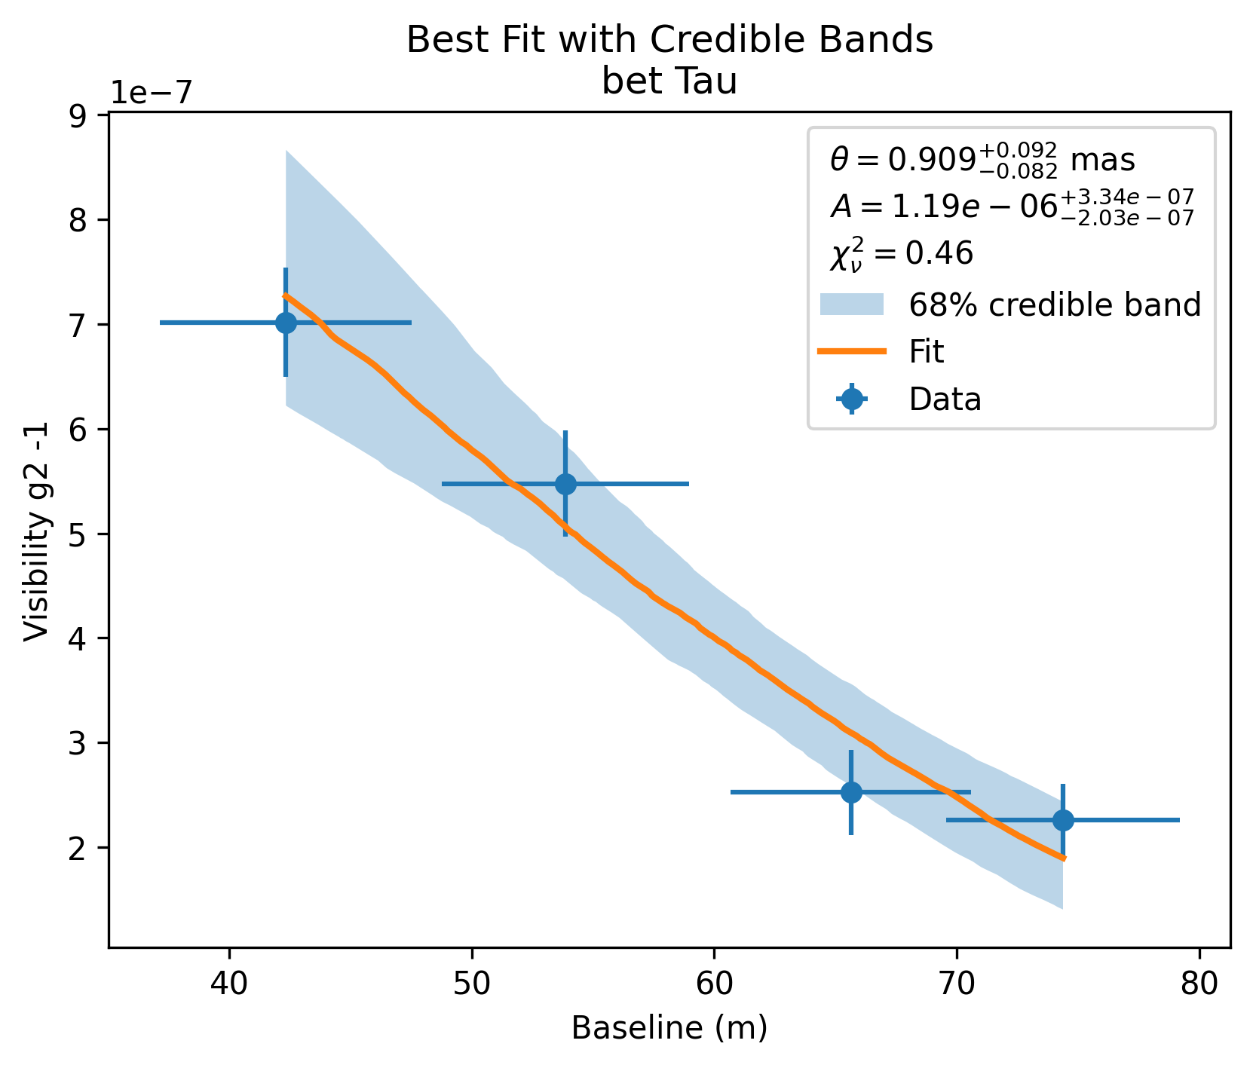
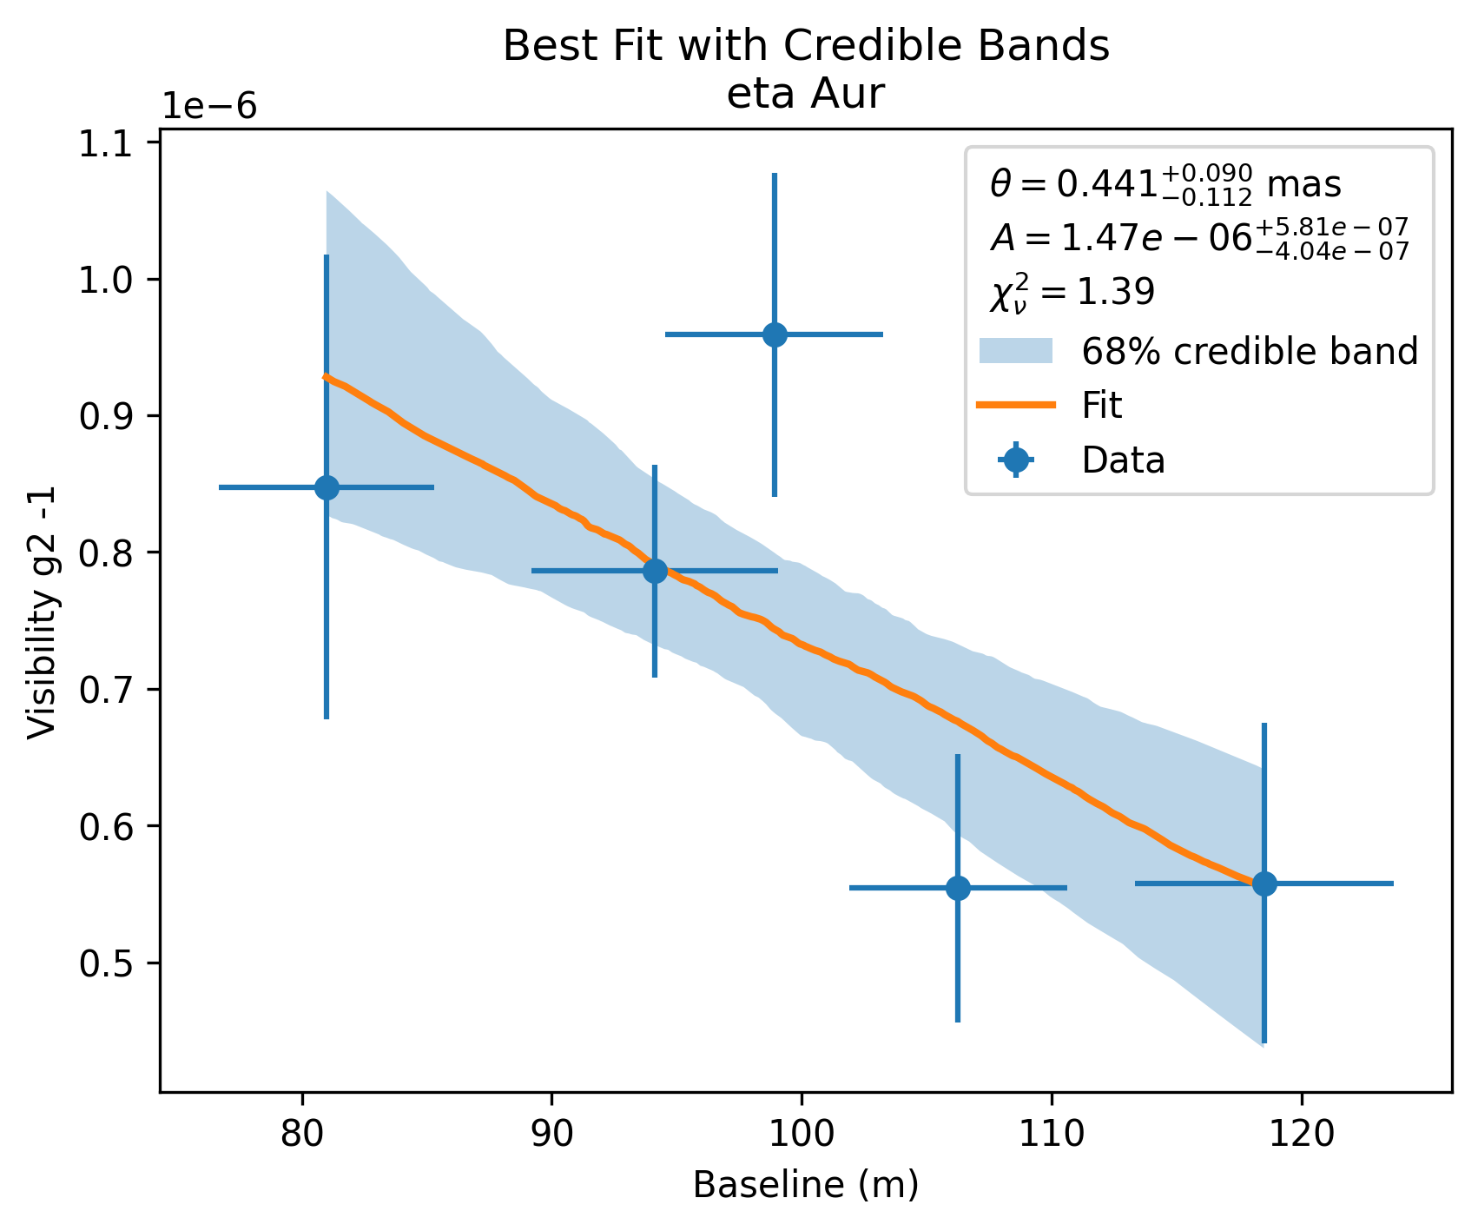
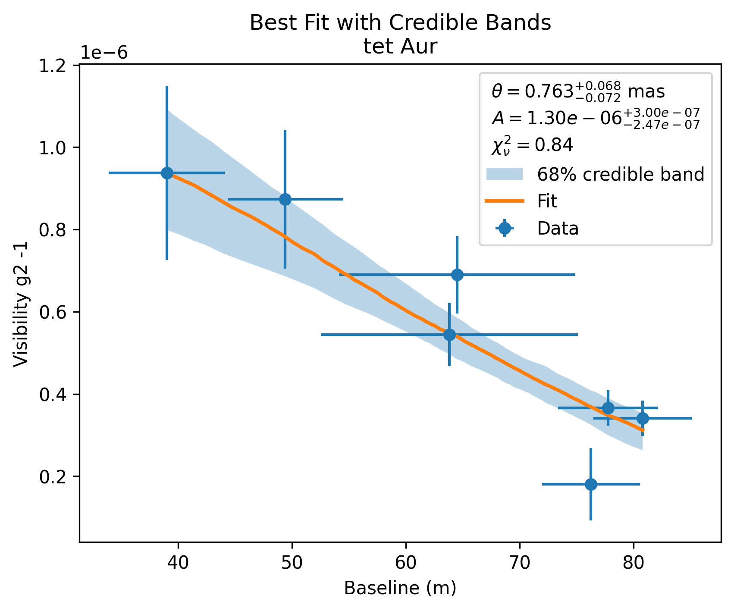
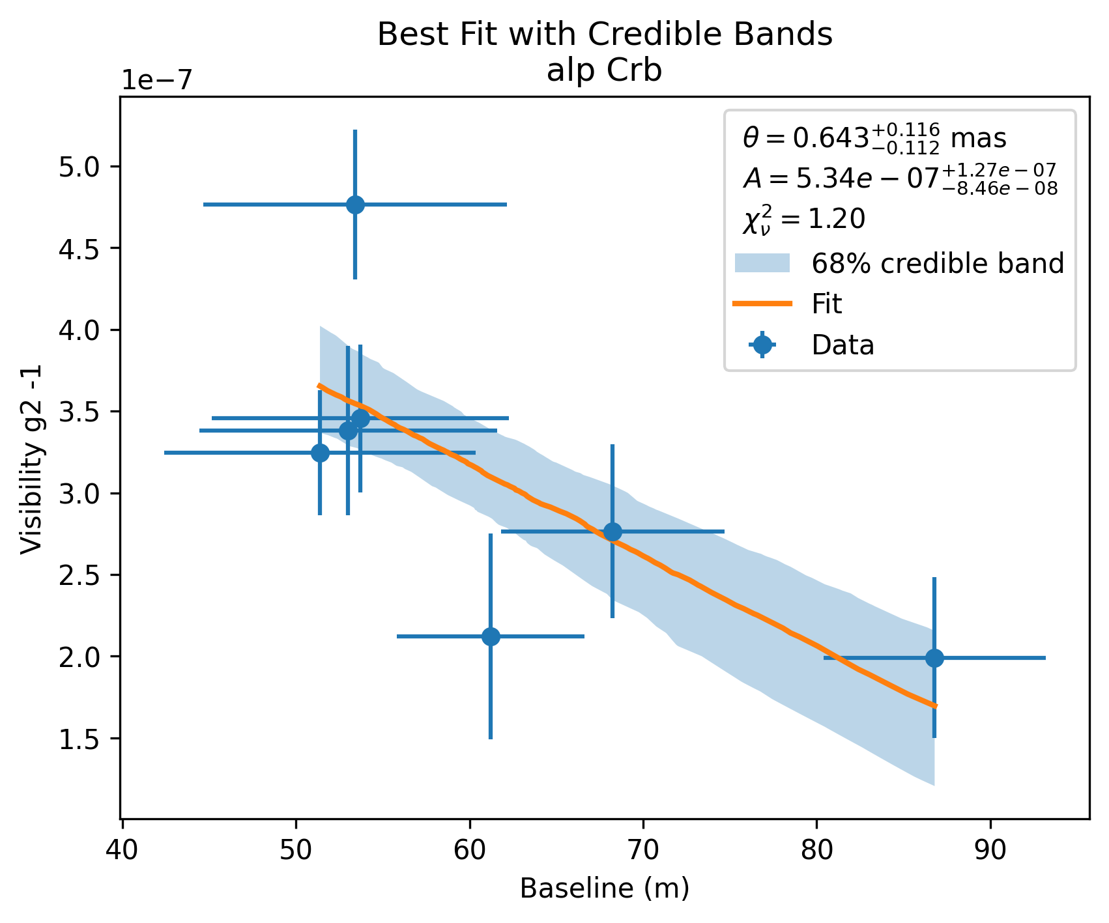
Short observation time sources (High S/N)
29

Slide 30
VSII Northern OBA Survey 10/6/2026
High S/N database of VSII Observations (FPGA dataset)
Corrected for Moonlight/sky background effects, weather, tracking corrections
Text format output – easy to read
Two standard analysis fitters provided: Scipy ODR + MCMC
Specialized analysis to use standard analysis fitters: HA analysis, orbital analysis, etc.
Parallel path for VERSII processed data (not all FPGA data)
“Out of the box” accessibility: We can send a link to database & analysis tools to any interested person. Only requires python (+ libraries astropy, scipy, emcee, etc). About 5 minutes to do your first analysis
30

Slide 31
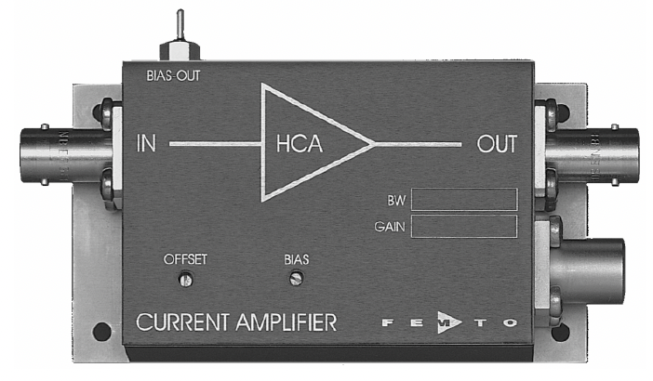
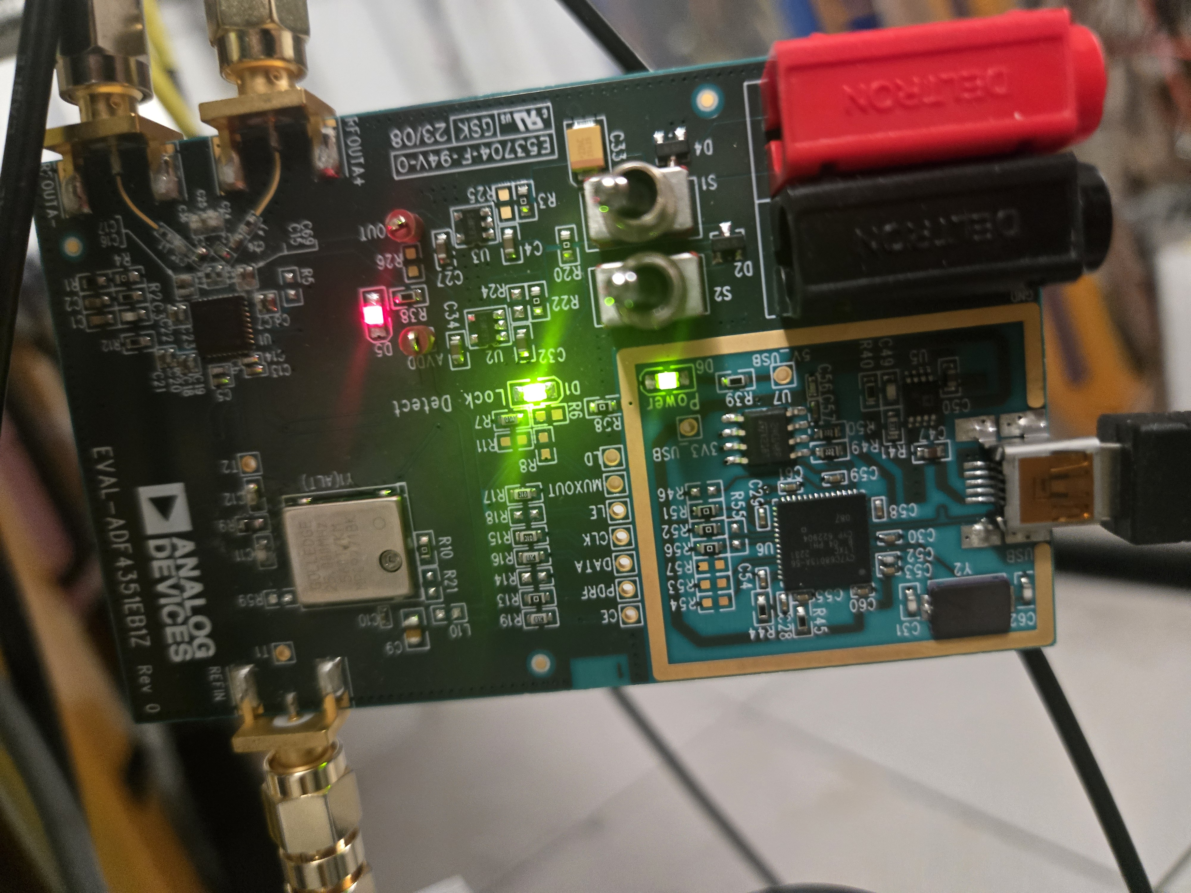
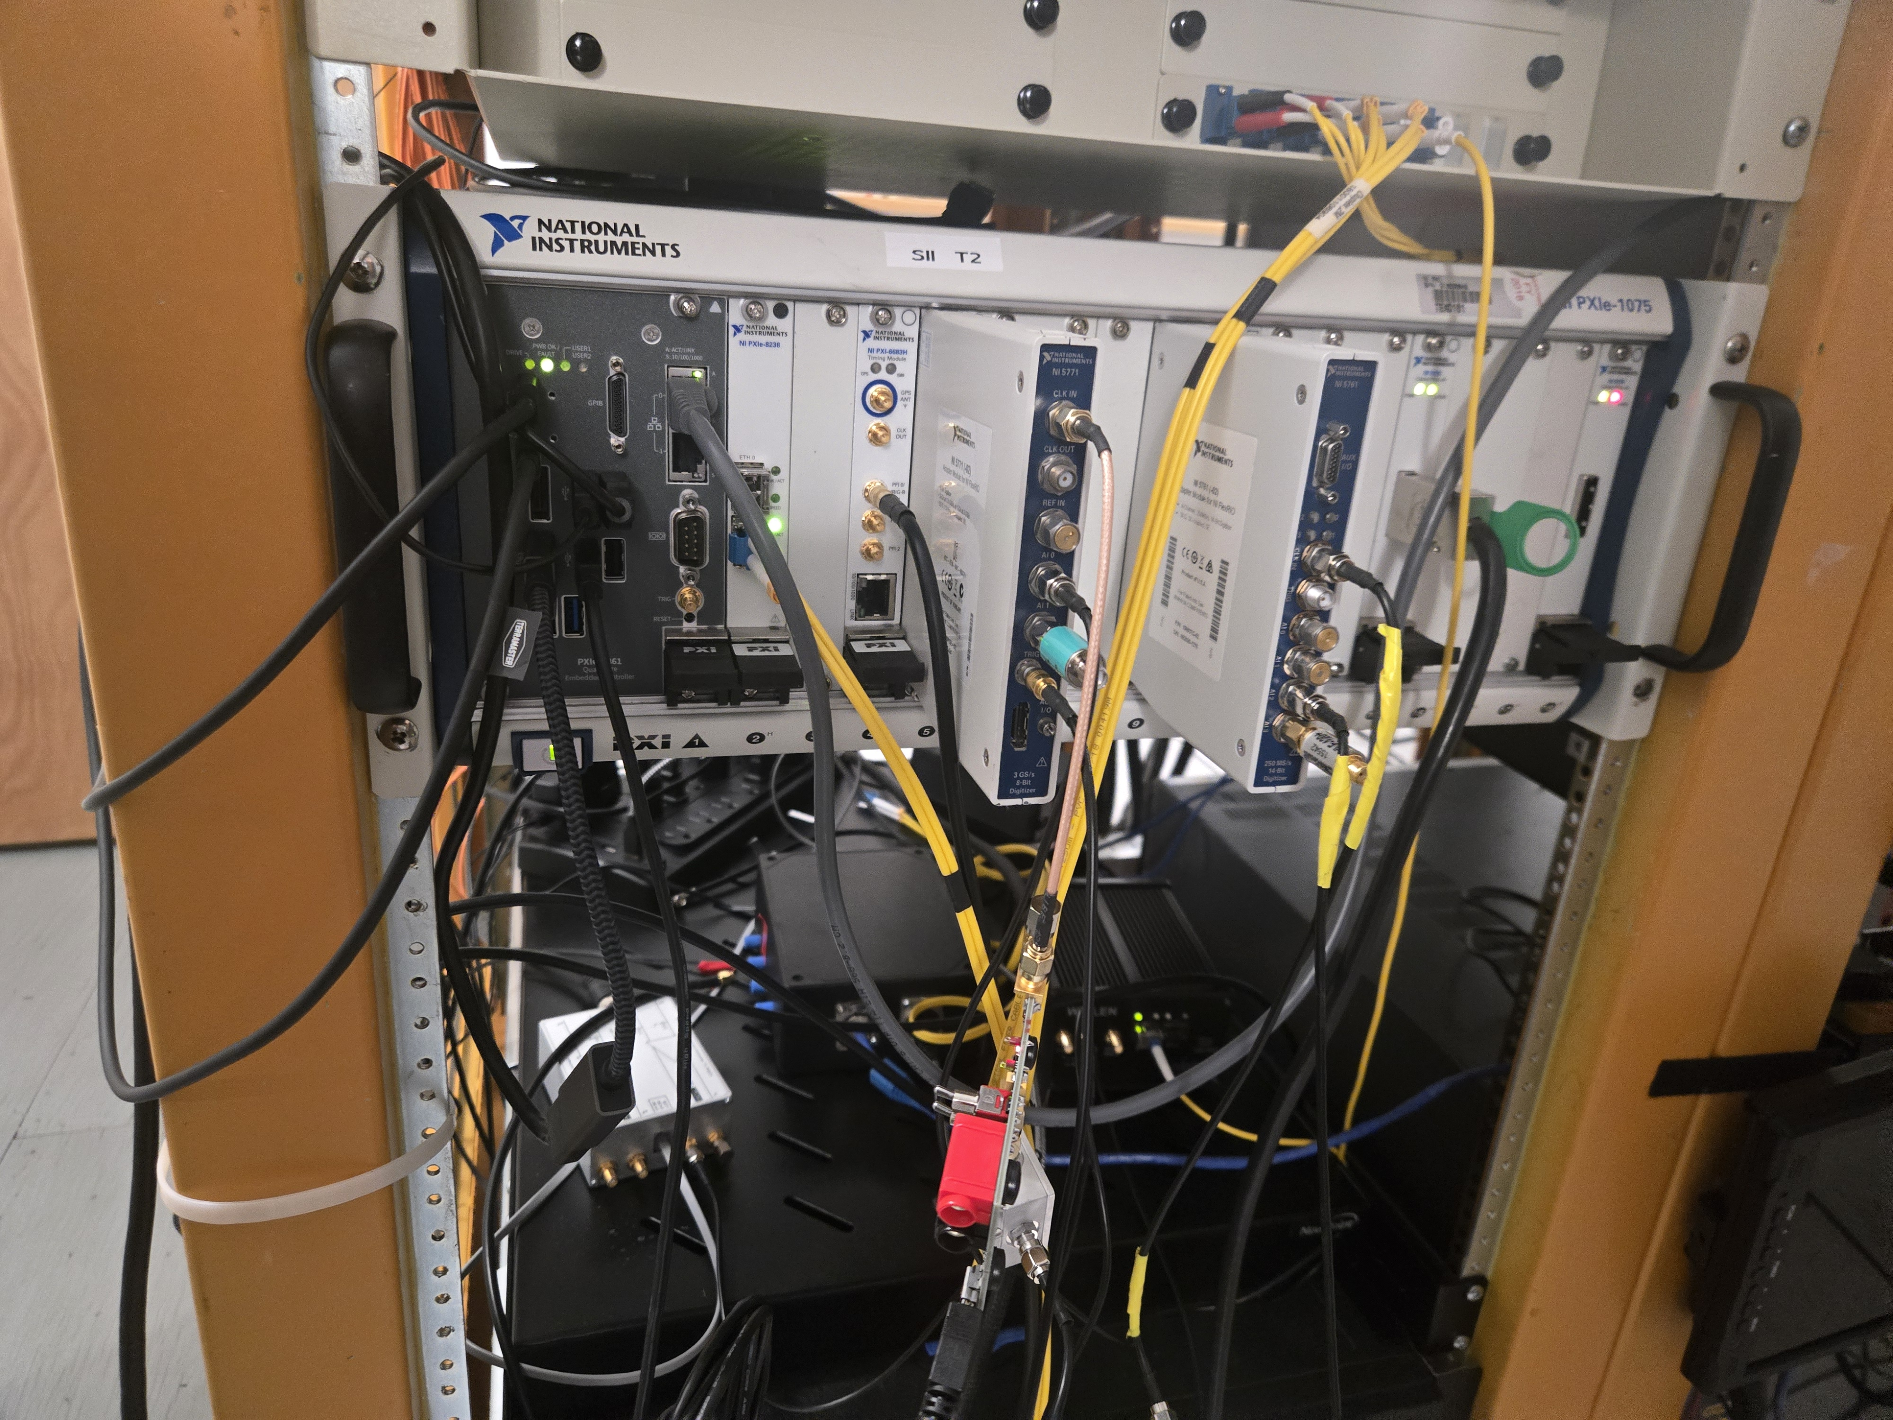
VERITAS-SII Hardware upgrades Sept 2026
PMT
Phase Lock Loop
NI 5771
3 Gs/sec
Digitizer
Sampling upgrade
250 MHz -> 750 MHz
White Rabbit
10 MHz
0.5-> 3 GHz
400
MHz
Preamp
3`

Slide 32



VSII Observations (2026-2028)
25% gain in mirror reflectivity = 1.25² = x 1.4
50% gain in usable data (no RF noise) = x 1.5
clock rate 250 MHz -> 750 MHz = x 3.0
Total improvement = factor of 6
One hour of 2025+ observations = 6 hours previously
~160 hours (2026-2028) ~ all previous observations
Follow more rapid variations of fast evolving binaries (Spica)
Masking off VSII mirror which
points to open sky or ground
32

Slide 33
Summary
  VSII Northern Sky Survey: 1000 hours of observation (2019-2026)
  Approaching 1% resolution in visibility curve
    Demonstrated measurements of slow & fast rotating stellar envelopes
    Resolution of orbital & mass parameters for binary systems
    Measurements at shorter wavelength (417 nm) provide complementary astrophysical information to longer wavelengths (CHARA, VLTI)
  Publication of full VSII Survey is nearing completion and will be submitted for publication (Fall 2026)
  Future provision of VSII observations to community with standard tools (eg. OIFITS) ( ~ 1 year )
  5
33

Slide 34

Key Science Motivators for SII
Stellar diameters, winds, photosphere structure
Rapid Rotators, Cepheid variables
Resolving Binary Systems, accretion disks
Stellar Novae (transient events)
Astrophysical lasers and emission lines
12

Slide 35







VERITAS-SII 2020 Observation of eps Ori
$$θ_{UD}=0.631±0.017 mas (4.25 hours)$$
$$λ=417 nm$$
NSII:$θ_{UD}=0.67 ±0.04 mas (56 hours)$
10

Slide 36

B. Katz, J. Aufdenberg 2026
16

