Slide 1
HBT and Binary Stars
Spectral multiplexing and the path to closure phases
hbtsim: an end-to-end simulator of stellar intensity interferometry, built on PHOENIX NewEra model atmospheres
Peter Nugent · Lawrence Berkeley National Laboratory
Stellar Intensity Interferometry Workshop 2026 · La Palma · 6 October 2026
Notes:
20 minutes + 5 for questions. One sentence: this is a code talk. I want to show what the simulator does, what the NewEra models change, and what it predicts, and to find people here who want to use it or correct it.
Symbols first used on this slide:
HBT: Hanbury Brown and Twiss: the correlation of intensity fluctuations between two telescopes, the effect intensity interferometry is built on.

Slide 2
A simulator looking for collaborators
hbtsim follows the light from a model atmosphere to a photon-counting S/N, for single stars and binaries, for II measurements on two or three telescopes.
What does spectral multiplexing buy today?
1
A night on 1 m telescopes, an hour on 10 m, for the g²(λ) of bright binaries.
2
What do realistic stellar models change?
PHOENIX NewEra: limb darkening, spectral lines and the definition of the radius. See the previous 30 years of work by Jason Aufdenberg…
3
What does a third telescope add?
Closure phases: Spica at the VLT in about half an hour with an R ≈ 5000 SPAD backend.
The ask: your detector numbers, your array layouts, your data, your targets.
The code is available to anyone here who wants to use it.
P. Nugent · hbtsim · SII Workshop 2026
2
Notes:
Set expectations: three questions the code answers, then the ask. About 1 minute.
Symbols first used on this slide:
II: intensity interferometry.
S/N: signal-to-noise ratio.
λ: wavelength.
g²(λ): the second-order (intensity) correlation between two telescopes at zero time delay, g² = <I1 I2> / (<I1><I2>), as a function of wavelength. For thermal light g² = 1 + |V|², so its excess over 1 is the squared visibility.
R: spectral resolving power, λ/Δλ. R ≈ 5000 means channels 0.1 nm wide at 500 nm.
SPAD: single-photon avalanche diode, the photon-counting detector.

Slide 3
hbtsim: from model atmosphere to photon-counting S/N
Stars and orbit
Model atmosphere
Sky image → V(u, v)
Instrument
Observables
Kepler orbit at its true sky orientation; single stars and binaries; hour-angle tracks
NewEra I(μ, λ) and F(λ), interpolated in Teff and log g, averaged over each channel
Rendered limb-darkened disks through eclipses; exact DFT; averaging over the pupils
Telescope, spectrograph channels, detector PDE, jitter, dead time, link ceiling, polarization
g² and g³ S/N, closure phase, multi-night campaigns, Poisson Monte Carlo
Python + JAX
258 tests
Presets
Access
CPU or GPU; a 240-frame orbit movie in about a minute
every piece validated against an analytic result
C2PU, Keck, VLT 4×UT, Subaru+Keck, EON; SPAD Lambda, MCP-PMT
github.com/nugent68/binary, private for now: ask me
P. Nugent · hbtsim · SII Workshop 2026
3
Notes:
Walk the pipeline left to right. Stress: exact DFT sampling of V(u,v) from a rendered image, so eclipses are handled; pupil averaging; the readout (time-tag link vs a real-time correlator with no link limit) is part of the model. 258 tests against analytic results. About 1.5 minutes.
Symbols first used on this slide:
I(μ, λ): specific intensity leaving the stellar surface, as a function of angle and wavelength.
μ: cosine of the angle between the line of sight and the local surface normal: μ = 1 at the centre of the disk, μ = 0 at the limb.
F(λ): the flux spectrum at the stellar surface (the intensity integrated over angle).
Teff: effective temperature of the star.
log g: base-10 logarithm of the surface gravity in cm/s².
V(u, v): the complex visibility: the Fourier transform of the sky brightness, normalized to 1 at zero baseline.
u, v: spatial frequencies: the east and north components of the projected baseline divided by the wavelength.
DFT: discrete Fourier transform.
PDE: photon detection efficiency of the detector.
g³: the third-order (triple) intensity correlation among three telescopes.

Slide 4
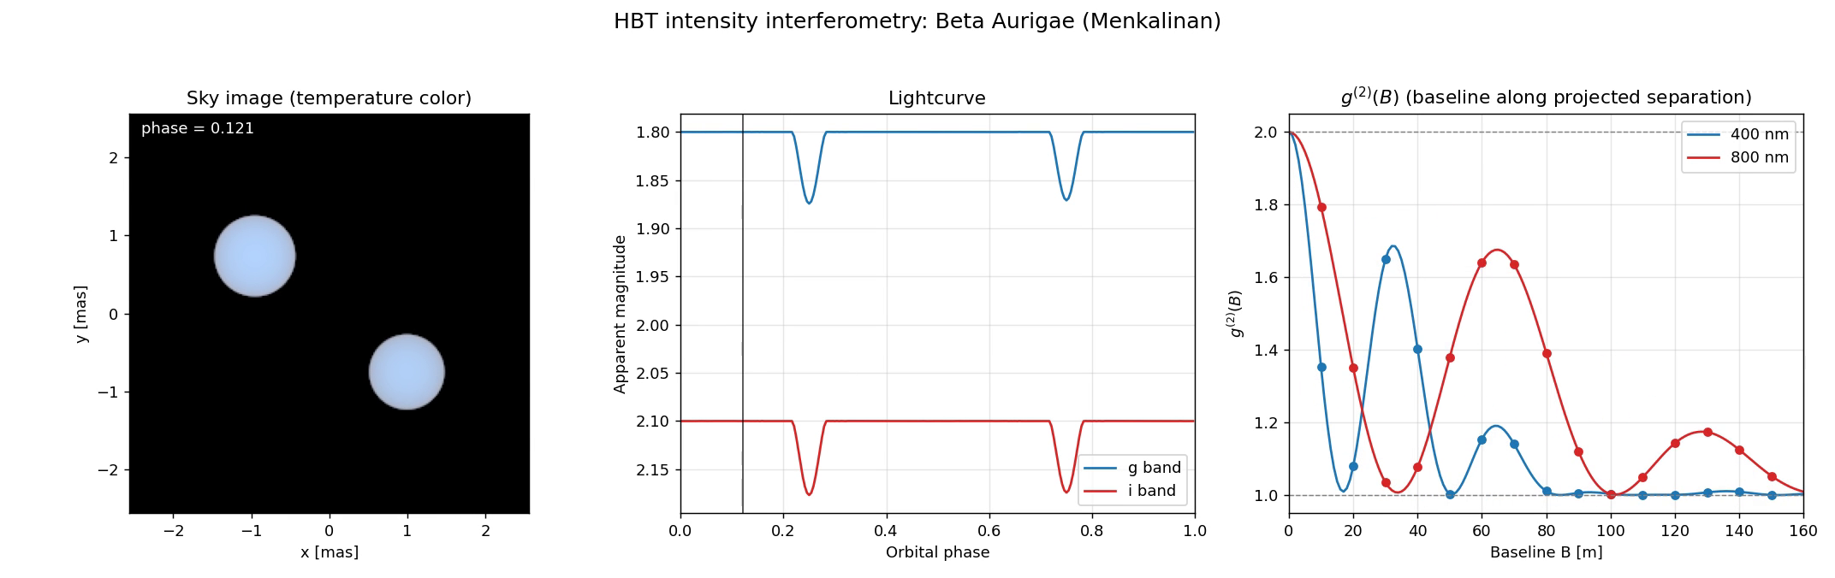
What it produces: β Aurigae through one orbit
β Aur: two A1 IV stars, P = 3.96 d, 3.3 mas apart. Sky image, light curve, and g²(B) at 400 and 800 nm along the projected separation. Idealized source model, with point-like apertures and no photon noise.
P. Nugent · hbtsim · SII Workshop 2026
4
Notes:
PLAY THE MOVIE (10 s, loop it). Left: sky image. Middle: light curve in g and i. Right: g2 against baseline at 400 and 800 nm, baseline along the projected separation. Point out the fringe period changing with separation and the eclipses. There is no telescope in this movie: it is the source model, with g2 evaluated for ideal point-like apertures and no photon noise; the dots only mark baselines every 10 m. Telescope size, pupil averaging and photon noise come in with the next two movies. About 1 minute.
Symbols first used on this slide:
B: baseline: the projected separation of the two telescopes, in metres.
g²(B): the intensity correlation as a function of baseline, at a fixed wavelength.
P: orbital period.
mas: milliarcsecond.
g band, i band: the two photometric filters of the light curve, centred at 477 and 763 nm.
phase: orbital phase: the fraction of the period elapsed, from 0 to 1.
x, y: offsets on the sky from the centre of mass, in mas.

Slide 5
Multiplexing: every channel is its own interferometer
The g² signal-to-noise of a channel does not depend on its bandwidth, so N channels give √N.
A 320-pixel SPAD line array behind a spectrograph is 320 simultaneous interferometers.
Each channel measures its own |V|² at its own B/λ: fringes, disk envelope, spectral lines.
Readout becomes the bottleneck: the detector's link ships at most 1.4 × 10⁸ photon time-tags per second, so a bright star must be attenuated and the S/N stalls at ≈ 20 per night on any telescope.
A real-time correlator with no link limit is the enabling development, for two telescopes as much as for three.
P. Nugent · hbtsim · SII Workshop 2026
5
Notes:
The key physics: the pair S/N does not depend on the optical bandwidth, so N channels give sqrt(N). Then the chart, S/N in one 8-hour night: from a marginal 2.5 with one filter, to 20 through today's time-tag link, to 40 and 150 with a dispersed SPAD array and no link limit on 1 m telescopes. The surprise: the time-tag link, not the telescope, sets the ceiling. About 2 minutes.
The readout bullet in full. Today's SPAD array stamps each photon with its arrival time and ships the time-tags over a cable; the computer correlates afterwards. The link carries at most 140 million tags per second (manufacturer's figure for the SPAD Lambda). Beta Aur on two 1 m telescopes already delivers about 3 x 10^8 detected photons per second over the 320 channels, and a hundred times more on 10 m telescopes. The excess must be attenuated. In intensity interferometry the S/N is proportional to the photon rate itself, not its square root, so once the rate is pinned the S/N is pinned at the same value whatever the mirror: about 7 per root hour, 20 per night, for beta Aur.
'No link limit' in the chart means a real-time correlator: coincidences are histogrammed in hardware as the photons arrive, so no per-photon link caps the rate. A correlator needs both telescopes' photons, so either both beams are fibred to one sensor (short baselines) or each detector streams tags over fast links to a central FPGA or GPU. This exists today for analog photomultiplier streams (MAGIC), not yet for multi-channel photon counting. Details on the readout backup slide.
Symbols first used on this slide:
N: number of spectral channels ("ch" in the chart labels).
|V|²: squared modulus of the visibility, the quantity g² − 1 measures. It is 1 for an unresolved source and falls toward 0 as the baseline resolves it.
B/λ: the spatial frequency a channel samples: baseline divided by wavelength.
counts/s: detected photons per second; 1.4 × 10⁸ counts/s (140 Mcps, the manufacturer's figure) is the most the current detector's time-tag link can transmit.
time-tag: the arrival time stamped on each detected photon; today's readout ships every tag to a computer.
no link limit: a real-time correlator: coincidences are counted in hardware as photons arrive, so the photon rate is limited only by the detector's dead time.

Slide 6
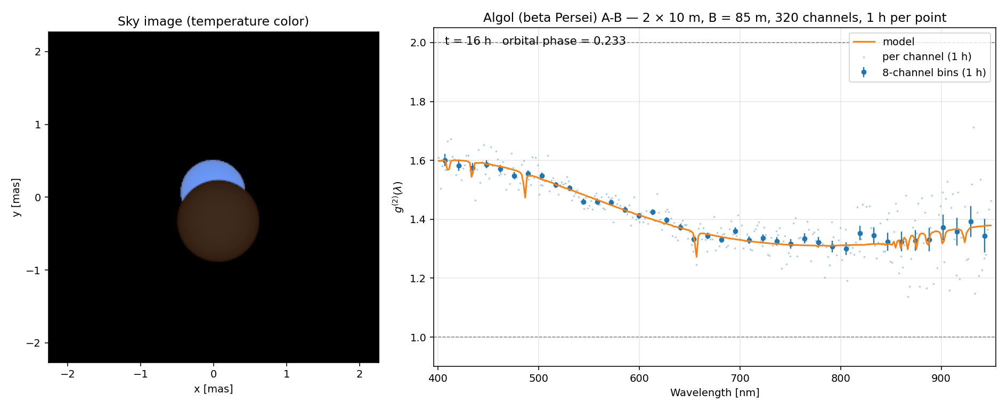
Algol on a 10 m pair: the eclipse reorganizes g²(λ)
Two 10 m telescopes 85 m apart, 320 channels, real-time correlator (no link limit), one hour per frame.
Points carry simulated photon noise.
P. Nugent · hbtsim · SII Workshop 2026
6
Notes:
PLAY THE MOVIE (about 9 s). One-hour integrations around the 2.87-day orbit, 320 channels, 85 m baseline. The orange line is the model, points are simulated data with photon noise. Watch the spectrum change shape through primary eclipse. About 1 minute.
Symbols first used on this slide:
t: time since the start of the orbit, in hours (shown in the movie with the orbital phase).

Slide 7
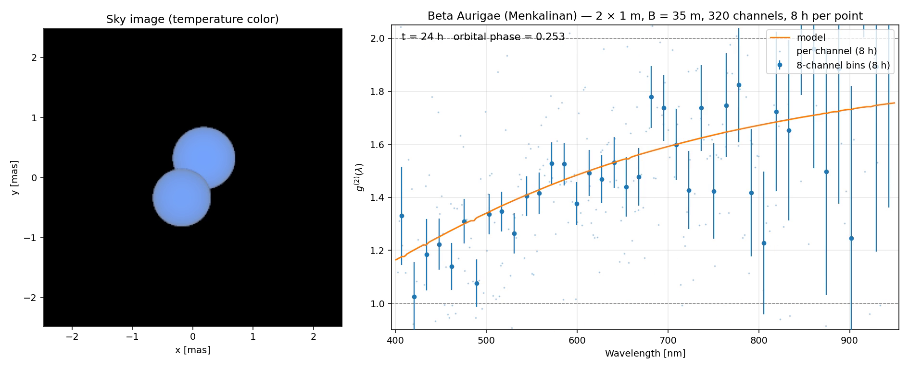
β Aurigae on two 1 m telescopes: one night per frame
Two 1 m telescopes 35 m apart, 320 channels, real-time correlator (no link limit), 8 h per frame: the binary signature in a night.
P. Nugent · hbtsim · SII Workshop 2026
7
Notes:
PLAY THE MOVIE. This is the small-telescope case: 1 m apertures, 35 m apart, the current 320-channel array read out with no link limit (a real-time correlator), 8 hours per point. The binary fringe is visible across the band in a single night. About 45 seconds.

Slide 8
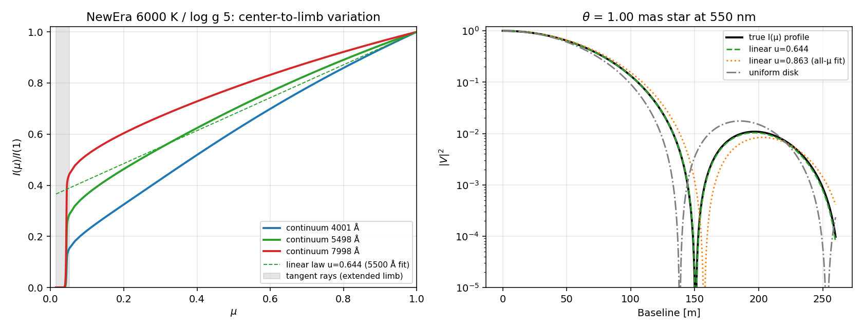
PHOENIX NewEra: stars as the instrument sees them
30 %
stronger blue limb darkening than the tabulated linear coefficients (A stars at 400 nm)
0.4–0.8 %
of radius between τ = 1 and the outer boundary in A stars; up to 16 % in a supergiant
Spherical PHOENIX models (Hauschildt, Baron et al. 2025). We use the angle-resolved intensities I(μ, λ) at full spectral resolution: 747 models, 3.8 TB, 2300–12 000 K, mirrored at NERSC and binned for hbtsim.
× 3.4
change of Algol's fringe contrast in the Hβ core against a blackbody
P. Nugent · hbtsim · SII Workshop 2026
8
Notes:
NewEra is the Hamburg PHOENIX grid (Hauschildt, Baron and collaborators, 2025). We use the angle-resolved files: intensity against angle at full spectral resolution. Figure: left, centre-to-limb profiles at three wavelengths with the sharp limb of a spherical model; right, what that does to |V|^2 against a uniform disk and a linear law. Then the three numbers. The grid is mirrored at NERSC and I can share access. About 1.5 minutes.
Symbols first used on this slide:
τ: optical depth measured inward from the surface (Rosseland mean). τ = 1 is the conventional photospheric radius.
Hβ: the hydrogen Balmer line at 486 nm.
I(μ)/I(1): intensity relative to the centre of the disk (figure, left panel).
u: linear limb-darkening coefficient: I(μ)/I(1) = 1 − u (1 − μ).
θ: angular diameter of the star (1 mas in the figure's right panel).

Slide 9
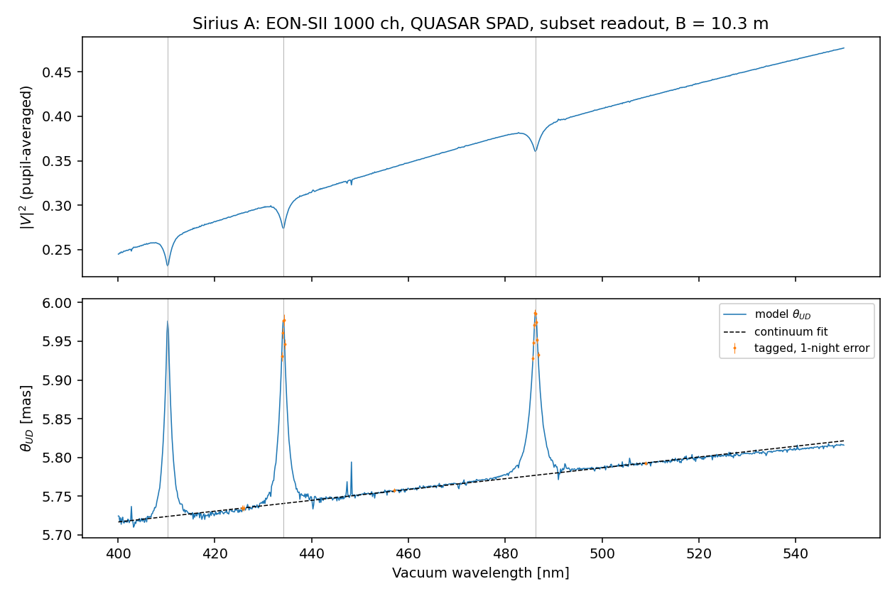
Single stars: Balmer cores look larger than continuum
+4.4 / +4.1 / +3.6 %
Hδ, Hγ, Hβ core diameters of Sirius A over the local continuum
1–2 nights
to 5σ with two EON 4 m units, every channel through the 1 GHz links
Tagging only the ~20 channels that fit the link at full rate gives tens of σ per night: the limit is systematics, not photons. Vega: +4.7 / +4.4 / +3.8 %.
P. Nugent · hbtsim · SII Workshop 2026
9
Notes:
A measurement a multiplexed instrument gets for free. Line cores form higher up, are less limb darkened, so the uniform-disk diameter is larger in the core. Sirius with EON's 400-550 nm band: all three Balmer lines at once. Readout strategy matters: tag only the channels that fit the link. This is a direct test of the model's upper photosphere. About 1.5 minutes.
Symbols first used on this slide:
Hδ, Hγ, Hβ: hydrogen Balmer lines at 410, 434 and 486 nm.
θ_UD: uniform-disk diameter (figure axis): the diameter of a uniformly bright disk that gives the same |V|² at that baseline and wavelength.
σ (as in 5σ): standard deviations of statistical significance.

Slide 10
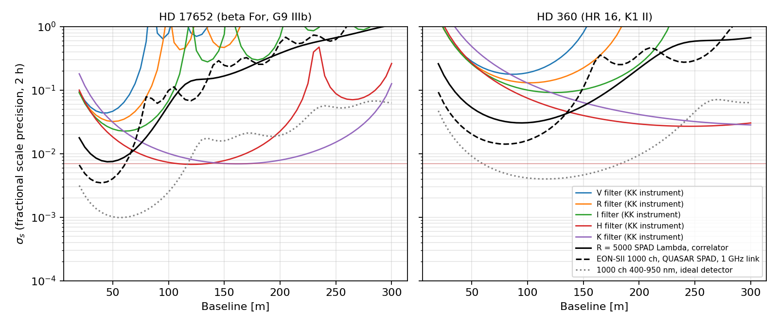
Single stars: red-clump diameters, cross-checked
1–6 %
agreement with their photon budget, band by band
0.0068
H-band diameter precision for HD 17652 in 2 h (theirs: < 0.007)
× 4 faster
Fractional diameter precision in 2 h with two 4 m telescopes: single filters (colours, Kim & Kaiser 2026) and multiplexed optical backends (black). HD 17652 and HD 360.
with a 1000-channel optical SPAD backend than one H filter
P. Nugent · hbtsim · SII Workshop 2026
10
Notes:
Link to Alex Kim's talk just before this one. We reproduced the Kim and Kaiser photon budget band by band, then asked what multiplexing and the models add. Figure: sigma_s against baseline in 2 hours, their filters in colour, multiplexed optical backends in black. Caveat on the radius definition for giants; the right models are requested. About 1.5 minutes.
Symbols first used on this slide:
σ_s: fractional 1-sigma precision on the angular scale s (figure axis). s multiplies the angular size of the model profile, so σ_s is the fractional error on the diameter.
V, R, I, H, K: photometric bands at about 0.55, 0.66, 0.81, 1.63 and 2.19 micrometres.
KK: Kim & Kaiser (2026), in the figure legend.

Slide 11
Binaries now: two telescopes, four systems
S/N per √hour | β Aur | Algol | δ Vel | Spica
2 × 1 m, 320 ch, time-tag link | 7 | 10 | 6 | 9
2 × 1 m, R = 5000, no link limit | 54 | 58 | 54 | 208
2 × 4 m EON, 1000 ch SPAD (1 GHz links) | 568 | 658 | 351 | 638
2 × 10 m, 320 ch, no link limit | 569 | 761 | 511 | 1431
2 × 10 m, R = 5000, no link limit | 4583 | 5433 | 4162 | 16 576
β Aur on 1 m telescopes: the binary signature in one night with today's 320-channel array.
10 m pairs: σ(|V|²) ≈ 0.02 per channel-hour, the full g²(λ) spectrum on hour timescales.
All four stars saturate a 1 GHz link by ×2–10: rates, not apertures, set the limit.
Mirror size matters: at δ Vel's widest separation the binary fringe repeats every 4.7 m of baseline in the blue, so mirrors larger than that average it away.
Best baseline along the separation at quadrature (10–35 m). Spica uses blackbodies: no NLTE hot-star grid yet…. This is a TBD Phoenix run once Peter H. gets back from vacation ;-)
P. Nugent · hbtsim · SII Workshop 2026
11
Notes:
The table: total S/N per root hour at the best baseline, NewEra models where the grid covers the stars. 1 m telescopes are useful with an R = 5000 backend; every one of these stars saturates even a 1 GHz link, so EON's numbers are link-limited. The time-tag row uses the SPAD Lambda's 140 Mcps link; 'no link limit' means a real-time correlator (readout backup slide). About 1.5 minutes.
The last bullet in full. A binary of separation ρ makes |V|² oscillate as the baseline changes, one full cycle every λ/ρ metres. For δ Vel at its widest (17.5 mas) and 400 nm that is 4.7 m; at 800 nm it is 9.4 m. A mirror is not a point: two mirrors of diameter D measure |V|² averaged over every pair of points on them, a spread of about ±D in baseline. If D is larger than the fringe period the oscillation cancels, and only the smooth part from the two stellar disks is left. Fringe contrast kept at 400 nm: 89 % with 1 m mirrors, 11 % with 4 m (EON), 1.6 % with 8.2 m (VLT). So the bigger mirror collects more photons but loses the binary signal. Near conjunction the stars are closer on the sky, the fringe period grows, and large mirrors recover it.
Symbols first used on this slide:
S/N per √hour: S/N grows as the square root of the integration time; the table gives its value for one hour. Multiply by √(hours) for longer integrations.
σ(|V|²): 1-sigma uncertainty on the squared visibility.
quadrature: the orbital phase at which the two stars are farthest apart on the sky.
ρ: angular separation of the two stars on the sky (used in the note above).
D: diameter of a telescope mirror (its pupil).
fringe period: the change of baseline that takes |V|² through one full cycle: λ/ρ.

Slide 12
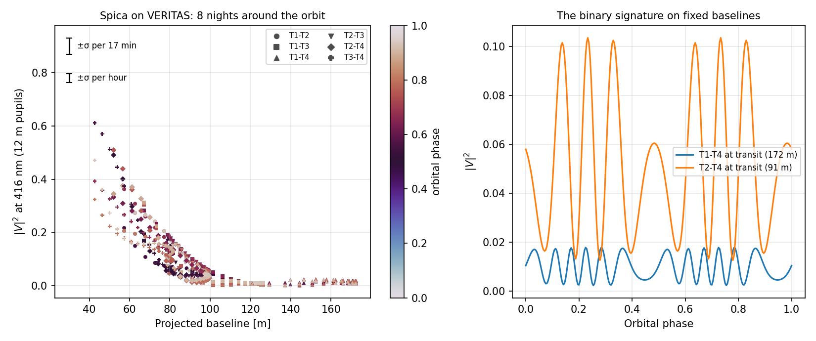
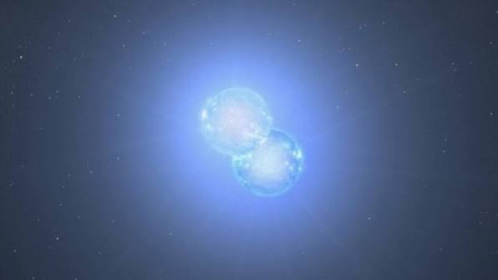
Spica on VERITAS: six baselines around the orbit
50–111 m
Spica's fringe period at 416 nm, inside their 43–173 m baselines; 12 m dishes keep 87 %
0.03 → 0.016
σ(|V|²) per pair per 17-min block → per hour; their sensitivity, calibrated to ε Ori
Model |V|² at 416 nm on the six VERITAS pairs over eight nights, averaged over the 12 m dishes, colour = orbital phase; right: |V|² against phase on fixed baselines at transit. Orbit: hbtsim a = 1.71 mas; Herbison-Evans 1971 (used by Raiola et al.) a = 1.54 mas: the data can tell.
0.09
orbit modulation of |V|² on a fixed 91 m baseline: 3σ per block, ~15σ per night
P. Nugent · hbtsim · SII Workshop 2026
12
Notes:
Michael Lisa presents five years of Spica on these six baselines tomorrow; this is what hbtsim says they should trace. Model: our Spica (blackbody plus linear limb darkening, anchored photometry, circular orbit), the analytic two-disk visibility on the projected VERITAS baselines, averaged over the 12 m dishes, at 416 nm. Sensitivity is theirs, not ours: the analog S/N formula with their constants, and the optical efficiency calibrated to their published 0.016 on |V|^2 per pair in 4.25 h on epsilon Ori. Three points: the binary fringe period, 50 to 111 m, sits inside their baselines, so VERITAS resolves the fringe itself; a 17-minute block gives 0.03 on |V|^2 and the orbit swings |V|^2 by up to 0.09 on a fixed baseline, so the orbital signature is a 3 sigma effect per block and 15 sigma per night; and the orbit solution matters: our a = 1.71 mas from masses, period and distance, versus 1.54 mas in the 1971 Narrabri solution that the Geneva/MAGIC simulations use. Ask for the six-baseline |V|^2 to compare. About 1.5 minutes.
Symbols first used on this slide:
projected baseline: the telescope separation as seen from the star, which rotates and shortens with hour angle.
fringe period: the change of baseline that takes the binary's |V|^2 through one cycle, lambda / separation.
block: VERITAS's 17-minute live-time unit per measurement.
N0 (zero-baseline normalization): their fitted calibration constant: |V|^2 is measured relative to it.

Slide 13
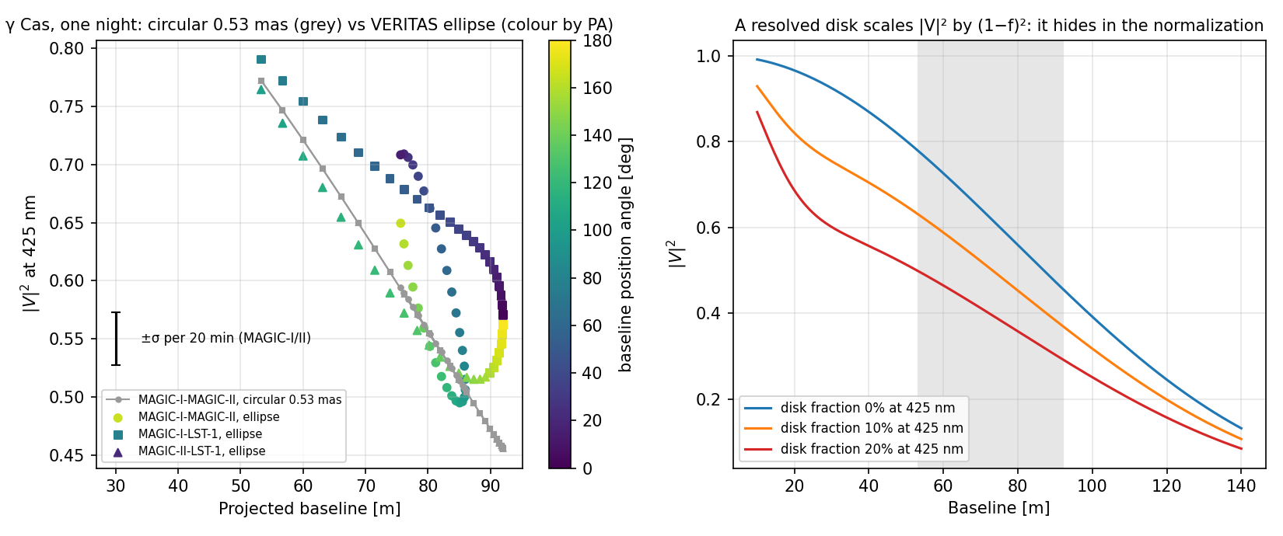
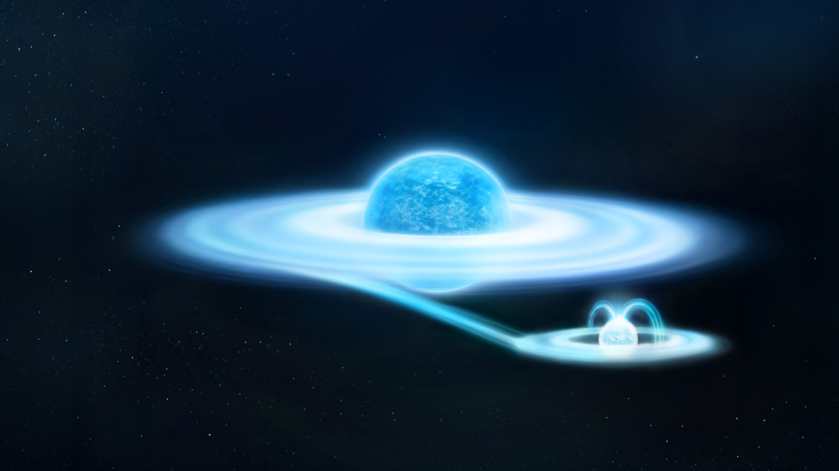
γ Cas on MAGIC + LST-1: oblateness and the disk
0.011
one-night statistical floor on the axis ratio (theirs: 0.76 ± 0.02; VERITAS 1.28 ± 0.04)
0.013 per h
σ(|V|²) on MAGIC-I–II from their S/N formula (0.010 with LST-1)
N₀ = 0.80
Left: one night's |V|² at 425 nm on the three pairs, circular 0.53 mas (grey) against the VERITAS ellipse (colour = position angle). Right: a resolved 2.9 mas disk scales |V|² by (1 − f)² at every baseline.
a 10 % disk: diameter unchanged, N₀ down. The disk hides in the calibration
P. Nugent · hbtsim · SII Workshop 2026
13
Notes:
Irene Jimenez presents gamma Cas with MAGIC and LST-1 tomorrow morning, and VERITAS published its oblateness this year. gamma Cas is beyond the NewEra grid (25 kK), so this is a blackbody with Spica's limb darkening, anchored to B and V; MAGIC's own S/N formula and constants; LST-1's mirror area and the triangle's orientation on the ground are assumptions, flagged. Left panel: the three baselines rotate through a night, so an oblate star shows as a position-angle-dependent spread at the same projected length; the Fisher floor on the axis ratio is 0.011 per night, statistics only, behind their preliminary 0.76 plus or minus 0.02. Right panel and third card: a circumstellar disk of 2.9 mas is fully resolved on all these baselines, so it multiplies |V|^2 by (1 - f)^2 everywhere, which is exactly what the free zero-baseline normalization absorbs. The diameter stays unbiased; the disk hides in the calibration. To measure the disk fraction you need a calibrator with known N0 or baselines short enough to see the disk partly coherent. Gravity darkening is not modeled: a hook for the SPAMMS work. About 1.5 minutes.
Symbols first used on this slide:
axis ratio: major over minor axis of the photosphere's projected ellipse (1 = circular).
PA (position angle): angle of a baseline or of the major axis on the sky, east of north.
f (disk fraction): fraction of the 425 nm flux coming from the circumstellar disk.
N0: zero-baseline normalization: the free calibration constant in the groups' |V|^2 fits.
Fisher floor: the smallest statistical uncertainty any unbiased fit can reach with these errors.

Slide 14
Three telescopes: what the triple correlation adds
g³ − (pair terms) = 2 |γ₁₂ γ₂₃ γ₃₁| cos φc
Rewards resolution
3
S/N₃ ∝ (1/σt) √(T/Δλ): narrow channels and fast timing are the levers, hence an R ≈ 5000 backend.
Measures cos φc
The sign and symmetry of the bispectrum, immune to telescope phases. Asymmetry lives where sin φc ≠ 0.
γ₃₁
γ₂₃
Needs calibration
Pair ridges are 50–750 times the triple term: the pair kernel must be known to 10⁻³.
1
2
Context
γ₁₂
First astrophysical g³: H.E.S.S. (Zmija et al. 2025). One channel needs ~10³ yr for Δcos φc = 0.1 on m ≈ 2 stars.
P. Nugent · hbtsim · SII Workshop 2026
14
Notes:
The formalism in four lines. The triple-correlation S/N scales as one over the jitter and as root T over delta lambda: unlike g2 it rewards spectral resolution directly. That is the case for an R of about 5000 backend. Two caveats that shape everything later: it measures the cosine of the closure phase, and the pair ridges must be subtracted to a part in a thousand. About 1.5 minutes.
Symbols first used on this slide:
γ_ij: complex degree of coherence between telescopes i and j: the normalized visibility on that baseline. |γ_ij|² is what g² measures.
φc: closure phase: the phase of the product γ12 γ23 γ31, i.e. the sum of the three baseline phases around the triangle.
S/N₃: signal-to-noise ratio of the triple-correlation term.
σt: rms timing jitter of a detector.
T: integration time.
Δλ: width of a spectral channel.
Δcos φc: 1-sigma uncertainty on cos φc.
m: apparent magnitude of the star.

Slide 15
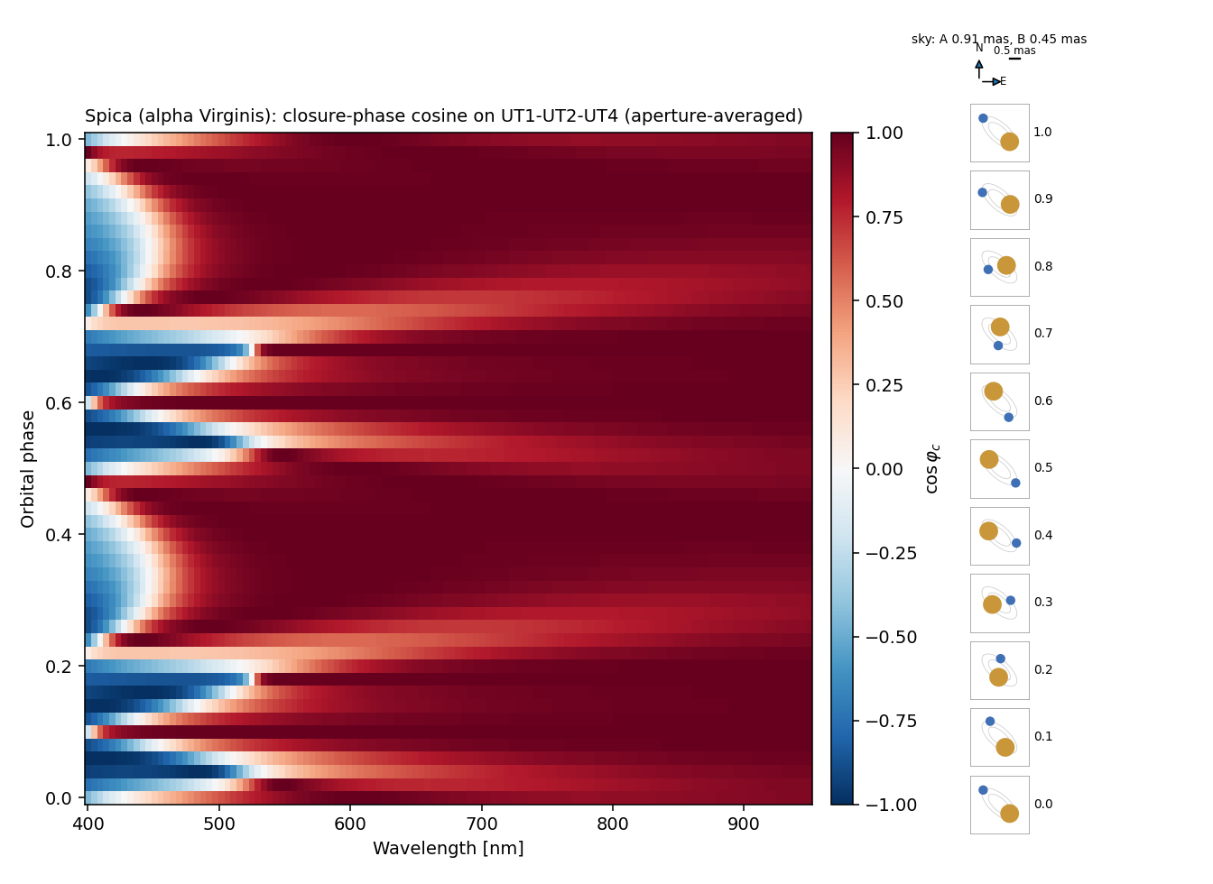
Spica at the VLT: a closure-phase template in half an hour
36 min
7 min
template detection, Δcos φc ≤ 0.1, four UTs, R = 5000 SPAD array, no link limit
with a polarizing beamsplitter (two streams per telescope)
9 nights
g ≈ 2
per epoch for closure-phase curves in R = 100 bins (14 h with the beamsplitter)
one-night limit: a dozen or more hot southern binaries and rapid rotators
With today's 320-channel detector: 150 nights even without the link limit.
P. Nugent · hbtsim · SII Workshop 2026
15
Notes:
The figure is the model cos of the closure phase on the UT1-UT2-UT4 triangle against wavelength and orbital phase; the column on the right shows the two stars on the sky at each phase. Red: the image looks symmetric; blue and white: the triangle resolves the pair. Numbers: 36 minutes to detect the whole pattern with a next-generation R = 5000 array with a real-time correlator on the four UTs; nights to resolve it in R = 100 bins. Mention Michael Lisa's VERITAS Spica talk tomorrow and the ESO session on Friday. About 2 minutes.
Figure 4 is a colour map of one number, cos φc, which describes how lopsided Spica's image looks to three of the VLT telescopes. Horizontally is the colour of light, vertically is where the two stars are in their 4-day orbit.
What one pair of telescopes measures. An interferometer doesn't take a picture. Each pair of telescopes acts like a double slit run in reverse: it measures one spatial-frequency component of the star's image, its Fourier component at a spatial frequency set by the telescope separation divided by the wavelength (B/λ). Like any Fourier coefficient, that component is a complex number:
The amplitude says how much structure the image has on that angular scale.
The phase says where that structure sits (left or right, which way it leans).
Ordinary (amplitude) interferometers measure both. Intensity interferometry, which correlates photon arrival times rather than combining light waves, gets only the amplitude squared, |V|². Without phases you can't build an image, just as you can't reconstruct a picture from its power spectrum alone.
Why a third telescope helps. Correlate the photon streams of three telescopes and you get the product of the three pair components around the triangle. Its phase is the sum of the three individual phases: the closure phase φc. Two properties make it useful:
Atmospheric errors cancel. Anything that shifts one telescope's phase (turbulence, path errors) enters the sum once with a plus sign and once with a minus sign.
It measures asymmetry. A point-symmetric object (a round star, or two identical stars) always gives φc = 0 or 180°. Any other value means the image is lopsided, for example two stars of different brightness.
The three-telescope intensity signal actually contains cos φc, not φc itself, and that is what the colour shows:
Red (+1): φc ≈ 0°; the image looks symmetric on that scale.
Blue (−1): φc ≈ 180°; also symmetric, but with a sign flip.
White (0): φc ≈ ±90°; the most strongly lopsided signal.
The axes.
Horizontal: wavelength (400–950 nm). Changing the wavelength at fixed telescope separation changes the spatial frequency B/λ being sampled. Blue light probes finer detail than red.
Vertical: orbital phase (0 to 1 = one 4-day orbit). As the two stars orbit, their separation on the sky changes in length and direction, and so does the image.
Reading the pattern.
The red half (λ ≳ 550 nm) is nearly uniform red. At longer wavelengths the telescopes probe coarser detail, and the two tiny stars (0.9 and 0.45 milliarcseconds across, 1.7 mas apart) are less resolved. The image looks like one fuzzy blob, and a blob looks symmetric: φc ≈ 0.
The blue half swings between red and blue. Here the telescopes resolve the pair. The binary lays a fringe-like stripe pattern across the Fourier plane, and each pair's phase goes like 2π(B·ρ)/λ, where ρ is the star separation. As λ or ρ changes, the phases wind round and their sum swings through 0°, 90° and 180°, giving the bands and bubbles.
The pattern repeats every half orbit. After half an orbit the stars have swapped sides, so the image is rotated by 180°. That flips the sign of φc, but cos(−φc) = cos φc, so the colours repeat. This also shows a limitation: measuring only cos φc can't tell which star is on which side.
"Averaged over the three pupils." Each 8.2 m mirror isn't a point; different parts of it sample slightly different spatial frequencies. The figure averages over the mirror areas, which blurs the finest fringes; it is what the instrument would really see.
Why it matters. The pattern is a model prediction, a template. The paper's feasibility numbers ask how long it takes to detect this pattern as a whole (about half an hour on the VLT with an advanced detector), and how long to measure it channel by channel (nights). Detecting it would be the first closure phase ever measured with intensity interferometry: phase information that no two-telescope intensity measurement can provide, and the first step towards making actual images this way.
Symbols first used on this slide:
UT: Unit Telescope: one of the four 8.2 m telescopes of the VLT.
template: the model pattern of cos φc over wavelength and time; "template detection" means measuring its overall amplitude.
R = 100 bins: channels combined to a resolving power of 100, to measure the pattern itself bin by bin.
g ≈ 2: here g is the star's magnitude in the g band (477 nm), not the correlation function.

Slide 16
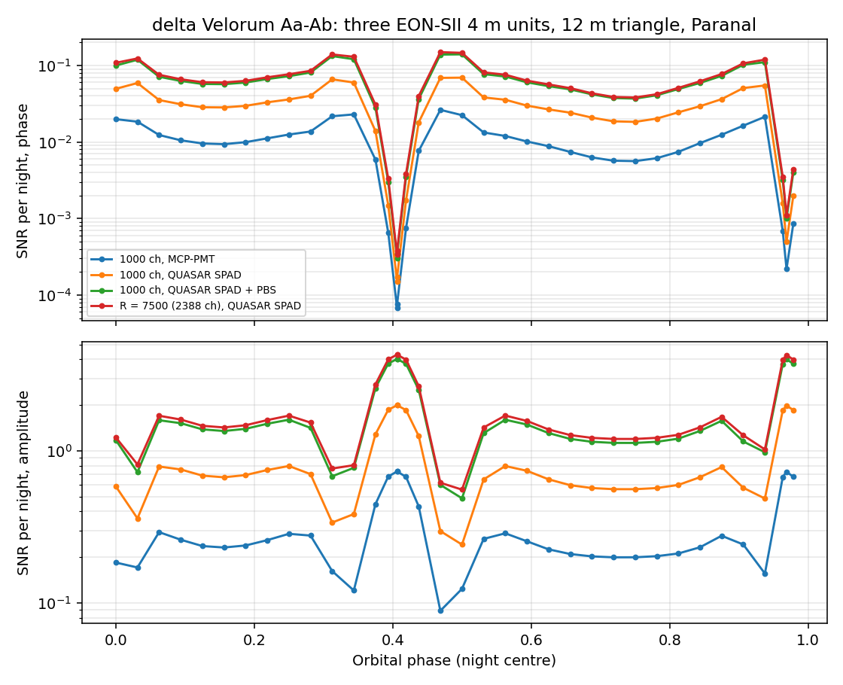
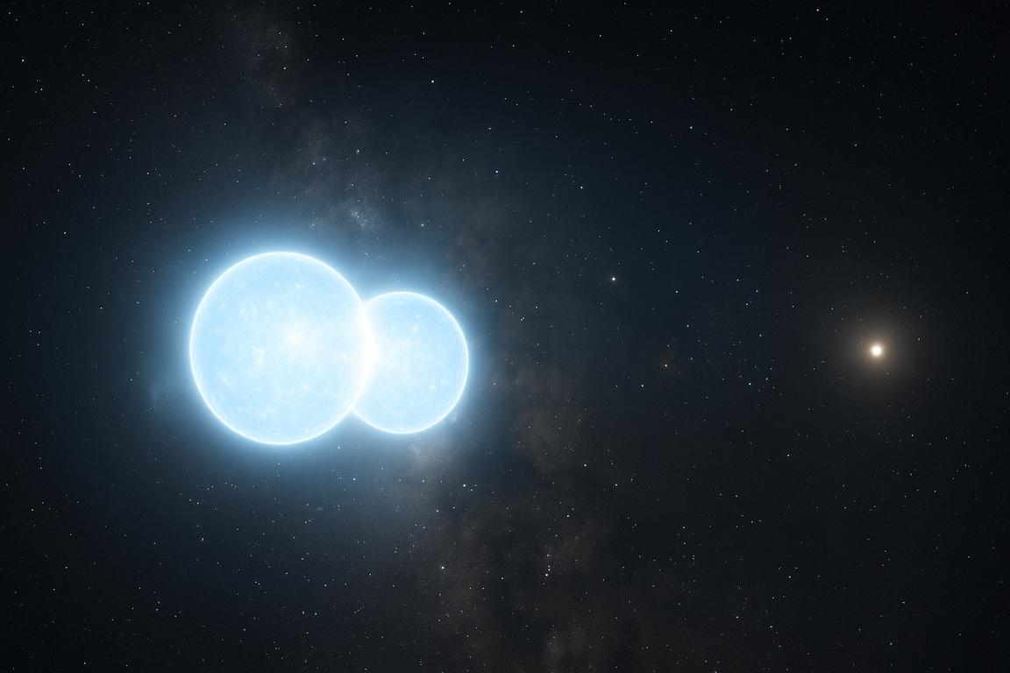
δ Velorum: wide orbits, big pupils and three EON units
At 25.1 pc the orbit spans 16.6 mas. The 4.7 m blue fringe at maximum separation is averaged away by 8.2 m pupils: 20–27 nights at the VLT.
Three EON 4 m units on a 12 m triangle at Paranal: the closure-phase template in about 20 nights spread around the orbit.
The asymmetric part of the closure phase stays out of reach (~10⁴ nights): g³ sees only cos φc, and φc sits near 0 or π.
Lesson: pupil size against fringe period matters as much as collecting area.
P. Nugent · hbtsim · SII Workshop 2026
16
Notes:
Delta Vel is the instructive case. At its orbital-parallax distance, 25.1 pc, the orbit is 16.6 mas wide and the blue fringe period at maximum separation is 4.7 m, smaller than an 8 m mirror, so the VLT needs 20 to 27 nights. Three EON 4 m units on a 12 m triangle at Paranal do as well, but only the symmetric part of the closure phase is reachable: g3 measures cos phi. Figure: S/N per night around the orbit; the phase information peaks where the amplitude dips. About 2 minutes.
Symbols first used on this slide:
pc: parsec.
"amplitude" S/N (figure, lower panel): √Σ (S/N per channel × cos φc)²: the sensitivity to the overall pattern (the template).
"phase" S/N (figure, upper panel): √Σ (S/N per channel × sin φc)²: the sensitivity to a shift of the closure phase, which is where the image asymmetry shows.

Slide 17
Summary
Multiplexing works now.
A dispersed SPAD array turns marginal small-telescope intensity interferometry into routine g²(λ) spectra; readout is the limit.
The models matter.
NewEra limb darkening, lines and radius conventions change what a per-cent measurement means – they are themselves a testable quantity. Still to do: NLTE models for hot stars, 3-D models, hydro (pulsating stars), novae, supernovae,…
Closure phases are feasible in the future – but hard work.
Spica at the VLT in half an hour with an R ≈ 5000 backend and a real-time correlator; g³ gives cos φc, so targets must be chosen with care.
hbtsim and the NERSC mirror of the NewEra models are open to collaborators.
penugent@lbl.gov · github.com/nugent68/binary (access on request) · with thanks to E. Baron and P. Hauschildt for the NewEra models
Notes:
Three sentences, then the invitation. Leave this slide up for questions.

Slide 18
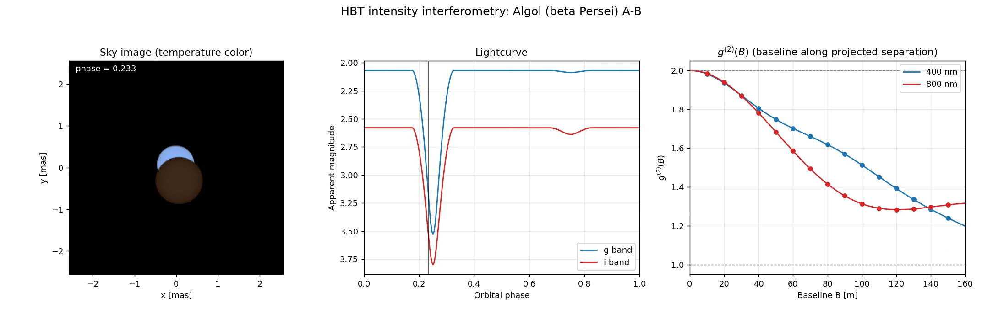
Backup: Algol through its orbit
Algol A–B (B8 V + K0 IV, P = 2.87 d): sky image, light curve, and g²(B) at 400 and 800 nm. Source model only: ideal point-like apertures, no photon noise.
P. Nugent · hbtsim · SII Workshop 2026
19
Notes:
Backup movie: Algol's 3-panel orbit movie, with the deep primary eclipse. As for beta Aur, this is the source model: ideal point-like apertures, no photon noise.

Slide 19
Backup: cross-check against the EON design study
30 %
× 10–25
2–6 ps
agreement of photon rates per channel and per telescope on Sirius B
longer integration times in hbtsim as configured (× 2.5–5 at best)
coincidence window that would reproduce the study, against 12–28 ps pair jitter
The study's photon-level S/N equals our matched filter when η = ½ and its time window is √π times the pair jitter.
Poisson Monte Carlo of the Sirius B case (10 h, 1000 channels): the matched filter is unbiased at its analytic scatter.
A coincidence box narrower than the jitter, without a capture correction, biases the diameter by +30 to +130 %.
Resolution: measured detector timing. If the effective window is a few picoseconds, one parameter changes in hbtsim.
P. Nugent · hbtsim · SII Workshop 2026
20
Notes:
Backup for questions on EON sensitivity. Neutral framing: photon rates agree; the times differ through the assumed coincidence window. The matched filter is unbiased in our Monte Carlo; this is a point to settle with measured detector timing.
Symbols first used on this slide:
η: the efficiency factor in the design study's S/N formula; ½ for unpolarized light.
pair jitter: rms width of the two-detector coincidence peak: the two detectors' timing jitters added in quadrature.
ps: picosecond.

Slide 20
Backup: readout, from time tags to a real-time correlator
140 Mcps
× 2 to × 200
≈ 1 Tb/s
most that today's SPAD Lambda can ship as time-tags (6 Gbps over two USB3 links)
by which β Aur exceeds that link on 1 m and on 10 m telescopes (3 × 10⁸ and 3 × 10¹⁰ counts/s)
of tags from one 10 m telescope at 32 bits each; 10 Gb/s from a 1 m telescope
Today: analog photomultiplier streams are correlated in real time (MAGIC, on a GPU) or offline (VERITAS). Photon-counting arrays time-tag and correlate offline (LinoSPAD2, SPAD Lambda).
Route 1, short baselines: fibre both telescopes to one sensor and count coincidences in its FPGA, so only histograms leave.
Route 2, any baseline: detectors synchronized by White Rabbit stream tags over fast links to a central FPGA or GPU correlator (the QUASAR and EON approach).
Also needed on 10 m telescopes: several pixels per channel (10 ns dead time). A cheaper step: tag only the channels that carry the signal.
P. Nugent · hbtsim · SII Workshop 2026
21
Notes:
Backup for the question 'how do you correlate without the link?'. A correlator needs both telescopes' photons, so it cannot sit on one telescope's detector. hbtsim's 'no link limit' is an idealization of a real-time correlator: nothing caps the photon rate between detection and the coincidence histogram except the detector's dead time.
State of the art. MAGIC digitizes photomultiplier currents at 500 MS/s and correlates in real time on a GPU at 4 GB/s: a working real-time correlator, but one broad channel per telescope. VERITAS streams 250 MS/s to disk and correlates offline. SPAD arrays (LinoSPAD2, SPAD Lambda) time-tag photons and correlate offline; the SPAD Lambda's link tops out at 140 Mcps. On-chip coincidence logic exists in quantum-imaging sensors but has not been used between telescopes. Nobody yet correlates multi-channel photon-counting data between telescopes in real time at 10^9 counts/s or more.
Path. Rates: beta Aur gives about 3 x 10^8 counts/s per 1 m telescope (10 Gb/s of tags, ordinary networking) and 3 x 10^10 on 10 m (about 1 Tb/s, the scale of radio-astronomy correlators). Timing: White Rabbit, already used by VERITAS and planned by QUASAR. QUASAR is building readout for a custom 64 x 64 SPAD array; EON plans picosecond time-tagging into a central correlator at about 1 GHz per telescope (confirm with T. Schweizer).
Symbols first used on this slide:
Mcps: million counts (detected photons) per second.
Gb/s, Tb/s: gigabits and terabits per second of data.
FPGA, GPU: field-programmable gate array and graphics processing unit: the hardware a real-time correlator runs on.
White Rabbit: a fibre-based timing network that synchronizes distant clocks to well below a nanosecond.

Slide 21
Where I would like to work with you
Topic | hbtsim offers | It needs | Talks here
Binaries on sky | Orbit-resolved |V|²(λ) and closure-phase predictions for Spica, β Aur, Algol, δ Vel | Real data to confront; tidal distortion and SPH surfaces in place of static disks | Lisa, Raiola, Rai
Multiplexed detectors | Photon budgets for any channel count, jitter, PDE and readout; channel-subset strategies | Measured PDE, jitter, cross-talk and link limits; kernel calibration to 10⁻³ | Walter, Sliusar, Kulkov, Mozdzen, Tolila
EON | EON presets, a three-unit closure-phase campaign, Sirius B Monte Carlo | Instrument timing and estimator details: our times are longer than the design study's | Schweizer, Izraelevitch-Patitucci
Massive and rotating stars | NewEra limb profiles and line-resolved diameters | Gravity darkening and Roche geometry; an NLTE hot-star grid | Simón-Díaz, Galán Diéguez, Jiménez
Arrays and imaging | N-station arrays with uv tracks; simulated |V|² and cos φc data sets | Real layouts (CTAO, VERITAS, MAGIC, ASTRI); reconstruction from cos φc | Biteau, Kieda, Dalal, ESO session
Distance scale | Red-clump precision reproduced; chromatic limb darkening | Giant models (requested); the PIONIER radius convention | Kim
P. Nugent · hbtsim · SII Workshop 2026
17
Notes:
The point of the talk. Go down the rows and name the people in the room. What the code offers on the left, what it needs on the right. End with: come and find me, the code and the NERSC mirror of the models are open to collaborators. About 2 minutes.
Symbols first used on this slide:
SPH: smoothed-particle hydrodynamics.
NLTE: non-local thermodynamic equilibrium (needed for the hottest stars).

