Slide 1
GRAFAGEN PROJECT
SYNTHESIS AND CHARACTERIZATION OF GRAPHENE-BASED MATERIALS FOR HYDROGEN STORAGE
Alberto J. Quejido - M. Isabel Rucandio - Rodolfo Fernández - M. Belén Gómez
Chemistry Division of CIEMAT

Slide 2
Outline
Objectives
Introduction
Proposed Method
Further study
Capabilities

Slide 3
1. Objectives of the GRAFAGEN project
1.1 Preparation of graphene supported in different material by CVD
1.2 Applications of graphene for PV applications
1.3 Synthesis of different graphene bases materials for H₂ storage
Synthesis of a different graphene-based materials hydrothermal processing of Graphene Oxide, previously prepared by Hummers method, with transition metals salts followed by calcination.
Characterization of synthetized materials by different macro-, micro- and nanoestructural techniques.
Study of adsorption/absorption and desorption of hydrogen in the prepared materials-

Slide 4
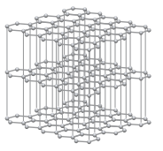
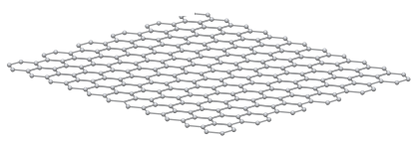
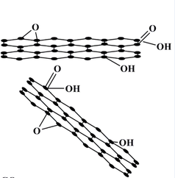
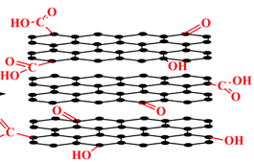
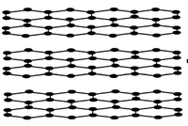
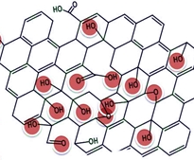
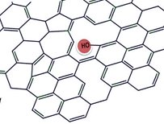
2. Introduction
2.1 Graphene-based materials
Mechanical exfoliation(adhesive tape technique),
Graphite(Gt)
Graphene
Oxidation
(Hummers method)
Exfoliation
(sonication, stirring)
Graphite(Gt)
Graphite oxide(GtO)
Graphene oxide(GO)
Reduction (chemical reduction, thermal annealing)
Graphene oxide(GO)
Reduced graphene oxide(rGO)

Slide 5
2. Introduction
2.2 Graphene-based materials: Properties
Electrical
Zero-overLap semimetal with both holes and electrons as charge carriers
Very high electrical conductivity (depending on the quality of graphene)
Mechanical
Young’s modulus ~ 1TPa
Optical
Transmittance ~ 97,7%
Thermal
Conductivity Above 3000 W.m.K⁻¹
High Specific Surface Area
Theoretically ~ 2620 m².g⁻¹

Slide 6
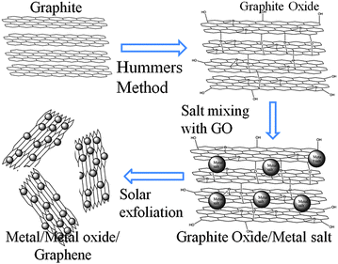
2. Introduction
2.3 Metal Oxide-rGO nanocomposites by hydrogen storage
Graphite Powder
Graphite Oxide
Oxidation
(Hummers
Method)
Metal Salt mixing with GO. Sonication
Hydrothermal
treatment
and Calcination
Metal Oxide-rGO
Graphite Oxide/Metal Salt

Slide 7
3. Proposed Method
3.1 Starting point conditions
Starting approach based on: “Effect of calcination temperatures on the electrochemical performances of nickel oxide/reduction graphene oxide (NiO/RGO) composites synthesized by hydrothermal method” Chen et al. (2016) Journal of Physics and Chemistryof Solids 98 209–219
Easy implementation with our capabilities : Basic laboratory operations such as ultrasonic sonication, hydrothermal treatment, filtration, centrifugation…
No highly sophisticated instrumentation is required.
Cost-effective: minimum organic solvents consumption
Adaptation of ZnO and NiO proportions according to those from Z-Sorb III sorbent:
ZnO 42,5% w/w and NiO 6,6% w/w are normalised to ZnO 86,5% w/w and NiO 13,5% w/w

Slide 8
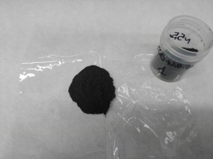
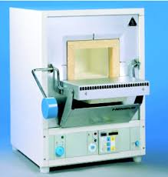
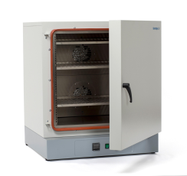
3. Proposed Method
3.2 Applied procedure
Graphite oxidation
Graphite Powder (0,3g)
Hummers method
(KMnO₄, H₂SO₄)
Graphite Oxide
Mechanical exfoliation
(Ultrasonication)
Graphene Oxide
(GO)
Synthesis of composite
Slow addition of
5.8 g Zn(NO ₃)₂
+ 0.9 g Ni(NO ₃)₂
+1 g Urea
Hydrothermal
treatment:
120 ˚C, 24h
Transfer to centrifuge tubes: Centrifugation Washing repeteadly with DI water and Ethanol
GO solution in DI water: 5 mg.L⁻¹
NiO/ZnO-rGO powder
Calcination:
250 ˚C, 24h
Drying under vacuum:
60 ˚C, 24h

Slide 9
3. Proposed Method
3.3 Scheme of the device for H₂ adsorption/desorption
Gas exhaust
Vacuum pump
Cylinder containing graphene sample
M1
H₂
Stopper
He for system purge
Gas exhaust
Output for gas sampling and analysis (µGC)

Slide 10
4. Further studies
Test GO obtained by improved Hummers method as starting material
Increase the efficiency of graphite oxidation
Test different weight ratios among GO - Zn(NO₃)₂ - Ni(NO₃)₂
Test different calcination temperatures

Slide 11
5. Capabilities of the Chemistry Division of CIEMAT
Chemical synthesis of different graphene-based materials (doping, structural modifications or prepared in different forms – powder, sheets, ribbons-).
Structural characterization and chemical purity.
To check electrical properties of prepared materials.
To build specifically designed devices for different applications.

Slide 12
Thanks for your kind attention and we are ready for your questions or suggestions!!

